Slide 1

BIOE 320 - Session 1 Introduction to BIOPAC
Instructor: Dr. Renata Ramos
Renata.Ramos@Rice.edu
Ryon Lab 111A

Slide 2
Objectives
Become familiar with BIOPAC Student Lab
Data viewing/analysis tools
Measurement tools
Journal

Slide 3
Course Material
Lab Kit (1/group)
Course website resources:
Lab procedures (GROUP)
Pre-lab (INDIVIDUAL)
Post-lab (INDIVIDUAL)
Syllabus
Schedule

Slide 4
Hardware and Software
MP30 - MP35 - MP36 Data Acquisition Unit
Accepts signals from various transducers
Sends conditioned signal to the PC
BIOPAC Student Lab Software (BSL)
Graphical user interface for the BIOPAC system
Notes:
Point out the computers with Biopac installed.

Slide 5
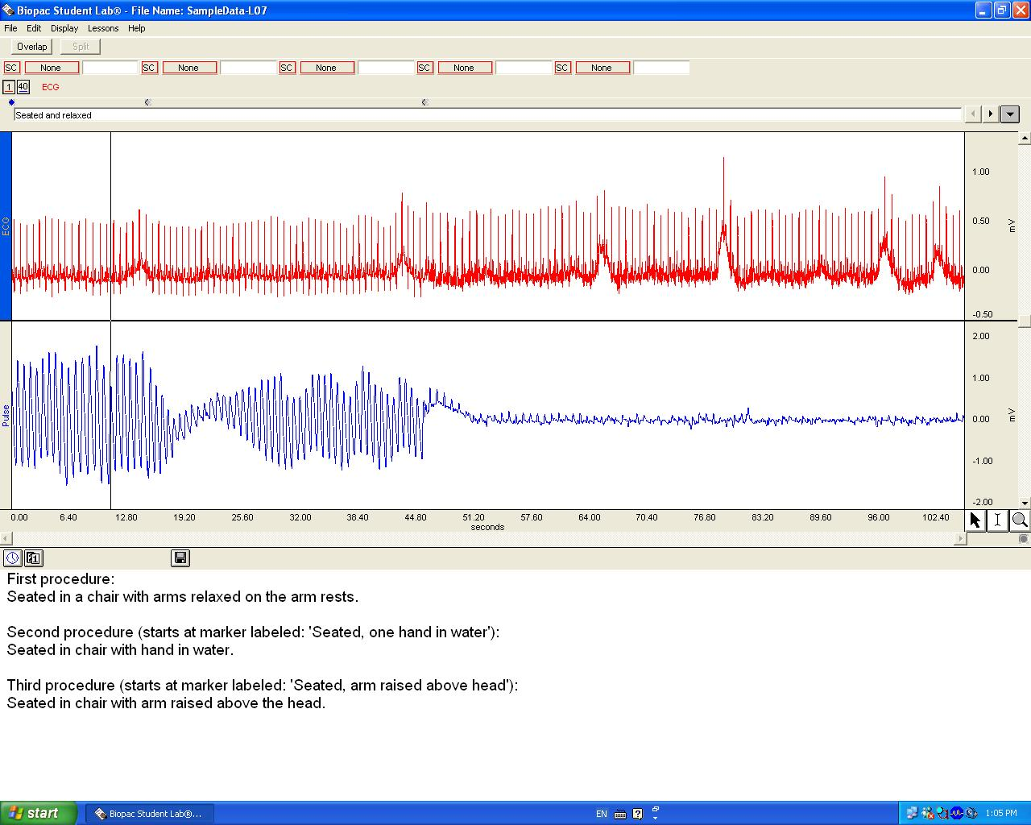
Notes:
Describe: data window, channels, measurement boxes, markers, toolbox, how to zoom out,copying to the journal and saving

Slide 6
Notes for the Introduction Session
BIOPAC Tutorial
Login to course website using netid & password
Lab1 – Intro to BIOPAC
Table 1.2 gives definitions of measurements
Posted on the side of the computer
Take your time to learn the software
BIOPAC book & Medical Physiology Text
available in lab. Do NOT take home

Slide 7
Assignments
Weekly Lab Activities
Pre-lab
In-lab (group assignment)
Post-lab
Peer-leader lab activity
In lab section – sign up (group assignment)
Oral presentation (group assignment)
Research Paper (group assignment)
Review Article Report

