Slide 1




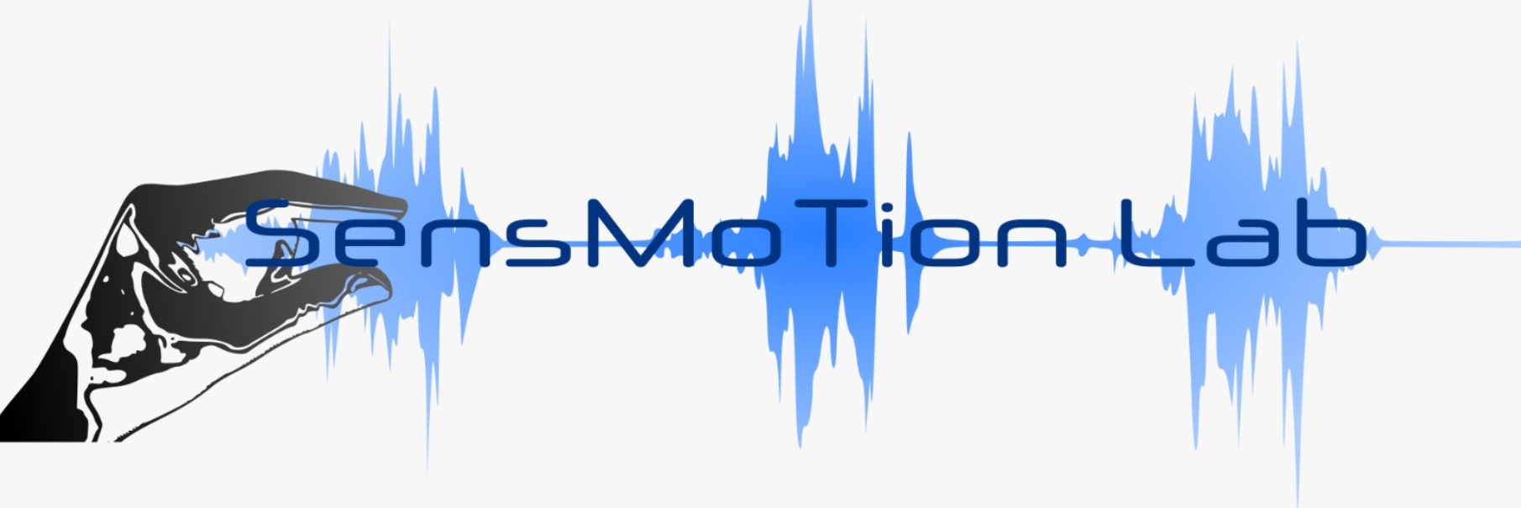


Deep learning in reach movement
James Mathew

Slide 2
Coming up
Synthetic reach data – OFC- LQG
CNN- LSTM model for reach trajectory generation
Open loop
Closed loop with sensory feedback and offline adaptation
Closed loop with sensory feedback and online adaptation

Slide 3
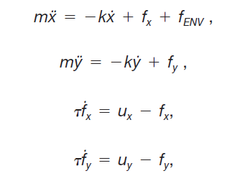
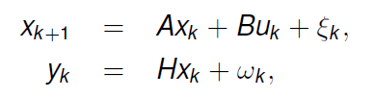
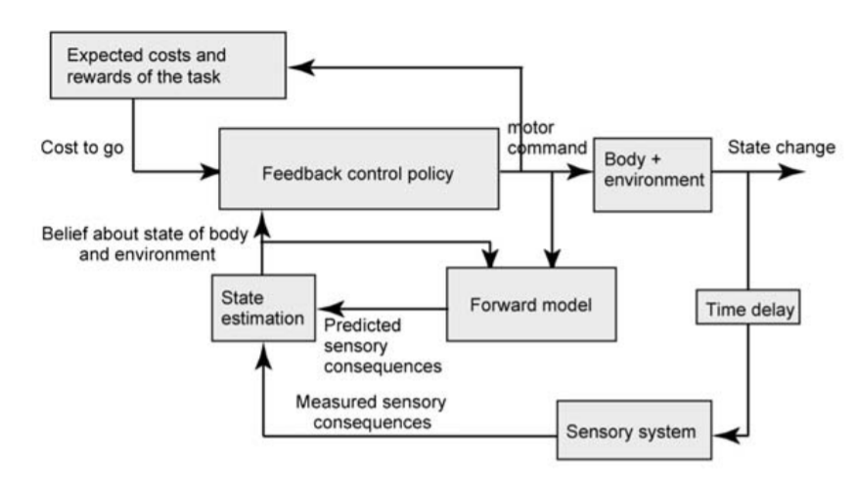
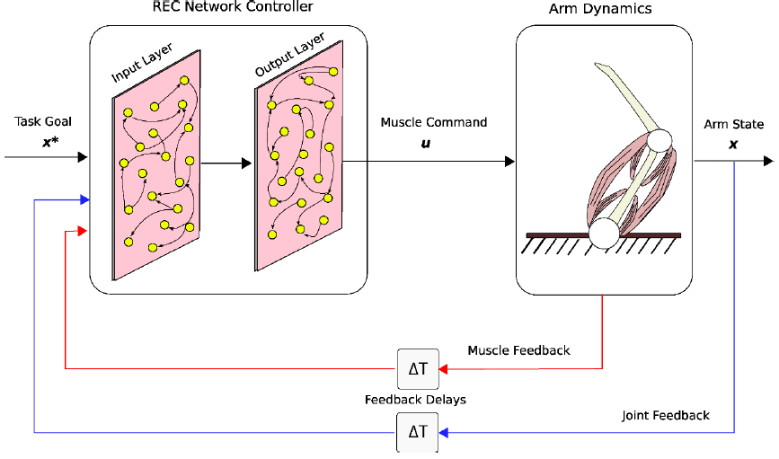
Computational model of reach movement - LQG
Linear dynamical system
Muscle model
State space representation
ẋ
ẏ
ẍ
ÿ
ḟx
ḟy
x
y
ẋ
ẏ
fx
fy
=
A
B
ux
uy
+
x_{k}
A
u
B
X_{k+1}
x_{k}
y_{k}
A
u
B
X_{k+1}
H
x_{k}
H
ỹ_{k}
K
y_{k}
Shadmehr,Krakeur (2008)

Slide 4
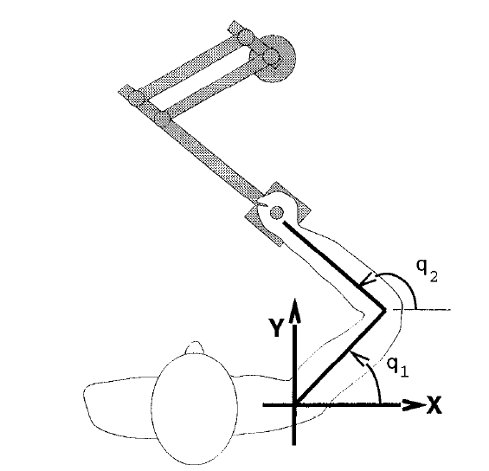
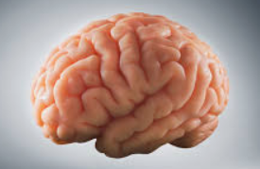
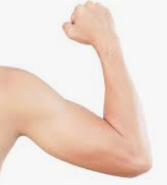
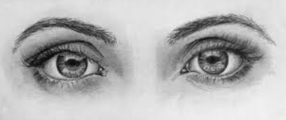
Computational model of reach movement - LQG
State space representation
Start-end coordinate /initial state
(x_{start},y_{start}, x_{end},y_{end})
Motor command vector (Ux,uy)
Trajectory dynamics
(ẋ,ẏ,ẍ,ÿ,ḟx,ḟy)
ẋ
ẏ
ẍ
ÿ
ḟx
ḟy
x
y
ẋ
ẏ
fx
fy
=
A
B
ux
uy
+

Slide 5
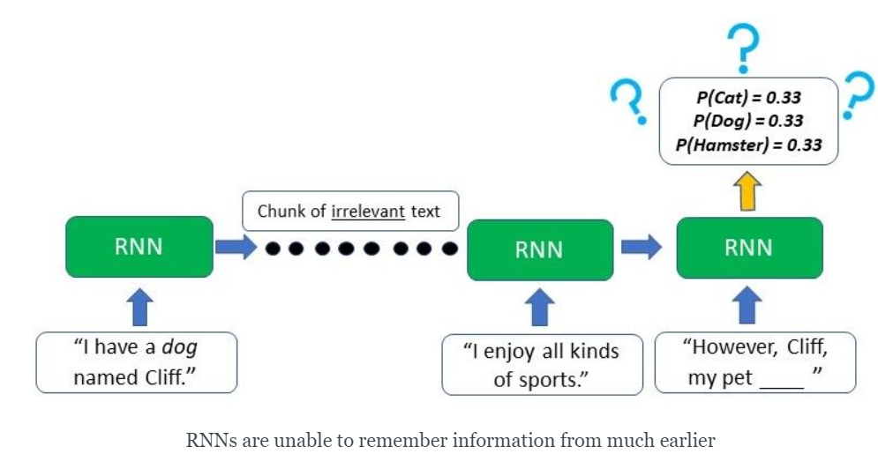
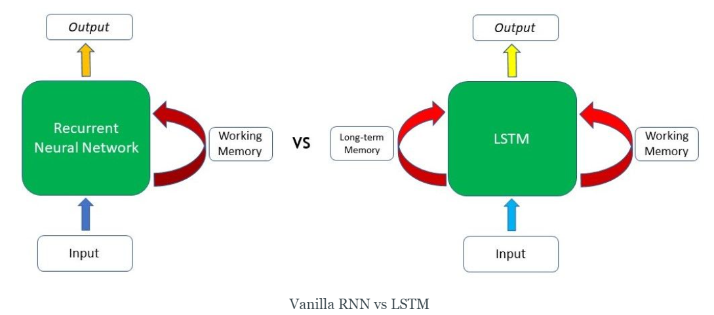
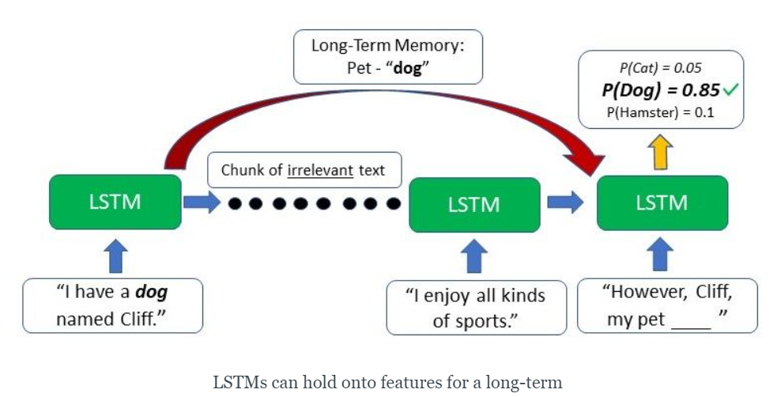
Benefits of Long Short Term Memory (LSTM) nets

Slide 6
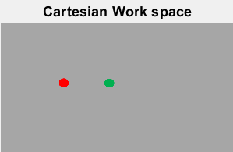
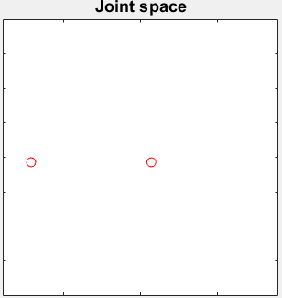
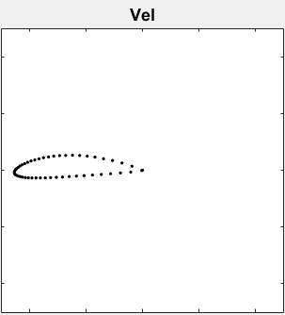
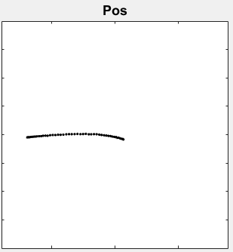
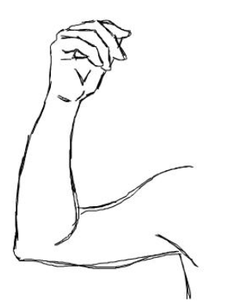
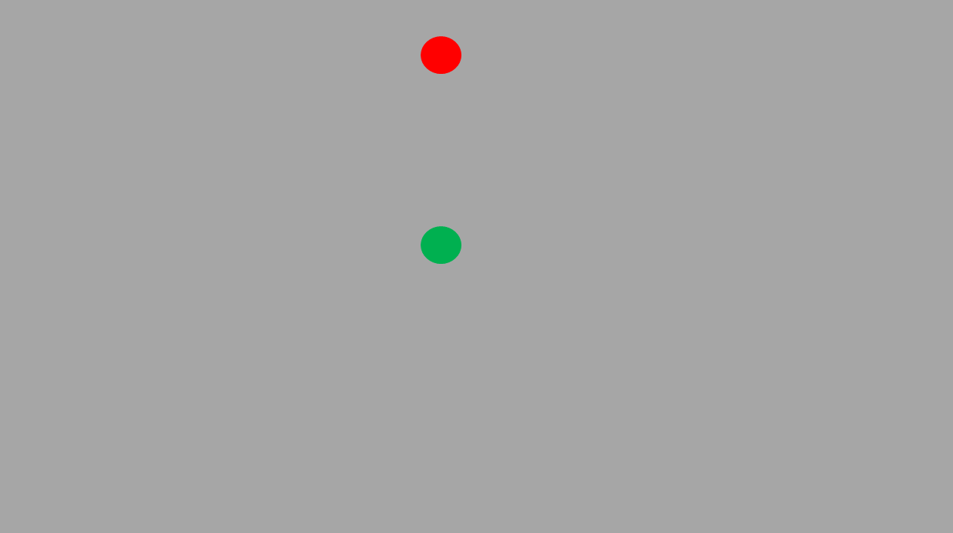
CNN-LSTM RNN network model of reach movement generation
LSTM architecture: sequenceInputLayer -> bilstmLayer -> fullyConnectedLayer -> regressionLayer
CNN
LSTM
Visual pathways
LSTM RNN
Net
Spinal & muscular level
Start-End
coordinates
Joint velocity
CNN
Task Image
Movement trajectory

Slide 7
CNN-LSTM network model of reach movement with sensory feedback and adaptation
Spinal & muscular level
Start-End
coordinates
Visual pathways
LSTM₁
Control signal
LSTM₂
Control signal
LSTM₃
Joint velocity
Inter trial updation
CNN
Perturbation
FB Error signal
Task Image
FB Control
signal
LSTM₄
FB Joint velocity
Movement trajectory
Sensory Feedback

Slide 8
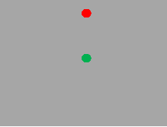
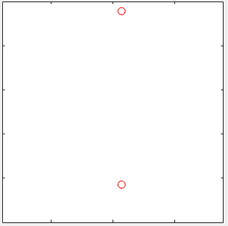
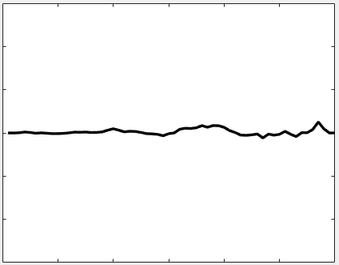
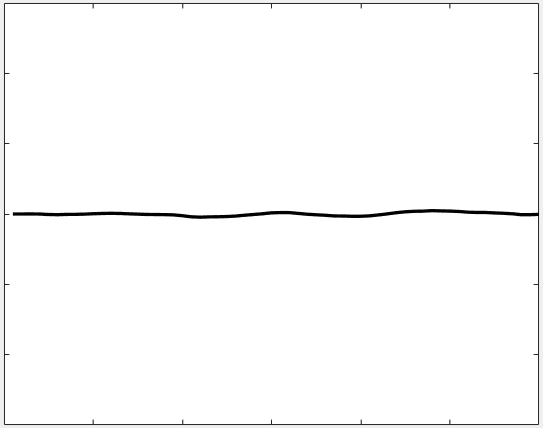
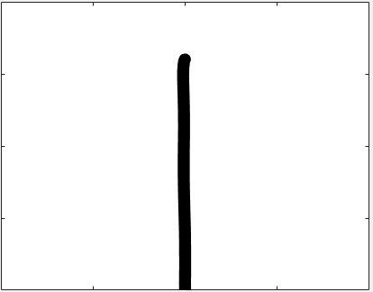
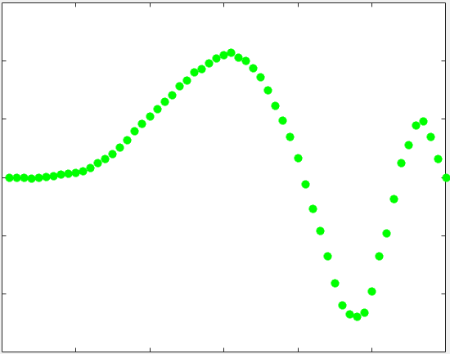
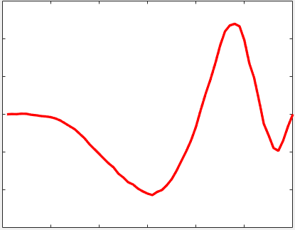
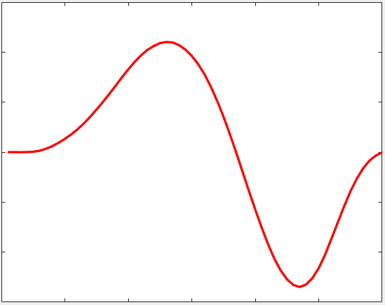
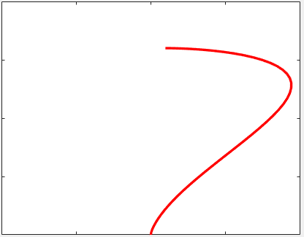
CNN-LSTM network model :Simulation- offline adaptation
Visual Stimuli
Start-end points X-Y
Control Signal X
Control Signal X
Velocity X
Position X-Y
CNN
LSTM₁
LSTM₂
LSTM₃
Inter trial updation
FB Error Signal X
FB Control Signal X
FB Velocity X
FB Position X-Y
LSTM₄

Slide 9
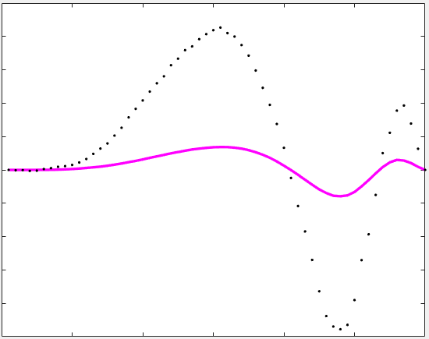
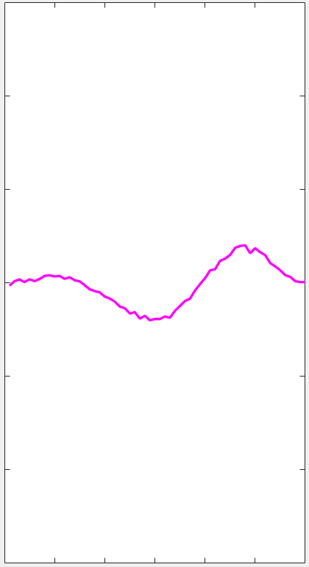
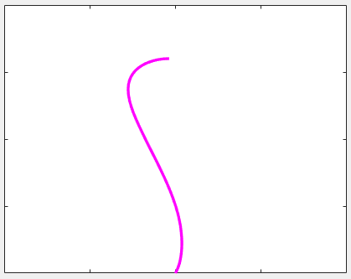
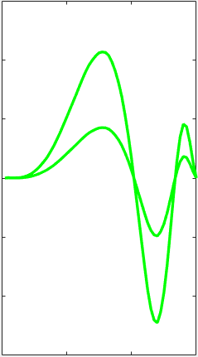
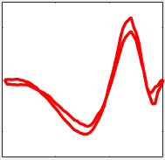
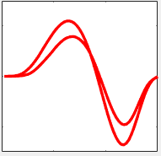
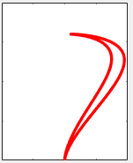
CNN-LSTM network model :Simulation- offline adaptation
Visual Stimuli
Start-end points
Control Signal
Control Signal
Velocity
Position
CNN
LSTM₁
LSTM₂
LSTM₃
Inter trial updation
FB Error Signal
FB Control Signal
FB Velocity
FB Position
LSTM₄

Slide 10
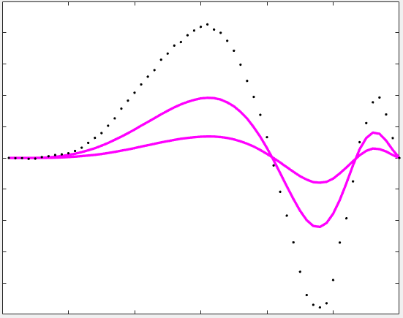
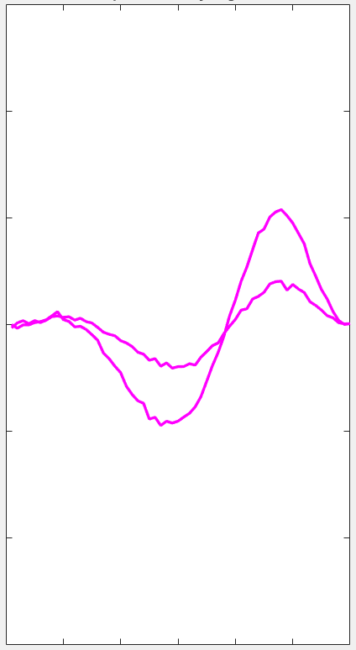
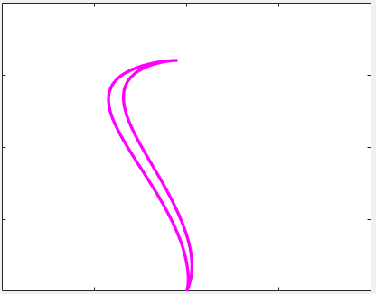

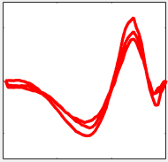
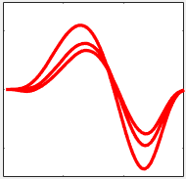
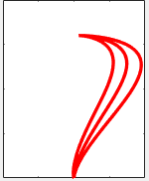
CNN-LSTM network model :Simulation- offline adaptation
Visual Stimuli
Start-end points
Control Signal
Control Signal
Velocity
Position
CNN
LSTM₁
LSTM₂
LSTM₃
Inter trial updation
FB Error Signal
FB Control Signal
FB Velocity
FB Position
LSTM₄

Slide 11
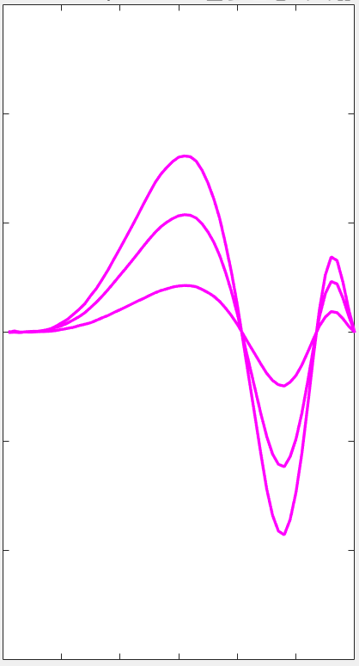
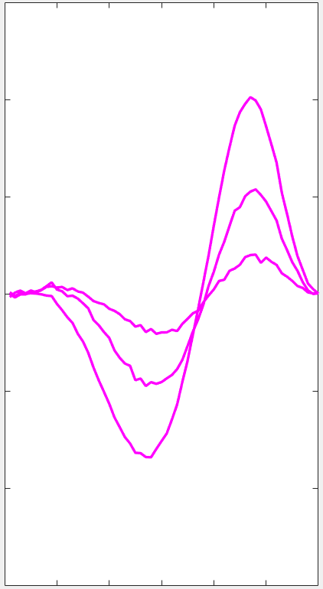
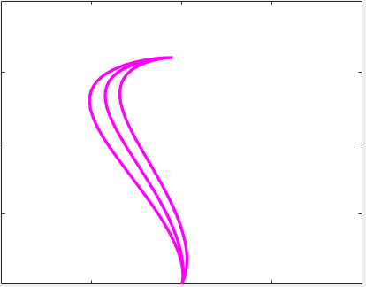
CNN-LSTM network model :Simulation- offline adaptation
Visual Stimuli
Start-end points
Control Signal
Control Signal
Velocity
Position
CNN
LSTM₁
LSTM₂
LSTM₃
Inter trial updation

Slide 12
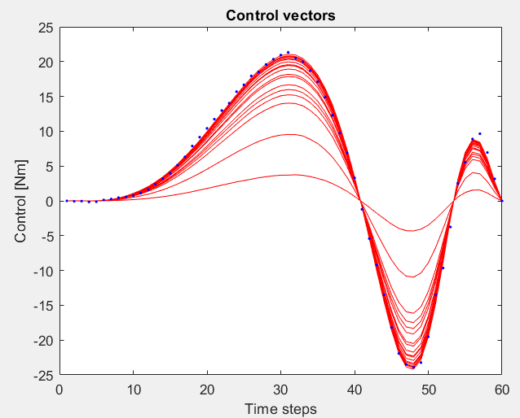
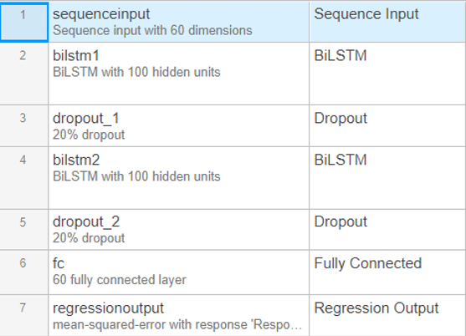
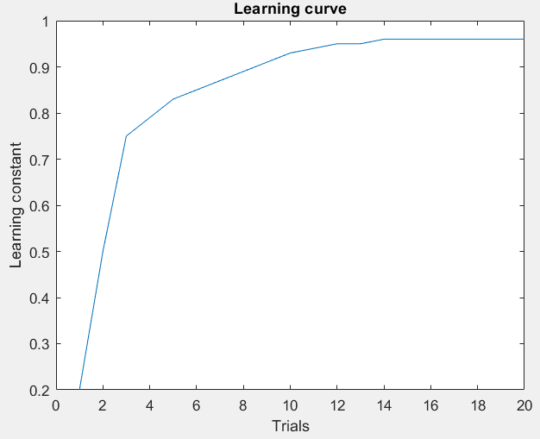
CNN-LSTM network model :Simulation- offline adaptation
LSTM₂ LSTM₃ LSTM₄ architecture

Slide 13
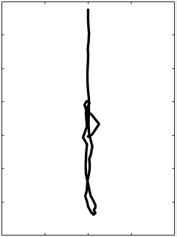
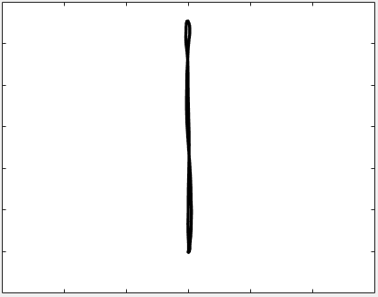
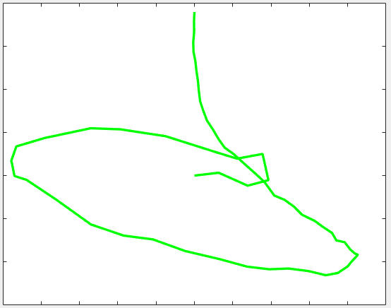
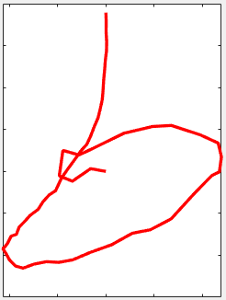

CNN-LSTM network model :Simulation- offline adaptation
Visual Stimuli
Start-end points X-Y
Control Signal X-Y
Control Signal X-Y
Velocity X-Y
Position X-Y
CNN
LSTM₁
LSTM₂
LSTM₃
Inter trial updation
FB Error Signal X-Y
FB Control Signal X-Y
FB Velocity X-Y
FB Position X-Y
LSTM₄

Slide 14
Feedforward-feedback adaptation
Feedback mediated online correction1
Feedback mediated online correction3
Feedback mediated online correction2
1st 2nd 3rd 4th 5th
1st 2nd 3rd 4th 5th
Feedforward adaptation
Offline update of the controller during the inter-trial time
Feedback adaptation
Online update of the controller during the movement time

Slide 15
CNN-LSTM network model :Simulation- online adaptation
Visual Stimuli
Start-end points X-Y
Control Signal X
Control Signal X
Velocity X
Position X-Y
CNN
LSTM₁
LSTM₂
LSTM₃
Within trial updation
FB Error Signal X
LSTM2 get updated every 200ms with respect to trial error history
FB Control Signal X
FB Velocity X
FB Position X-Y
LSTM₄

Slide 16
CNN-LSTM network model :Simulation- online adaptation
Visual Stimuli
Start-end points
Control Signal
Control Signal
Velocity
Position
CNN
LSTM₁
LSTM₂
LSTM₃
Within trial updation
FB Error Signal
FB Control Signal X
FB Velocity X
FB Position X-Y
LSTM₄

Slide 17
CNN-LSTM network model :Simulation- online adaptation
Visual Stimuli
Start-end points
Control Signal
Control Signal
Velocity
Position
CNN
LSTM₁
LSTM₂
LSTM₃

Slide 18
CNN-LSTM network model :Simulation- online adaptation
Visual Stimuli
Start-end points
Control Signal
Control Signal
Velocity
Position
CNN
LSTM₁
LSTM₂
LSTM₃
Inter trial updation
FB Error Signal
FB Control Signal X
FB Velocity X
FB Position X-Y
LSTM₄

Slide 19



CNN-LSTM network model : Simulation- online adaptation
LSTM2 get updated every 200ms with respect to trial error history
Adapted Control Signal
Adapted Velocity
Adapted Trajectory
Increasing updation time – computational cost, need more time -GPU
Solution:- parallel computing?

Slide 20
CNN-LSTM network model – Parallel LSTM’s
Inter trial
LSTM_{2a}
Spinal & muscular level
Start-End
coordinates
Visual pathways
LSTM₁
Control signal
Control signal
LSTM₃
Joint velocity
LSTM_{2b}
Within trial
CNN
Task Image
Perturbation
FB Error signal
LSTM₄
FB Joint velocity
FB Control
signal
Movement trajectory
Sensory Feedback

Slide 21




CNN-LSTM network model : Parallel LSTM’s
Updation every 200ms
Updation every 50ms

Slide 22
Implementation
Scripting
LQG : Matlab, Python, R
CNN-Auto decoder : Matlab
CNN-LSTM : Matlab (DeepLearning/parallel computingToolbox), Python (Keras, tensorflow, pytorch)

Slide 23
Merci Beaucoup

