Slide 1




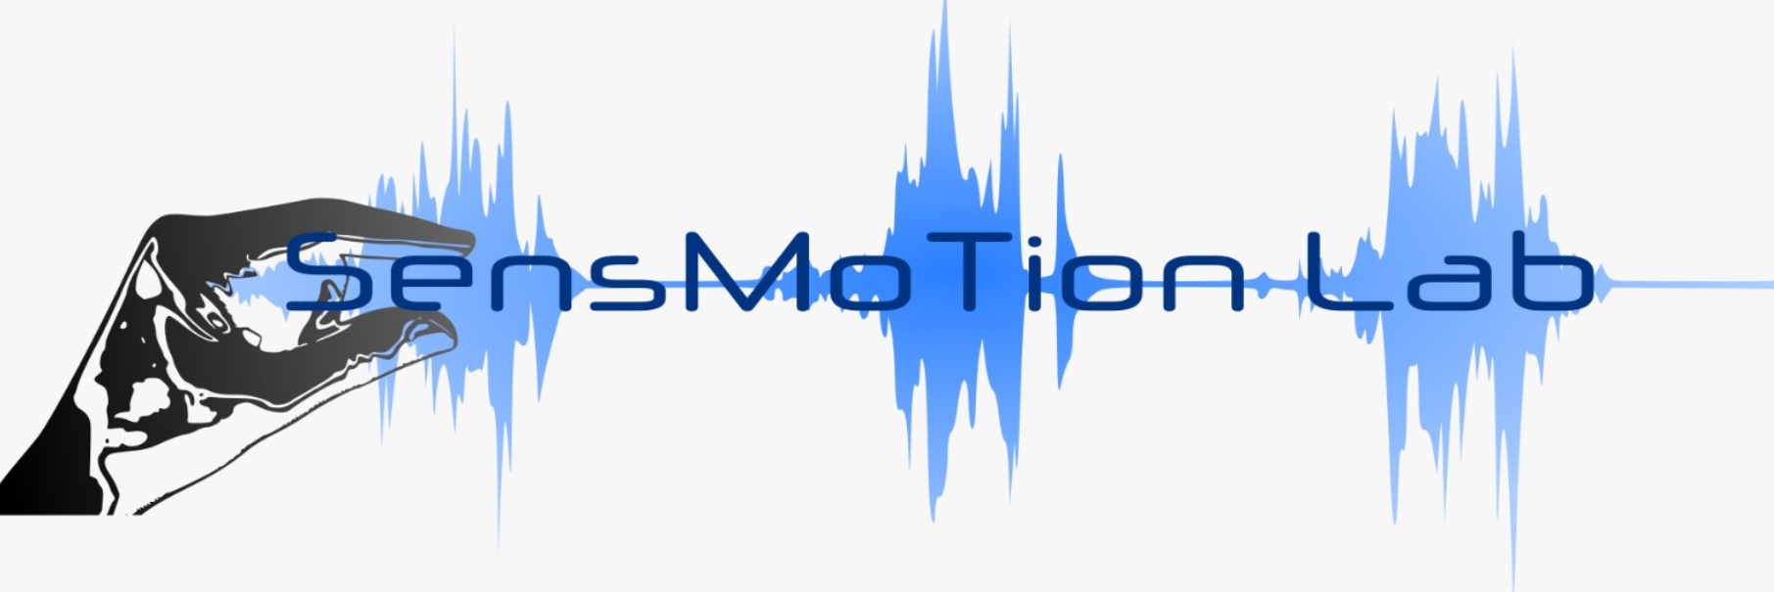


Deep learning in reach movement
James Mathew

Slide 2
Today’s talk
Synthetic Data - Simulated reach parameters using LQG
CNN-Auto decoder model for reach trajectory generation
Auto encoding & decoding
CNN- LSTM model for reach trajectory generation
Open loop
Closed loop with sensory feedback and offline adaptation
Closed loop with sensory feedback and online adaptation

Slide 3
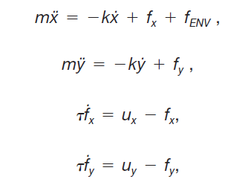
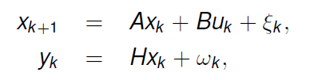
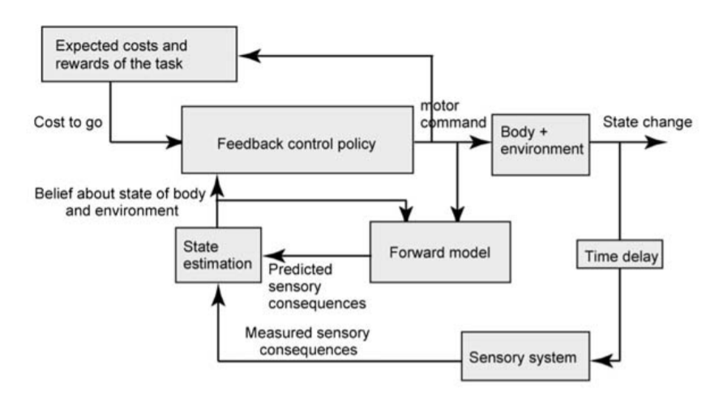
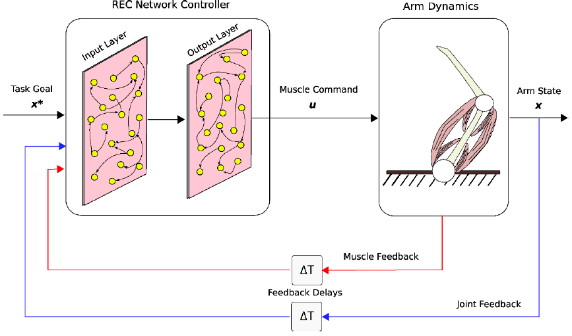
Computational model of reach movement - LQG
Linear dynamical system
Muscle model
State space representation
ẋ
ẏ
ẍ
ÿ
ḟx
ḟy
x
y
ẋ
ẏ
fx
fy
=
A
B
ux
uy
+
x_{k}
A
u
B
X_{k+1}
x_{k}
y_{k}
A
u
B
X_{k+1}
H
x_{k}
H
ỹ_{k}
K
y_{k}
Shadmehr,Krakeur (2008)

Slide 4
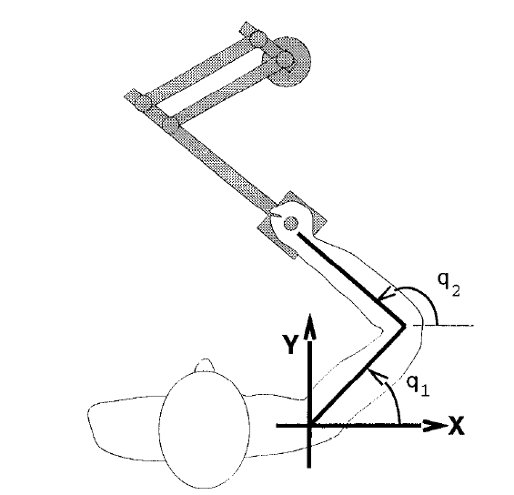
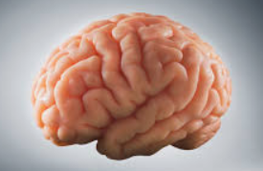
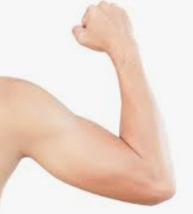
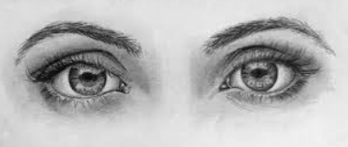
Computational model of reach movement - LQG
State space representation
Start-end coordinate /initial state
(x_{start},y_{start}, x_{end},y_{end})
Motor command vector (Ux,uy)
Trajectory dynamics
(ẋ,ẏ,ẍ,ÿ,ḟx,ḟy)
ẋ
ẏ
ẍ
ÿ
ḟx
ḟy
x
y
ẋ
ẏ
fx
fy
=
A
B
ux
uy
+

Slide 5
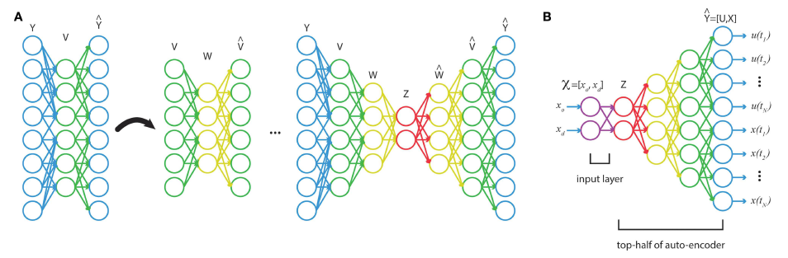
Deep Neural Nets :Auto decoder nets for motor control functions
Autoencoding – dimension reduction technique
With initial and target states as inputs, deep network can be trained to output an accurate temporal profile of the optimal command and state trajectory for a point-to-point reach of a non-linear limb model, even when influenced by varying force fields.
Bernicker & Kording (2015)

Slide 6

CNN – Auto decoder model
Visual pathways
Start-End
coordinates
CNN
Task Image

Slide 7
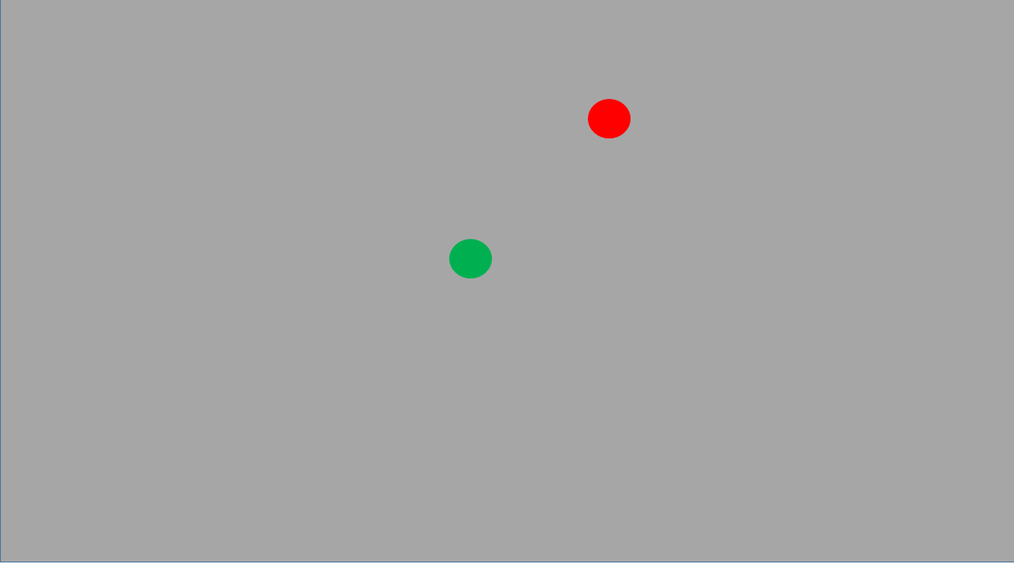
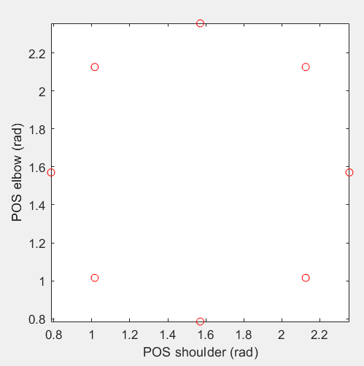
CNN – Auto decoder model
Extrinsic work space
Intrinsic joint space
CNN
……….
8 target locations
Training 20 images per position
CNN training
layers = [ ...
imageInputLayer([28 28 1])
convolution2dLayer(12,25)
reluLayer
fullyConnectedLayer(4)
regressionLayer];

Slide 8
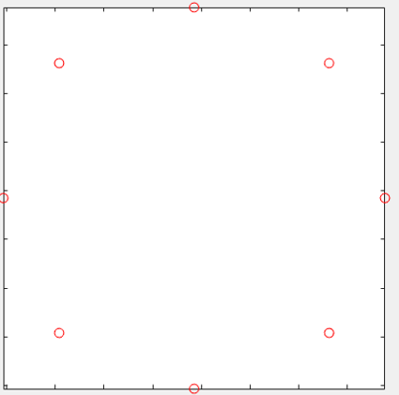
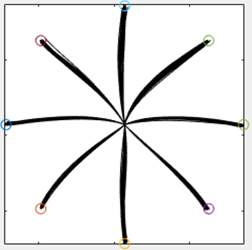
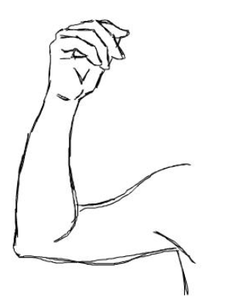
CNN – Auto decoder model
Dimension reduction
Supervised training
Linear Dynamical
System
LQG
Auto decoder NN
Auto encoder NN
Visual pathways
Spinal & muscular level
Input:
Start-End
coordinates
Autodecoder
Net
Output:
Joint velocity
CNN
Input:
Task Image
Output:
Movement trajectory

Slide 9
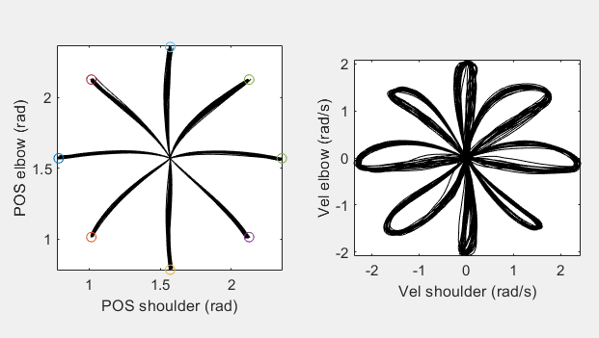
CNN – Auto decoder model
Simulated hand movements in 8 directions : Input data for autoencoding
Linear Dynamical Network
LQG
Todorov, E. and Li, W. (2005)
Input matrix dimension:
(51 xPos Shoulder,51 xPos Elbow,51 Vel Shoulder, 51 Vel Elbow, 51 Control command Shoulder, 51 Control command Elbow) * (20trials*8direction) =
304 * 160

Slide 10
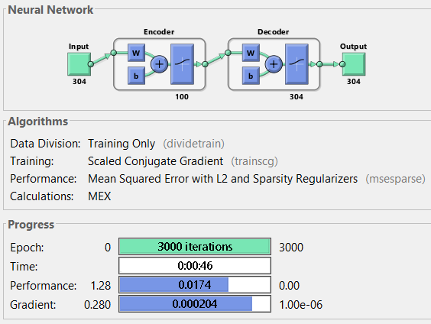
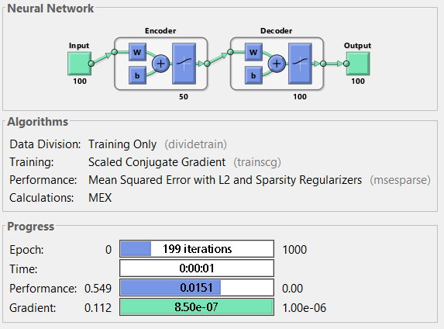
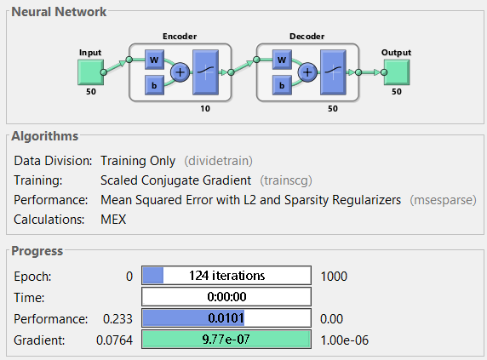
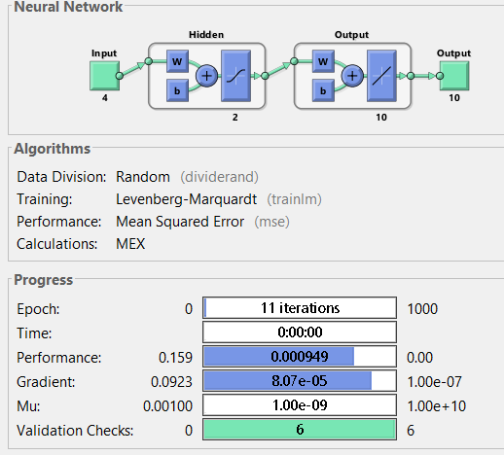
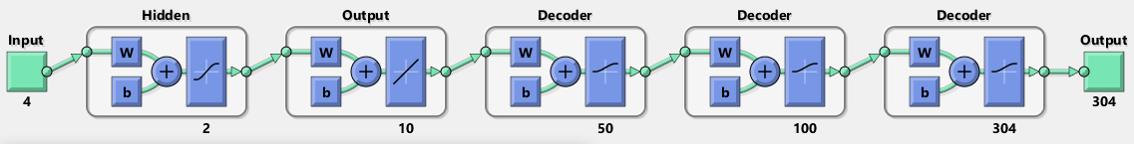
Trajectory velocity : Deep net auto encoder-decoder training
AutoEncoder1
AutoEncoder2
AutoEncoder3
Feedforward net
Fully stacked layer

Slide 11
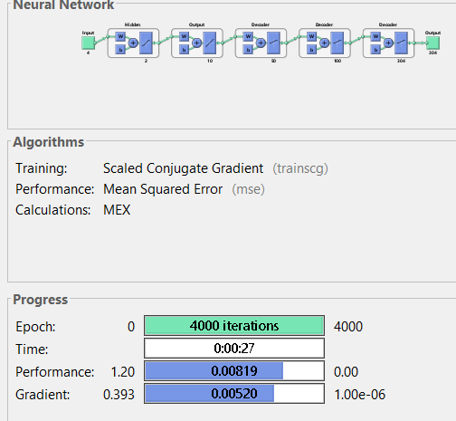
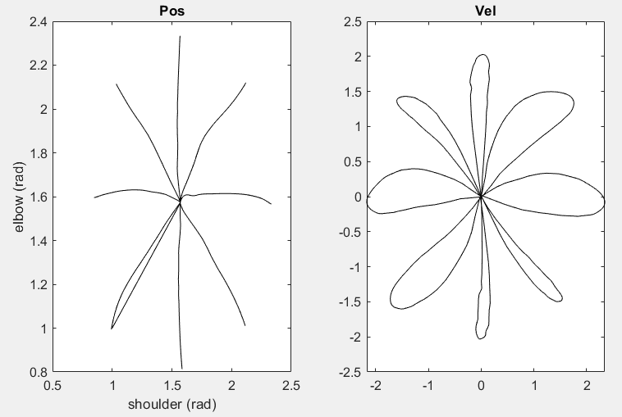
Joint angle to trajectory velocity : Fully stacked autodecoder network training
Train fully stacked layer
Visualize decoded test data

Slide 12
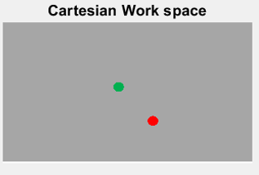
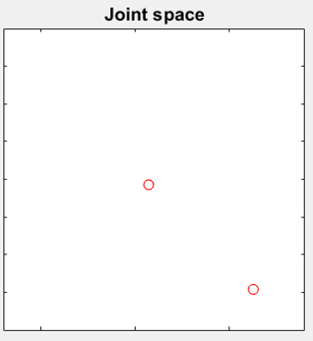
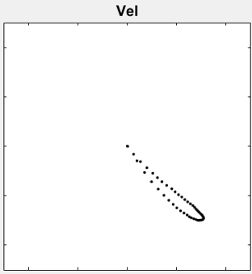
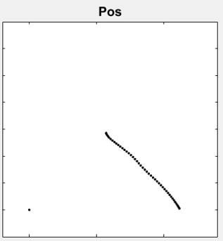
CNN-Auto decoder network model of reach movement generation
CNN
Autodecoder
Net
Visual pathways
Autodecoder
Net
Spinal & muscular level
Start-End
coordinates
Joint velocity
CNN
Task Image
Movement trajectory

Slide 13
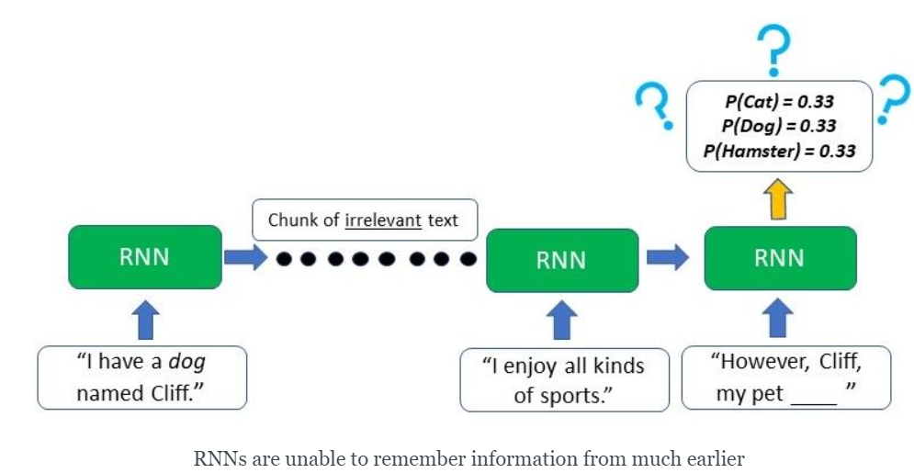
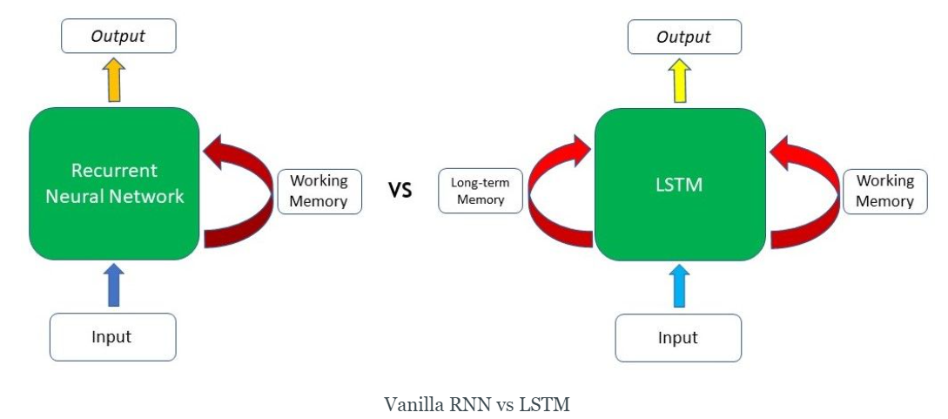
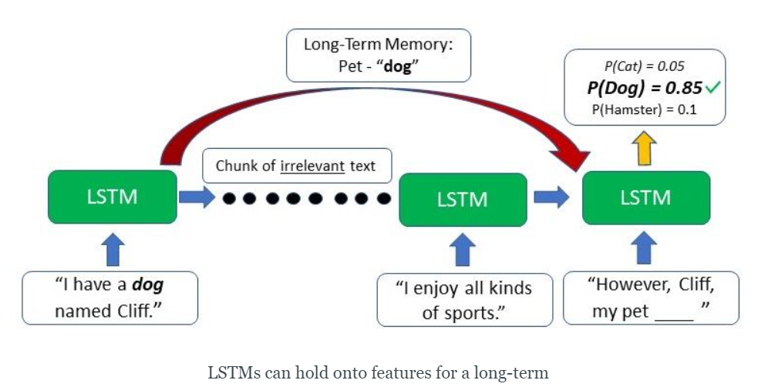
Benefits of Long Short Term Memory (LSTM) nets

Slide 14
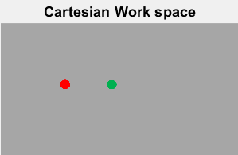
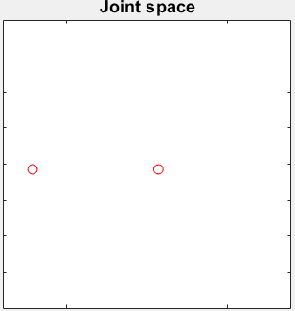
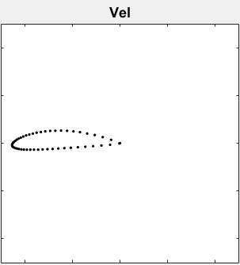
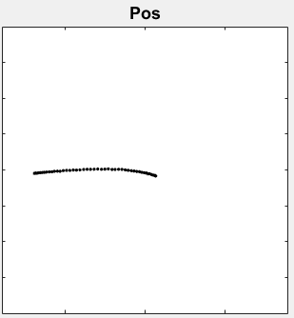
CNN-LSTM RNN network model of reach movement generation
LSTM architecture: sequenceInputLayer -> bilstmLayer -> fullyConnectedLayer -> regressionLayer
CNN
LSTM
Visual pathways
LSTM RNN
Net
Spinal & muscular level
Start-End
coordinates
Joint velocity
CNN
Task Image
Movement trajectory

