Slide 1


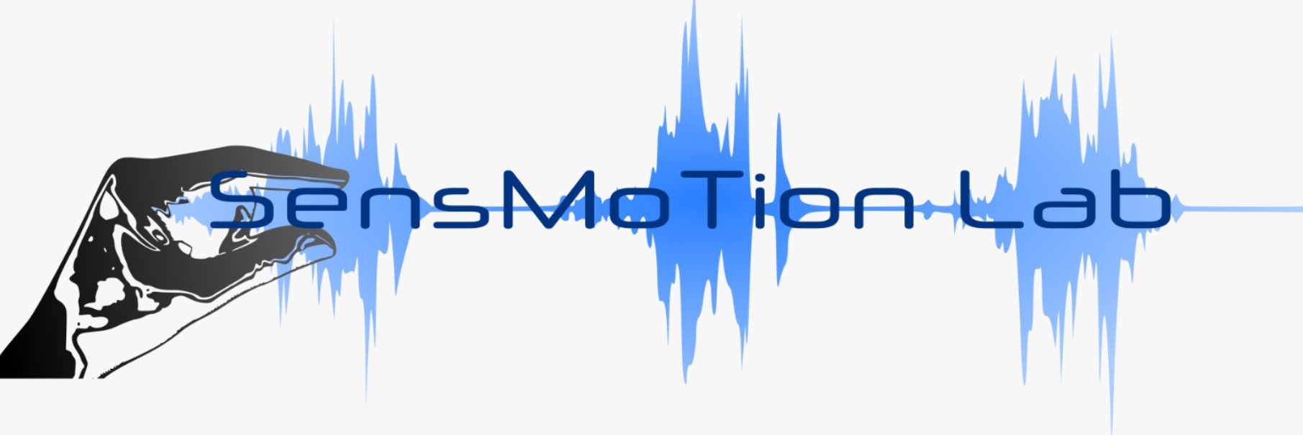


Feedback adaptation
James Mathew

Slide 2
Contents
Background – Forcefield perturbation
Feedforward & feedback adaptation
Features of feedback adaptation
4 previous studies & one new data

Slide 3
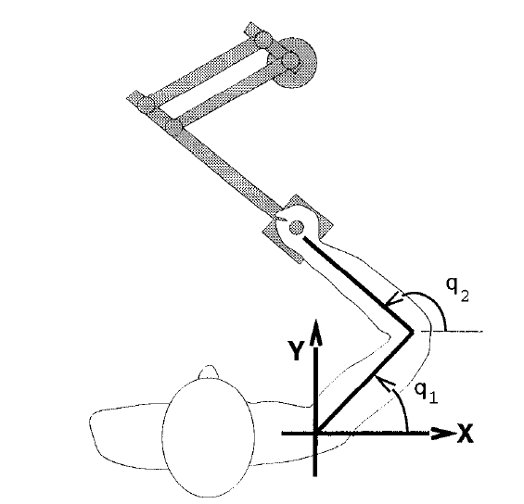
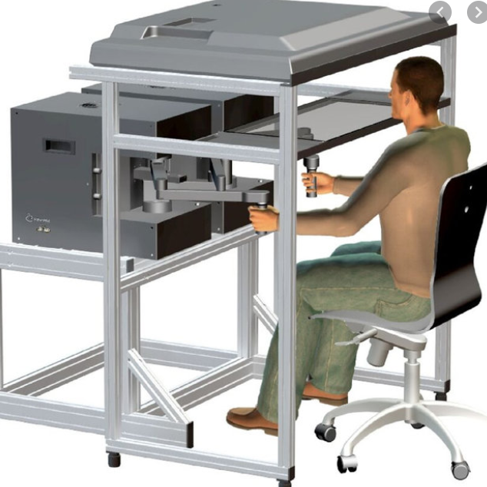
Forward reaching movement with mechanical perturbation
CCW
Velocity dependent force field
fx =Ly˙, L = -13Nsm⁻¹).
CW
Lateral deviation (cm)
Adaptation curve
Readaptation
Time gap
Trials

Slide 4
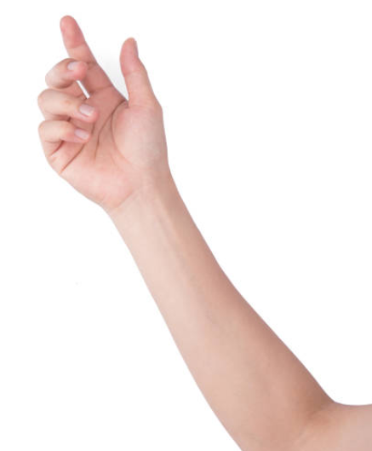
Feedforward adaptation
Motor command
Desired target
Feedforward controller
Sensory error/
State estimate
(Offline)
Forward model
Expected FB
1st 2nd Last
Actual sensory FB
Feedforward adaptation
Offline update of controller during inter-trial time
System identification/Prediction : predict the sensory consequences of our motor commands
State estimation : combine these predictions with actual sensory feedback to form a belief about the state of our body and the world
Optimal control : given this belief about the state of our body and the world, adjust the gains of the sensorimotor feedback loops so as to maximize performance by minimizing error.
1st 2nd 3rd
In a random design, no feedforward adaptation
Unpredictable direction
Adaptation is possible with cues

Slide 5
Feedback adaptation
In a random design, adaptation is possible even without cues
Feedforward controller
Feedback mediated online correction1
Feedback mediated online correction3
Feedback mediated online correction2
Motor command
Desired target
Feedback controller
Forward model
1st 2nd 3rd 4th 5th
Sensory error
(Online)
Expected FB
Feedback adaptation
Online update of the controller during the movement time
Actual
sensory FB

Slide 6
Feedback adaptation
In a random design, adaptation is possible even without cues
Feedforward controller
Feedback mediated online correction1
Feedback mediated online correction3
Feedback mediated online correction2
Motor command
Desired target
Feedback controller
Forward model
1st 2nd 3rd 4th 5th
Sensory error
(Online)
Expected FB
Feedback adaptation
Online update of the controller during the movement time
Actual
sensory FB

Slide 7
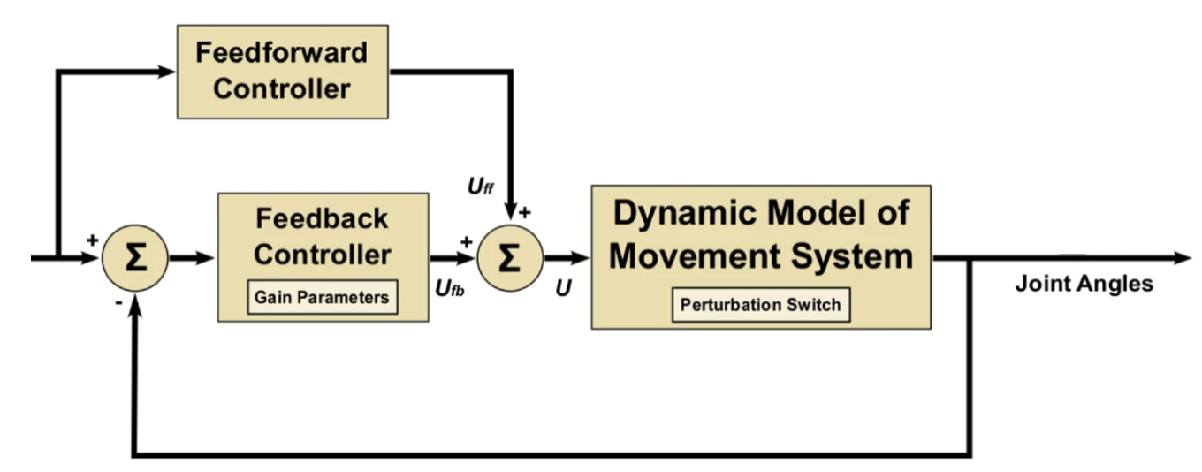
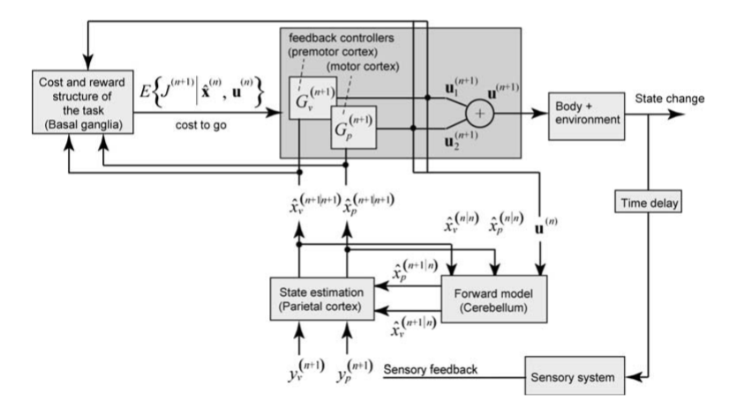
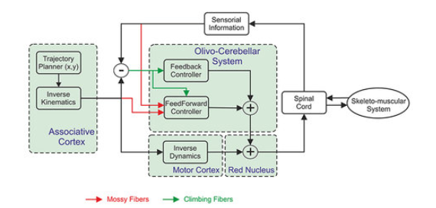
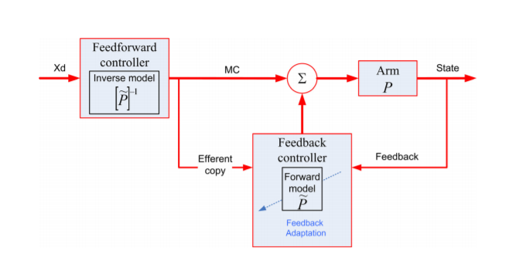
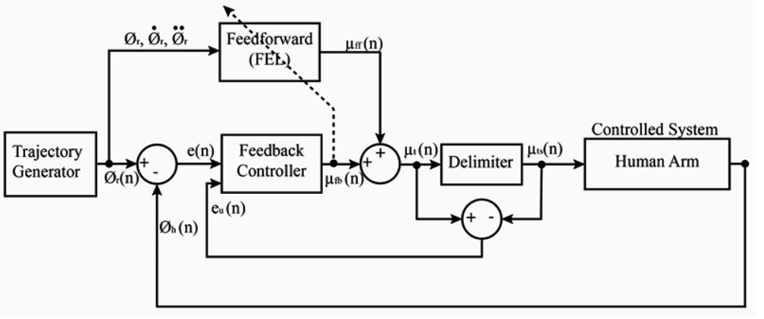
Feedforward & Feedback controllers / adaptation
Babic,Kawato, 2016
Shadmehr & krakeur, 2008
Botzer, Karniel 2013

Slide 8
Feedback adaptation
Feedback adaptation imprints in EMG (Crevecoeur 2020a)
Feedback adaptation imprints in after-effects (Crevecoeur 2020b)
Temporal aspects of feedback adaptation (Mathew 2020)
Feedback adaptation underlines savings
Spatial aspects of feedback adaptation

Slide 9
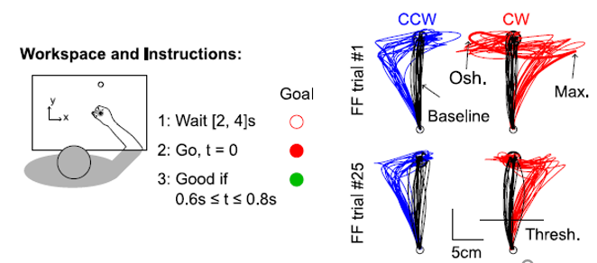
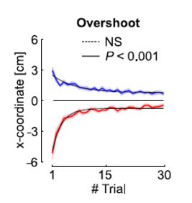
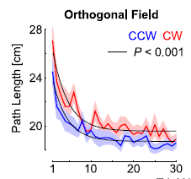
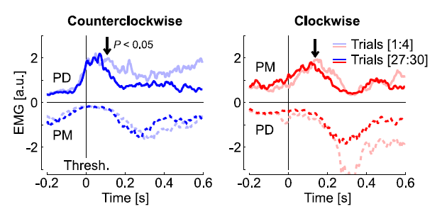
1. Feedback adaptation imprints in EMG
Baseline, CW, CCW- all randomly mixed in one block
Traces of feedback adaptation in EMG around 250ms from reach onset
Could we identify traces of feedback adaptation in behavior?

Slide 10
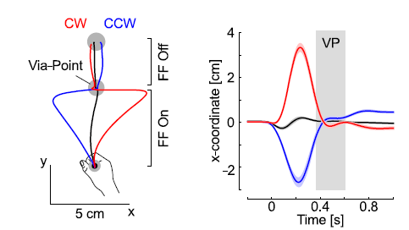
2. Feedback adaptation imprints in after-effect
Via-point experiments
VP
VP Baseline
VP FFon
VP FFoff
The movement after VP was interpreted as an after effect, showing that the feedback correction elicited prior to the via-point could change movement representations online.
Does the motor system forgets the effect of online feedback corrections very fast ?
Does these changes are retained in memory for enough time to impact behaviour in the next trial ?

Slide 11
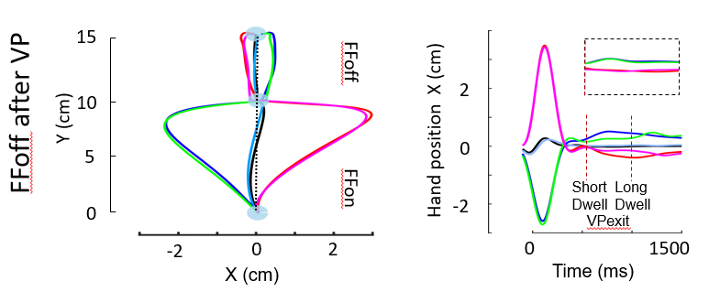
3. Temporal aspects of Feedback adaptation
Wait Go
Wait Go
Wait
500ms
at VP
Wait
500ms
at VP
VP ShortDwell
FFon
VP ShortDwell
FFoff
VP
LongDwell
FFon
VP
LongDwell
FFoff
Online corrections to the internal representation of reach dynamics can be preserved in memory for around 850ms of resting time.
Underlying mechanism associated with feedback adaptation contributed to the trial-by-trial adaptation
Short Dwell CW Long Dwell CW Short Dwell CCW Long Dwell CCW
Baseline (Short Dwell) Baseline (Long Dwell)

Slide 12
Feedback adaptation
Feedback adaptation imprints in EMG (Crevecoeur 2020a)
Feedback adaptation imprints in after-effects (Crevecoeur 2020b)
Temporal aspects of feedback adaptation (Mathew 2020)
Feedback adaptation underlines savings
Spatial aspects of feedback adaptation

Slide 13
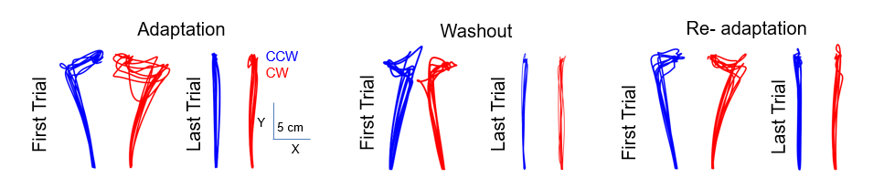
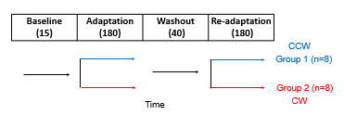
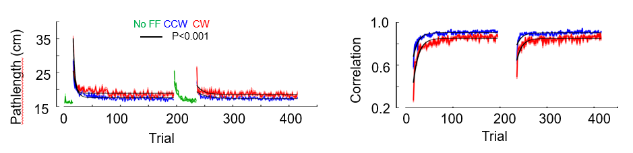
4. Feedback adaptation underlines savings
Savings : When exposed to the same perturbation a second time, relearning is faster and more complete than during the first exposure
Relearning was faster
The very first relearning movement was better adapted to the external disturbance
The online corrections in the first re-exposure trial carry imprints of feedback adaptation from the previous sessions in the absence of any anticipation or explicit cognitive strategy.
Savings in human force field learning supported by feedback adaptation

Slide 14
Feedback adaptation
Feedback adaptation imprints in EMG (Crevecoeur 2020a)
Feedback adaptation imprints in after-effects (Crevecoeur 2020b)
Temporal aspects of feedback adaptation (Mathew 2020)
Feedback adaptation underlines savings
Spatial aspects of feedback adaptation

Slide 15
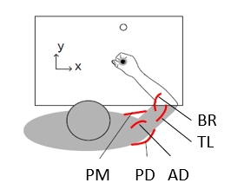
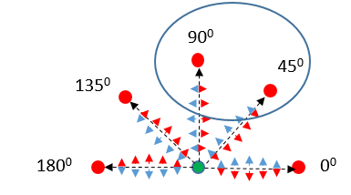
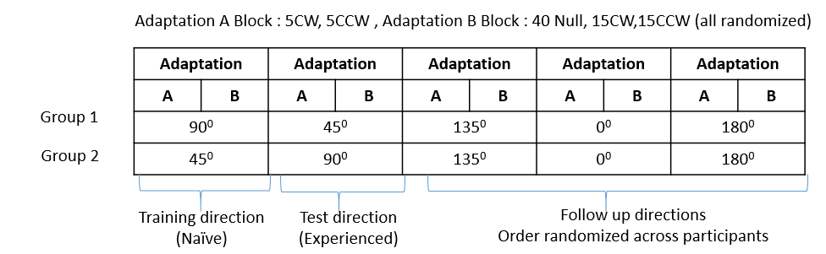
5. Spatial aspects of Feedback adaptation
Experiment 1

Slide 16
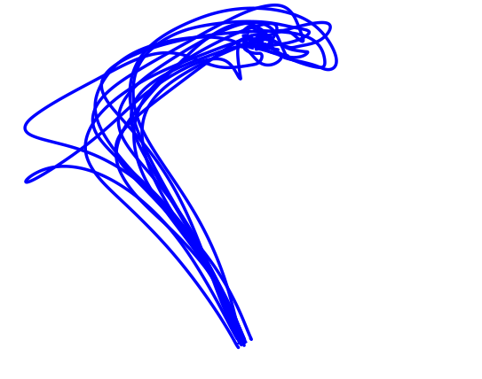
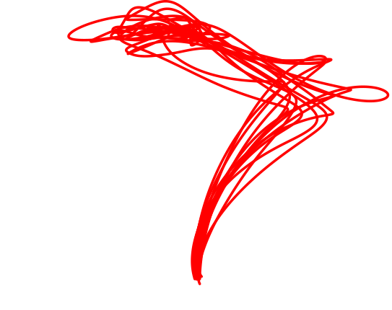
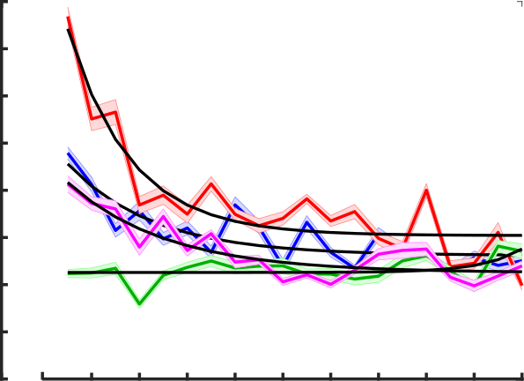
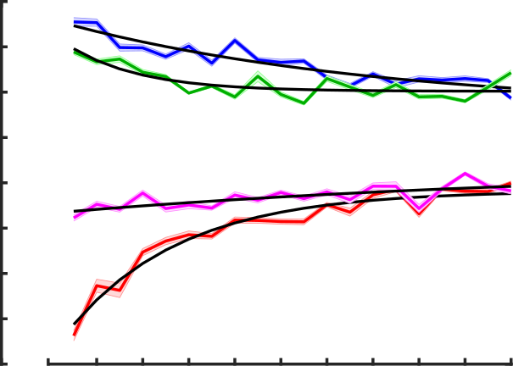
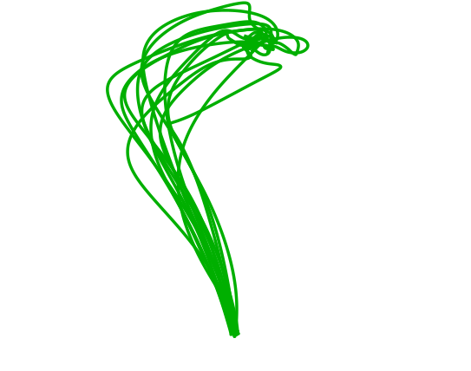
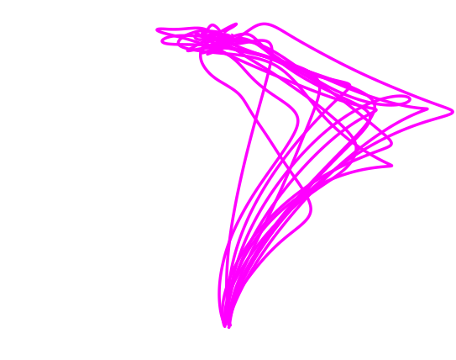
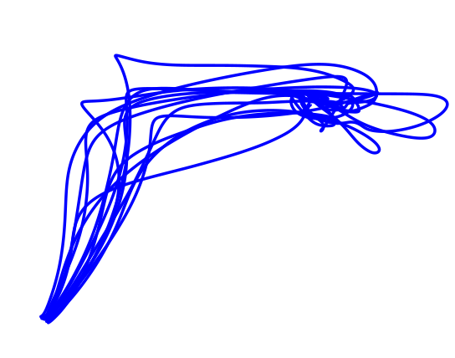
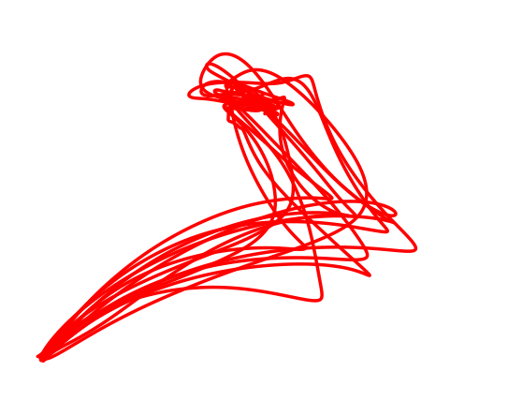
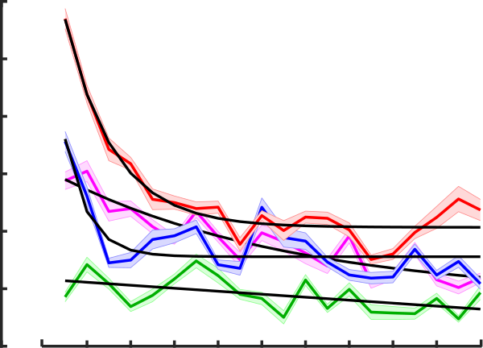
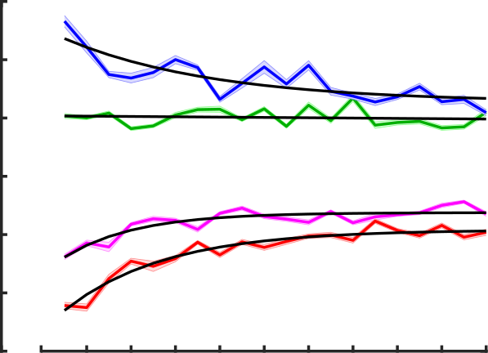
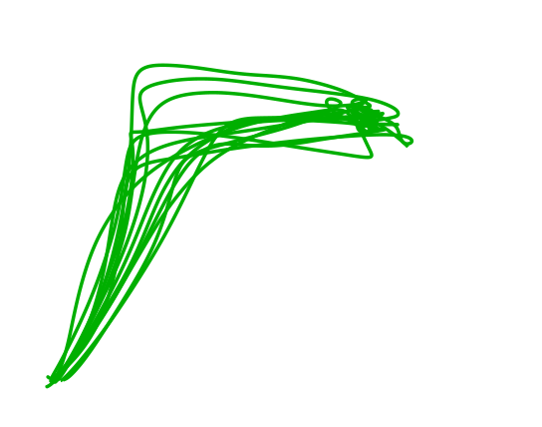
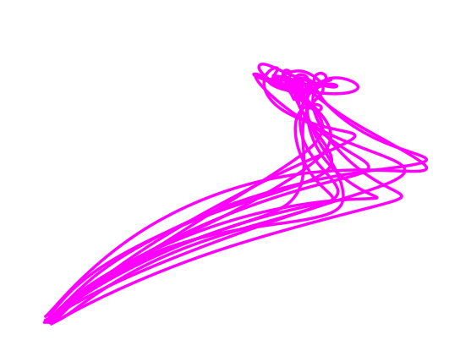
5a. Feedback adaptation generalize in neighboring direction space
a
b
c
36
32
28
24
20
CCW Naïve
CW Naïve
CCW Experienced
CW Experienced
Group 1
Naïve
2
0
-2
-4
Direction 90⁰
Pathlength (cm)
Target overshoot (cm)
Group 2
Experienced
Y
5cm
X
0 4 8 12 16 20
0 4 8 12 16 20
Trial
Trial
d
e
f
32
Group 2
Naïve
2
Y
5cm
28
Direction 45⁰
X
Pathlength (cm)
Target overshoot (cm)
0
24
Group 1
Experienced
-2
20
0 4 8 12 16 20
0 4 8 12 16 20
Trial
Trial
Good transfer of feedback adaptation across neighboring direction space

Slide 17
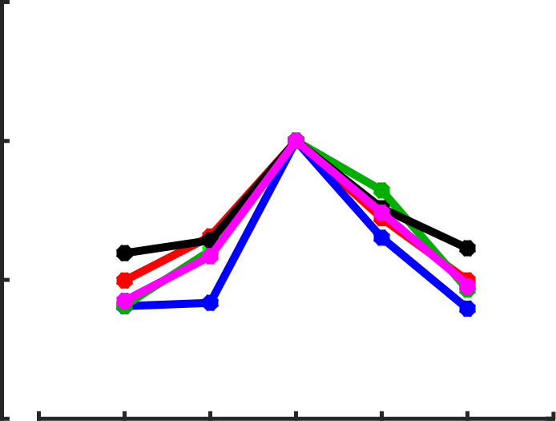
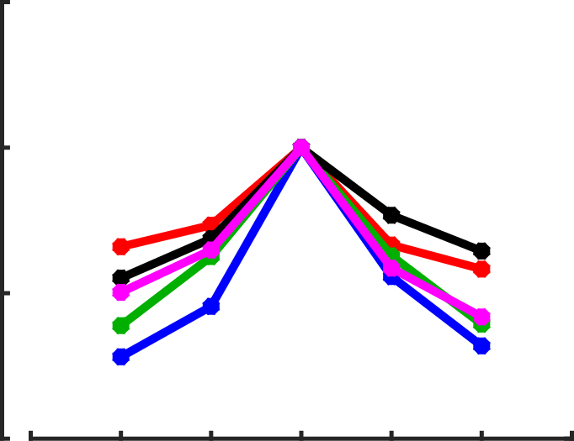
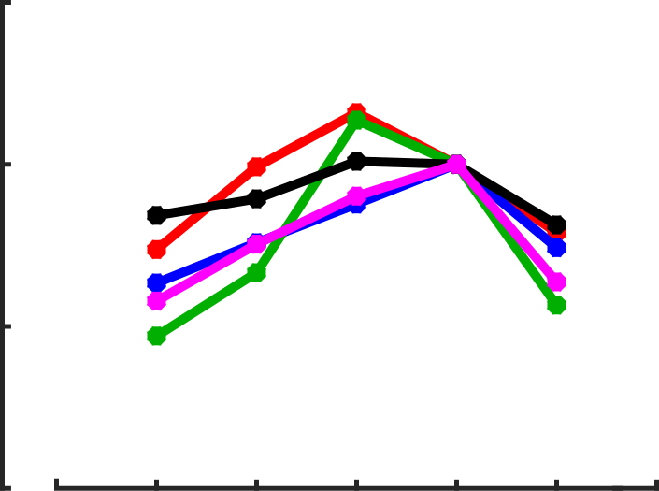
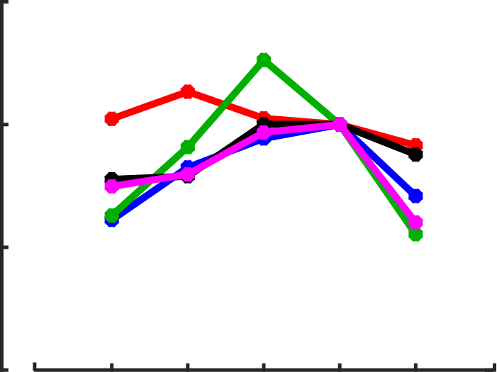
5b. Feedback adaptation produce narrow generalization in direction space: imprints in EMG
a
1.5
1.0
0.5
0
b
CW
1.5
1.0
0.5
0
CCW
5 muscles
Mean EMG of first 4 trials
Mean from -50 to 400ms from reach onset
Normalised to the training direction
PM
PD
AD
TL
BR
Normalized EMG [a.u]
180⁰ 135⁰ 90⁰ 45⁰ 0⁰
180⁰ 135⁰ 90⁰ 45⁰ 0⁰
c
Reach direction
d
1.5
1.0
0.5
0
1.5
1.0
0.5
0
CCW
CW
Normalized EMG [a.u]
180⁰ 135⁰ 90⁰ 45⁰ 0⁰
180⁰ 135⁰ 90⁰ 45⁰ 0⁰
Reach direction
EMG can be tuned according to the training direction

Slide 18
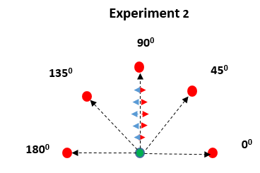
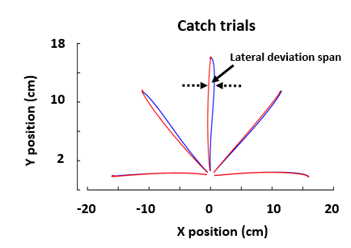
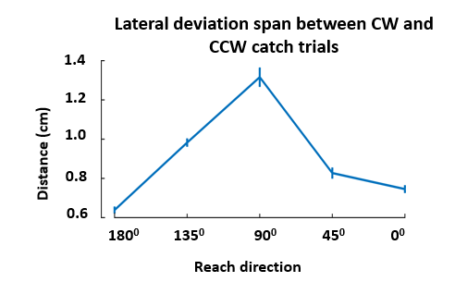
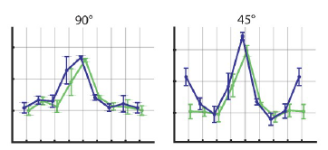
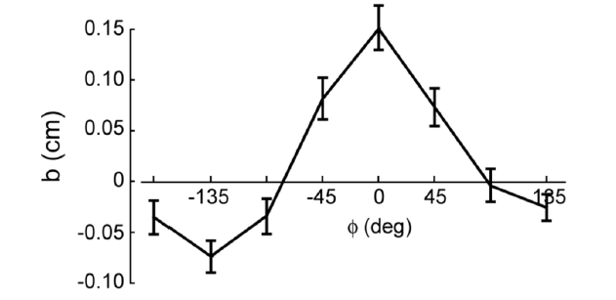
5c. Feedback adaptation produce narrow generalization in direction space : imprints in behavior
Narrow generalization in direction space (Thoroughman and Shadmehr, 2000)
Adaptation generalizes strongly in intrinsic coordinates joints and muscles (Hwang and Shadmehr, 2005).
This generalization reflects learning in a network in which the neurons primarily encode movements in the coordinates of joints and muscles.
(Thoroughman and Shadmehr, 2000)
(Rezazadeh, Bernicker, 2019)

Slide 19
Feedback adaptation
Traces of feedback adaptation in EMG around 250ms from reach onset (Crevecoeur 2020a)
Traces of feedback adaptation in via-point-after-effects (Crevecoeur 2020b)
Temporal aspects of feedback adaptation (Mathew 2020)
Underlying mechanism associated with feedback adaptation can be preserved in memory long enough to contribute to the trial-by-trial adaptation
Feedback adaptation underlines savings
The neural mechanism underlying faster relearning involve a feedback adaptation component
Spatial aspects of feedback adaptation
Feedback adaptation generalize well in near neighboring direction space
Feedback adaptation produce narrow generalization in direction space: imprints in EMG & behaviour

Slide 20
Thank You

Slide 21
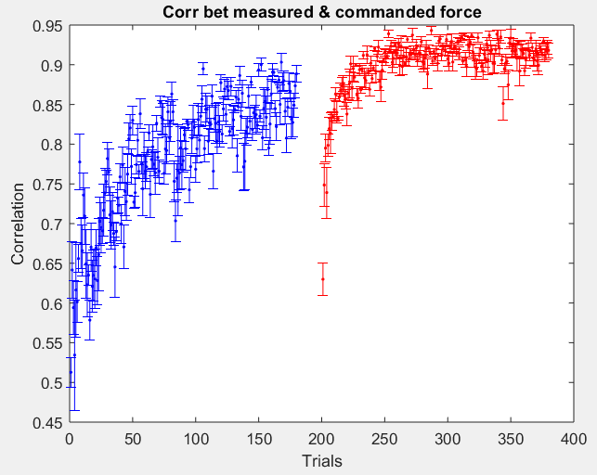
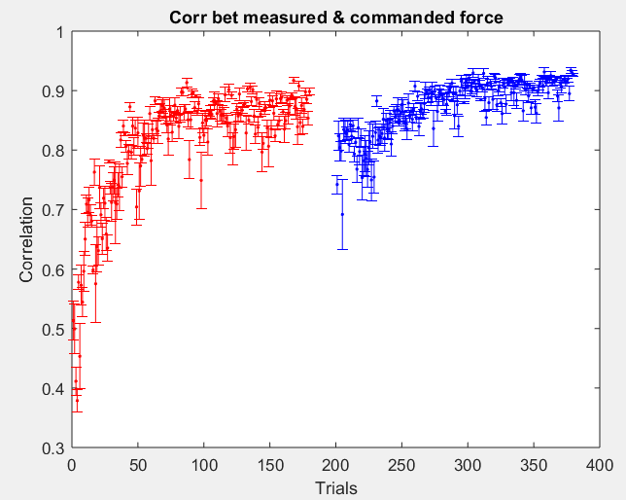
Faster Relearning in opposite perturbation
180 CCW -> 20Washout -> 180 CW
4 subjects
180 CW -> 20Washout -> 180 CCW
4 subjects
CCW
CW
CW
CCW

