Slide 1
Random Lasso
Sams Khan
James Matthew Hamilton
Jason Wein
Devyn Wilkins
Seung Myeong Choo

Slide 2
Sams Khan
Hello, I am Sams Khan, I am currently working on the Random Lasso Package project. My primary tasks include :
Assigning tasks for the Python package and website.
Setting up group meetings.
Leading the efforts around testing and writing the python implementation of the Lasso package.

Slide 3
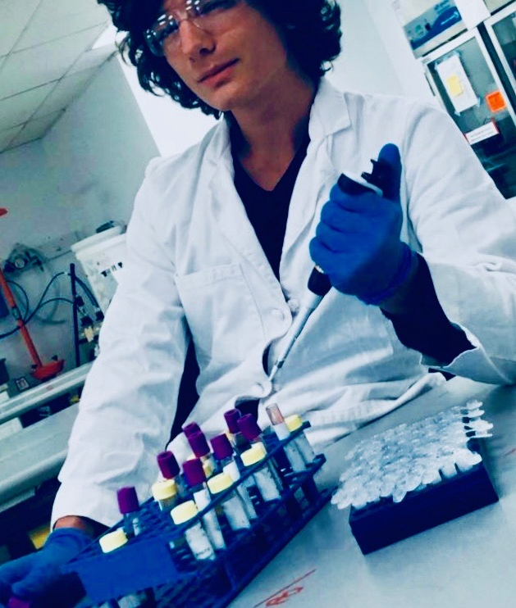
James Matthew Hamilton
Writing random lasso algorithm from scratch in R.
Creating a package for random lasso in R that can be used by anyone.
Adding optional parallel programing to random lasso using Spark.
Advising the website builders on educational material for random lasso.

Slide 4
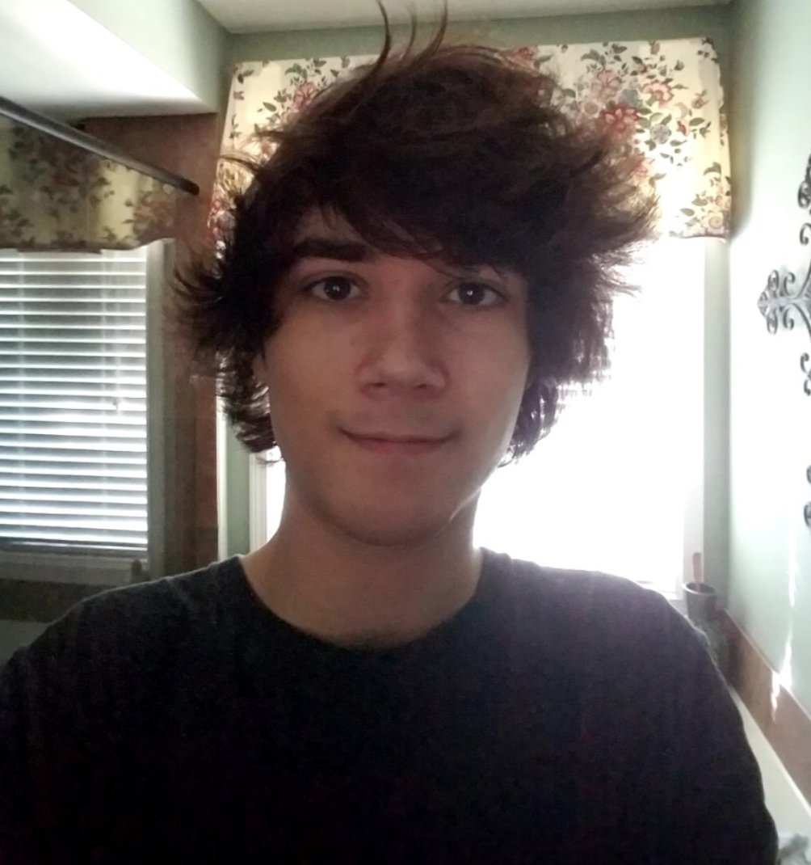
Jason Wein
My name is Jason Wein and I am a computer science major senior with a minor in mathematics. My role in the project includes working primarily on the python package, such as documentation and research, and assisting with creating and maintaining the website and creating educational materials on LASSO and Hi-LASSO.

Slide 5
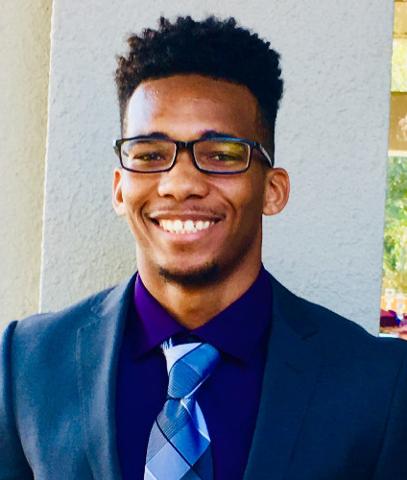
Devyn Wilkins
Current senior undergraduate enrolled in Kennesaw State University with an expected spring 2019 graduation. Working towards Bachelor of Science in Computer Science. Currently a security analyst intern with Anthem and enjoy building custom desktops. In regards to this project I am responsible for continual project research and full stack web development utilizing the Django framework (python), CSS, and HTML to visualize our data. After development, will move forward to deploying the website onto a Linux server.

Slide 6
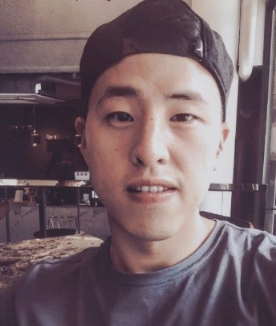
Seung Myeong Choo
My name is Seung Myeong Choo. My role in this project is researching and implementing Random Lasso libraries in Python, and collaborate with other members on publishing project in the website. Currently my goal of work is to figure out how the lasso and Randomized lasso make differences and implement them with some data sets from sklearn libraries. Also I will research how Pyspark is used for regression analysis in Python for expected goal of works.

