Slide 1
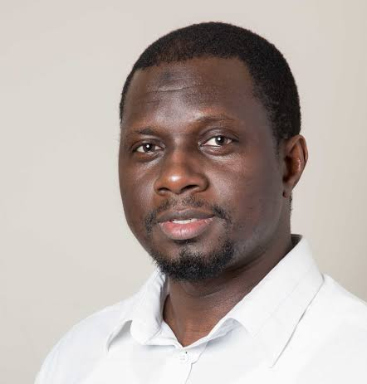
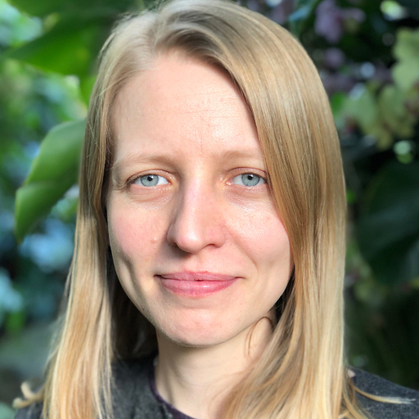
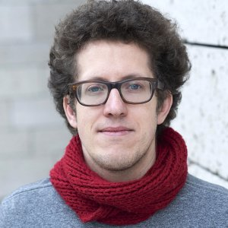
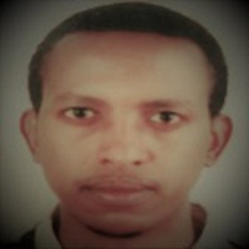
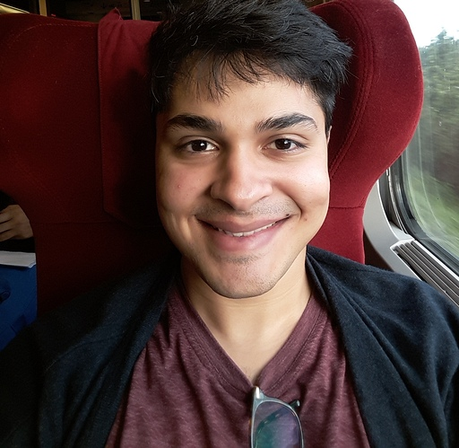
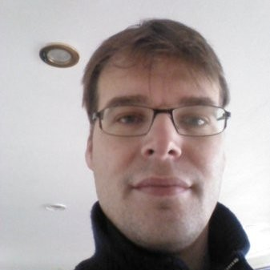
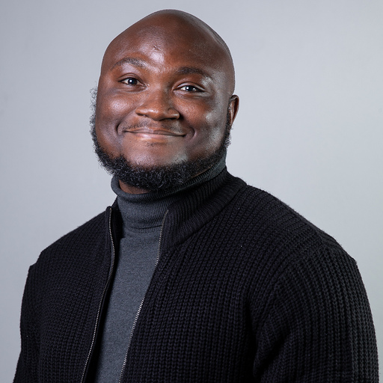

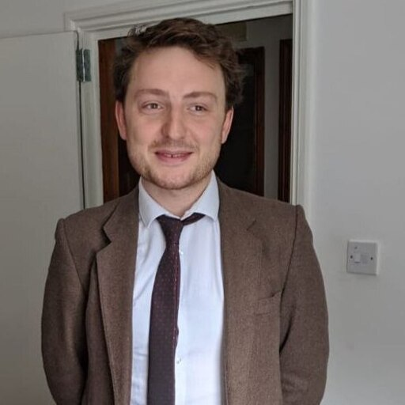

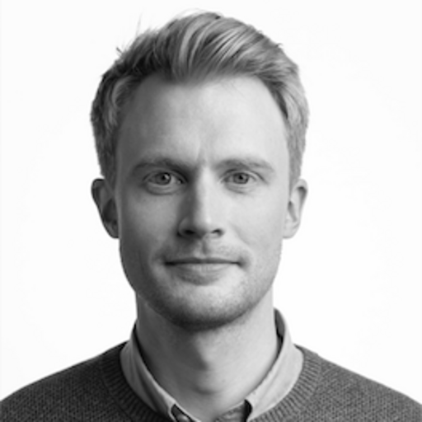
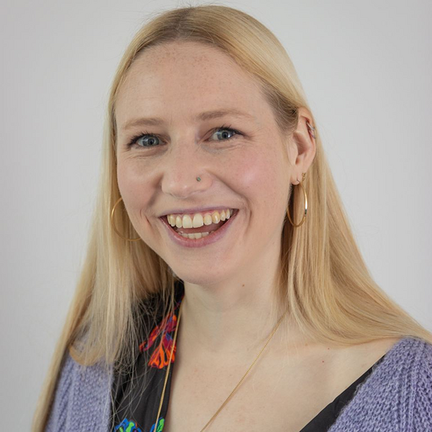
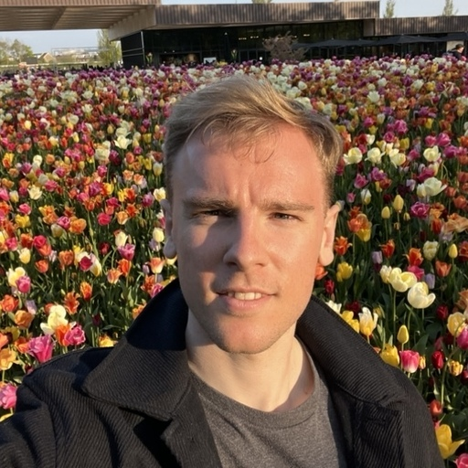
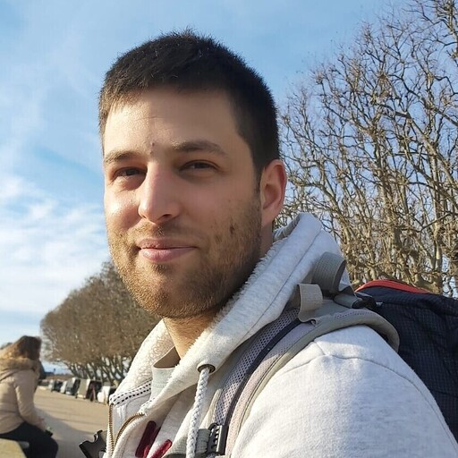
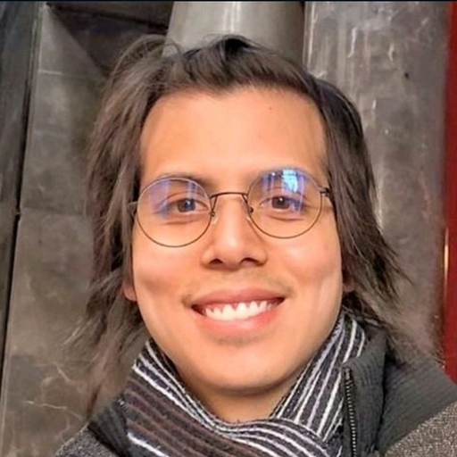
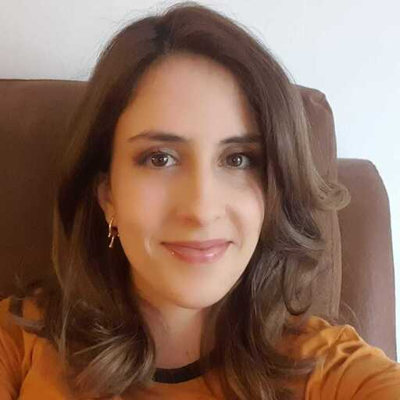
The Epiverse TRACE team (LSHTM-MRCG )
Data science tools for field epi (MRCG)
Real-time modelling
Long-term planning & policy
Bubacarr Bah
(Lead)
Roz Eggo
(Lead)
Seb Funk
(Lead)
Nuredin Mohammed (Associate Prof)
Pratik Gupte
(RSE)
Edwin Van Leeuwen
(RF)
James Azam
(RSE)
Karim Mané
(RSE)
Tim Russell
(RF)
Tim Taylor (UKHSA)
External integration & collaboration
System interoperability
Community building & training
Adam Kucharski
(Lead)
Anna Carnegie
(Lead)
Josh Lambert (RSE)
Hugo Gruson
(Snr RSE, data.org)
Andree Valle Campos
(RF)
Carmen Tamayo (RF)

