Slide 1
COVID-19
Dr. Jean Claude Dejon Agobé
MD, PhD
jcagobe@cermel.org

Slide 2
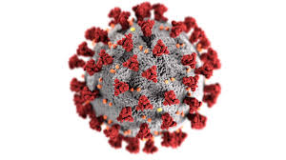
General information
Covid-19
Infectious disease
Causes by organism
Virus => Coronavirus 2019 (SARS-CoV-2)
Symptomatic or Asymptomatic
Symptoms (wide range)
Fever or chills
Cough
Shortness of breath or difficulty breathing
Sore throat
Congestion or runny nose
New loss of taste or smell
Fatigue
Muscle or body aches
Headache
Nausea or vomiting
Diarrhea

Slide 3
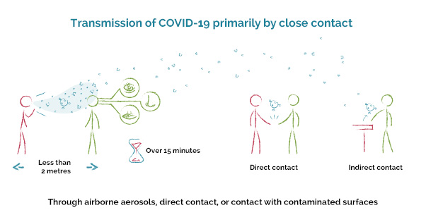
General information
Mode of transmission
Airbone aerosols
The virus spread from an infected person’s mouth or nose in small liquid particles when they cough, sneeze, speak, sing or breathe.
Direct contact
Indirect contact

Slide 4
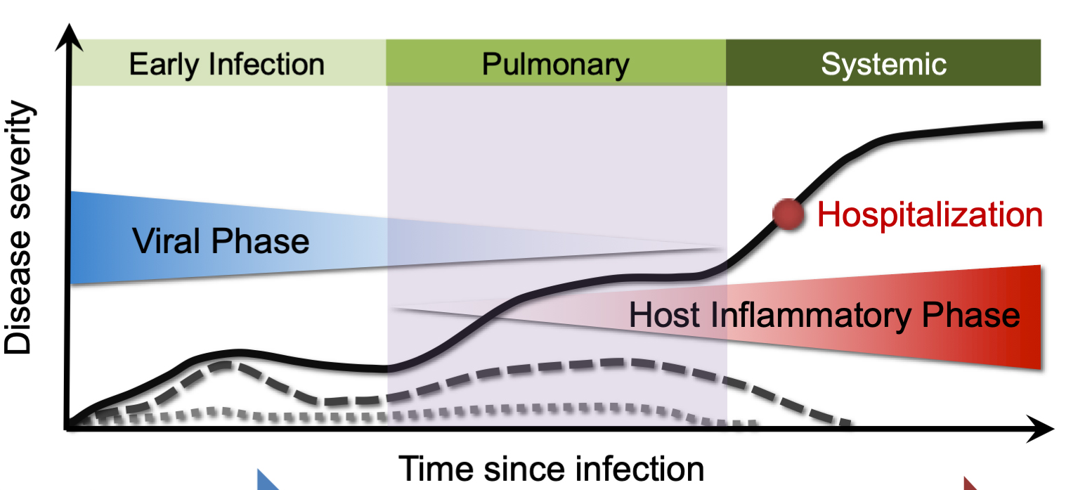
General information
Pathophysiology of COVID-19
Viral replication
Inflammatory response
=> begins when the virus replicates in local macrophages, resulting in apoptosis
Immune response to the first infection
Cellular response => cytokin storm ultimately result in multi-organ failure and death
Humoral response => antibody production (which provides protection against new infection)
Abnormal blood clots => organ damage, heart attack and stroke

Slide 5
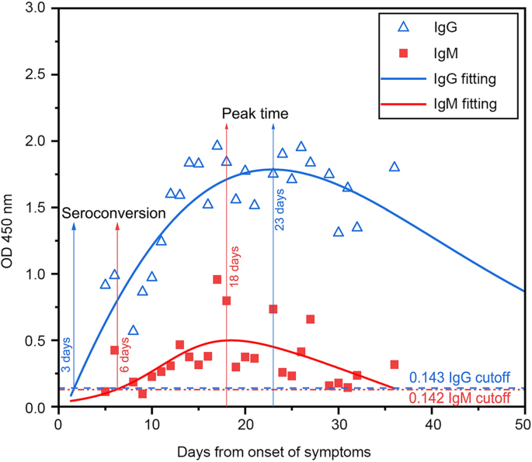
General information
Pathophysiology of COVID-19
Immune humoral response to covid-19 virus
Figure. Longitudinal profile of IgG and IgM antibodies in 131 chineese patients with COVID-19.(Huaqing Shu et al., 2020)

Slide 6
Disease phases
Some definitions
Latent phase (or pre-infectious phase): the period from the time of infection to the time of becoming infectious
Incubation phase: the time between exposure to an infectious disease and the start of symptoms
Infectious phase: the period during which the patient is contagious, can spread the virus
Clinical phase: the period during which the patient develops symptoms of the disease

Slide 7
Disease phases
Natural history of COVID-19
Progression of a disease process in an individual over time, in the absence of treatment
Susceptibility of the disease
age, sex, preexisting comorbidities such as hypertension, cardiovascular diseases, diabetes, obesity, cancer.
Exposure (Infection)
Latent phase will last 2 or 3 days
Infectious phase which can last 12 days
Incubation phase ≈ 5 days (but depends on the variant)
Duration of symptoms ≈ 8 to 10 days
Recovery ≈ 2 weeks (or death)
Protective Immunity will last ≈ 2 to 3 months

Slide 8
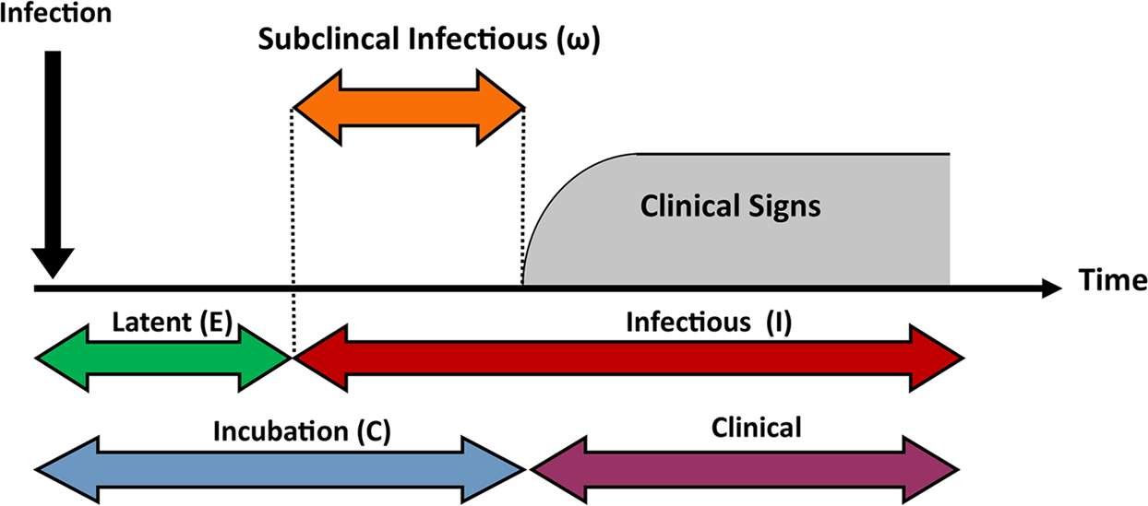
2 days
Day 0
Day 3
Day 5
Day 14
3 days
12 days
2 days
10 days

Slide 9
Preventing measures
Barrier measures:
Wearing a mask during times of high transmission, staying 6 feet apart, washing hands often and avoiding sick people
Herd immunity ?:
Resistance to the spread within a population based on immunity of a high proportion of individuals as a result of previous infection or vaccination
Vaccination
Quarantine ??

