Slide 1
Project Management Tool Trade Study
James McLellan
Notes:
Hi I’m James McLellan and I will be talking to you about project management tools.

Slide 2
Overview
Rationale
  Software Development touches the Business in many different areas.
Notes:
A quick bit first about the origin of this study:
I’ve been in software development for about a decade and a half, and like you, after only a little while something becomes terribly obvious: this job is more complicated than it looks.
And after a little while, you realize also that your software development activity touches your business in countless different ways. Yes, you are making a product or service to sell to the customer.
However, you are also buying or building capital equipment: software tools, or software libraries, or even hardware that you can use to solve internal business problems.
You are also performing research, and for your research to have any value at all, you must communicate it effectively, and in today’s society, portably so that people can reference your research on their time and at their location.
You consume resources from the business just by breathing. And the business, if it is to stay in business, has to account for how those resources were put to use, and use that data to forecast the business’ needs for the coming year.
Additionally, you are building capability for your company: be it skill sets, or floor space, or server farms, network infrastructure, or software products. This capability is what your marketing and sales folks must know about in order to go out in the world and effectively sell you to the world, so that everybody gets paid.

Slide 3
Overview
Rationale
  Software Development touches the Business in many different areas.
  There is no obvious tool already in use.
Notes:
Another reason I started comparing project management tools several years ago is because there is no obvious tool or tool chain that is already in use.
Everybody knows Microsoft Project, and I imagine for most people, it is the first or second project management tool you ever used. And if it is the second tool, your first was most likely Microsoft Excel. Admit it, we’ve all made those spreadsheets.
Ultimately, your realize MS Project is limited and doesn’t do everything you want. You can not easily export your task list into micro work orders for people to go and do[CHECK]. It’s doesn’t help you prioritize your tasks when you are having difficulty putting first things first yourself. It’s not very well equipped to be your information sharing resource. And although you can export many reports, it does not help you tremendously with either the importing, and sharing or requirements and resource data, nor the exporting of that data into inventories and capabilities lists. It doesn’t make your ROMs or do your payroll or compute your taxes or do your business forecasts for you.

Slide 4
Overview
Rationale
  Software Development touches the Business in many different areas.
  There is no obvious tool already in use.
  You either:
    build and maintain your own, which can be expensive and eventually lag behind commercial tools in features, or
    buy several specialized tools and resign yourself to the overhead of manually or semi-manually keeping the tools in sync.
Notes:
So, if you’re like me and the people I’ve seen, you roll your own solution. Usually, back to your first project management tool - the spreadsheet.
Or, you roll your own database and wind up trying to maintain it for your organization’s many needs and wants. And this can actually work for a while, but it is exhausting, and you will eventually one day stumble across an existing tool that has nearly everything on your “to do” list for new features, right out of the box.
Instead, you buy a tool that is better specialized to one of the functions in your business: an accounting tool, a requirements management tool, an inventory tracker, and then you commit yourself to a certain overhead of personal time manually copying data from one tool’s format into the next. You might build some scripts to help the process.
I have seen some businesses devote as much as a third of their total manpower to the care and upkeep of their business tool chain.

Slide 5
Overview
Summary
  A list of high-level needs the should be common to every organization
  A list of low-level wants that includes some very handy time saving features
  How several commercially available project management tools compare in implementing these needs and wants out of the box
Notes:
So, if you’re like me and the people I’ve seen, you roll your own solution. Usually, back to your first project management tool - the spreadsheet.
Or, you roll your own database and wind up trying to maintain it for your organization’s many needs and wants. And this can actually work for a while, but it is exhausting, and you will eventually one day stumble across an existing tool that has nearly everything on your “to do” list for new features, right out of the box.
Instead, you buy a tool that is better specialized to one of the functions in your business: an accounting tool, a requirements management tool, an inventory tracker, and then you commit yourself to a certain overhead of personal time manually copying data from one tool’s format into the next. You might build some scripts to help the process.
I have seen some businesses devote as much as a third of their total manpower to the care and upkeep of their business tool chain.

Slide 6
Overview
Take away
  Un-addressed business needs and tools that might help satisfy those needs
  Features you didn’t know your tool had
Notes:
The purpose for this study then, for me, was to understand what business needs are un-addressed, and what features are out there that some ot these tools provide.
In the process, I learned some new features of the tools that I did have or had reviewed.
My hope is that you’ll walk away from this study likewise informed about a tool that may help fill a need or want, or learn something new about the tool set that you already possess.

Slide 7
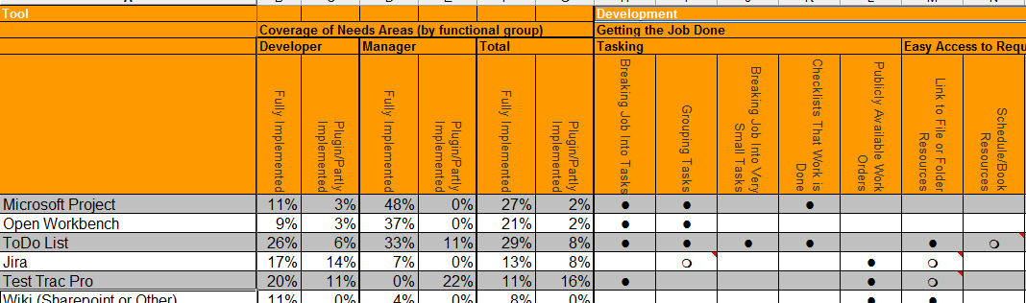
The Tools and Criteria
Results
    https://github.com/jamesmclellan/ProjectToolsTradeStudyPresentation
Notes:
For this study, I looked at twelve tools and ninety-one features and criteria.
The features were generated by a wish list of things I have, at some point, wished I had in a tool. It’s not meant to be an exhaustive list.. However, I would suggest the number of items may cover features you’ve wished for also.
In order to make summary and presentation manageable, I have grouped features by functional domain: software development, project or product management, accounting and marketing.
For the sake of this presentation, I will hit the hilights of each category. The complete spreadsheet is available for download at the URL shown here.

Slide 8
The Tools
MS Project
CA Open Workbench
Abstract Spoon ToDo List
Seapine Test Track Pro
Sparx Systems Enterprise Architect
IBM Rational DOORS
TiddlyWiki
Microsoft Outlook
Microsoft Word
Microsoft Excel
Microsoft Powerpoint
Notes:
The twelve tools include six project management tool chains, and six of the old standbys for comparison.
They are: Micrsoft Project, Niku (now Computer Associate’s) Open Workbench, Abstract Spons ToDo List, Seapine’s Test Track Pro, Sparx Systems’ Enterprise Architect, and IBM/Rational DOORS.
For Comparison, the old standbys are TiddlyWiki, although in many cases SharePoint would be a fine substitute, and the Microsoft Office Suite.

Slide 9
The Tools
MS Project
CA Open Workbench
Abstract Spoon ToDo List
Seapine Test Track Pro
Sparx Systems Enterprise Architect
IBM Rational DOORS
TiddlyWiki
Microsoft Outlook
Microsoft Word
Microsoft Excel
Microsoft Powerpoint
Notes:
The twelve tools include six project management tool chains, and six of the old standbys for comparison.
They are: Micrsoft Project, Niku (now Computer Associate’s) Open Workbench, Abstract Spons ToDo List, Seapine’s Test Track Pro, Sparx Systems’ Enterprise Architect, and IBM/Rational DOORS.
For Comparison, the old standbys are TiddlyWiki, although in many cases SharePoint would be a fine substitute, and the Microsoft Office Suite.

Slide 10
The Tools
MS Project
CA Open Workbench
Abstract Spoon ToDo List
Seapine Test Track Pro
Sparx Systems Enterprise Architect
IBM Rational DOORS
TiddlyWiki
Microsoft Outlook
Microsoft Word
Microsoft Excel
Microsoft Powerpoint
Notes:
Microsoft Project should be well known as an industry standard project management tool. Honestly, I don’t think I have ever worked anywhere where MS Project wasn’t being used by some part of the organization.
CA Technologies’ Open Workbench is a low cost alternative to Microsoft Project. It inherits from Project Workbench, with a first release in 1984, like MS Project. So the two tools have roughly the same amount of experience in the wild.
AbstractSpoon has a developer’s tool called ToDoList. ToDoList has a swiss army knife of helpful features that seem to have a developer’s needs in mind as to how they are laid out and used.
Seapine’s Test Track issue management system is a very handy resource for testers and managing requirements fulfillment.
Atlassian also has an issue management system, Jira, that has grown significantly in capability through a large library of third party add ons.
In the course of preparing this presentation, I discovered Microsoft’s Dynamics AX Enterprise Resource Management system. However, I haven’t had an opportunity to review it.

Slide 11
The Tools
MS Project
CA Open Workbench
Abstract Spoon ToDo List
Seapine Test Track Pro
Sparx Systems Enterprise Architect
IBM Rational DOORS
TiddlyWiki
Microsoft Outlook
Microsoft Word
Microsoft Excel
Microsoft Powerpoint
Notes:
Sparx Systems’ Enterprise Architect is a modelling tool that has set it’s sights on management capabilities. It has some features that do make it very useful to developers.
IBM Rational DOORS was, and I think still is a standard for requirements management.
Finally, there are wiki’s for communication and the Microsoft Office suite, which has been always a solid platform for building your own solution to a problem that doesn’t seem to have been solved anywhere else.

Slide 12
The Criteria
Functional Groups
  Developer
  Manager
  Accounting
  Marketing
Notes:
To group a wish list of features into something more meaningful, I tried to identify four key sections of a small software development business.
The developer is the obvious first category. In a one man shop, that’s you. Actually, all four of these categories are you. The developer designs and generates work product, and needs to effectively communicate his or her work and progress.
The manager is a nearly obvious second category. While in a one man show, requirements management is the developers responsibility, the evolution of someone who specialized in requirements management is usually one of the first evolutions of a growing business.
The accountant is also an obvious first category. Especially in a software service business, labor invoices and payroll are a big part of the job description, and the accountant is very much dependent on accurate reporting of time spent and progress from the developers or managers to be able to do his or her job effectively.
And finally, some firms grow fairly large before evolving a business development or marketing branch. Nevertheless, this branch of a business consumes data from the customers (in terms of feedback) that is very important for developers and managers. This branch also consumes capabilities data from development to compare against other business and the needs of the marketplace.

Slide 13
The Criteria
Functional Sub-Groups
  Developer
    Getting the Job Done, Reporting
  Manager
    Requirements Management and Reporting
  Accounting
    Capital Equipment, Capital, Inventory, Purchasing
  Marketing
    Information
Notes:
Under these second level categories are the specific features that I chose to compare among the products I have had available.
For the developer, features I’ve really wanted in a tool are: those that help me break a complex job into smaller tasks, allow me to keep my notes together with my tasks, allow me to keep track of my work product., and help automate my reporting requirements.
As a manager, features I have longed for are text parsers to import and help digest lengthy requirements documents into something more easily understood and managed. Likewise, I am looking for something that helps me schedule my tasks accurately and without a great expenditure of time. And I’m looking for a tool that can help me visualize progress along that schedule, and communicate the schedule in easy ways.
As an accountant, I want a tool that can reduce my labor hours and mistakes copying and pasting and collating time and expense reports. Ideally, I would love a tool that implements the DRY principle (don’t repeat yourself). Additionally, I desire a tool that can handle incentives or clever compensation schemes, delayed payments, and show me cash flow under hypothetical scenarios so that I can visualize milestone payments or new hires as reasonable or unreasonable, and summaries that make tracking budgets and budget burn easier.

Slide 14
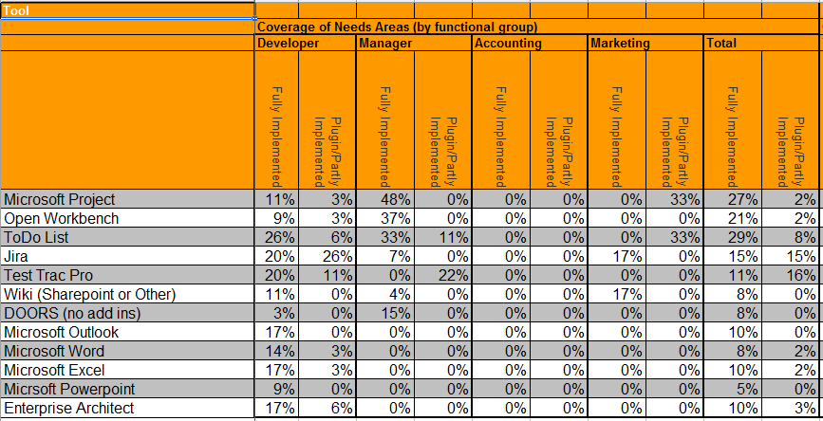
Feature Coverage by Top Level Category
Notes:
This is the summary roll up of my feature comparison.
I added two additional non-feature categories: is this item implemented out-of-the-box, or will I have to install plugins, add ons, or integrate with other tools in order to get the functionality I want.
I was pleasantly surprised to find that Microsoft Project, out of the box, satisfies most of my wishes in a Project Management tool. However, I also confirmed a suspicion that Project doesn’t assist very well outside of it’s specific area of regard.
I was also pretty pleased to discover the free alternative to Microsoft Project, Open Workbench, compares fairly well with Project, especially given the price differential.
As much as Abstract Spoon’s ToDoList looks like Microsoft Project and Open Workbench, ToDoList has a feature set that is much better suited to a developer. Nevertheless, it is also a handy management tool. Especially, when extended using interfaces for Google Calendar and Microsoft Outlook.

Slide 15
Feature Coverage by Top Level Category
Notes:
If you spend the time to install and configure the add ons, Jira becomes the most well suited tool across all of the categories. As a web based tool, Jira can also easily provide a customer-facing interface to receive feedback.
Test Track Pro, with requirements, test case management add ons and Surround SCM integration is a comparable tool.
DOORs has some unique and very useful requirements management tools. Although it may be extensible to do much more, I haven’t had the opportunity to explore that capability.
The Office tools require setting up your custom solution. However, together, they still present enough capability to accomplish almost any business goal, given you have enough time to create and maintain your templates and tools.
Enterprise Architect is very good as a developer’s assistat for visualizing a design and communicating a design. It doesn’t seem to be ready, yet, to take on a resource management and scheduling role; although I look forward to it developing those capabilities.

Slide 16
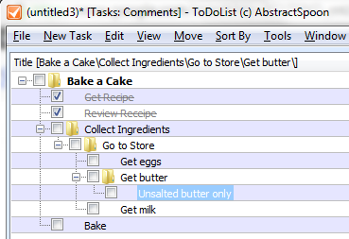
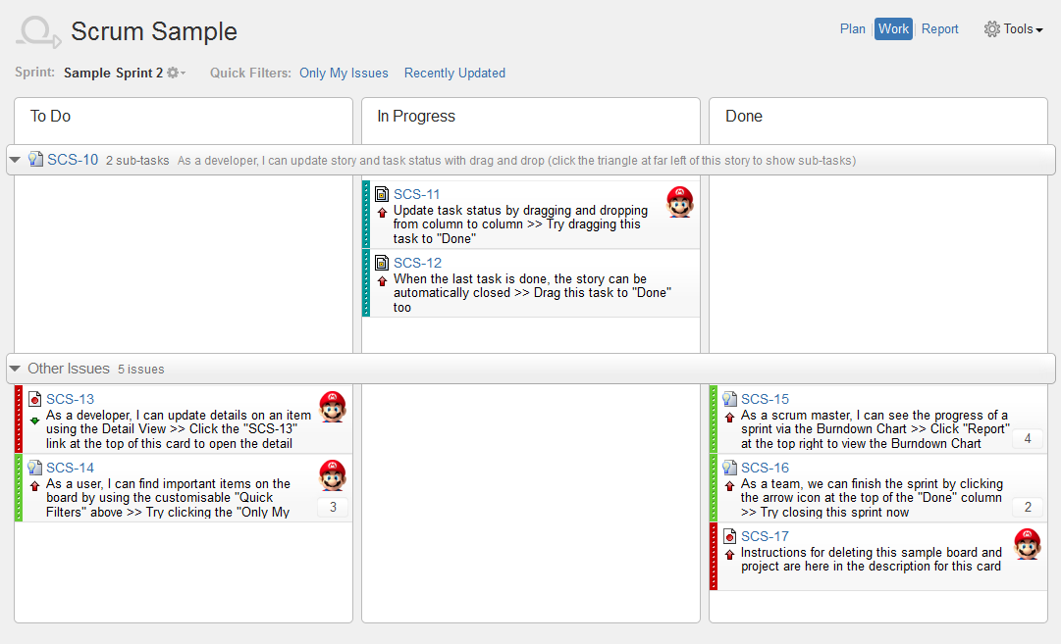
Hilights for the Developer
Tasking
  Micro-Tasking
  Published Work Orders

Slide 17
Hilights for the Developer
Booking and Deconflicting Resources
  Booking Locally
  Deconflicting Globally

Slide 18
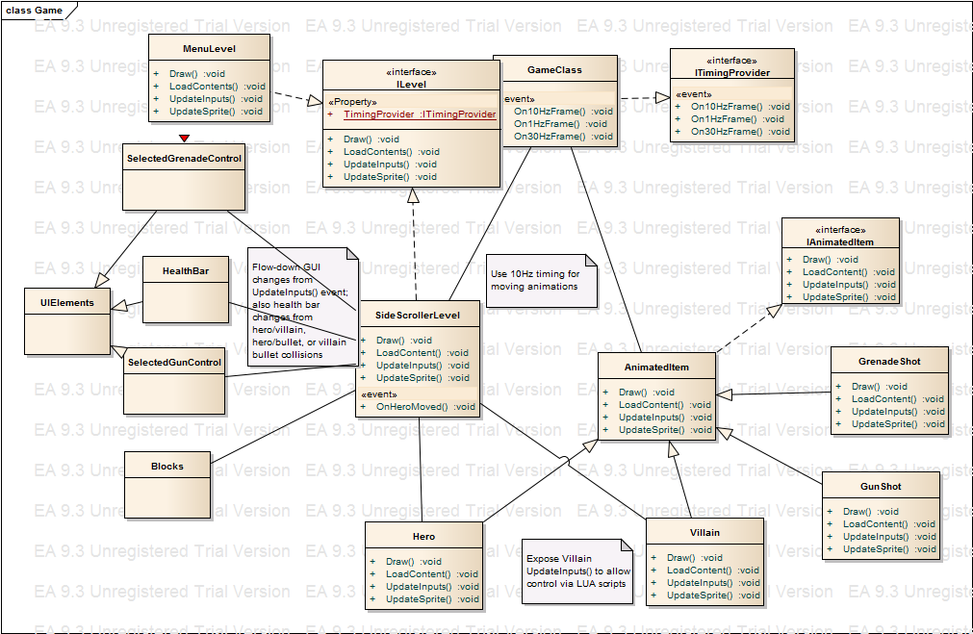
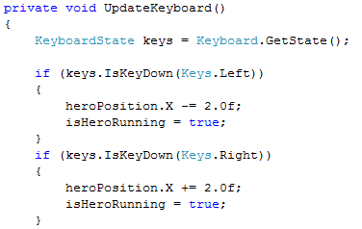
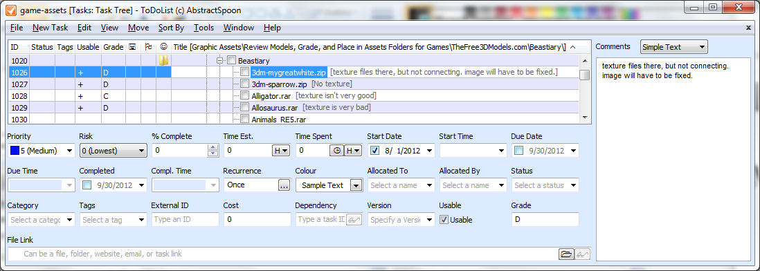
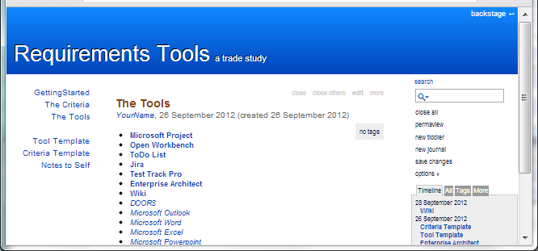
Hilights for the Developer
Designing Work Product
  Diagram Generation
  Code Generation
  Organizing Notes
  Cross Referencing

Slide 19
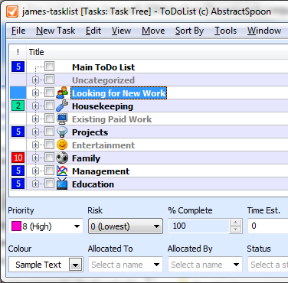
Hilights for the Developer
Creating Work Product
Workflow
Prioritizing
Testing
Alerts
  Email, Text Message, Popup
Reporting
  Recording time

Slide 20
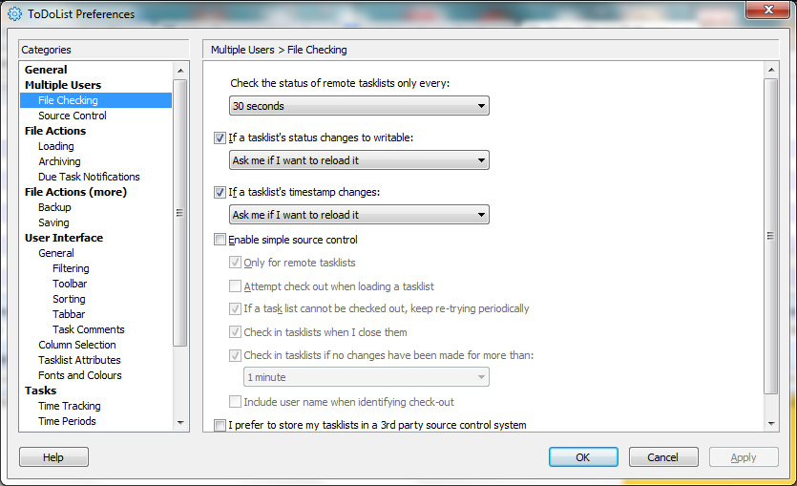
Hilights for the Manager
Scheduling
  Task Based
  Resource Based
Requirements Management
  Automatic Import
  Sharing, Merging
  Version Control
  Baselines

Slide 21
Hilights for the Manager
Reporting
  Timeline
  Burndown/Burnup

Slide 22
Hilights for the Accountant
Timesheet Integration to Invoicing

Slide 23
Hilights for the Marketer
Customer Feedback
Capabilities and Features Information

