Slide 1
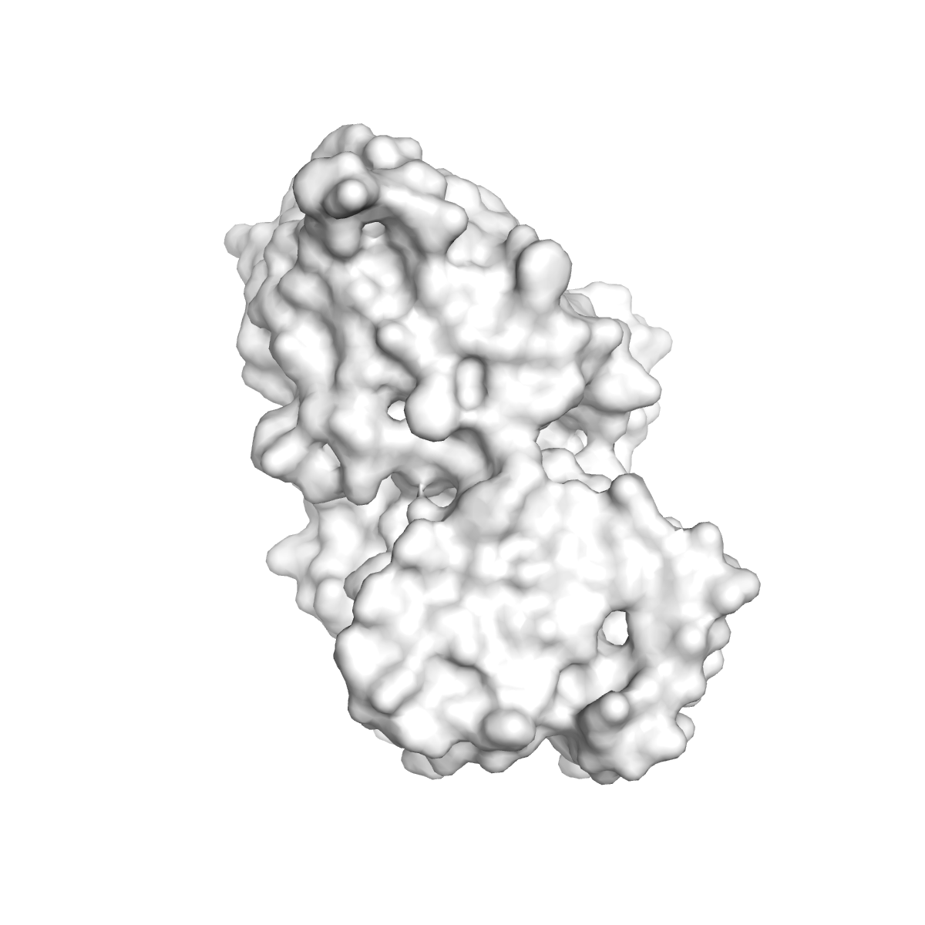
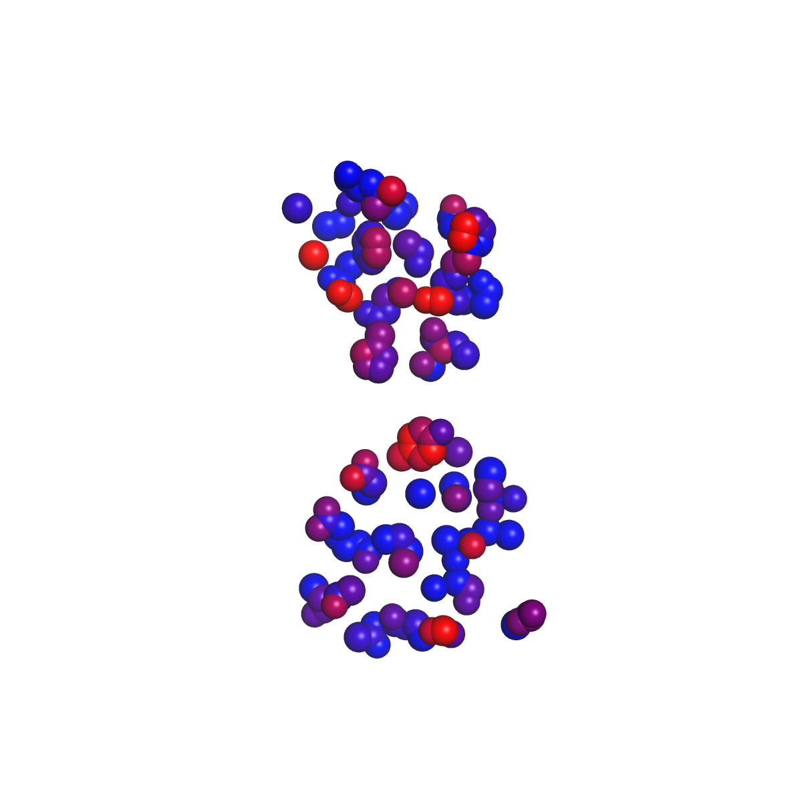
A4/A4 homomer 4gpa AB
(from symmetry)
42.7
32.6

