Slide 1
A Crash Course on Java
A Brief Introduction
http://docs.oracle.com/javase/tutorial/java/index.html

Slide 2
A Short History of Java by Jamie Mercer, Writer, Pearson Frank
How old is Java?
In 1990, Sun Microsystems engineer Patrick Naughton became increasingly annoyed with the state of Sun’s C++ and C APIs and was given the opportunity to create an alternative language as part of The Stealth Project.
The Stealth Project soon changed to the Green Project, with Mike Sheridan and James Gosling joining the ranks, and the group began developing new technology for programming next-generation smart appliances.

Slide 3
Initial ideas revolved around combining Mesa and C and producing an OO environment in C++.
They decided to rule out C++ because
  it needed too much memory
  its complexity led to developer errors
  the lack of garbage collection was resulting in programmers having to manually manage system memory, which often resulted in mistakes.
They also wanted a platform that would port easily to all types of devices.

Slide 4

Gosling attempted to modify/extend C++ (a development he refers to as "C++ ++ --"), but quickly abandoned this in favor of creating an entirely new language called Oak.
The new language took 18 months to finish.
By the fall of 1992, the team was able to present their first demonstration where they built a personal digital assistant called Star7, which had a graphical interface to assist the user. It also featured a smart agent called

Slide 5
The Green Project became Firstperson, a subsidiary of Sun Microsystems, and started to look at building highly interactive devices. They were approached by Time Warner to create an interactive set-top box but responded with a proposal for an entire set-top box platform!
The TV industry thought that this gave too much power to the user and Firstperson lost their bid before eventually being rolled back into Sun after they were unable to find further funding in the TV industry.

Slide 6
In 1994, after several days of brainstorming, the team refocused the platform on the World Wide Web, which was gathering a lot of momentum at the time.
With the dawn of graphical web browsers such as Mosaic, the team figured that the Internet could evolve into the same highly interactive medium that they had envisioned for cable TV.
Naughton would write a small browser named WebRunner (an homage to the movie Blade Runner) which would later become HotJava.

Slide 7
In the same year, Sun changed the name of the Oak language to Java, after a trademark dispute from Oak Technology.
The name 'Java' was the result of a brainstorming session which James Gosling described as “continuous wild craziness.”

Slide 8
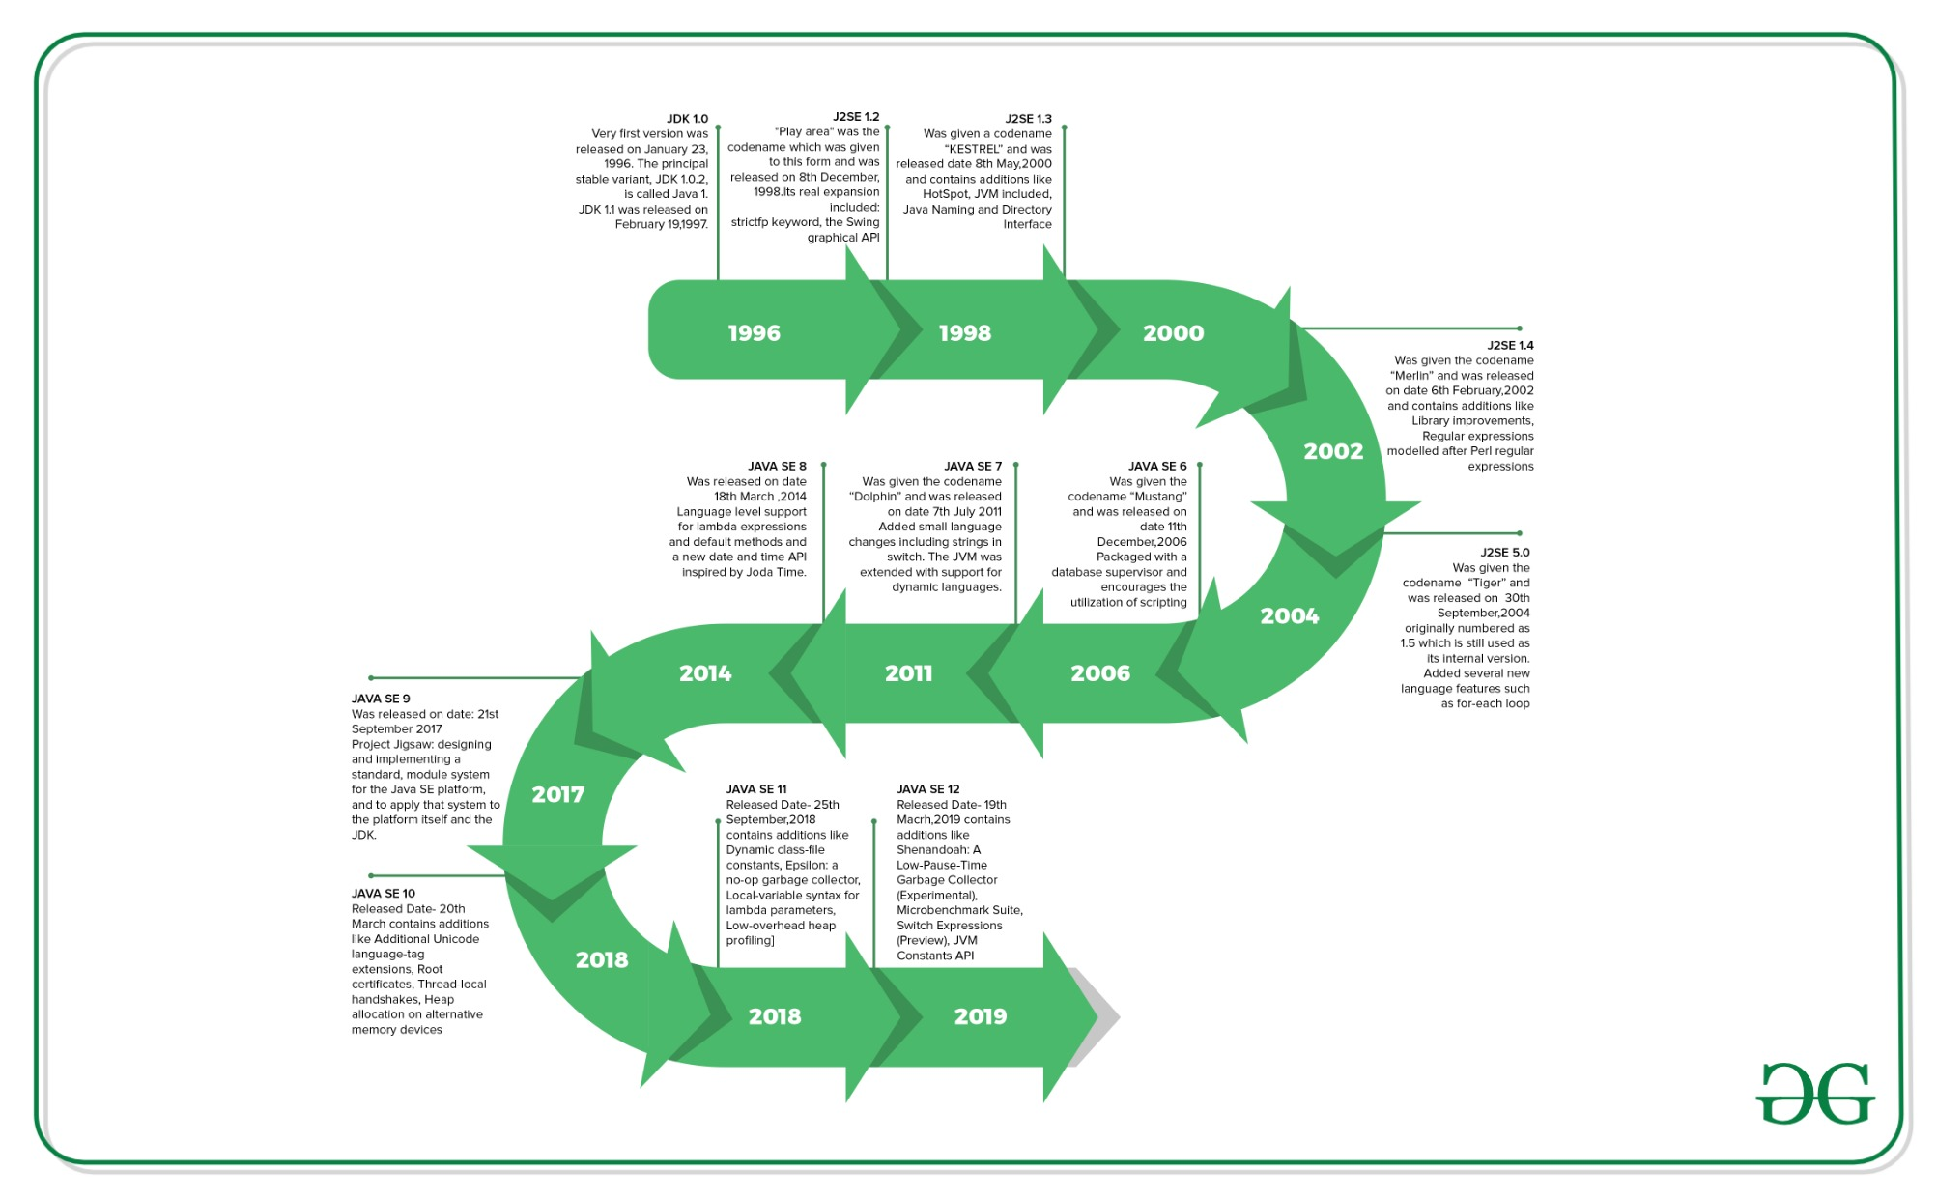
https://www.geeksforgeeks.org/the-complete-history-of-java-programming-language/

Slide 9
About the Java Technology
The Java Programming Language
The Java Platform

Slide 10
Java Programming Language
Simple Object oriented Distributed Multithreaded Dynamic | Architecture neutral Portable High performance Robust Secure
Each of the preceding buzzwords is explained in The Java Language Environment , a white paper written by James Gosling and Henry McGilton.

Slide 11

All source code is written in text files with .java extension.
Source files are compiled into .class files by javac compiler.
A .class file contains bytecodes — the machine language of the Java VM.
java launcher runs application on Java VM.

Slide 12
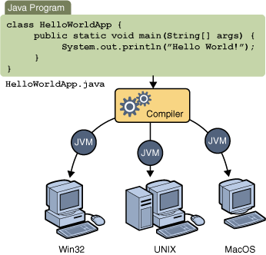
Compile once, run everywhere
JVM is available on different operating systems
The same .class files are capable of running on Microsoft Windows, the Solaris TM Operating System (Solaris OS), Linux, or Mac OS.
Some virtual machines, such as the Java SE HotSpot at a Glance, perform additional steps at runtime to give your application a performance boost.
  finding performance bottlenecks
  recompiling (to native code) frequently used sections of code.

Slide 13
The Java Platform
A platform is the hardware or software environment in which a program runs.
  Microsoft Windows, Linux, Solaris OS, and Mac OS.
Most platforms can be described as a combination of the operating system and underlying hardware.
Java platform is a software-only platform that runs on top of other hardware-based platforms.

Slide 14
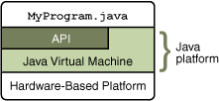
Java platform consists of
The Java Virtual Machine
The Java Application Programming Interface (API)

Slide 15
Java Class Libraries
All Java programs consist of classes
Classes consist of data members and function members (methods/operations)
Java programmers can write their own classes
They can also use existing classes in Java class libraries (Java API – Application Programming Interfaces)

Slide 16
Set Up Java Development Environment (JDK)
Download JDK installer from
http://www.oracle.com/technetwork/java/javase/downloads/index.html
(Choose the basic JDK to download)
Install the JDK
Set up the platform environment (PATH)
  http://docs.oracle.com/javase/tutorial/essential/environment/index.html

Slide 17
Steps to create Java Program
Creating a program using any editor and save the file as .java file such as test.java
Compile Java program into bytecodes
%javac test.java
Initiate JVM to execute program
%java test
  Load a program into memory
  Bytecode verification
  Execution

Slide 18
Where to find help
Getting started http://docs.oracle.com/javase/tutorial/getStarted/index.html
For tutorial
http://docs.oracle.com/javase/tutorial/
Documentations: APIs, Programmer Guides
Java SE Documentation - APIs & Documentation (oracle.com)

Slide 19
The "Hello World!" Application
  /**
  * The HelloWorldApp class implements an application that
  * simply prints "Hello World!" to standard output.
  */
  class HelloWorldApp {
  public static void main(String[] args) { System.out.println("Hello World!"); // Display the string.
  }
  }

Slide 20
Java Commenting Styles
/* comments */ or // comments
/** documentation */
  The javadoc tool uses doc comments when preparing automatically generated documentation.
  Javadoc Tool Home Page (oracle.com)

Slide 21
Object-Oriented
Programming Concepts
What Is an Object?
What Is a Class?
What Is Inheritance?
What Is an Interface? (to be discuss later)
What Is a Package? (to be discuss later)

Slide 22
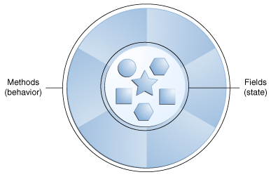
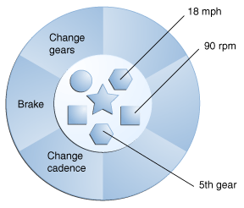
What Is an Object?
An object is a software bundle of related state and behavior.
Software objects are often used to model the real-world objects that you find in everyday life.

Slide 23
Bundling code into individual software objects provides benefits:
Modularity: The source code for an object can be written and maintained independently of the source code for other objects.
Information-hiding: By interacting only with an object's methods, the details of its internal implementation remain hidden from the outside world.
Code re-use: If an object already exists (perhaps written by another software developer), you can use that object in your program.
Pluggability and debugging ease: If a particular object turns out to be problematic, you can simply remove it from your application and plug in a different object as its replacement.

Slide 24
What Is a Class?
A class is a blueprint or prototype from which objects are created.
In object-oriented terms, a bicycle object is an instance of the class of objects known as bicycles.

Slide 25
class Bicycle {
int cadence = 0;
int speed = 0;
int gear = 1;
void changeCadence(int newValue) {
cadence = newValue;
}
void changeGear(int newValue) {
gear = newValue;
}
void speedUp(int increment) {
speed = speed + increment;
}
void applyBrakes(int decrement) {
speed = speed - decrement;
}
void printStates() {
System.out.println("cadence:" +
cadence + " speed:" +
speed + " gear:" + gear);
}
}
class BicycleDemo {
public static void main(String[] args) {
// Create two different Bicycle objects
Bicycle bike1 = new Bicycle();
Bicycle bike2 = new Bicycle();
// Invoke methods on those objects
bike1.changeCadence(50);
bike1.speedUp(10);
bike1.changeGear(2);
bike1.printStates();
bike2.changeCadence(50);
bike2.speedUp(10);
bike2.changeGear(2);
bike2.changeCadence(40);
bike2.speedUp(10);
bike2.changeGear(3);
bike2.printStates();
}
}

Slide 26
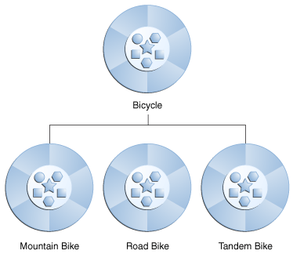
What Is Inheritance?
Inheritance provides a powerful and natural mechanism for organizing & structuring software.
Different kinds of objects often have some features in common. Yet each also defines additional features that make them different.
Classes inherit state and behavior from superclasses.

Slide 27
Java Language Basics
Variables
  Local Variables
  Parameters
  Instance Variables (Non-Static Fields)
  Class Variables (Static Fields)

Slide 28
Naming
  Variable names are case-sensitive.
  Always begin your variable names with a letter.
  Use full words instead of cryptic abbreviations.
  If the name you choose consists of only one word, spell that word in all lowercase letters. If it consists of more than one word, capitalize the first letter of each subsequent word.
  gearRatio and currentGear
  If your variable stores a constant value
  final int NUM_GEARS = 6

Slide 29
Array
  int[] anArray; // declares an array of integers
  anArray = new int[10]; // create an array of integers
  anArray[0] = 100; // initialize first element
  anArray[1] = 200; // initialize second element

Slide 30
Numbers and String Classes
Self reading http://docs.oracle.com/javase/tutorial/java/data/index.html

Slide 31
Classes declarations include:
class MyClass {
// field, constructor, and
// method declarations
}
class MyClass extends ASuperClass implements AnInterface {
// field, constructor, and
// method declarations
}
Modifiers such as public, private, protected.
The class name, with the initial letter capitalized by convention.
The first (or only) word in a method name should be a verb.
The class body, surrounded by braces, { }.

Slide 32
The name of the class's parent (superclass) preceded by the keyword extends. A class can only extend (subclass) one parent.
A list of interfaces implemented by the class preceded by the keyword implements. A class can implement more than one interface.

Slide 33
Declaring Member Variables
Member variables in a class—these are called fields.
Variables in a method or block of code—these are called local variables.
Variables in method declarations—these are called parameters.

Slide 34
The Bicycle class uses the following red lines of code to define its fields:
public class Bicycle{
private int cadence;
private int gear;
public int speed;
......
}
Field declarations are composed of three components, in order:
  Zero or more access modifiers, such as public or private.
  The field's type.
  The field's name.

Slide 35
Defining Methods
public double calculateAnswer(double wingSpan, int numberOfEngines,
double length, double grossTons) {
//do the calculation here
}
Modifiers: public, private, etc.
The return type.
The method name.
The parameter list in parenthesis—a comma-delimited list of input parameters, preceded by their data types, enclosed by parentheses, ( ).
An exception list.
The method body, enclosed between { }.

Slide 36
public class Bicycle {
private int cadence;
private int gear;
private int speed;
public Bicycle(int startCadence, int startSpeed, int startGear) {
gear = startGear;
cadence = startCadence;
speed = startSpeed;
}
public int getCadence() {
return cadence;
}
public void setCadence(int newValue) {
cadence = newValue;
}

Slide 37
public int getGear() {
return gear;
}
public void setGear(int newValue) {
gear = newValue;
}
public int getSpeed() {
return speed;
}
public void applyBrake(int decrement) {
speed -= decrement;
}
public void speedUp(int increment) {
speed += increment;
}
}

Slide 38

Variable declarations: associate a variable name with an object type.
Instantiation: “new” is a Java operator that creates the object.
Initialization: “new” is followed by a call to a constructor, which initializes the new object.

Slide 39
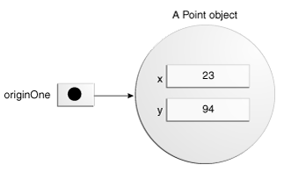
public class Point {
private int x = 0;
private int y = 0;
//constructor
public Point(int a, int b) {
x = a;
y = b;
}
}
Point originOne = new Point(23, 94);

Slide 40
public class Rectangle {
private int width = 0;
private int height = 0;
private Point origin;
public Rectangle() { // four constructors
origin = new Point(0, 0);
}
public Rectangle(Point p) {
origin = p;
}
public Rectangle(int w, int h) {
origin = new Point(0, 0);
width = w;
height = h;
}
public Rectangle(Point p, int w, int h) {
origin = p;
width = w;
height = h;
}
public void move(int x, int y) { // moving the rectangle
origin.x = x;
origin.y = y;
}
public int getArea() { //computing the area of the rectangle
return width * height;
}
}

Slide 41
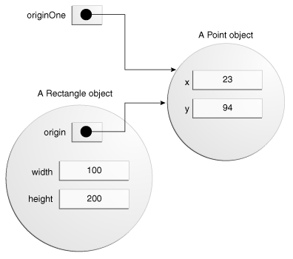
Rectangle rectOne = new Rectangle(originOne, 100, 200);

Slide 42
Understanding Instance and Class Variables
When a number of objects are created from the same class, they each have their own distinct copies of instance variables.
To have variables that are common to all objects, use static modifier to create static fields or class variables.
Every instance of the class shares a class variable, which is in one fixed location in memory.
Any object can change the value of a class variable.
Class variables can also be manipulated without creating an instance of the class.

Slide 43
public class Bicycle{
private int cadence;
private int gear;
public int speed;
public static int numberOfBicycles = 0;
......
}

Slide 44
Class variables/methods can be referred to by using class name directly
Bicycle.numberOfBicycles
Instance variables/methods have to be referred to using object name
Bicycle b1;
b1.speed

Slide 45
Understanding Instance and Class Methods
Java also supports static methods by adding a static modifier in their declarations.
Invoke with the class name,
ClassName.methodName(args)
Or refer to static methods with an object reference (discouraged):
instanceName.methodName(args)
A common use for static methods is to access static fields.
public static int getNumberOfBicycles() {
return numberOfBicycles; }

Slide 46
Things to be aware of
Instance methods can access instance variables and instance methods directly.
Instance methods can access class variables and class methods directly.
Class methods can access class variables and class methods directly.
Class methods cannot access instance variables or instance methods directly—they must use an object reference.
Class methods cannot use this keyword as there is no instance for this to refer to.

Slide 47
Constants
The final modifier declares a variable not modifiable
final double PI;
A final variable must be initialized at the end of each constructor.
The static modifier, in combination with the final modifier, can be used to define constants.
static final double PI = 3.141592653589793;
Constants cannot be reassigned, and it is a compile-time error if your program tries to do so.

Slide 48
Initializing Fields
Provide an initial value for a field in its declaration if the value is available or simple:
public class BedAndBreakfast {
public static int capacity = 10; //initialize to 10
private boolean full = false; //initialize to false
}
If initialization requires some logic:
  Class variables can be initialized using static initializer blocks or private static method.
  Instance variables can be initialized in constructors, initializer blocks and final methods.

Slide 49
Initializing instance variables
constructors
Initializer blocks (Java compiler copies initializer blocks into every constructor.)
{
// code to initialize instance variables
}
final methods
class Whatever {
private varType myVar = initializeInstanceVariable();
protected final varType initializeInstanceVariable() {
  //initialization code goes here
  }
}

Slide 50
Initializing class variables
Static initializer blocks
static {
// code to initialize class variables
}
Private static methods
class Whatever {
public static varType myVar = initializeClassVariable();
private static varType initializeClassVariable() {
//initialization code goes here
}
}

Slide 51
Nested Classes
Define a class within another class.
Nested classes are divided into two categories: static and non-static.
  class OuterClass {
    ...
    static class StaticNestedClass {
    ...
    }
    class InnerClass {
    ...
    }
  }
A nested class is a member of its enclosing class.
Non-static nested classes (inner classes) have access to other members of the enclosing class, even if they are declared private.
Static nested classes do not have access to other members of the enclosing class.
A nested class can be declared private, public, protected, or package private.

Slide 52
Why Use Nested Classes?
It is a way of logically grouping classes that are only used in one place.
It increases encapsulation.
Nested classes can lead to more readable and maintainable code.

Slide 53
Static Nested Classes
A static nested class is associated with its outer class.
A static nested class cannot refer directly to instance variables or methods defined in its enclosing class — it can use them only through an object reference.
A static nested class interacts with the instance members of its outer class (and other classes) just like any other top-level class.
Static nested classes are accessed using the enclosing class name:
OuterClass.StaticNestedClass nestedObject = new OuterClass.StaticNestedClass();

Slide 54
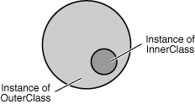
Inner Classes
An inner class is associated with an instance of its enclosing class and has direct access to all its methods and fields.
Because an inner class is associated with an instance, it cannot define any static members itself.
Objects that are instances of an inner class exist within an instance of the outer class.

Slide 55
To instantiate an inner class, you must first instantiate the outer class.
OuterClass outerObject = new OuterClass();
Then, create the inner object within the outer object with this syntax:
OuterClass.InnerClass innerObject = outerObject.new InnerClass();

Slide 56
public class StackOfInts {
private int[] stack;
private int next = 0; // index of last item in stack + 1
public StackOfInts(int size) {//create an array to hold the stack stack = new int[size];
}
public void push(int on) {
if (next < stack.length)
stack[next++] = on;
}
public boolean isEmpty() {
return (next == 0);
}
public int pop(){
if (!isEmpty())
return stack[--next]; // top item on stack
else
return 0;
}
public int getStackSize() {
return next;
}

Slide 57
private class StepThrough {// beginning of StepThrough inner class
// start stepping through at i=0
private int i = 0;
// increment index
public void increment() {
if ( i < stack.length) i++;
}
// retrieve current element
public int current() {
return stack[i];
}
// last element on stack?
public boolean isLast(){
if (i == getStackSize() - 1) return true;
else return false;
}
} // end of StepThrough inner class
public StepThrough stepThrough() {
return new StepThrough();
}

Slide 58
  public static void main(String[] args) {
  // instantiate outer class as "stackOne"
  StackOfInts stackOne = new StackOfInts(15);
  // populate stackOne
  for (int j = 0 ; j < 15 ; j++) {
  stackOne.push(2*j);
  }
  // instantiate inner class as "iterator"
  StepThrough iterator = stackOne.stepThrough();
  // print out stackOne[i], one per line
  while(!iterator.isLast()) {
  System.out.print(iterator.current() + " ");
  iterator.increment();
  }
  System.out.println();
  } // end of main method
} // end of StackOfInts

Slide 59
There are two additional special kinds of inner classes:
  local classes
  anonymous classes (also called anonymous inner classes).
You can declare an inner class within the body of a method. Such a class is known as a local inner class.
You can also declare an inner class within the body of a method without naming it. These classes are known as anonymous inner classes.

Slide 60
public class LocalInnerClass {
private static Test monitor = new Test();
private int count = 0;
Counter getCounter(final String name) { // A local inner class:
class LocalCounter implements Counter{
public LocalCounter() { // Local inner class can have a //constructor
System.out.println("LocalCounter()"); }
public int next() {
System.out.print(name); // Access local final
return count++; }
}
return new LocalCounter();
} // end of getCounter

Slide 61
// The same thing with an anonymous inner class:
Counter getCounter2(final String name) {
return new Counter()
{ // Anonymous inner class cannot have a named
// constructor, only an instance initializer:
{ System.out.println("Counter()"); }
public int next() {
System.out.print(name); // Access local final
return count++; }
};
} // end of getCounter2

Slide 62
Shadowing
If a declaration of a type (such as a member variable or a parameter name) in a particular scope (such as an inner class or a method definition) has the same name as another declaration in the enclosing scope, then the declaration shadows the declaration of the enclosing scope.
You cannot refer to a shadowed declaration by its name alone.

Slide 63
public class ShadowTest {
public int x = 0;
class FirstLevel {
public int x = 1;
void methodInFirstLevel(int x) {
System.out.println("x = " + x);
System.out.println("this.x = " + this.x);
System.out.println("ShadowTest.this.x = " + ShadowTest.this.x);
}
}
public static void main(String... args) {
ShadowTest st = new ShadowTest();
ShadowTest.FirstLevel fl = st.new FirstLevel();
fl.methodInFirstLevel(23);
}
}
x = 23
this.x = 1
ShadowTest.this.x = 0

Slide 64
When to Use Nested Classes, Local Classes, Anonymous Classes
Local class: Use it if you need to create more than one instance of a class, access its constructor, or introduce a new, named type (because, for example, you need to invoke additional methods later).
Anonymous class: Use it if you need to declare fields or additional methods.
Nested class: Use it if your requirements are similar to those of a local class, you want to make the type more widely available, and you don't require access to local variables or method parameters.
Use a non-static nested class (or inner class) if you require access to an enclosing instance's non-public fields and methods. Use a static nested class if you don't require this access.

Slide 65
Using the this Keyword
Within an instance method or a constructor, this is a reference to the current object — the object whose method or constructor is being called.
You can refer to any member of the current object from within an instance method or a constructor by using this.

Slide 66
Using this with a Field
The most common reason for using the this keyword is because a field is shadowed by a method or constructor parameter.
public class Point {
  private int x = 0;
  private int y = 0;
  //constructor
  public Point(int a, int b) {
  x = a;
  y = b;
  }
}
public class Point {
private int x = 0;
private int y = 0;
//constructor
public Point(int x, int y){
this.x = x;
this.y = y;
}
}

Slide 67
Explicit constructor invocation
use this keyword to call another constructor within a constructor
public class Rectangle {
private int x, y;
private int width, height;
public Rectangle() {
this(0, 0, 0, 0);
}
public Rectangle(int width, int height) {
this(0, 0, width, height);
}
public Rectangle(int x, int y, int width, int height) {
this.x = x;
this.y = y;
this.width = width;
this.height = height;
}
}

Slide 68
Controlling Access to Class and
Members of a Class
At the class level:
  public: visible to all classes everywhere
  package-private (no explicit modifier): visible only within its own package
At the member level:
  public:
  package-private (no explicit modifier)
  private: visible in its own class
  protected: visible within its own package and by a subclass of its class in another package.

Slide 69
public class LocalInnerClass {
private static Test monitor = new Test();
private int count = 0;
Counter getCounter(final String name) { // A local inner class:
class LocalCounter implements Counter{
public LocalCounter() { // Local inner class can have a //constructor
System.out.println("LocalCounter()"); }
public int next() {
System.out.print(name); // Access local final
return count++; }
}
return new LocalCounter();
} // end of getCounter

Slide 70
// The same thing with an anonymous inner class:
Counter getCounter2(final String name) {
return new Counter()
{ // Anonymous inner class cannot have a named
// constructor, only an instance initializer:
{ System.out.println("Counter()"); }
public int next() {
System.out.print(name); // Access local final
return count++; }
};
} // end of getCounter2

Slide 71
Abstract class & abstract method
An abstract class is a class that is declared abstract—it may or may not include abstract methods.
Abstract classes cannot be instantiated, but they can be subclassed.
An abstract method is a method that is declared without an implementation:
abstract void moveTo(double deltaX, double deltaY);

Slide 72
Abstract class usages
An abstract class declares common attributes and behaviors of the various classes in a class hierarchy.
It typically contains one or more abstract methods that sub class must override if the sub classes are to be concrete.
The instance variables and concrete methods of an abstract class are subject to the normal rules of inheritance.

Slide 73
What Is an Interface?
In software engineering, disparate groups of programmers need to know how each other’s software interacts without knowing the implementation details.
Example:
  Automobile manufacturers write software (Java, of course) that operates the automobile — stop, start, accelerate, turn left, and so forth.
  electronic guidance instrument manufacturers write software that receive GPS position data and traffic conditions and use that information to drive the car.
  Neither group needs to know how the other group's software is implemented.

Slide 74
An interface is typically used when unrelated classes need to share common methods and constants.
This allows objects of unrelated classes to be processed polymorphically:
  i.e., objects of classes that implement the same interface can respond to the same method calls.

Slide 75
An interface is a contract between a class and the outside world.
When a class implements an interface, it promises to provide the behavior published by that interface.
Implementing an interface allows a class to become more formal about the behavior it promises to provide.
The contract is enforced at build time by the compiler.

Slide 76
Interfaces in Java
An interface is a reference type that can contain only constants, method signatures, and nested types. There are no method bodies.
Interfaces cannot be instantiated—they can only be implemented by classes or extended by other interfaces.

Slide 77
Defining an Interface
public interface GroupedInterface extends Interface1, Interface2, Interface3 {
// constant declarations
double E = 2.718282;
// method signatures
void doSomething (int i, double x);
int doSomethingElse(String s);
}

Slide 78
A method declaration within an interface is followed by a semicolon.
All methods declared in an interface are implicitly public.
An interface can contain constant declarations and they are implicitly public, static, and final.

Slide 79
To use an interface
A concrete class must specify that it implements an interface
When an concrete class implements an interface, it must provide a method body for every method declared in the interface.

Slide 80
Implementing an Interface
To declare a class that implements an interface, you include an “implements” clause in the class declaration.
By convention, the implements clause follows the extends clause, if there is one.
A class can implement more than one interface.
When a class implements an interface, it must provide a method body for every method declared in the interface.

Slide 81
public interface OperateCar {
  int signalTurn(Direction direction, boolean signalOn);
  int getRadarFront(double distanceToCar, double speedOfCar);
  int getRadarRear(double distanceToCar, double speedOfCar);
  int turn(Direction direction, double radius, double startSpeed, double endSpeed);
  int changeLanes(Direction direction, double startSpeed, double endSpeed);
}
public class OperateBMW760i implements OperateCar {
int signalTurn(Direction direction, boolean signalOn) {
  //code to implement this function for BMW
}
int getRadarFront(double distanceToCar, double speedOfCar){
  //code to implement this function for BMW
}
int getRadarRear(double distanceToCar, double speedOfCar){
  //code to implement this function for BMW
}
int turn(Direction direction, double radius, double startSpeed, double endSpeed){
//code to implement this function for BMW
}
int changeLanes(Direction direction, double startSpeed, double endSpeed){
//code to implement this function for BMW
}
}

Slide 82
Extending Interfaces
Consider an interface that you have developed called DoIt:
public interface DoIt {
void doSomething(int i, double x);
int doSomethingElse(String s);
}
Suppose that, at a later time, you want to add a third method to DoIt,
  You can either
  public interface DoIt {
  void doSomething(int i, double x);
  int doSomethingElse(String s);
  boolean didItWork(int i, double x, String s);
  }
  Create a DoItPlus interface that extends DoIt:
public interface DoItPlus extends DoIt {
boolean didItWork(int i, double x, String s);
}

Slide 83
Using an Interface as a Type
When you define a new interface, you are defining a new reference data type.
You can use interface names anywhere you can use any other data type name.
If you define a reference variable whose type is an interface, any object you assign to it must be an instance of a class that implements the interface.

Slide 84
Interfaces & Multiple Inheritance
The Java programming language does not permit multiple inheritance, but interfaces provide an alternative.
In Java, a class can inherit from only one class but it can implement more than one interface.

Slide 85
Summary of Interfaces
An interface defines a protocol of communication between two types of objects.
An interface declaration contains signatures, but no implementations, for a set of methods, and might also contain constant definitions.
A class that implements an interface must implement all the methods declared in the interface.
An interface name can be used anywhere a type can be used.

Slide 86
Abstract Class vs. Interface
Both of them:
are the ways to implement Polymorphism.
can not be instantiated.
can only be used as super classes.
need to declare in same name file with .java extension.
Abstract methods and methods in an interface can only be signatures without any state or implementation.
Abstract methods and methods in an interface need to be implemented in concrete classes.

Slide 87
Abstract Class vs. Interface
But:
Abstract classes serve states and or implementations while interfaces can’t.
Interfaces only serve method signatures and constants.
Abstract classes will be extended but Interfaces will be implemented.
Unlike classes all the interfaces’ methods must be public.

Slide 88
Applications:
An interface is just a pattern while an abstract class is a real class with all the abilities.
Interfaces and Abstract classes both share a common design.
Interfaces are useful when you need to create disparate and unrelated objects with same behaviors.
Abstract classes are useful when you need to create closely related objects with common implementations.
Abstract classes help you to have a more extensible and reusable code.
Interfaces help you to have more structured code.
When you want a super class without any default implementation interfaces are what you want.
In Java, classes are not allowed to inherit from more than one class but it’s possible by interfaces.
Declaring constants in interfaces keeps your code clear and easy to maintain.

Slide 89
《interface》
Payable
Invoice
Employee
HourlyEmployee
SalariedEmployee
Commission
Employee
BonusPlusCommission
Employee
Click here to see the source code

Slide 90

Generics

Slide 91
Annotations
Annotations, a form of metadata, provide data about a program that is not part of the program itself.
Annotations have no direct effect on the operation of the code they annotate.
Annotations have a number of uses:
  Information for the compiler — Annotations can be used by the compiler to detect errors or suppress warnings.
  Compile-time and deployment-time processing — Software tools can process annotation information to generate code, XML files, and so forth.
  Runtime processing — Some annotations are available to be examined at runtime.

Slide 92
The Format of an Annotation
In its simplest form:
@Entity
(@) indicates to the compiler that what follows is an annotation.
@Override
void mySuperMethod() { ... }
The annotation can include elements, which can be named or unnamed, and there are values for those elements:
    @Author( name = "Benjamin Franklin",
    date = "3/27/2003"
    )
    class MyClass() { ... }
    @SuppressWarnings(value = "unchecked")
    void myMethod() { ... }
    @SuppressWarnings("unchecked")
    void myMethod() { ... }
If the annotation has no elements, then the parentheses can be omitted

Slide 93
It is also possible to use multiple annotations on the same declaration:
  @Author(name = "Jane Doe")
  @EBook
  class MyClass { ... }
If the annotations have the same type, then this is called a repeating annotation:
  @Author(name = "Jane Doe")
  @Author(name = "John Smith")
  class MyClass { ... }

Slide 94
The annotation type can be one of the types that are defined in the java.lang or java.lang.annotation packages of the Java SE API.
Override and SuppressWarnings are predefined Java annotations.
It is also possible to define your own annotation type. The Author and Ebook annotations are custom annotation types.

Slide 95
Where Annotations Can Be Used
Annotations can be applied to declarations: declarations of classes, fields, methods, and other program elements.
When used on a declaration, each annotation often appears, by convention, on its own line.

Slide 96
Declaring an Annotation Type
public class Generation3List extends Generation2List {
// Author: John Doe
// Date: 3/17/2002
// Current revision: 6
// Last modified: 4/12/2004
// By: Jane Doe
// Reviewers: Alice, Bill, Cindy
// class code goes here
}

Slide 97
To add this same metadata with an annotation, you must first define the annotation type.
        @interface ClassPreamble {
        String author();
        String date();
        int currentRevision() default 1;
        String lastModified() default "N/A";
        String lastModifiedBy() default "N/A";
        // Note use of array
        String[] reviewers();
        }
After the annotation type is defined, you can use annotations of that type, with the values filled in:
        @ClassPreamble (
        author = "John Doe",
        date = "3/17/2002",
        currentRevision = 6,
        lastModified = "4/12/2004",
        lastModifiedBy = "Jane Doe",
        // Note array notation
        reviewers = {"Alice", "Bob", "Cindy"}
        )
        public class Generation3List extends Generation2List {
        // class code goes here
        }

Slide 98
To make the information in @ClassPreamble appear in Javadoc-generated documentation, you must annotate the @ClassPreamble definition with the @Documented annotation:
        // import this to use @Documented
        import java.lang.annotation.*;
        @Documented
        @interface ClassPreamble {
        // Annotation element definitions
        }

Slide 99
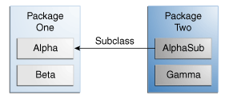
Class Member Visibility
Member Modifier | Alpha (class) | Beta (package) | AlphaSub (subclass) | Gamma (world)
public | Y | Y | Y | Y
protected | Y | Y | Y | N
no modifier | Y | Y | N | N
private | Y | N | N | N

Slide 100
Tips on choosing access level
Use the most restrictive access level that makes sense for a particular member.
Use private unless you have a good reason not to.
Avoid public fields except for constants.

Slide 101
What Is a Package?
To make types easier to find and use, to avoid naming conflicts, and to control access, programmers bundle groups of related types into packages.
A package is a grouping of related types (class, interface, enumerations, annotation) providing access protection and name space management.
java.lang
java.io
Types refers to classes, interfaces, enumerations, and annotation types.
To create a package, put a package statement with that name at the top of every source file that you want to include in the package.
package graphics;
class Window{
}

Slide 102
//in the Draggable.java file
package graphics;
public interface Draggable { . . . }
//in the Graphic.java file
package graphics;
public abstract class Graphic { . . . }
//in the Circle.java file
package graphics;
public class Circle extends Graphic implements Draggable { . . . }
//in the Rectangle.java file
package graphics;
public class Rectangle extends Graphic implements Draggable { . . . }

Slide 103
Note
If you put multiple classes in a single source file, only one can be public, and it must have the same name as the source file.
You can include non-public types in the same file as a public class, but only the public type will be accessible from outside of the package.
All the top-level (class), non-public types will be package private.

Slide 104
Naming Conventions
Package names are written in all lowercase
Some companies use their reversed Internet domain name to begin their package names
package com.example.orion;
is used for a package named orion created by programmers at example.com.

Slide 105
Ways to use a public package class from outside its package
Refer to the member by its fully qualified name
graphics.Rectangle myRect = new graphics.Rectangle();
Import the package member
import graphics.Rectangle;
Rectangle myRectangle = new Rectangle();
Import the member's entire package
import graphics.*;
Circle myCircle = new Circle();
Rectangle myRectangle = new Rectangle();

Slide 106
For convenience, Java compiler imports the following three packages for all source files:
the package with no name
the java.lang package
the current package (the package for the current file).

Slide 107
Hierarchies of Packages
Not hierarchical
  the Java API includes a
  java.awt
  java.awt.color
  java.awt.font
  and many other packages with
  java.awt.xxx
  The prefix java.awt (the Java Abstract Window Toolkit) is used for a number of related packages
  to make the relationship evident, but not to show inclusion.

Slide 108
Importing java.awt.* imports
  all of the types in the java.awt package,
  but it does not import java.awt.color, java.awt.font, or any other java.awt.xxx packages.
If you plan to use the types in java.awt.color as well as those in java.awt, you must import both packages:
import java.awt.*;
import java.awt.color.*;

Slide 109
Managing Source and Class Files
Put the source code in a text file whose name is the simple name of the public class with extension .java.
// in the Rectangle.java file
package graphics;
public class Rectangle() { . . . }
Then, put the source file in a directory whose name reflects the name of the package to which the type belongs:
.....\graphics\Rectangle.java

Slide 110
.class file directory
You can arrange your source and class directories separately, as:
<path_one>\sources\com\example\graphics\Rectangle.java <path_one>\classes\com\example\graphics\Rectangle.class
The full path to the classes directory, defined in CLASSPATH, should be set to
<path_one>\classes

Slide 111
Compilation
When you compile a source file, the compiler creates a different output file for each type defined in it.
The base name of the output file is the name of the type, and its extension is .class.
For example:
// in the Rectangle.java file
package com.example.graphics;
public class Rectangle{ . . . }
class Helper{ . . . }
then the compiled files will be located at:
<class path>\com\example\graphics\Rectangle.class
<class path>\com\example\graphics\Helper.class

Slide 112
More About Java
http://docs.oracle.com/javase/tutorial/java/IandI/index.html
and
Java How to Program
By
Deitel & Deitel

Slide 113
Object class
All classes in Java inherit directly or indirectly from the Object class (java.lang)
It has 11 methods that are inherited by all other classes.

Slide 114
clone method
protected method
Default implementation is to perform a shallow copy.
A typical overridden clone method will perform a deep copy.

Slide 115
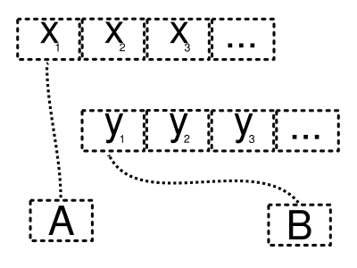
Two object references A, B

Slide 116
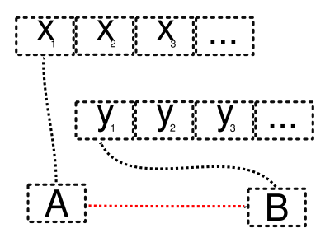
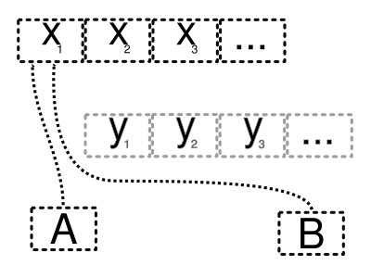
Shallow copy process

Slide 117
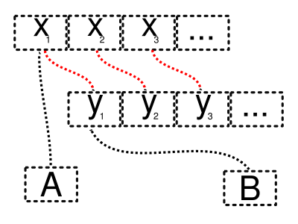
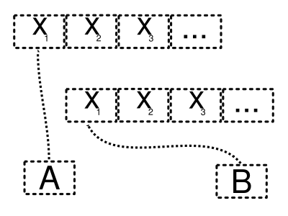
Deep copy

Slide 118
Lazy copy
A lazy copy is a combination of both strategies above.
When initially copying an object, a (fast) shallow copy is used.
A counter is also used to track how many objects share the data.
When the program wants to modify an object, it can determine if the data is shared (by examining the counter) and can do a deep copy if necessary.

Slide 119
euqals method
protected method
Return a boolean value
Default implementation is to determine whether two references refer to the same object.

Slide 120
finalize method
protected method
Take no parameter and return void
Default implementation is to do nothing
Called by the garbage collector to perform termination house keeping on an object before the object is reclaimed by garbage collector

Slide 121
getClass method
public final method
Returns an object of class Class (java.lang)
The object of Class contains the information about an object (its class name, etc)

Slide 122
public class Base {
}
public class Derived extends Base {
}
// Test the getClass() method for the above classes.
Base base = new Base();
Base derived = new Derived();
System.out.println("Class for base object = " +
base.getClass().getName());
System.out.println("Class for derived object = " +
derived.getClass().getName());
OUTPUT:
Class for base object = Base
Class for derived object = Derived

Slide 123
Object API
http://docs.oracle.com/javase/1.5.0/docs/api/java/lang/Object.html
http://docs.oracle.com/javase/tutorial/java/IandI/objectclass.html

