Slide 1
The Observer Pattern

Slide 2
Statement of Work
Given WeatherData object, which tracks current weather conditions (temperature,humidity, barometric pressure).
Our job is to
Create an application that uses WeatherData object to create real time display for current conditions, weather statics, and simple forecast

Slide 3
WeatherData
Object
Display
data
Pull data

Slide 4
Weather Monitoring Application
Humidity
Sensor
Weather
Station
Pulls
Data
displays
Temp
Sensor
Weather Data
Object
Display
Device
Pressure
Sensor

Slide 5
We are given WeatherData class
Three getters to retrieve data
WeatherData
getTemperature()
getHumidity()
getPressure()
measurementsChanged()
//other methods
When data change, this method is called to update three (?) displays

Slide 6
What needs to be done?
WeatherData
getTemperature()
getHumidity()
getPressure()
measurementsChanged()
/*
* Call this method
* whenever measurements are
* Updated
*/
Public void measurementsChanged(){
// your code goes here
}
Update three
different displays

Slide 7
Problem specification
weatherData class has three getter methods
measurementsChanged() method called whenever there is a change
Three display methods needs to be supported: current conditions, weather statistics and simple forecast
System should be expandable

Slide 8
First cut at implementation
public class WeatherData {
public void measurementsChanged(){
float temp = getTemperature();
float humidity = getHumidity();
float pressure = getPressure();
currentConditionsDisplay.update (temp, humidity, pressure);
statisticsDisplay.update (temp, humidity, pressure);
forecastDisplay.update (temp, humidity, pressure);
}
// other methods
}

Slide 9
First cut at implementation
public class WeatherData {
public void measurementsChanged(){
float temp = getTemperature();
float humidity = getHumidity();
float pressure = getPressure();
currentConditionsDisplay.update (temp, humidity, pressure);
statisticsDisplay.update (temp, humidity, pressure);
forecastDisplay.update (temp, humidity, pressure);
}
// other methods
}
Area of change which can be
Managed better by encapsulation
By coding to concrete implementations
there is no way to add additional display
elements without making code change

Slide 10
Basis for observer pattern
Fashioned after the publish/subscribe model
Works off similar to any subscription model
Buying newspaper
Magazines
List servers

Slide 11
Newspaper subscriptions
A publisher begins to publishing newspapers
Subscribers subscribe to one(more) newspaper(s)
Every time there are new editions of the newspapers, they are delivered to subscribers.
Customers can subscribe/unsubscribe to the newspapers.

Slide 12
Observer Pattern
Publishers (Subject) + Subscribers (Observer)
=
Observer Pattern
Defines a one-to-many dependency between objects so that when one object changes state, all of its dependents are notified and updated automatically.
《interface》
Subject
registerObserver()
removeObserver()
notifyObserver()

Slide 13
《interface》
Subject
registerObserver()
removeObserver()
notifyObserver()
《interface》
Observer
update()
ConcreteSubject
registerObserver(){…}
removeObserver(){…}
notifyObserver(){…}
getState()
setState()
ConcreteObserver
update(){…}
// other methods

Slide 14
The Power of Loose Coupling
Observer pattern provides an object design where subjects and observers are loosely coupled
The only thing the subject knows about an observer is that it implements a certain interface
New observers can be added at any time
We never need to modify the subject to add new types of observers
We can reuse subjects or observers independently of each other
Changes to either the subject or an observer will not affect the other.

Slide 15
Design Principle #4
Strive for loosely coupled designs between objects that interact.

Slide 16
Observer Pattern – Weather data
<<interface>>
Observer
observers
<<interface>>
DisplayElement
<<interface>>
Subject
update()
registerObserver()
removeObserver()
notifyObservers()
display()
subject
CurrentConditionsDisplay
StatisticsDisplay
WeatherData
update()
display()
update()
display()
registerObserver()
removeObserver()
notifyObservers()
getTemperature()
getPressure()
measurementsChanged()
ForecastDisplay
update()
display()

Slide 17
《interface》
Subject
registerObserver()
removeObserver()
notifyObserver()
《interface》
Observer
update()
ForecastDisplay
update(){…}
display(){…}
// other methods
WeatherData
registerObserver(){…}
removeObserver(){…}
notifyObserver(){…}
getTemperature()
getHumidity()
getPressure()
measurementsChanged()
CurrentConditionDisplay
update(){…}
display(){…}
// other methods
StatisticsDisplay
update(){…}
display(){…}
// other methods

Slide 18
《interface》
Subject
registerObserver()
removeObserver()
notifyObserver()
《interface》
Observer
update()
ForecastDisplay
update(){…}
display(){…}
// other methods
WeatherData
registerObserver(){…}
removeObserver(){…}
notifyObserver(){…}
getTemperature()
getHumidity()
getPressure()
measurementsChanged()
WhateverDisplay
update(){…}
display(){…}
// other methods
CurrentConditionDisplay
update(){…}
display(){…}
// other methods
StatisticsDisplay
update(){…}
display(){…}
// other methods

Slide 19
Weather data interfaces
public interface Subject {
public void registerObserver(Observer o);
public void removeObserver(Observer o);
public void notifyObservers();
}
public interface Observer {
public void update(float temp, float humidity, float pressure);
}
public interface DisplayElement {
public void display();
}

Slide 20
Implementing subject interface
public class WeatherData implements Subject {
private ArrayList observers;
private float temperature;
private float humidity;
private float pressure;
public WeatherData() {
observers = new ArrayList();
}

Slide 21
Register and unregister
public void registerObserver(Observer o) {
observers.add(o);
}
public void removeObserver(Observer o) {
int i = observers.indexOf(o);
if (i >= 0) {
observers.remove(i);
}
}

Slide 22
Notify methods
public void notifyObservers() {
for (int i = 0; i < observers.size(); i++) {
Observer observer = (Observer)observers.get(i);
observer.update(temperature, humidity, pressure);
}
}
public void measurementsChanged() {
notifyObservers();
}

Slide 23
Push or pull
The notification approach used so far pushes all the state to all the observers
One can also just send a notification that something has changed and let the observers pull the state information
Java observer pattern support has built in support for both push and pull in notification

Slide 24
Java implementation
Look at API documentation
java.util.Observable
java.util.Observer
Look at weather station re-implementation

Slide 25
Java Observer Pattern – Weather data
<<interface>>
Observer
observers
<<interface>>
DisplayElement
Observable
update()
addObserver()
deleteObserver()
notifyObservers()
setChanged()
Observable is a class
And not an interface
display()
subject
CurrentConditionsDisplay
StatisticsDisplay
WeatherData
update()
display()
update()
display()
getTemperature()
getPressure()
getHumidity()
measurementsChanged()
ForecastDisplay
update()
display()

Slide 26
Behind the scenes (pseudocode for Observable class)
setChange(){
changed = true;
}
notifyObservers(Object arg){
if (changed){
for every observer on the list {
call update(this, arg)
}
}
changed = false;
}
notifyObservers(){
notifyObservers(null);
}

Slide 27
Behind the scenes (For Observer interface)
update(Observable o, Object arg){
}

Slide 28
importing
import java.util.Observable;
import java.util.Observer;
public class WeatherData extends Observable {
private float temperature;
private float humidity;
private float pressure;
public WeatherData() { }
public void measurementsChanged() {
setChanged();
notifyObservers();
}
public void setMeasurements(float temperature, float humidity, float pressure) {
this.temperature = temperature;
this.humidity = humidity;
this.pressure = pressure;
measurementsChanged();
}
public float getTemperature() {
return temperature;
}
public float getHumidity() {
return humidity;
}
public float getPressure() {
return pressure;
}
}
subclassing
Don’t keep track observers
Constructor does not need to create data structure for observers
Indicate “change of state” and PULL data

Slide 29
Implementing the interface
import java.util.Observable;
import java.util.Observer;
public class CurrentConditionsDisplay implements Observer, DisplayElement {
Observable observable;
private float temperature;
private float humidity;
public CurrentConditionsDisplay(Observable observable) {
this.observable = observable;
observable.addObserver(this);
}
public void update(Observable obs, Object arg) {
if (obs instanceof WeatherData) {
WeatherData weatherData = (WeatherData)obs;
this.temperature = weatherData.getTemperature();
this.humidity = weatherData.getHumidity();
display();
}
}
public void display() {
System.out.println("Current conditions: " + temperature
+ "F degrees and " + humidity + "% humidity");
}
}
Takes an Observable and add the current Condition object as an Observer

Slide 30
Problems with Java implementation
Observable is a class
You have to subclass it
You cannot add observable behavior to an existing class that already extends another superclass
You have to program to an implementation – not interface
Observable protects crucial methods
Methods such as setChanged() are protected and not accessible unless one subclasses Observable.
You cannot favor composition over inheritance.
You may have to roll your own observer interface if Java utilities don’t work for your application

Slide 31
Other uses of the Observer pattern in Java
GUI interface classes – JButton
Look at Java API for AbstractButton and JButton

Slide 32
Java Event Handling Example
Name in Design Pattern | Actual Name in JButton Event Handling
Subject | JButton
Observer | ActionListener
ConcreteObserver | The class that implements ActionListener interface
Attach() | addActionListener
Notify() | actionPerformed

Slide 33
class ButtonActionListener implement ActionListener{
public void actionPerformed(ActionEvent actionEvent) {
...
}
}
ActionListener listener = new ButtonActionListener();
JButton button = new JButton("Pick Me");
button.addActionListener(listener);
JButton button = new JButton("Pick Me");
button.addActionListener(new ActionListener(){
public void actionPerformed(ActionEvent actionEvent) {
...
}
});

Slide 34
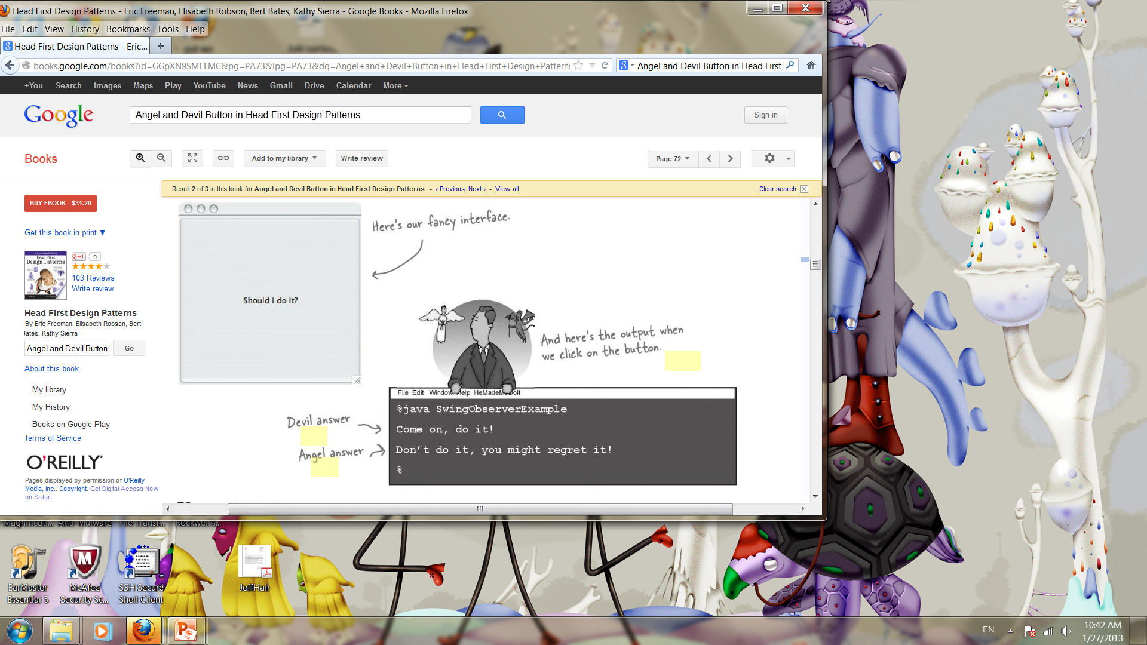

Slide 35
public class SwingObserverExample {
JFrame frame;
public static void main(String[] args) {
SwingObserverExample example = new SwingObserverExample();
example.go();
}
public void go() {
frame = new JFrame();
JButton button = new JButton("Should I do it?");
button.addActionListener(new AngelListener());
button.addActionListener(new DevilListener());
frame.getContentPane().add(BorderLayout.CENTER, button);
// Set frame properties
frame.setDefaultCloseOperation(JFrame.EXIT_ON_CLOSE);
frame.getContentPane().add(BorderLayout.CENTER, button);
frame.setSize(300,300);
frame.setVisible(true);
}
class AngelListener implements ActionListener {
public void actionPerformed(ActionEvent event) {
System.out.println("Don't do it, you might regret it!");
}
}
class DevilListener implements ActionListener {
public void actionPerformed(ActionEvent event) {
System.out.println("Come on, do it!");
}
}
}
Add angel and devil as observers of the button
When state changes, actionPerformed is called

Slide 36
Summary so far..
Observer pattern defines one-to-many relationship between objects
You can use push or pull with observer pattern
Java has several implementations of observer pattern – in util, swing, javabeans and RMI
Swing makes heavy use of this pattern

Slide 37
Design Principle for Observer Pattern
Encapsulate what varies
What varies in the Observer Pattern is the state of the Subject and the number and types of Observers. With this pattern, you can vary the objects that are dependent on the state of the Subject, without having to change that Subject. Plan ahead!
Favor composition over inheritance
The Observer Pattern uses composition to compose any number of Observers with their Subjects. These relationships are not set up by some kind of inheritance hierarchy. No, they are set up at runtime by composition!
Program to interfaces not to implementations
Strive for loosely coupled designs between objects that interact
Both the Subject and Observer use interfaces. The Subject keeps track of objects implementing the Observer interface, while the observers register with, and get notified by, the Subject interface. This keeps things nice and loosely coupled.

Slide 38
Observer pattern
Intent
Define a one-to-many dependency between objects so that when one object changes state, all its dependents are notified and updated automatically. [GoF, p293]
The "View" part of Model-View-Controller.

Slide 39
Observer Pattern – Class diagram
<<interface>>
Subject
observers
<<interface>>
Observer
registerObserver()
removeObserver()
notifyObservers()
Update()
ConcreteSubject
subject
ConcreteObserver
registerObserver()
removeObserver()
notifyObservers()
Update()

Slide 40
Typical usages
Listening for an external event.
Listening for changes of the value of an object property.
In a mailing list, where every time an event happens (a new product, a gathering, etc.) a message is sent to the people subscribed to the list.

Slide 41
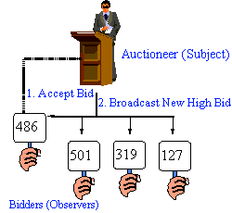

Slide 42
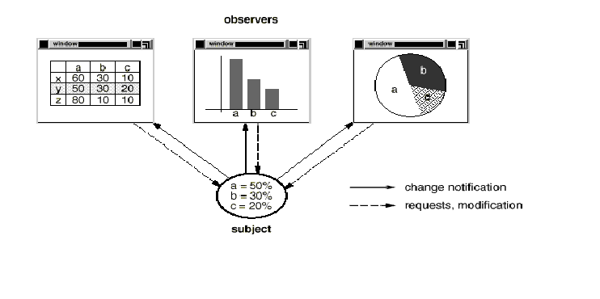
In the model-view-controller (MVC) paradigm, the observer pattern is used to create a loose coupling between the model and the view. Typically, a modification in the model triggers the notification of model observers which are actually the views.

Slide 43
Summary so far..
OO Basics
Encapsulation
Inheritance
Polymorphism
OO Principles
Encapsulate what varies
Favor composition over inheritance
Program to interfaces not to implementations
Strive for loosely coupled designs between objects that interact
OO Patterns
The Observer Pattern defines a one-to-many dependency between objects so that when one object changes state, all of its dependents are notified and updated automatically.
The Strategy Pattern defines a family of algorithms, Encapsulates each one, and makes them interchangeable. Strategy lets the algorithm vary independently from clients that use it.

