Slide 1
Inheritance
http://docs.oracle.com/javase/tutorial/java/concepts/index.html
and
“Java - How to Program” (6th) by Deitel & Deitel

Slide 2
What is inheritance?
A form of a software reuse
A new class is created by
  absorbing an existing class’s members
  embellishing them with new or modified capabilities
Benefits:
  Save development time
  Improve quality (reuse proven, debugged code)

Slide 3
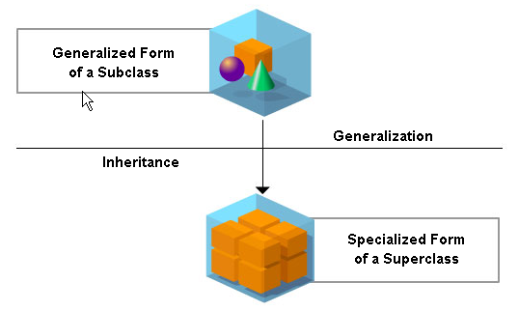
Notes:
Although generalization and inheritance both referred to creating categories on the basis of similarities, there is a basic difference between the two concepts. While inheritance means that a subclass is a specialized form of super class, generalization means a super class is a generalized form of a subclass.

Slide 4
Super/sub classes
The existing class is called the super (base in C++) class. The new class is called the sub (derived in C++) class.
A subclass is derived from a super class.
A class may concurrently be a super class and a sub class.
A class that serves as the root class of a derivation hierarchy is called abstract super class (object in Java).

Slide 5
Sub classes inherit all (public, private, and protected) attributes and behaviors of their super classes.
Sub classes also add its owns fields and methods.
The direct super class is the super class from which the subclass explicitly inherits.
The indirect super class is any class above the direct super class.

Slide 6
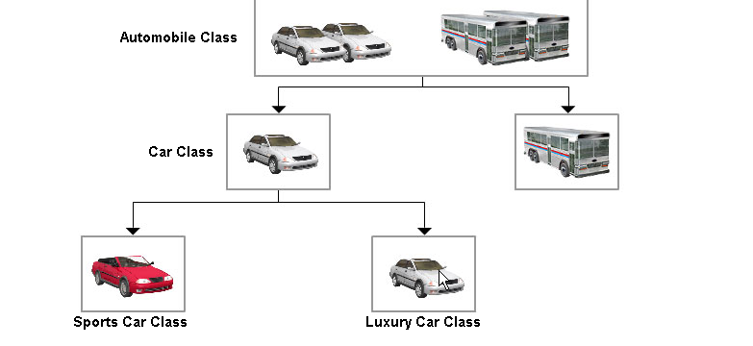
Examples
Notes:
A class can either be a super class or a subclass. A subclass can be derived from a superclass. Subclasses inherit the attributes and behaviors of the super class they belong to. For example, cars and buses are subclass of the automobile superclass.

Slide 7
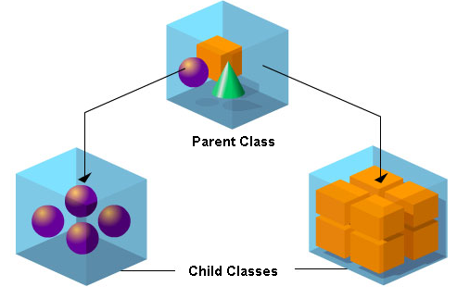
Notes:
Children inherit traits from their parents, but they also have individual traits. When classes care grouped together in a hierarchy, the class that has all the generic attributes found in the other classes is designed as the parent class. The classes that have some of the attributes of the parents class are designated as child classes.

Slide 8
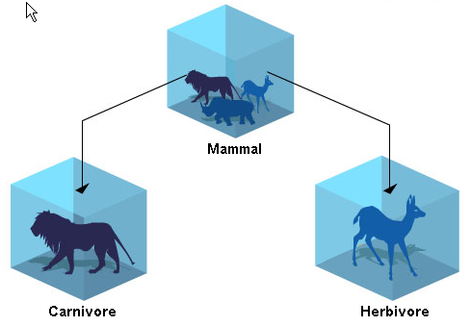
Notes:
All mammals give birth to young ones and have four limbs. However, mammals may be carnivores or herbivores. In spite of having distinct traits, carnivores and herbivores are classified as sub classes of the mammals super class. The common attributes that determine the basis of the classification of sub classes are called discriminators.
In this example, mammal is s super class and herbivores and carnivores its sub classes. All the animals classified under these subclasses would inherit the attributes of the super class. However, they all will have individual traits that distinguish them from each other. For instance, lions will hunt for prey and a deer would eat grass, even though both of them are mammals.

Slide 9
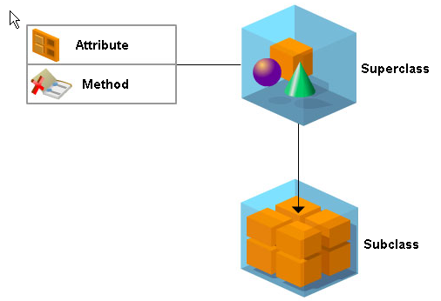
A root class of a derivation hierarchy is called abstract super class.
Notes:
Sub classes are a specialized form of their super classes. A super class that may be undefined and unimplemented is known as an abstract class. This means that although the super class would have defined attributes, it will not have defined methods for implementation.

Slide 10
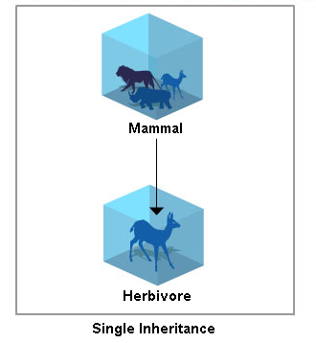
Single inheritance is when a class is derived from one direct super class.
Notes:
Some programming languages use single inheritance while others use multiple inheritance. When a subclass inherits the attributes of just one parent class, the inheritance is called single inheritance. For example, the instance of the herbivore class inheriting the attributes of the super class mammal is known as single inheritance.

Slide 11
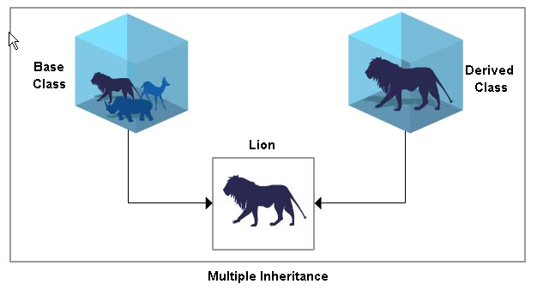
Multiple inheritance is when a class is derived from more than one direct super class.
Notes:
Alternatively, when a subclass inherits attributes from more than one parent class, the inheritance is known as multiple inheritance. For instance a lion would inherit the attributes of the mammal parent as well as the carnivore parent class. A super class is also called the base class and its sub class is called the derived class.

Slide 12
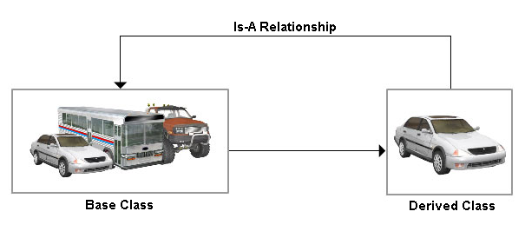
Sub and super class has
“Is-A” Relationship
An object of a sub class is an object of a super class
Notes:
When a derived class and a base class have the same type and interface, you can substitute an object of the derived class with an object of the base class. This kind of relationship between a base class and a derived class is called an is-a relationship. For instance, the car class has is-a relationship with the automobile class.

Slide 13
What is inherited?
A sub class inherits all the members (fields, methods, and nested classes) from its super class.
BIG four (constructor, destructor, copy constructor, overloaded =) are not members, so they are not inherited by subclasses.

Slide 14
How inherited?
A public member of the super class will become a public member of a sub class
A protected member of the super class will become a protected (or public) member of a sub class
A private member of the super class will become a private (protected, or public) member of a sub class

Slide 15
Accessibility
A sub class can only refer to public and protected members of super class directly by using the member names.
A sub class can not refer to private members of super class directly. It can only access private members through the public/protected members of the super class.

Slide 16
Hiding
You can declare a field in the sub class with the same name as the one in the super class, thus hiding it (not recommended).
write a new static method in the subclass that has the same signature as the one in the super class, thus hiding it.
Hidden members can be accessed through “super.”

Slide 17
public class Superclass {
public void static printMethod() {
System.out.println("Printed in Superclass.");
}
}
public class Subclass extends Superclass {
public void static printMethod() { //hides printMethod in Superclass
super.printMethod();
System.out.println("Printed in Subclass");
}
public static void main(String[] args) {
Subclass s = new Subclass();
s.printMethod();
}
}
Printed in Superclass
Printed in Subclass

Slide 18
Overriding
An instance method in a subclass with the same signature and return type as an instance method in its super class overrides the super class's method.
If a sub class overrides a super class method, the super class method can be referred from the sub class by preceding the method name with “super.”

Slide 19
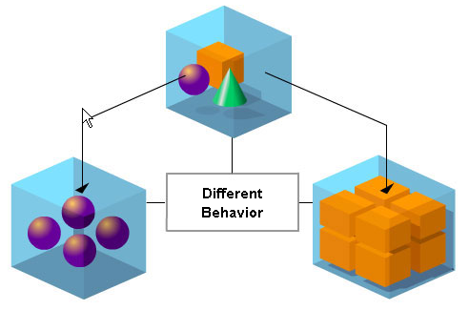
Overriding an inherited method
Notes:
When a child class extends the functionality of the parent class, it is called overriding. When a method is overridden, the behaviour of both the parent objects and the child object is different. Polymorphism enables the programmer to define different draw methods for the derived classes Sphere and Cuboid. No matter what shape an object is, applying the draw method to it will return the correct results.

Slide 20
public class Superclass {
public void printMethod() {
System.out.println("Printed in Superclass.");
}
}
public class Subclass extends Superclass {
public void printMethod() { //overwrites printMethod in Superclass
super.printMethod();
System.out.println("Printed in Subclass");
}
public static void main(String[] args) {
Subclass s = new Subclass();
s.printMethod();
}
}
Printed in Superclass
Printed in Subclass

Slide 21
Static and Dynamic Binding
The version of the hidden method that gets invoked depends on the type of the referring variable. (static binding – compilation time)
The version of the overridden method that gets invoked depends on the type of the referred instance. (dynamic binding – run time)

Slide 22
public class Animal {
public static void testClassMethod() {
System.out.println("The class method in Animal.");
}
public void testInstanceMethod() {
System.out.println("The instance method in Animal.");
}
}
public class Cat extends Animal {
public static void testClassMethod() {
System.out.println("The class method in Cat.");
}
public void testInstanceMethod() {
System.out.println("The instance method in Cat.");
}
public static void main(String[] args) {
Cat myCat = new Cat();
myCat.testClassMethod();
myCat.testInstanceMethod();
Animal myAnimal = myCat;
myAnimal.testClassMethod();
myAnimal.testInstanceMethod();
}
}
The class method in Cat.
The instance method in Cat.
The class method in Animal.
The instance method in Cat.

Slide 23
Invocation of Hidden Class Methods
A hidden class (static) method can be invoked by using a reference whose type is the class that actually contains the declaration of the method.
In this respect, hiding of static methods is different from overriding of instance methods.

Slide 24
class Super {
static String greeting() { return "Goodnight"; }
String name() { return "Richard"; }
}
class Sub extends Super {
static String greeting() { return "Hello"; }
String name() { return "Dick"; }
}
class Test {
public static void main(String[] args) {
Super s = new Sub();
System.out.println(s.greeting() + ", " + s.name());
}
}
Goodnight, Dick

Slide 25
What else sub class can do?
Declare new fields in the sub class that are not in the super class.
Declare new methods in the subclass that are not in the super class.
Write a sub class constructor that invokes the constructor of the super class, either implicitly (don’t need to do anything or by using the keyword “super”.
  super();
  super(parameter list);

Slide 26
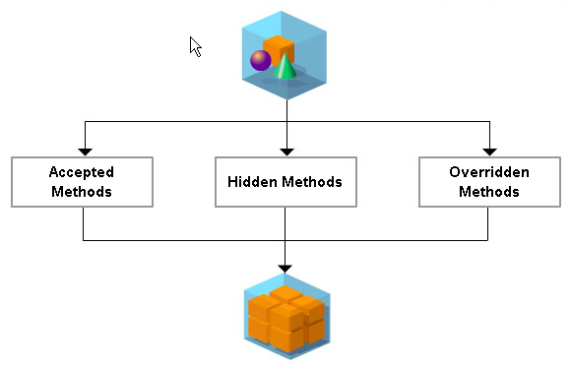
Notes:
When a new class is inherited from a parent class, it inherits all the methods of the parent class and these methods can not be rejected. You can accept, hide or override those methods. You can reject these methods by not defining a method of the child class with same name as a member of the parent class.

Slide 27
Good practices
Reduce the chance to refer to super class members directly in both super class and sub classes, instead, use public methods of the super class to manipulate them.
DO NOT OVER-USE INHERITANCE!!!!

Slide 28
Polymorphism
http://java.sun.com/docs/books/tutorial/java/concepts/index.html
and
“Java - How to Program” (6th) by Deitel & Deitel

Slide 29
What is polymorphism?
The literal meaning of polymorphism is many shapes/forms.
It is an important feature of inheritance and is fundamental to OOP.
It allows two or more classes in an inheritance hierarchy to have identical member functions that perform distinct tasks.

Slide 30
Polymorphism allows the assignment of different meanings and usage to the same entity (variable, function or object) in different contexts.
A program can have a single function call for different objects and have the runtime system select the appropriate member function to be called.

Slide 31
Polymorphism Examples

Slide 32
Polymorphism is implemented through dynamic binding
Dynamic binding is when a super class refers at a sub class object, the type of the actual referred object , not the type of the reference determines which overridden method is called.
i.e., invoking an overridden method on a sub class object via a super class reference invokes the sub class version of the method.

Slide 33
// Fig. 10.1: PolymorphismTest.java
// Assigning superclass and subclass references to superclass and
// subclass variables.
public class PolymorphismTest
{
public static void main( String args[] )
{
// assign superclass reference to superclass variable
CommissionEmployee3 commissionEmployee = new CommissionEmployee3(
"Sue", "Jones", "222-22-2222", 10000, .06 );
// invoke toString on superclass object using superclass variable
System.out.printf( "%s %s:\n\n%s\n\n",
"Call CommissionEmployee3's toString with superclass reference ",
"to superclass object", commissionEmployee.toString() );
superclass method is called through a superclass reference

Slide 34
// assign subclass reference to subclass variable
BasePlusCommissionEmployee4 basePlusCommissionEmployee =
new BasePlusCommissionEmployee4(
"Bob", "Lewis", "333-33-3333", 5000, .04, 300 );
// invoke toString on subclass object using subclass variable
System.out.printf( "%s %s:\n\n%s\n\n",
"Call BasePlusCommissionEmployee4's toString with subclass",
"reference to subclass object",
basePlusCommissionEmployee.toString() );
subclass method is called through a subclass reference

Slide 35
// invoke toString on subclass object using superclass variable
CommissionEmployee3 commissionEmployee2 =
basePlusCommissionEmployee;
System.out.printf( "%s %s:\n\n%s\n",
"Call BasePlusCommissionEmployee4's toString with superclass",
"reference to subclass object", commissionEmployee2.toString() );
} // end main
} // end class PolymorphismTest
subclass overridden method is called through a superclass reference

Slide 36
Software Engineering Benefits
Polymorphism enables programmers to deal in generalities and let the execution-time environment handle the specifics.
Polymorphism allows us to write programs that process objects that share the same super class in a class hierarchy as if they are all object of the superclass.
Polymorphism promotes extensibility:
  software that invokes polymorphic behavior (by calling non-static method) is independent of the referred object type.
  New object types that provide the same non-static method can be incorporated into a system without modifying the base system.
  Only client code that instantiates new objects needs to know about the new types.

Slide 37
Assignments between super/subclass
Assign a super class reference to a super class variable is OK
Assign a sub class reference to a sub class variable is OK
Assign a sub class reference to a super class variable is safe, although this reference can only reference to superclass members
Assign a super class reference to a sub class variable directly causes error and must be cast to a subclass type explicitly - downcasting

Slide 38




<=
<=
<=
<=

Slide 39
Operator “instanceof” & Downcasting
// Fig. 10.9: PayrollSystemTest.java
// Employee hierarchy test program.
public class PayrollSystemTest
{
public static void main( String args[] )
{
// create subclass objects
SalariedEmployee salariedEmployee =
new SalariedEmployee( "John", "Smith", "111-11-1111", 800.00 );
HourlyEmployee hourlyEmployee =
new HourlyEmployee( "Karen", "Price", "222-22-2222", 16.75, 40 );
CommissionEmployee commissionEmployee =
new CommissionEmployee(
"Sue", "Jones", "333-33-3333", 10000, .06 );
BasePlusCommissionEmployee basePlusCommissionEmployee =
new BasePlusCommissionEmployee(
"Bob", "Lewis", "444-44-4444", 5000, .04, 300 );

Slide 40
System.out.println( "Employees processed individually:\n" );
System.out.printf( "%s\n%s: $%,.2f\n\n",
salariedEmployee, "earned", salariedEmployee.earnings() );
System.out.printf( "%s\n%s: $%,.2f\n\n",
hourlyEmployee, "earned", hourlyEmployee.earnings() );
System.out.printf( "%s\n%s: $%,.2f\n\n",
commissionEmployee, "earned", commissionEmployee.earnings() );
System.out.printf( "%s\n%s: $%,.2f\n\n",
basePlusCommissionEmployee,
"earned", basePlusCommissionEmployee.earnings() );
// create four-element Employee array
Employee employees[] = new Employee[ 4 ];
// initialize array with Employees
employees[ 0 ] = salariedEmployee;
employees[ 1 ] = hourlyEmployee;
employees[ 2 ] = commissionEmployee;
employees[ 3 ] = basePlusCommissionEmployee;

Slide 41
System.out.println( "Employees processed polymorphically:\n" );
// generically process each element in array employees
for ( Employee currentEmployee : employees ) // for every element in array employees
{
System.out.println( currentEmployee.toString()); // invokes toString
// determine whether element is a BasePlusCommissionEmployee
if ( currentEmployee instanceof BasePlusCommissionEmployee )
{
// downcast Employee reference to
// BasePlusCommissionEmployee reference
BasePlusCommissionEmployee employee =
( BasePlusCommissionEmployee ) currentEmployee;
double oldBaseSalary = employee.getBaseSalary();
employee.setBaseSalary( 1.10 * oldBaseSalary );
System.out.printf(
"new base salary with 10%% increase is: $%,.2f\n",
employee.getBaseSalary() );
} // end if
System.out.printf(
"earned $%,.2f\n\n", currentEmployee.earnings() );
} // end for
Superclass cannot access sub-class “only” methods

Slide 42
When downcasting an object, a ClassCastException occurs, if at execution time the object does not have an is-a relationship with the type specified in the cast operator

Slide 43
object class has a method called getClass()
getClass() returns an object of class Class which contains the class information about initiating object
class Class has a method called getName() which return the class name of that “initiating object”
// get type name of each object in employees array
for ( int j = 0; j < employees.length; j++ )
System.out.printf( "Employee %d is a %s\n", j,
employees[ j ].getClass().getName() );
} // end main
} // end class PayrollSystemTest

Slide 44
final methods and classes
final methods, static methods (implicitly final) and private (implicitly final) methods can not be overridden.
All calls to the above methods are resolved as compilation time, i.e., Static binding

