Slide 1
Intro to Design Pattern

Slide 2
It started with a simple …
A highly successful duck pond simulation game called SimUDuck
The game can show a large variety of duck swimming and making quacking sounds

Slide 3
The initial design of the system
Duck
quack()
swim()
display()
//other duck-like method
MallardDuck
display()
//looks like a mallard
RedheadDuck
display()
//looks like a redhead

Slide 4
But now we need the ducks to fly
Duck
quack()
swim()
display()
//other duck-like method
MallardDuck
display()
//looks like a mallard
RedheadDuck
display()
//looks like a redhead

Slide 5
So we use OO inheritance
Duck
quack()
swim()
display()
fly()
//other duck-like method
Add fly() in super class
MallardDuck
display()
//looks like a mallard
RedheadDuck
display()
//looks like a redhead

Slide 6
By putting fly() in super class
We gave flying ability to ALL ducks , haha…
Duck
quack()
swim()
display()
fly()
//other duck-like method
MallardDuck
display()
//looks like a mallard
RedheadDuck
display()
//looks like a redhead

Slide 7
Including those that shouldn’t…
Duck
quack()
swim()
display()
fly()
//other duck-like method
RubberDuck
quack(){
//overridden to Squeak}
fly(){
???}
display()
//looks like a rubberduck
MallardDuck
display()
//looks like a mallard
RedheadDuck
display()
//looks like a redhead

Slide 8
No problem, a temporary fix!!!
Duck
quack()
swim()
display()
fly()
//other duck-like method
RubberDuck
quack(){
//overridden to Squeak}
fly(){
//overridden to do nothing}
display()
//looks like a rubberduck
MallardDuck
display()
//looks like a mallard
RedheadDuck
display()
//looks like a redhead

Slide 9


Slide 10
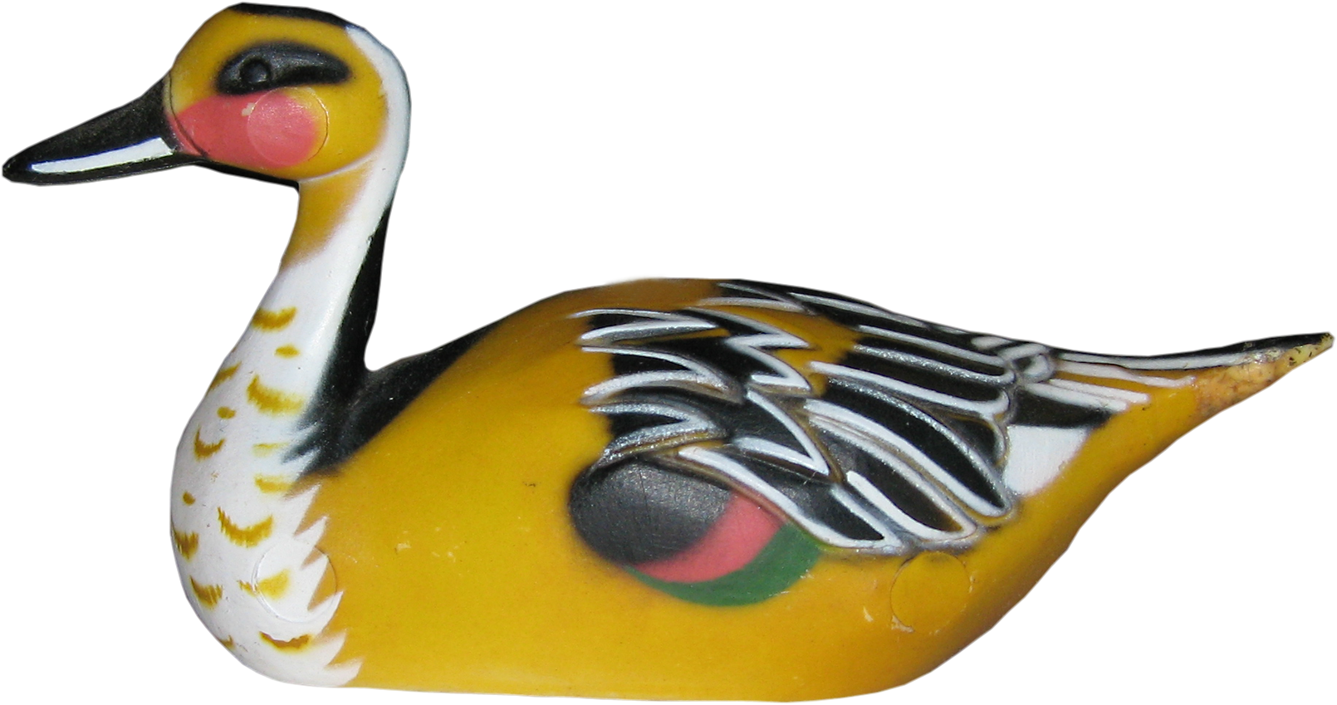

Slide 11
Another temporary fix??
Duck
quack()
swim()
display()
fly()
//other duck-like method
DecoyDuck
quack(){
//overridden to mute}
fly(){
//overridden to do nothing}
display()
//looks like a decoyduck
MallardDuck
display()
//looks like a mallard
RedheadDuck
display()
//looks like a redhead
RubberDuck
quack(){
//overridden to Squeak}
fly(){
//overridden to do nothing}
display()
//looks like a rubberduck

Slide 12
Something went wrong
Having to override fly() to nothing for all those no-flying ducks
The cause for this problem is when new duck features (flyable) are added to duck super class, we have
some concrete ducks fly and some concrete ducks don’t
some concrete ducks quack and some concrete ducks don’t
Inheritance is not the right answer here

Slide 13

Here is our first try …
Since flyable and quackable are not common behaviours of all ducks, we should take them out of the super class!
Where to put them?
Put them in separate interfaces
Only use them when needed (i.e., for those ducks that fly, use the flyable interfaces, for those ducks who don’t, don’t use them)

Slide 14
How about an interface (Java and C++)
《interface》
Quackable
quack()
Duck
swim()
display()
//other duck-like method
《interface》
Flyable
fly()
MallardDuck
quack(){
//implement}
fly(){
//implement}
display()
//looks like a mallard
RedheadDuck
quack(){
//implement}
fly(){
//implement}
display()
//looks like a redhead
RubberDuck
quack(){
//implement to Squeak}
display()
//looks like a rubberduck

Slide 15
Oh, no! this time, something went horribly wrong …
Implement similar fly() in all subclasses (duplicate code)
Image what will happen if we want to make a small change to fly()
This approach solves one problem (having to undo the method in superclass, i.e., no flying rubber duck anymore), but it destroys the code reuse (having to re-implement similar fly() in some subclass)

Slide 16
Pros and cons
Not all inherited methods make sense for all subclasses – hence inheritance is not the right answer
But by defining interfaces, every class that needs to support that interface needs to implement that functionality… destroys code reuse!
So if you want to change the behavior defined by interfaces, every class that implements that behavior may potentially be impacted
And….

Slide 17
Why this is happening?
By adding the feature that some ducks can fly
CHANGE, CHANGE,CHANGE
When dealing with this change, inheritance is not the right answer
Wishful thinking:
Building software so that when we need to change it,
we can do so with the least possible impact
on the existing code.

Slide 18
Design Principle #1
Identify the aspects of the application that vary and separate them from what stays the same.

Slide 19
Applying Design Principle #1
Design Principle #1:
Identify the aspects of the application that vary and separate them from what stays the same.
In SimUDuck case
Not change – display, swim (remain in Duck class)
Change – fly, quack (pull out of Duck class )
Duck behaviours will live in a separate class

Slide 20
In the Duck simulation context…
Parts that vary
Parts that stay the same
Duck
Behaviors
Flying Behaviors
Duck Class
Quacking Behaviors

Slide 21
Design Duck behaviors classes
Keep things flexible, i.e., allow new behaviours added without changing existing code
Only specify behavior when we have to, i.e., specify the flying feature of mallard duck when we initiate a mallard duck
Change behaviors whenever we want dynamically, i.e., at runtime

Slide 22
Design Principle #2
Program to a super type (an interface), not a concrete implementation
Animal
makeSound()
super class
Concrete Implementation
Dog
makeSound(){
Bark();}
Bark(){//bark sound}
Cat
makeSound(){
meow();}
Meow(){//meow sound}

Slide 23
Polymorphism
The declared type of the variables should be super type (interface or an abstract class) so that the objects assigned to those variable can be of any concrete implementation of the super type.

Slide 24
Example
super class
Animal
makeSound()
Concrete Implementation
Dog
makeSound(){
Bark();}
Bark(){//bark sound}
Cat
makeSound(){
meow();}
Meow(){//meow sound}

Slide 25
Programming to implementation
Programming to super type
Dog d = new Dog();
d.bark();
Or
d.makeSound();
Animal d = new Dog();
d.makeSound();
Or even better (why?)
Animal d = getAnimal();
d.makeSound();

Slide 26
Example
super class
Animal
makeSound()
Concrete Implementation
Dog
makeSound(){
Bark();}
Bark(){//bark sound}
Cat
makeSound(){
meow();}
Meow(){//meow sound}

Slide 27
Applying Design Principle #2
Design Principle #2:
Program to a supertype (an interface),
not an implementation
Duck behaviours are designed as two interfaces
Then the implementation of each interfaces are given
《interface》
Flyable
fly()
《interface》
Quackable
quack()

Slide 28
How about an interface (Java and C++)
《interface》
Quackable
quack()
Duck
swim()
display()
//other duck-like method
《interface》
Flyable
fly()
MallardDuck
quack(){
//implement}
fly(){
//implement}
display()
//looks like a mallard
RedheadDuck
quack(){
//implement}
fly(){
//implement}
display()
//looks like a redhead
RubberDuck
quack(){
//implement to Squeak}
display()
//looks like a rubberduck

Slide 29
《interface》
Flyable
fly()
FlyWithWings
fly(){
//implement duck flying}
FlyNoWay
fly(){
// do nothing}
《interface》
Quackable
quack()
Quack
quack(){
//implement duck quacking}
Squeak
quack(){
//implement duck squeaking}
Mute
quack(){
//do nothing – can’t quack!}

Slide 30
Advantages
Other types of duck can reuse of fly and quack behaviors (they are not hidden away in Duck)
Add new behaviors without modifying existing code

Slide 31
How about an interface (Java and C++)
《interface》
Quackable
quack()
Duck
swim()
display()
//other duck-like method
《interface》
Flyable
fly()
MallardDuck
quack(){
//implement}
fly(){
//implement}
display()
//looks like a mallard
RedheadDuck
quack(){
//implement}
fly(){
//implement}
display()
//looks like a redhead
RubberDuck
quack(){
//implement to Squeak}
display()
//looks like a rubberduck

Slide 32
Integrating the duck behavior
Key now is that Duck class will delegate its flying and quacking behavior instead of implementing these itself.

Slide 33
Integrating the Duck behaviours to super Duck class…
Duck
FlyBehavior: flyBehavior
QuackBehavior: quackBehavior
performQuack()
swim()
display()
performFly()
//other duck-like methods
Duck
Behaviors
Flying Behaviors
Quacking Behaviors

Slide 34
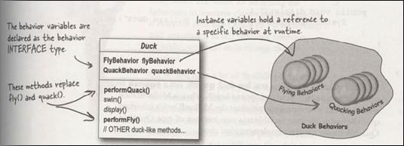
Integrating the Duck behavior to super Duck class

Slide 35
Even better – setter functions
Duck
FlyBehavior flyBehavior
QuackBehavior quackBehavior
performFly()
performQuack()
swim()
display()
setFlyBehavior()
setQuackBehavior()
//other duck-like method
change behaviors at runtime

Slide 36
Duck simulation recast using the new approach
HAS-A
(Composition)
<<interface>>
FlyBehavior
Duck
fly()
FlyBehavior: flyBehavior
QuackBehavior: quackBehavior
performQuack()
performFly()
setFlyBehavior()
setQuackBehavior()
swim()
display()
FlyWithWings
FlyNoWay
fly()
// implements duck
flying
fly()
// do nothing –
Can’t fly
IS-A
(Inheritance)
<<interface>>
QuackBehavior
quack()
Quack
Squeak
quack()
// implements duck
quacking
quack()
// implements squeak
MallardDuck
RedHeadDuck
RubberDuck
DecoyDuck
display()
display()
display()
display()
Mutequack
quack()
// do nothing

Slide 37
How about an interface (Java and C++)
《interface》
Quackable
quack()
Duck
swim()
display()
//other duck-like method
《interface》
Flyable
fly()
MallardDuck
quack(){
//implement}
fly(){
//implement}
display()
//looks like a mallard
RedheadDuck
quack(){
//implement}
fly(){
//implement}
display()
//looks like a redhead
RubberDuck
quack(){
//implement to Squeak}
display()
//looks like a rubberduck

Slide 38
Design Principle #3
Favor composition over inheritance
HAS-A can be better than IS-A
Allows changing behavior at run time

Slide 39
Three Design Principles
Identify the aspects of the application that vary and separate them from what stays the same.
Program to a super type (an interface), not an implementation
Favor composition over inheritance

Slide 40
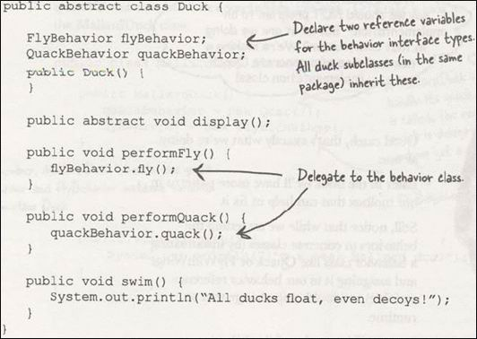
Implementation is shared by all subclasses

Slide 41
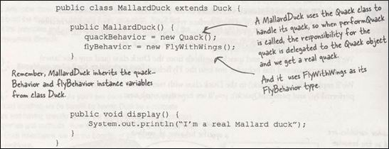

Slide 42
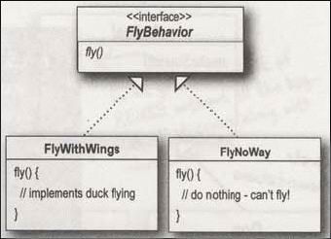
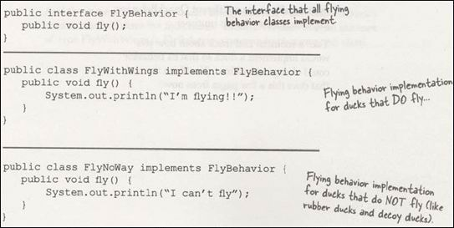

Slide 43
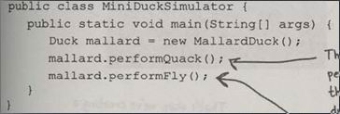
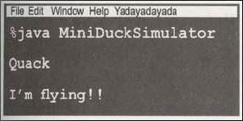

Slide 44
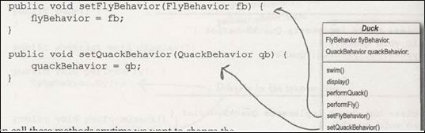

Slide 45
《interface》
Flyable
fly()
FlyWithWings
fly(){
//implement duck flying}
FlyNoWay
fly(){
// do nothing}
FlyRocketPowered
fly(){
// implement rocketed powered flying}

Slide 46

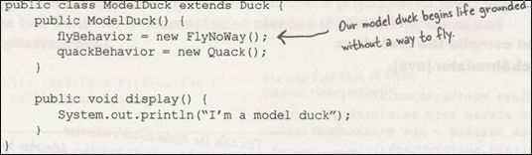

Slide 47
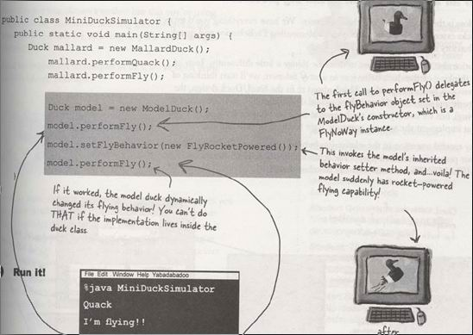
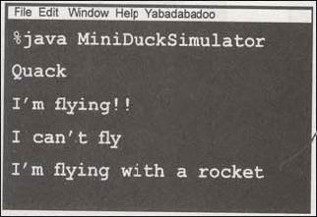

Slide 48
Duck simulation recast using the new approach
HAS-A
(Composition)
<<interface>>
FlyBehavior
Duck
fly()
FlyBehavior: flyBehavior
QuackBehavior: quackBehavior
performQuack()
performFly()
setFlyBehavior()
setQuackBehavior()
swim()
display()
FlyWithWings
FlyNoWay
fly()
// implements duck
flying
fly()
// do nothing –
Can’t fly
IS-A
(Inheritance)
<<interface>>
QuackBehavior
quack()
Quack
Squeak
quack()
// implements duck
quacking
quack()
// implements squeak
MallardDuck
RedHeadDuck
RubberDuck
DecoyDuck
display()
display()
display()
display()
Mutequack
quack()
// do nothing

Slide 49
Strategy Pattern
Define a family of algorithms, encapsulates each one, and makes them interchangeable.
Strategy lets the algorithm vary independently from clients that use it.

Slide 50
Character
KnifeBehavior
BowAndArrowBehavior
WeaponBehavior weapon;
fight();
useWeapon()
//implements cutting with
// a knife
useWeapon()
//implements fight with
// bow and arrows
AxeBehavior
<<interface>>
WeaponBehavior
Queen
useWeapon()
//implements fight with
// an axe
fight()
useWeapon()
SpearBehavior
King
Knight
Bishop
useWeapon()
//implements fight with
// a spear
fight()
fight()
fight()
setWeapon(WeaponBehavior w){
this.weapon = w;
}

Slide 51
Abstract
Character
WeaponBehavior weapon;
fight();
KnifeBehavior
useWeapon()
//implements cutting with
// a knife
BowAndArrowBehavior
useWeapon()
//implements fight with
// bow and arrows
AxeBehavior
<<interface>>
WeaponBehavior
useWeapon()
//implements fight with
// an axe
Queen
useWeapon()
fight()
SpearBehavior
King
Knight
Bishop
useWeapon()
//implements fight with
// a spear
fight()
fight()
fight()
setWeapon(WeaponBehavior w){
this.weapon = w;
}

Slide 52
Abstract
Behavior Interface
Character
<<interface>>
WeaponBehavior
WeaponBehavior weapon;
fight();
useWeapon()
BowAndArrowBehavior
AxeBehavior
KnifeBehavior
useWeapon()
//implements fight with
// bow and arrows
useWeapon()
//implements fight with
// an axe
useWeapon()
//implements cutting with
// a knife
Queen
fight()
SpearBehavior
King
Knight
Bishop
useWeapon()
//implements fight with
// a spear
fight()
fight()
fight()
setWeapon(WeaponBehavior w){
this.weapon = w;
}

Slide 53
Abstract
Behavior Interface
Character
<<interface>>
WeaponBehavior
WeaponBehavior weapon;
fight();
useWeapon()
AxeBehavior
BowAndArrowBehavior
King
Knight
fight()
fight()
useWeapon()
//implements fight with
// an axe
useWeapon()
//implements fight with
// bow and arrows
Bishop
Queen
fight()
fight()
KnifeBehavior
SpearBehavior
useWeapon()
//implements cutting with
// a knife
useWeapon()
//implements fight with
// a spear
setWeapon(WeaponBehavior w){
this.weapon = w;
}

Slide 54
Behavior Interface
Abstract
<<interface>>
WeaponBehavior
Character
WeaponBehavior weapon;
fight();
setWeapon(WeaponBehavior w){
this.weapon = w;
}
useWeapon()
AxeBehavior
BowAndArrowBehavior
useWeapon()
//implements fight with
// an axe
useWeapon()
//implements fight with
// bow and arrows
King
Knight
fight()
fight()
KnifeBehavior
SpearBehavior
useWeapon()
//implements cutting with
// a knife
useWeapon()
//implements fight with
// a spear
Bishop
Queen
fight()
fight()

Slide 55
The Open-Closed Principle and Strategy Pattern

Slide 56
The Open-Closed Principle (OCP)
Software entities (classes, modules, functions, etc) should be open to extension, but closed for modification

Slide 57
Description
Modules that conform to the OCP have two primary
attributes:
Open For Extension
This means that the behavior of the module can be extended. That we can make the module behave in new and different ways as the requirements of the application change, or to meet the needs of new applications.
Closed for Modification
The source code of such a module is inviolate. No one is allowed to make source code changes to it.

Slide 58
Abstraction is the Key
The abstractions are abstract base classes, and the unbounded group of possible behaviors is represented by all the possible derivative classes.
Favor composition over inheritance

Slide 59
Strategy Pattern
Define a family of algorithms, encapsulate each one, and make them interchangeable. It lets the algorithm vary independently from clients that use it. – [Gang Of Four]
Moving the common code from detailed strategy class to its base abstract class
Hiding complex detail information from client
Client decides to use which strategy dynamically

Slide 60
Strategy Class Diagram
Context
<<interface>>
Strategy Interface
ConcreteStrategyA
ConcreteStrategyB
ConcreteStrategyC

Slide 61
Implement the Strategy pattern
Implement a Strategy interface for your strategy objects
Implement ConcreteStrategy classes that implement the Strategy interface, as appropriate
In your Context class, maintain a private reference to a Strategy object.
In your Context class, implement public setter and getter methods for the Strategy object .

Slide 62
Context class
class Context {
IStrategy strategy;
// Constructor
public Context(IStrategy strategy) {
this.strategy = strategy;
}
public void execute() {
strategy.execute();
}
}

Slide 63
abstract strategy interface and concrete strategies
interface IStrategy {
void execute();
}
// Implements the algorithm using the strategy interface
class ConcreteStrategyA implements IStrategy {
public void execute() {
System.out.println( "Called ConcreteStrategyA.execute()" );
}
}
class ConcreteStrategyB implements IStrategy {
public void execute() {
System.out.println( "Called ConcreteStrategyB.execute()" );
}
}
class ConcreteStrategyC implements IStrategy {
public void execute() {
System.out.println( "Called ConcreteStrategyC.execute()" );
}
}

Slide 64
Applications
class MainApp {
public static void main() {
Context context;
// Three contexts following different strategies
context = new Context(new ConcreteStrategyA());
context.execute();
context = new Context(new ConcreteStrategyB());
context.execute();
context = new Context(new ConcreteStrategyC());
context.execute();
}
}

Slide 65
Layout Manager Sample
Container
-layoutManager
:LayoutManager
+Container(LayoutManager)
+setLayoutManager(
LayoutManager):void
<<interface>>
LayoutManager
FormLayout
GridLayout
SelfDefined

Slide 66
Input Validation Sample
Context
<<interface>>
InputValidationStrategy
+validate:void
UserGroupA
+validate:void
UserGroupB
+validate:void
UserGroupC
+validate:void

Slide 67
Swing border example
You can draw borders around almost all Swing components.
Swing provides numerous border types for its components: bevel, etched, line, titled, and even compound.
JComponent class acts as the base class for all Swing components which implements functionality common to all Swing components.
JComponent implements paintBorder(), a method for painting borders around components.

Slide 68
The wrong way
class JComponent {
…
protected void paintBorder(Graphics g) {
switch(getBorderType()) {
case LINE_BORDER: paintLineBorder(g);
break;
case ETCHED_BORDER:
paintEtchedBorder(g);
break;
case TITLED_BORDER:
paintTitledBorder(g);
break;
...
}
…
}

Slide 69
The right way
class JComponent {
…
private Border border;
public void setBorder(Border border) {
Border oldBorder = this.border;
this.border = border;
}
public Border getBorder() {
return border;
}
protected void paintBorder(Graphics g) {
Border border = getBorder();
if (border != null) {
border.paintBorder(this, g, 0, 0, getWidth(), getHeight());
}
}
…
}

Slide 70
