Slide 1
Native App Development for iOS, Android, and Windows in Visual Studio
James Montemagno, Developer Evangelist
@JamesMontemagno

Slide 2

Hi, I’m James.
Xamarin Developer Evangelist

Slide 3
Visual Studio 2013

Slide 4
Code Sharing
File Linking into Each App
File Linking to Separate Projects
Project Cloning
Portable Class Libraries

Slide 5
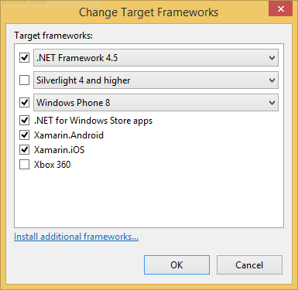
Portable Class Libraries
1 Assembly
Multiple Platforms

Slide 6
PCL Supported Features
Core
LINQ
IQueryable
Network Class Library
Serialization
WCF
MVVM
XLINQ
More!

Slide 7
Platform Specific Code
Abstraction through Interfaces
//CODE Sample

Slide 8
More PCL Libraries
NuGet!
  //sample

Slide 9
Demo
Notes:
Let’s look at Xamarin and VS 2013 to build modern apps on
iOS, Android, and Windows
Let’s start with something familiar

