Slide 1
Backward Compatibility in Xamarin.Android Made Easy
James Montemagno, Developer Evangelist
@JamesMontemagno, http://MotzCod.es
Jérémie Laval, Developer
@jeremie_laval, http://neteril.org

Slide 2
Fragmentation & Compatibility
Versions: 19 API Levels
  9 are relevant today
Screen Sizes: Phone, Tablet, TV
Resolution: [l,m,h,xh,xxh,xxxh]dpi

Slide 3
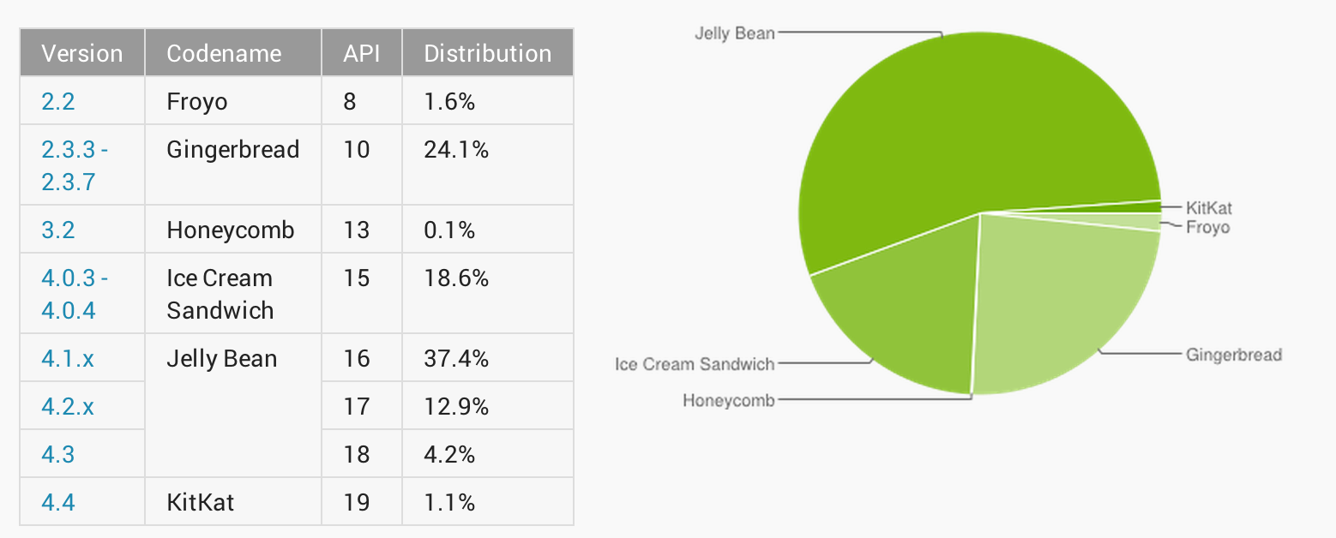
Android Versions
19 SDK Versions
  9 relevant

Slide 4
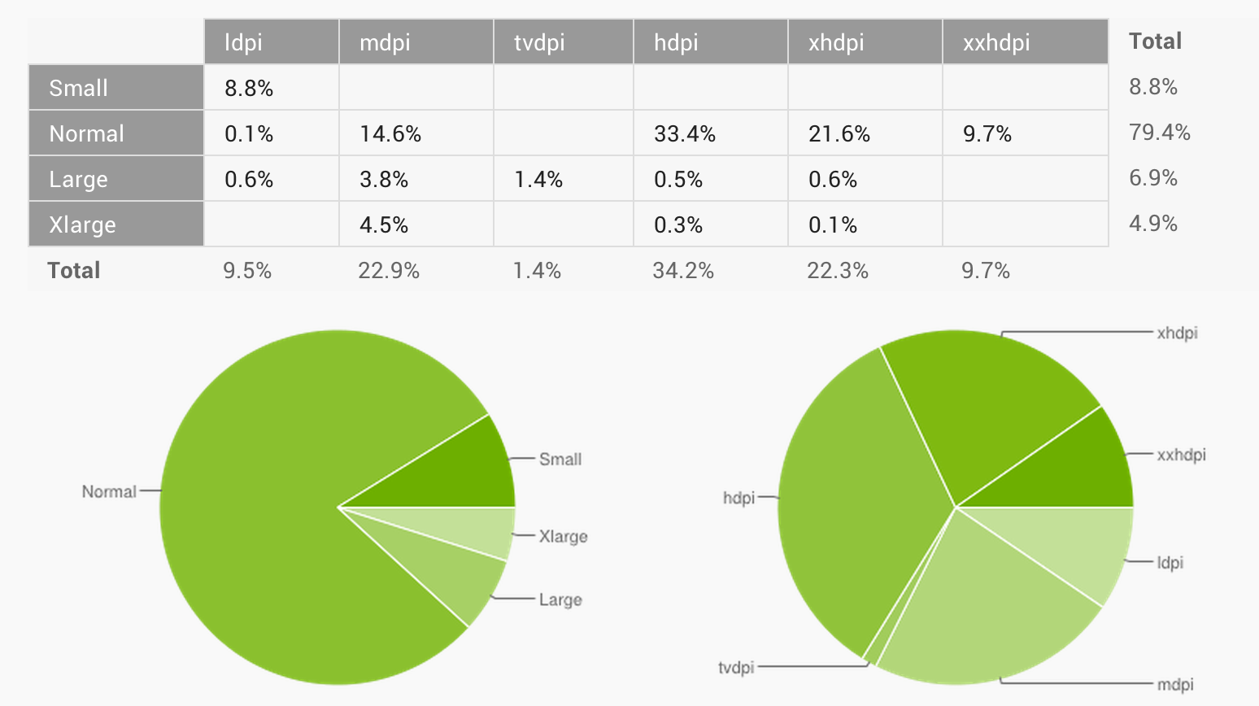
Android Screen Sizes

Slide 5
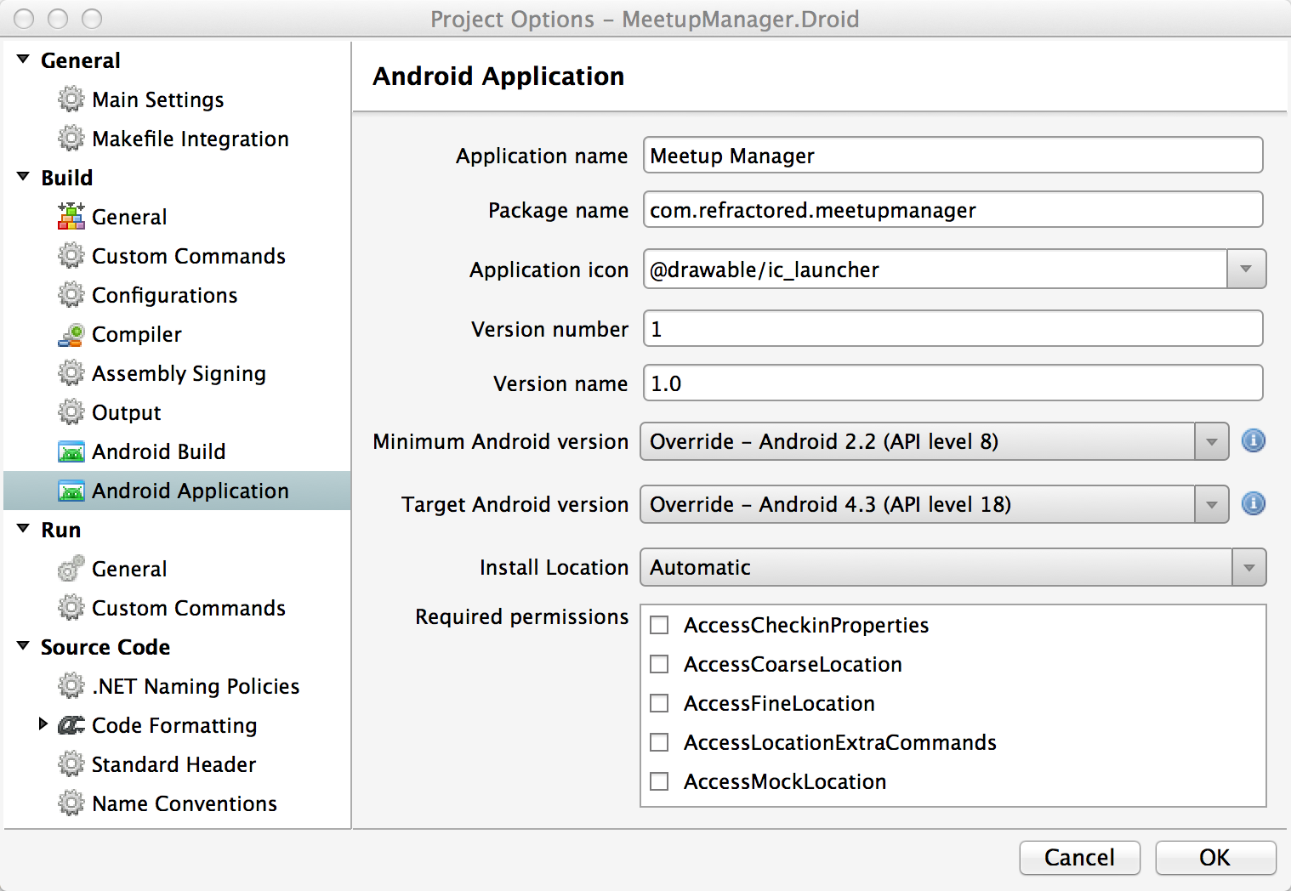
Easy to Target
Xamarin
Studio

Slide 6
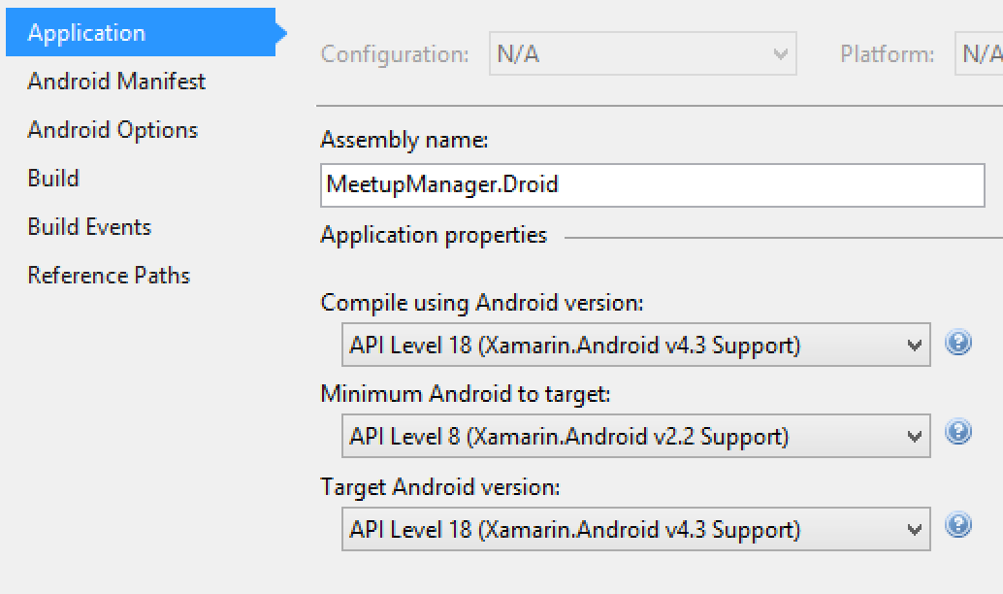
Easy to Target
Visual
Studio

Slide 7

Support Libraries
v4 (1.6)
Fragment
NotificationCompat
ViewPager
DrawerLayout
SlidingPaneLayout
FileProvider
Accessibility
MORE
v7 (2.1)
ActionBar
GridLayout
v8 (2.2)
RenderScript
v13 (3.2)
FragmentCompat

Slide 8
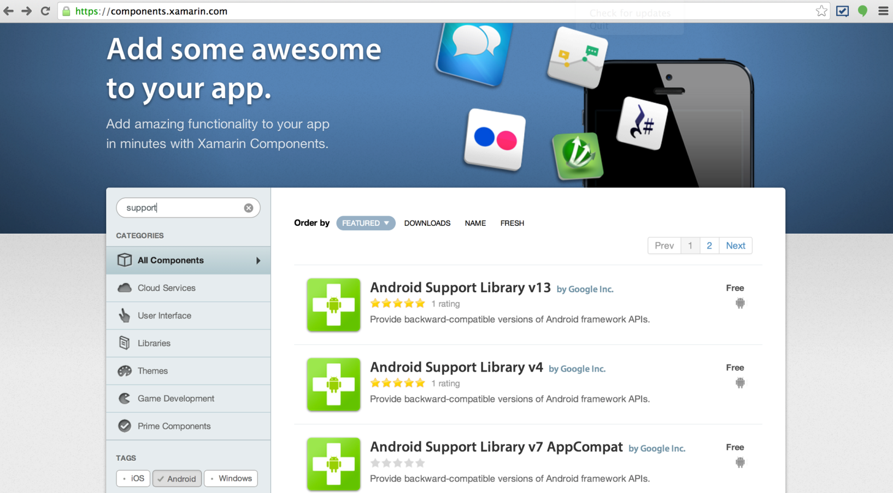
Easy to Add

Slide 9
Let’s Code!

Slide 10
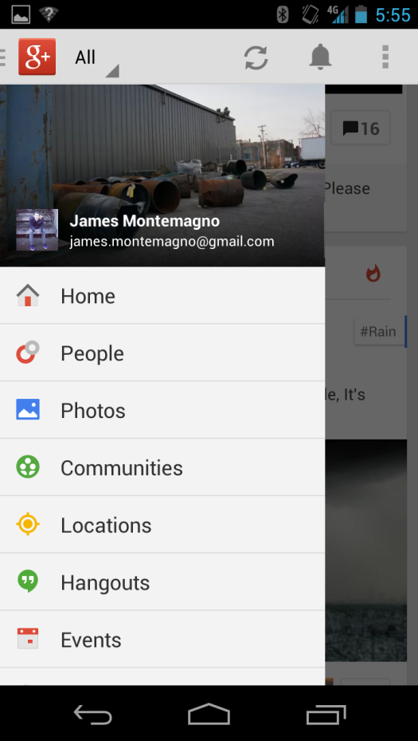
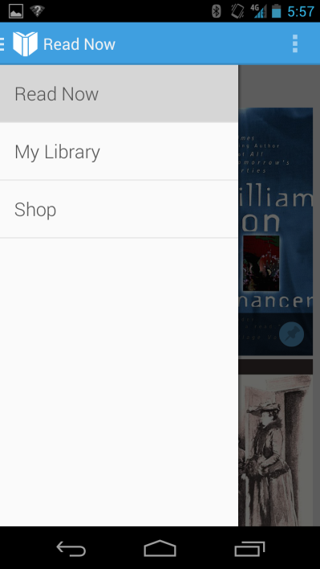
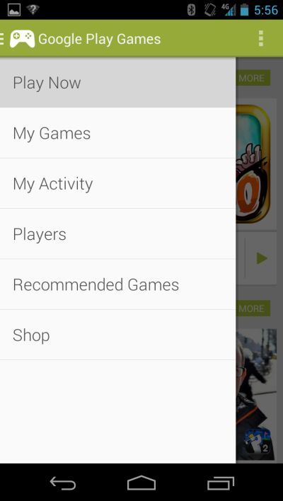
Navigation Drawer
Standard Control
Easy to implement
Highly Customizable
User familiarity
Works with ActionBarCompat

Slide 11
Let’s Code!

Slide 12

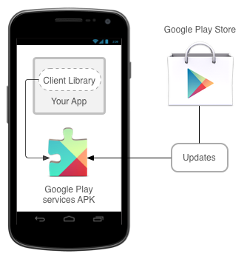
Google Play Services
Google Technology
Standard Authorization
Automatic Updates
Maps, G+ Login, Ads, Games, Wallet, and More

Slide 13
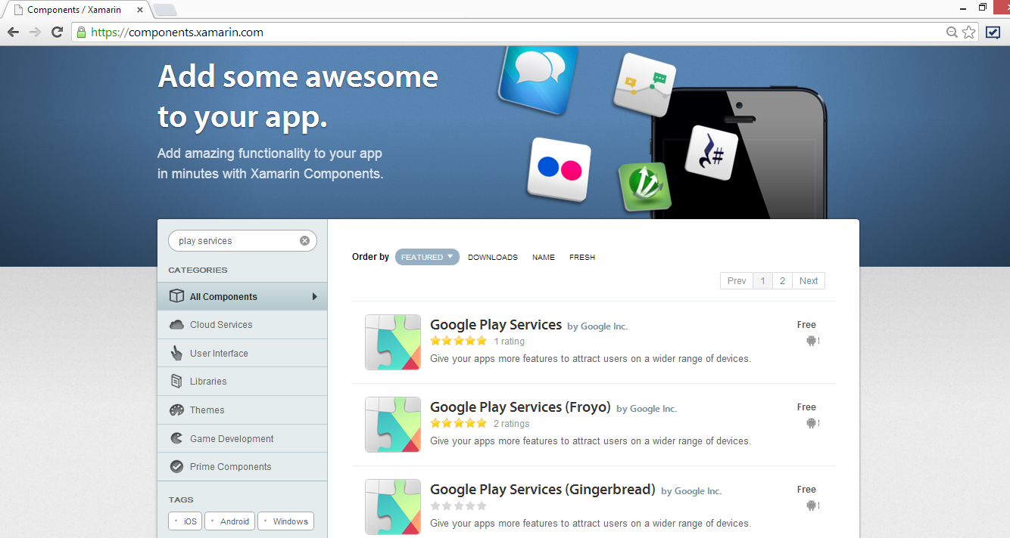
Easy to Add

Slide 14
Let’s Code!

