Slide 1
NDC OSLO 2026 · OSLO SPEKTRUM
GitHub Copilot
Workshop
01 VS CODE
Two tracks. One agentic journey.
VS Code first, then the Copilot app.
02 COPILOT APP
TWO WORK SURFACES
KAYLA CINNAMON × JAMES MONTEMAGNO
aka.ms/ndc-oslo-copilot-workshop

Slide 2
WORKSHOP ROUTE
Workshop at a glance
01
VS Code — agents in your editor
Skills, hooks, browser tools, and Plan mode.
02
Copilot app — issue to merge
Sessions, Plan, Autopilot, MCP testing, and Agent Merge.
03
One shared route map
Keep the site open; progress saves in your browser.
OUTCOME · Two practical, repo-backed development loops.
NDC OSLO × GITHUB COPILOT WORKSHOP
02

Slide 3
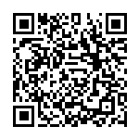
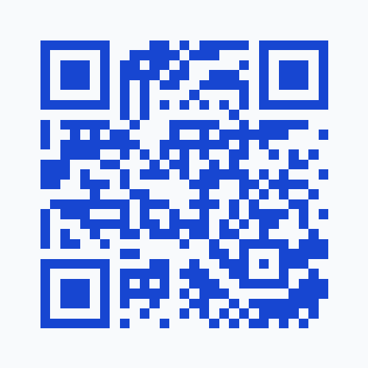
START HERE
Scan once. Keep it open.
Preparation, both labs, resources.
Open it on your laptop before we begin.
Progress saves in your browser.
SCAN TO OPEN
WORKSHOP · aka.ms/ndc-oslo-copilot-workshop
NDC OSLO × GITHUB COPILOT WORKSHOP
03
Notes:
Pause here so everyone can scan or type the workshop URL.

Slide 4
COMPLIMENTARY ACCESS
One month of GitHub Copilot Pro+
Use the redemption code shown by the presenters.
Sign in to the GitHub account you want to upgrade.
Enter it at github.com/redeem and confirm.
[ ADD REDEMPTION CODE ]
REDEEM · github.com/redeem
NDC OSLO × GITHUB COPILOT WORKSHOP
04
Notes:
Replace the placeholder redemption code on this slide before presenting.

Slide 5
ROUTE 01 / VS CODE
What we’ll do in VS Code
01
Engineer the context
/setup, /init, dogfooding, and reusable custom skills.
02
Design in Plan mode
Comment on real UI and keep your design instructions.
03
Orchestrate the agents
Quiz Master, Pixel Jam, TDD, hooks, logs, and UX review.
BUILD · Extend Bingo Mixer with observable agent behavior.
NDC OSLO × GITHUB COPILOT WORKSHOP
05
Notes:
Map the complete VS Code lab at a glance; individual exercise details remain in the workshop site.

Slide 6
VS CODE / DOCUMENTATION
Keep exploring VS Code agents.
01
Copilot in VS Code
code.visualstudio.com/docs/copilot/overview
02
Agent mode
code.visualstudio.com/docs/copilot/chat/chat-agent-mode
03
Custom agents
code.visualstudio.com/docs/copilot/customization/custom-agents
MORE · github.com/github/awesome-copilot
NDC OSLO × GITHUB COPILOT WORKSHOP
06
Notes:
End of the VS Code lab section. Leave this slide up during questions.

Slide 7
ROUTE 02 / COPILOT APP
What we’ll do in the app
01
Install and orient
Set up the app and walk the guided product tour.
02
Run real agent sessions
Custom instructions, Plan mode, and Autopilot on Tailspin.
03
Test, review, and merge
Playwright MCP, Agent Merge, and planning on canvases.
DELIVER · From issue to reviewed, tested, merged change.
NDC OSLO × GITHUB COPILOT WORKSHOP
07
Notes:
Map the complete Copilot App lab, including the restored guided tour before Tailspin work.

Slide 8
COPILOT APP / DOCUMENTATION
Keep exploring the Copilot app.
01
Copilot app overview
docs.github.com/copilot/how-tos/github-copilot-app
02
Agent sessions
docs.github.com/copilot/how-tos/github-copilot-app/agent-sessions
03
Canvases, issues & pull requests
aka.ms/ndc-oslo-copilot-workshop → Resources
ALL LINKS · aka.ms/ndc-oslo-copilot-workshop
NDC OSLO × GITHUB COPILOT WORKSHOP
08
Notes:
End of the Copilot App lab section. Leave this slide up during questions.

Slide 9
KEEP BUILDING
Take the route home.
Finish the lessons at your own pace.
Repeat the exercises on your own repos.
Scan to return at any time.
SCAN TO RETURN
WORKSHOP · aka.ms/ndc-oslo-copilot-workshop
NDC OSLO × GITHUB COPILOT WORKSHOP
09
Notes:
Closing slide. Keep this visible while attendees save the workshop URL.

