Slide 1



Git, Github, and why you should always use source control

Slide 2
Why don’t you use it?
Unfamiliar with it?
Time consuming?
One man show?

Slide 3
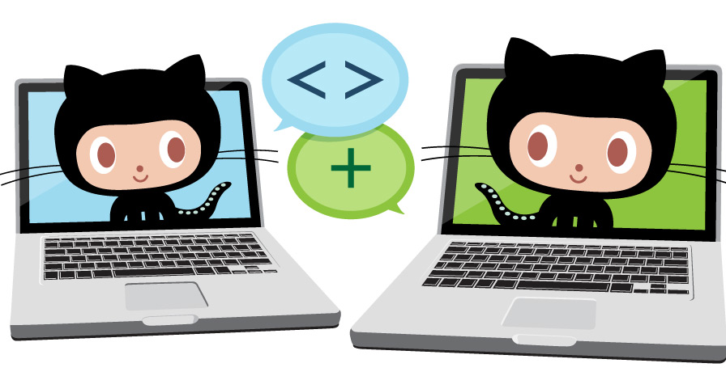
What is source control?
Management of source code (files) in a repository that allows users to work on the same project, at any location, while avoiding conflicts along the way
Allows groups of people to work on the same documents (often code) at the same time, and without stepping on each other's toes. It's a distributed version control system.

Slide 4

Why should you use it?
Sometimes we make stupid mistakes
Tag important milestones
Professional career
Storage efficiency
Compare history of your source tree
Experimentation with minimal consequences
Team/social collaboration
It’s a good habit!

Slide 5

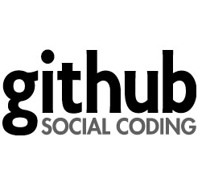

Git vs. Github
Git → version control system – it’s the tool
Github → “Social” front end for Git and a place to store your repositories (for free, publicly)

Slide 6
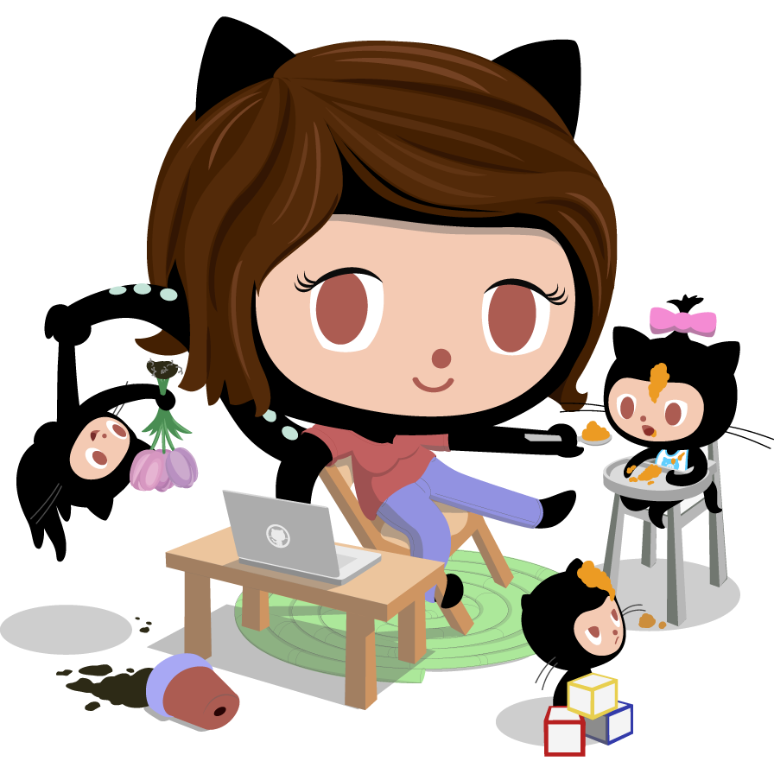
Git
Distributed version control system
There isn’t one centralized code base to pull code from. Different branches hold different parts of the code
Git allows you to take a series of snapshot (commits) of your code
Git stores your files locally and you can choose to push/sync those files to somewhere, like Github!
That means you can work offline, unlike other version control systems

Slide 7
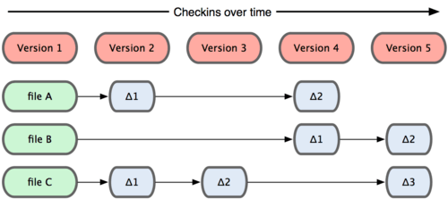
Git vs. SVN (and others)
SVN stores info as a list of file-based changes
Each file is compared to the base of that file overtime

Slide 8
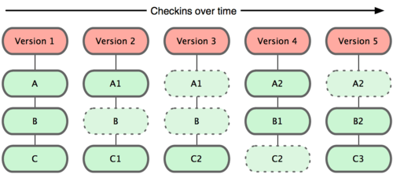
Git vs. SVN (and others)
Git takes a snapshot of what all of your files look like at that moment and stores a reference to that snapshot
if no changes are made it doesn’t resave the file

Slide 9
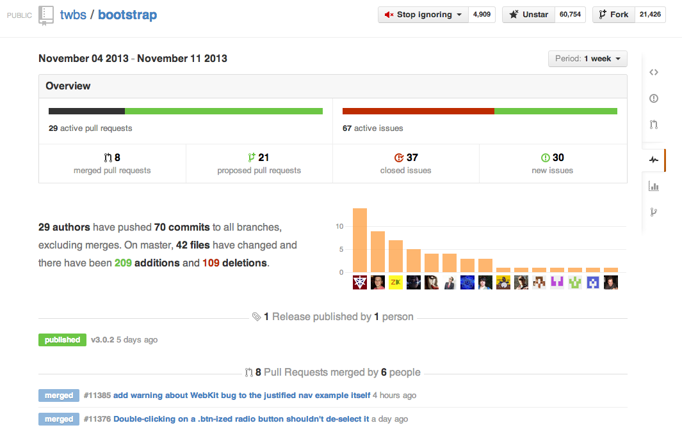
Social

Slide 10
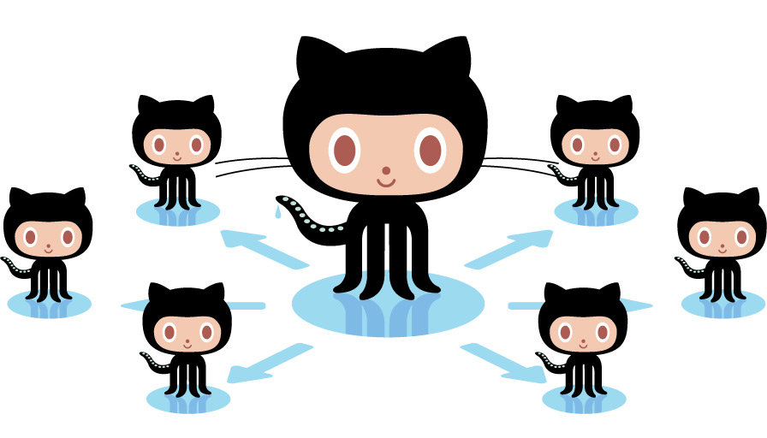
Basic Terms
Some Git Terms…
Repository (repo)
Branch
Pull
Push
Merge
Commit
Clone
Master
Origin
Trunk
Some Github Terms…
Pull Request
Issues
Wikis
Forking
Gists

Slide 11

Some Popular Repositories…
jQuery
Bootstrap
Node
Backbone
AngularJS
Durandal
Ruby
Rails
Jekyll

Slide 12
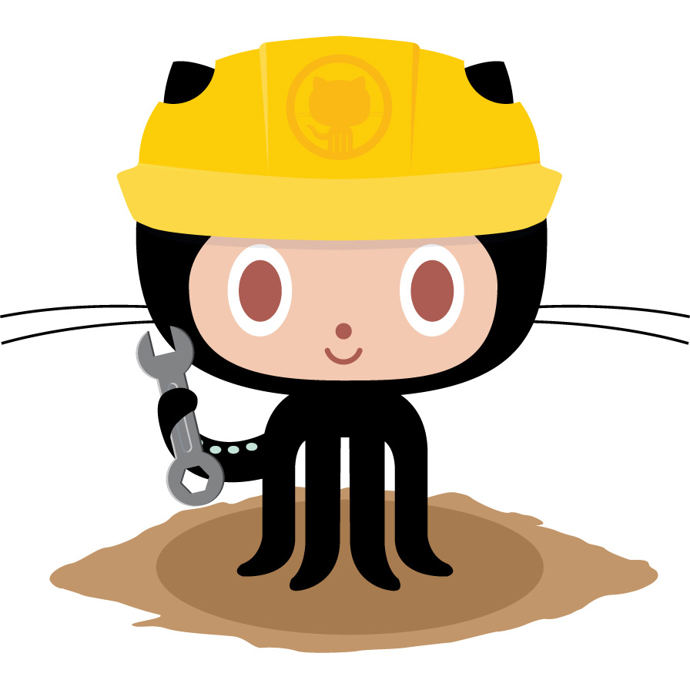
Getting started with Git/Github
Download & install Git
Setup Git via the Terminal/Command Prompt
Create a Github account
Grab the desktop app (Mac or Windows)
Create your first repo!
Notes:
http://stackoverflow.com/questions/11550931/adding-a-new-web-project-to-github

Slide 13
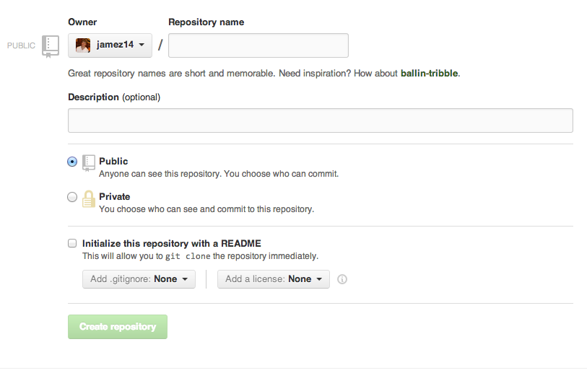
Repository setup

Slide 14
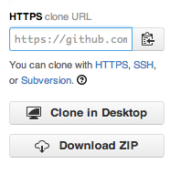
Cloning a repo (terminal/cmd)
Change directory to where you want to clone your repo…
cd Sites/Git
Now you can clone the repo you just made, go grab the URL from Github
git clone https://github.com/jamez14/myRepo.git

Slide 15
Cloning a repo (Github client)
Navigate to repo on github.com and Clone in Desktop
or open up Github client and clone from there…

Slide 16
Commit/Push changes to Github
Made changes locally on you computer & you want to put them on Github
On your computer, change directory to the folder where your repo is (make sure you’ve initialized the repo there already)
Add files to be committed (if new?)
git add . or git add myFile.html
Commit files and add a commit message
git commit –m ‘my commit message’
Push those files/changes to your Github repo/branch
git push origin master

Slide 17
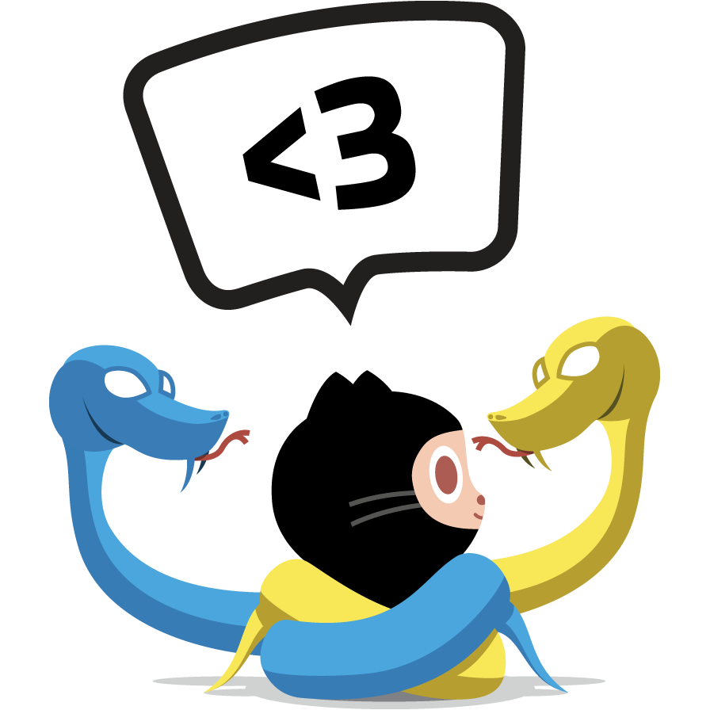
Conflict Resolution
You want to commit some changes you have locally, but the remote file was also changed and is conflicted
You need to merge the files
Plenty of tools available:
P4merge
Meld
Opendiff
Kdiff3
Tortoise Merge
Beyond Compare 3
Notes:
http://stackoverflow.com/questions/161813/how-do-i-fix-merge-conflicts-in-git

Slide 18
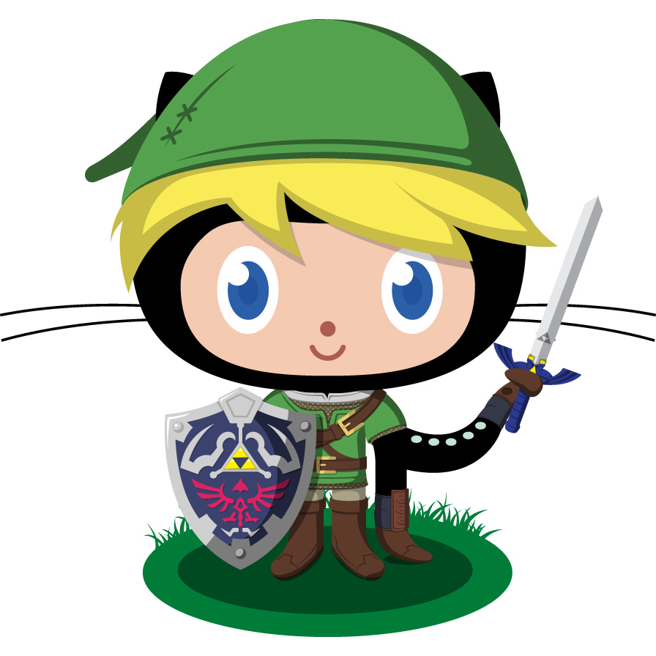
Forking & Pull Requests
Contribute to a repo or use their code as a starting point by forking a repository
If you want to submit your changes to the code you just forked, send a pull request
Pull request is a way for the “forker” to notify the original owner about the changes and then the owner reviews the changes

Slide 19

Two models of collaborative development
Fork & Pull
Anyone can grab the original source by forking and making changes
Changes can then be pulled in by the projects maintainer via pull request, which will notify them
Popular with open source projects because it allows people to work independently without coordinating with owner of the repo ahead of time

Slide 20

Two models of collaborative development
Shared Repository Model
Popular among small teams working on private projects
Everyone can grab the original source, but they usually branch per feature/topic
Pull requests are still used – they provide a way to notify others of changes for code review and discussions before being merged in

Slide 21
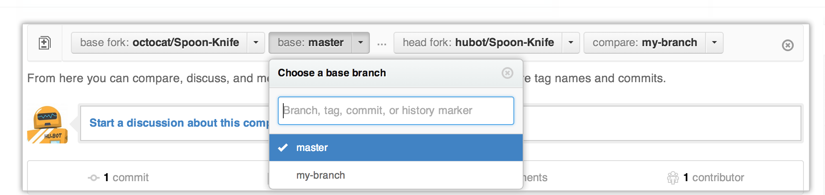
The Pull Request
You forked jQuery’s library, refactored it overnight, & want to have your changes pulled in
You can send pull requests from a branch or a commit –you should do it from a branch though so follow-up commits can be pushed if needed
You review your work and compare your branch to their master
Make sure your range is right –
the base branch is where you think changes should be applied, the head branch is what you would like to be applied

Slide 22
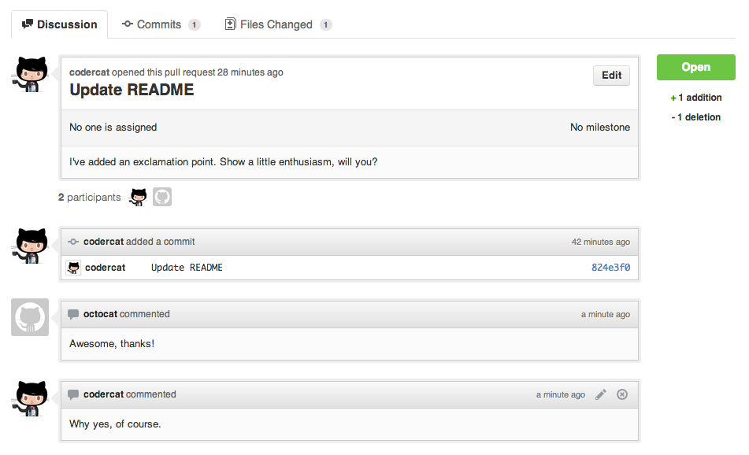
The Pull Request (cont.)
Start a discussion, giving some info on what you’ve done
Hit the Send Pull Request
Any subsequent pushes to your branch will automatically be updated with those commits

Slide 23

Gists
Gists are repositories, but with a little different functionality.
Gists are snippets of code (similar to jsFiddle or Codepen) and can be a simple file or a full blown application.
You can… discover (similar to explore), edit/create, review, fork, etc.

Slide 24
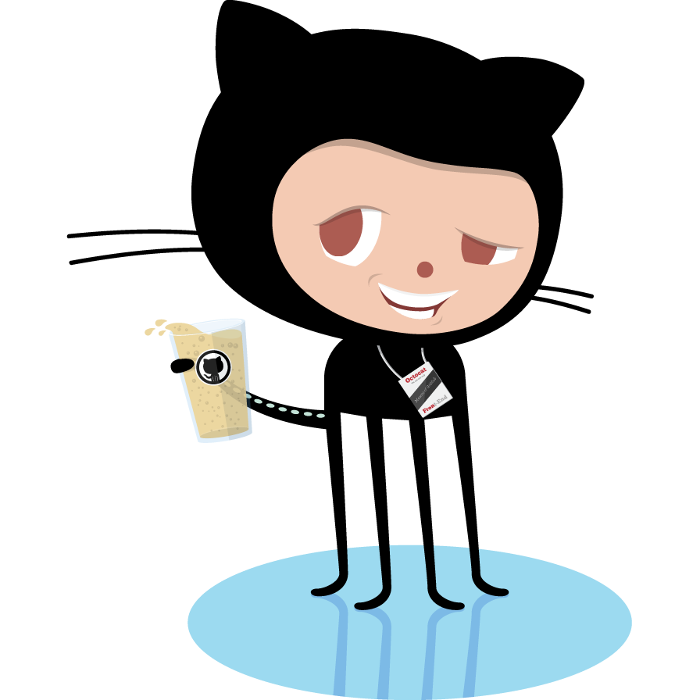
The End

