Slide 1

Interprocess Communication
PIPES
Material from:
https://pdfs.semanticscholar.org/presentation/dff0/af8a4ce3d0c898c08c39c1449373e4b1795e.pdf
Carlos Alberto Rincón Castro | carincon@uh.edu

Slide 2
Pipes
Create a pipe: system call pipe()
  #include <unistd.h>
int pipe(int fd[2]);
Create a unidirectional communication buffer with two file descriptors: fd[0] for read and fd[1] for write.
Data write and read on a first-in-first-out base. No external or permanent name, and can only be accessed through two file descriptors.
The pipe can only be used by the process that created it and its descendants (i.e., child & grand-child processes)

Slide 3
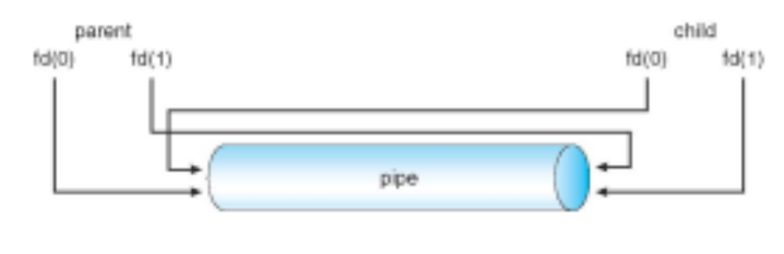
Pipes
Unnamed Pipes

Slide 4
Pipes
close(fd): closes a file descriptor.
dup(newfd) and dup2(newfd, oldfd): Duplicate a file descriptor.
Dup and dup2 system calls create a copy of a given file descriptor. This new descriptor actually does not behave like a copy, but like an alias of the old one.
Read
Not necessarily atomic: may read less bytes.
Blocking: if no data, but write file descriptor still opens.
If empty, and all file descriptors for the write end are closed, read sees end- of-file and returns 0.
Write
Atomic for at most PIPE_BUF bytes (512, 4K, or 64K).
Blocking: if buffer is full, and read file descriptors open.
When all file descriptors referring to the read end of a pipe are closed cause a SIGPIPE signal for the calling process.

Slide 5
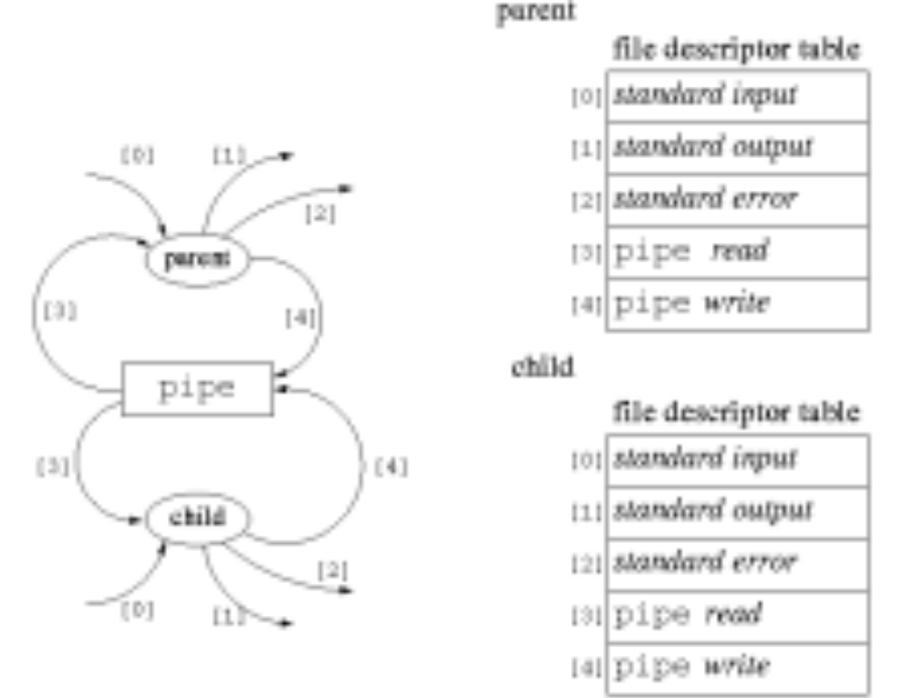
Pipes
After calling the pipe function

Slide 6
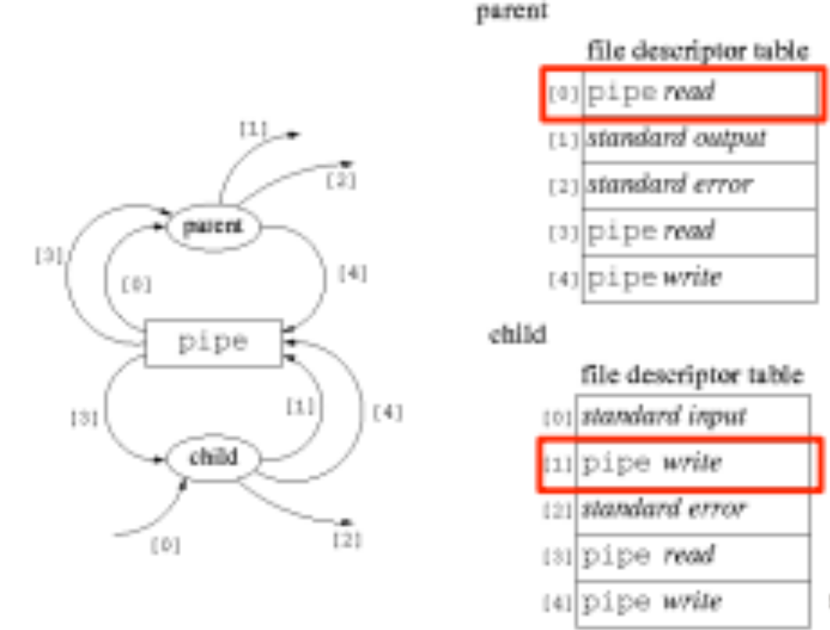
Pipes
After calling the dup2 function

Slide 7
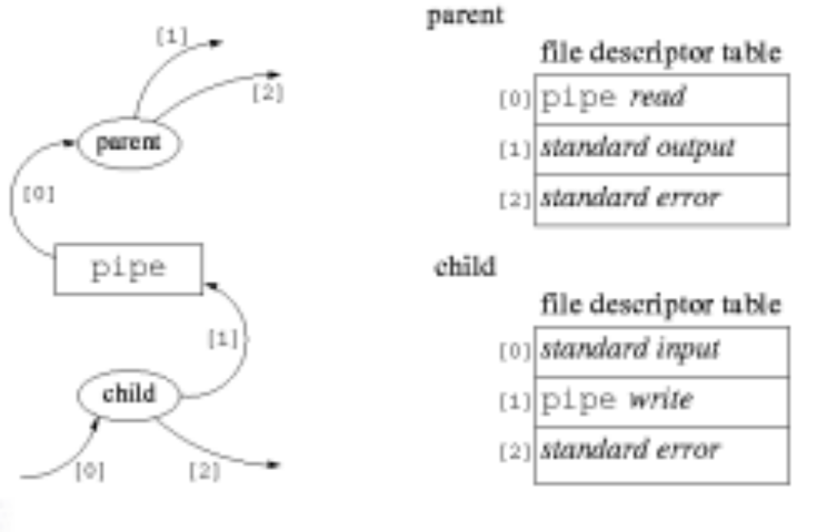
Pipes
After calling the close function

Slide 8
Pipes
Pros:
  Simple
  Flexible
  Efficient communication
Cons:
No way to open an already existing pipe. This makes it impossible for two arbitrary processes to share the same pipe, unless the pipe was created by a common ancestor process.

