Slide 1

HELPr
Bridging the online/offline eCommerce gap

Slide 2

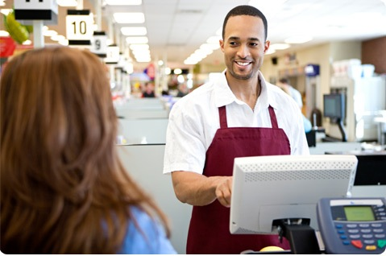

how to influence customer purchasing habits
Great Customer Service
Improve Brand Loyalty

Slide 3
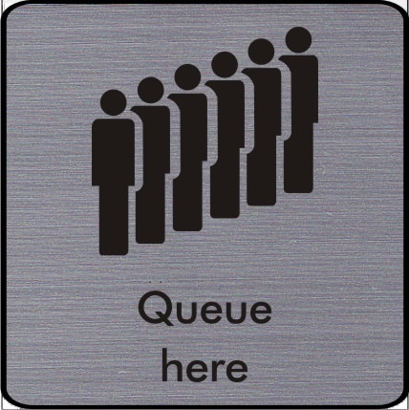
Customer service today

Slide 4

Customer service with HELPr

Slide 5
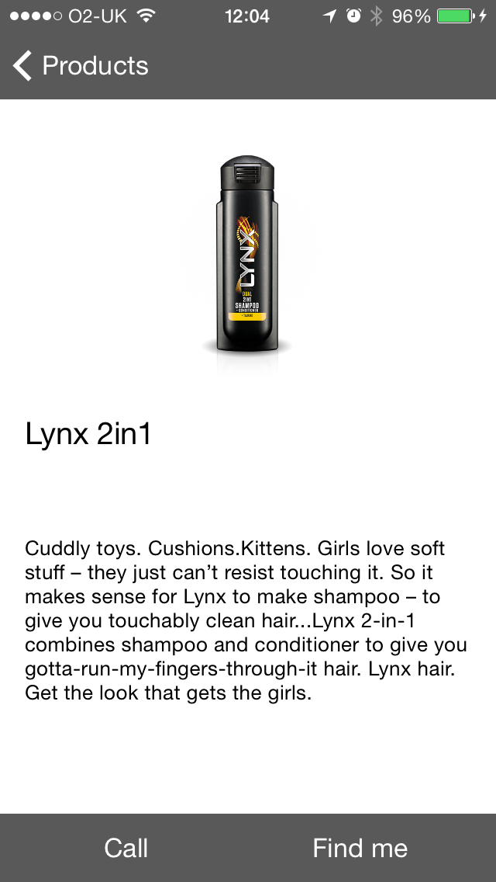
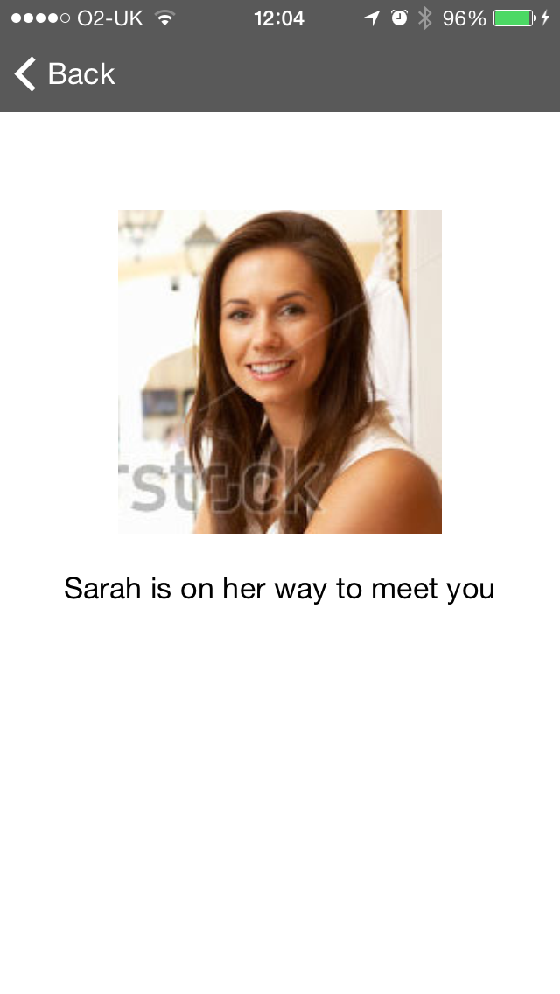
HELPr in-store focus on customer experience
Uses iBeacon proximity technology to do smart filtering to display only relevant products nearby
Can get a shop assistant to come to your location via a simple button click
Allows for personalised service in-store thus improving the overall customer experience

Slide 6
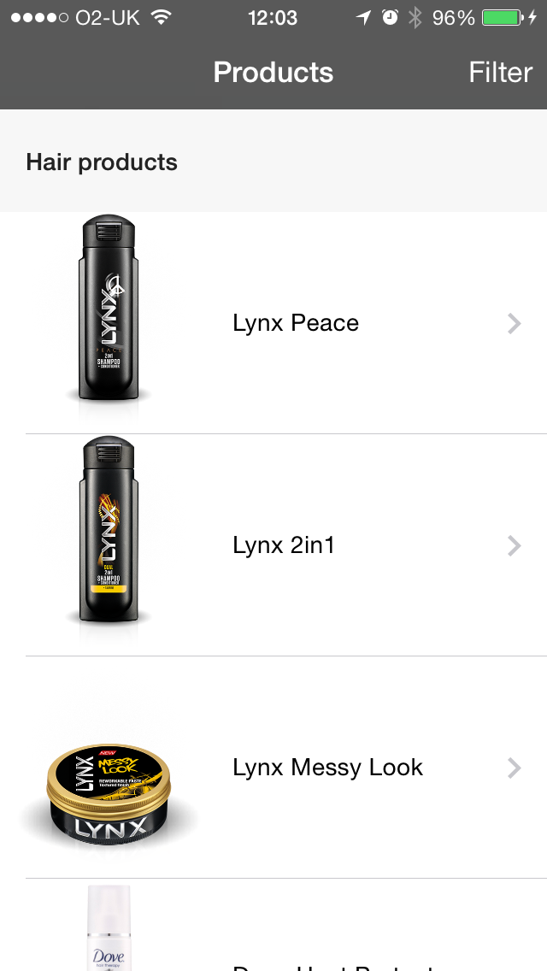
HELPr at Home focus on building brand loyalty
Browsing for products is unfiltered
Can call a Brand Ambassador to get personalised and unbiased recommendations
Brand Ambassadors can be Unilever employees or simply fans, that do it for recognition or promotional items

Slide 7
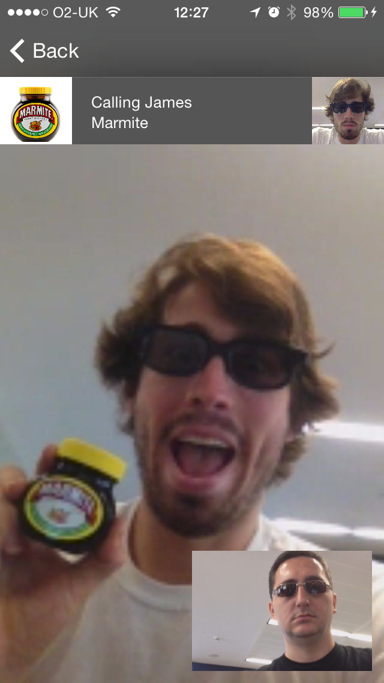
HELPr
Two worlds are now One
@VladPetroff
@jamiltz

