Slide 1
Traveling Salesman Problem
CS 375 – Design and Analysis of Algorithms
James Yao – Melanie Chen
CS 375 Project
1

Slide 2
Algorithm purpose
Introducing TSP | Brute force solution | Best first search | Nearest neighbor | Greedy heuristic | Time analysis
2
Suppose we want to visit every state capital in the US.
However, traveling from one city to another costs money.
How do we visit every city while minimizing cost?
Solving the traveling salesman problem is equivalent to finding a Hamiltonian cycle with minimum total cost
There is no polynomial time solution to find or verify the optimal solution
TSP is NP-hard

Slide 3
Algorithm purpose
Introducing TSP | Brute force solution | Best first search | Nearest neighbor | Greedy heuristic | Time analysis
3
There are several ways of solving for the optimal solution, but none so far are polynomial time algorithms
Instead, a heuristic approach to solving TSP can be used
Heuristics refer to approximation methods
Trade-off between accuracy and computation speed
Record the speeds of various algorithms
Analyze the runtime complexities
Estimate time as problem size gets big
Evaluate accuracy vs computation speed trade-off

Slide 4
Algorithm Analysis
Introducing TSP | Brute force solution | Best first search | Nearest neighbor | Greedy heuristic | Time analysis
Exact and Heuristic Algorithms
Brute force solution – O(n!)
Best first search – O(n!)
Nearest neighbor – O(n²)
Greedy heuristic – O(n³)
4

Slide 5
Brute force solution
Introducing TSP | Brute force solution | Best first search | Nearest neighbor | Greedy heuristic | Time analysis
4
Enumerate every single possible Hamiltonian cycle
Pick the one with the shortest total cost
O(n!) – Chose from i – 1 edges for every choice (n ∙ n-1 ∙ n-2 ∙ … ∙ 1)

Slide 6
Pseudocode
Introducing TSP | Brute force solution | Best first search | Nearest neighbor | Greedy heuristic | Time analysis
BRUTE-FORCE(A, v) path = [0, 1, 2, …, v-1] smallest_sum = INF for i = 0 to v! PERMUTE(path, v) cost = GET-COST(A, path) // Look up cost of traversing this path if cost < smallest_sum smallest_sum = cost PERMUTE(path, v) // Find the rightmost value that can still be maximized pivot = findRightmostNonMax(path) // For all values after pivot, insert in ascending order minimize(pivot, path)
5

Slide 7
Introducing TSP | Brute force solution | Best first search | Nearest neighbor | Greedy heuristic | Time analysis
6
[1,3,2,4]

Slide 8
Introducing TSP | Brute force solution | Best first search | Nearest neighbor | Greedy heuristic | Time analysis
6
[1,3,2,4]
Rightmost non-maximum element
(Swap with 4 and minimize rest)

Slide 9
Introducing TSP | Brute force solution | Best first search | Nearest neighbor | Greedy heuristic | Time analysis
6
[1,3,4,2]

Slide 10
Introducing TSP | Brute force solution | Best first search | Nearest neighbor | Greedy heuristic | Time analysis
6
[1,3,4,2]
Rightmost non-maximum element
(Swap with 4 and minimize rest)

Slide 11
Introducing TSP | Brute force solution | Best first search | Nearest neighbor | Greedy heuristic | Time analysis
6
[1,4,2,3]

Slide 12
Best first search
Introducing TSP | Brute force solution | Best first search | Nearest neighbor | Greedy heuristic | Time analysis
7
Start with a root node with a single vertex
Create a tree of nodes each with a corresponding path
Prune tree with nodes bounds greater than best so far
Create children nodes for each promising node (add them to the queue)
Remove nodes from the queue when visited
O(n!) – worst case of no pruning (one node for every enumerable Hamiltonian cycle)

Slide 13
Pseudocode
Introducing TSP | Brute force solution | Best first search | Nearest neighbor | Greedy heuristic | Time analysis
BEST-FIRST-SEARCH(A, v) // A is adjacency matrix, v is number of nodes Q = Ø min_cost = INF node = new Node node.path = [0] // First path is [0], child paths are [0,1],[0,2], … ,[0,v-1] node.cost = GET-BOUND(node.path, n, A, v) ENQUEUE(Q, node) while Q not empty node = GET-PRIORITY(Q) if node.cost < min_cost if not IS-LEAF(node) // C is array of children paths paths = GET-PATHS(node.path, A, v, C) for each path in paths child = Ø child.path = path // n is length of node.path child.cost = GET-BOUND(node.path, n, A, v) ENQUEUE(Q, child) else // If leaf is reached, a full path is completed if node.cost < min_cost min_cost = node.cost
8

Slide 14
Pseudocode
Introducing TSP | Brute force solution | Best first search | Nearest neighbor | Greedy heuristic | Time analysis
GET-BOUND(P, n, A, v) // P is parent path, n is length of parent path sum = 0 // Add cost of going from one fixed node to the next for i = 1 to n row = P[i] col = P[i+1] sum += A[row][col] for i = 1 to v // For each non-fixed node, add minimum cost of other nodes for j = 1 to v // Exclude self node and fixed nodes if (!CONTAINS(P, i) && i != j ) || (!CONTAINS(P,i) && i == P[len(P) – 1]) possible.append(i) sum += GET-MINIMUM(possible) return sum GET-PATHS(P, A, v, C) for i = 1 to n child_path = P ⋃ { i } C = C ⋃ child_path
9

Slide 15
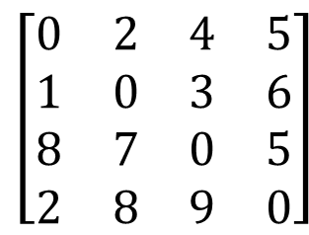
Introducing TSP | Brute force solution | Best first search | Nearest neighbor | Greedy heuristic | Time analysis
10
[0]
10
v₀ v₁ v₂ v₃
v₀ v₁v₂v₃
$$\left[\begin{matrix}0 & 2 & 4 & 5 \\ 1 & 0 & 3 & 6 \\ 8 & 7 & 0 & 5 \\ 2 & 8 & 9 & 0\end{matrix}\right]$$
v₀ | v₁, v₂, v₃
v₁ | v₀, v₂, v₃
v₂ | v₀, v₁, v₃
v₃ | v₀, v₁, v₂

Slide 16
Introducing TSP | Brute force solution | Best first search | Nearest neighbor | Greedy heuristic | Time analysis
10
[0]
10
[0, 1]
12
v₀ v₁ v₂ v₃
v₀ v₁v₂v₃
$$\left[\begin{matrix}0 & 2 & 4 & 5 \\ 1 & 0 & 3 & 6 \\ 8 & 7 & 0 & 5 \\ 2 & 8 & 9 & 0\end{matrix}\right]$$
v₀ | v₁
v₁ | v₂, v₃
v₂ | v₀, v₃
v₃ | v₀, v₂
$$\left[\begin{matrix}0 & 2 & 4 & 5 \\ 1 & 0 & 3 & 6 \\ 8 & 7 & 0 & 5 \\ 2 & 8 & 9 & 0\end{matrix}\right]$$

Slide 17
Introducing TSP | Brute force solution | Best first search | Nearest neighbor | Greedy heuristic | Time analysis
10
[0]
10
[0, 1]
12
[0, 2]
10
v₀ v₁ v₂ v₃
v₀ v₁v₂v₃
$$\left[\begin{matrix}0 & 2 & 4 & 5 \\ 1 & 0 & 3 & 6 \\ 8 & 7 & 0 & 5 \\ 2 & 8 & 9 & 0\end{matrix}\right]$$
v₀ | v₂
v₁ | v₀, v₃
v₂ | v₁, v₃
v₃ | v₀, v₁

Slide 18
Introducing TSP | Brute force solution | Best first search | Nearest neighbor | Greedy heuristic | Time analysis
10
[0]
10
[0, 1]
12
[0, 2]
10
[0, 3]
21
v₀ v₁ v₂ v₃
v₀ v₁v₂v₃
$$\left[\begin{matrix}0 & 2 & 4 & 5 \\ 1 & 0 & 3 & 6 \\ 8 & 7 & 0 & 5 \\ 2 & 8 & 9 & 0\end{matrix}\right]$$
v₀ | v₃
v₁ | v₀, v₂
v₂ | v₀, v₁
v₃ | v₁, v₂

Slide 19
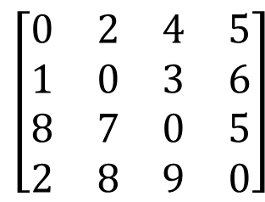
Introducing TSP | Brute force solution | Best first search | Nearest neighbor | Greedy heuristic | Time analysis
10
[0]
10
[0, 1]
12
[0, 2]
10
[0, 3]
21
[0,2,1,3]
19
[0,2,3,1]
18
v₀ v₁ v₂ v₃
v₀ v₁v₂v₃
$$\left[\begin{matrix}0 & 2 & 4 & 5 \\ 1 & 0 & 3 & 6 \\ 8 & 7 & 0 & 5 \\ 2 & 8 & 9 & 0\end{matrix}\right]$$
min cost = 18

Slide 20
Introducing TSP | Brute force solution | Best first search | Nearest neighbor | Greedy heuristic | Time analysis
10
[0]
10
[0, 1]
12
[0, 2]
10
[0, 3]
21
[0,1,2,3]
25
[0,1,3,2]
10
[0,2,1,3]
19
[0,2,3,1]
18
v₀ v₁ v₂ v₃
v₀ v₁v₂v₃
$$\left[\begin{matrix}0 & 2 & 4 & 5 \\ 1 & 0 & 3 & 6 \\ 8 & 7 & 0 & 5 \\ 2 & 8 & 9 & 0\end{matrix}\right]$$
min cost = 10

Slide 21
Introducing TSP | Brute force solution | Best first search | Nearest neighbor | Greedy heuristic | Time analysis
10
[0]
10
[0, 1]
12
[0, 2]
10
[0, 3]
21
[0,1,2,3]
25
[0,1,3,2]
10
[0,2,1,3]
19
[0,2,3,1]
18
[0,3,1,2]
24
[0,3,2,1]
22
v₀ v₁ v₂ v₃
v₀ v₁v₂v₃
$$\left[\begin{matrix}0 & 2 & 4 & 5 \\ 1 & 0 & 3 & 6 \\ 8 & 7 & 0 & 5 \\ 2 & 8 & 9 & 0\end{matrix}\right]$$
min cost = 10

Slide 22
Nearest neighbor
Introducing TSP | Brute force solution | Best first search | Nearest neighbor | Greedy heuristic | Time analysis
11
Pick a starting node
Pick the lowest cost edge leaving that node
Continue for picked node
Do not account for edges that cannot yield a Hamiltonian cycle
O(n²) – For each edge, chose from at most n edges

Slide 23
Pseudocode
Introducing TSP | Brute force solution | Best first search | Nearest neighbor | Greedy heuristic | Time analysis
NEAREST-NEIGHBOR(A, v ):
costs = [∞, … ,∞] // array of size v
shortest_path = [ ] // array of size v
for i = 1 to v :
for j = 1 to v :
if j in shortest_path :
continue
if A [shortest_path [i -1]][j ] < costs [i -1]:
costs [i -1] = A [shortest_path [i -1]][j ]
shortest_path [i ] = j
total_cost = SUM(costs )
12

Slide 24
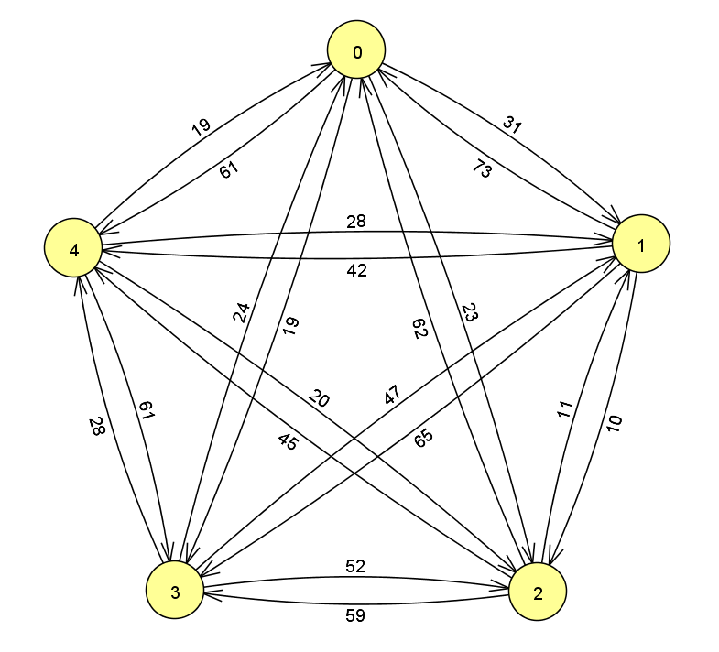
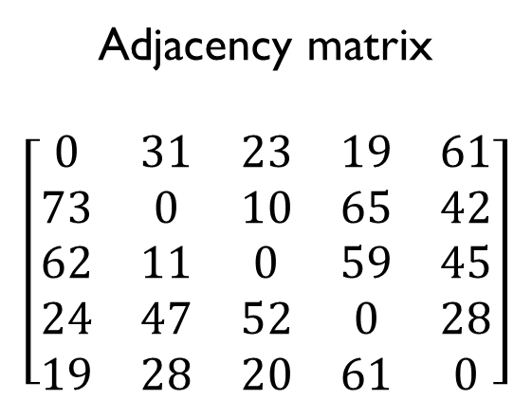
Introducing TSP | Brute force solution | Best first search | Nearest neighbor | Greedy heuristic | Time analysis
13
Adjacency matrix
$$\left[\begin{matrix}0 & 31 & 23 & 19 & 61 \\ 73 & 0 & 10 & 65 & 42 \\ 62 & 11 & 0 & 59 & 45 \\ 24 & 47 & 52 & 0 & 28 \\ 19 & 28 & 20 & 61 & 0\end{matrix}\right]$$

Slide 25
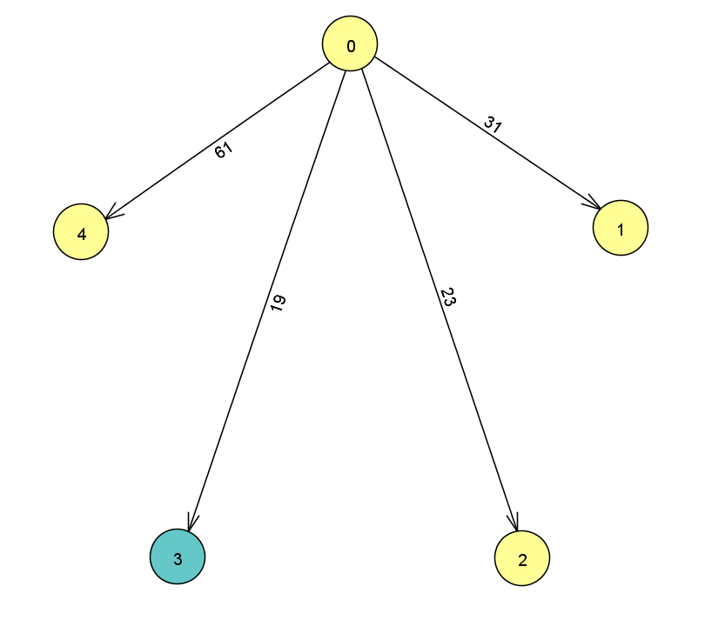
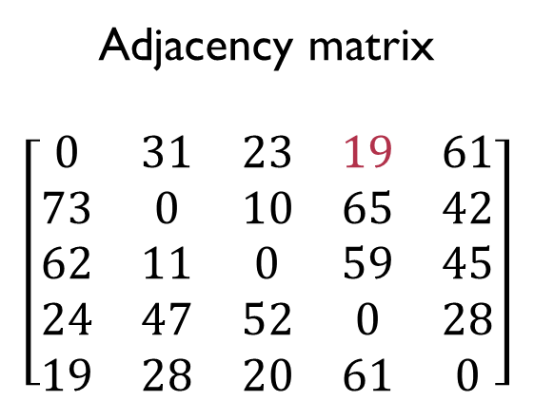
Introducing TSP | Brute force solution | Best first search | Nearest neighbor | Greedy heuristic | Time analysis
13
Adjacency matrix
$$\left[\begin{matrix}0 & 31 & 23 & 19 & 61 \\ 73 & 0 & 10 & 65 & 42 \\ 62 & 11 & 0 & 59 & 45 \\ 24 & 47 & 52 & 0 & 28 \\ 19 & 28 & 20 & 61 & 0\end{matrix}\right]$$

Slide 26
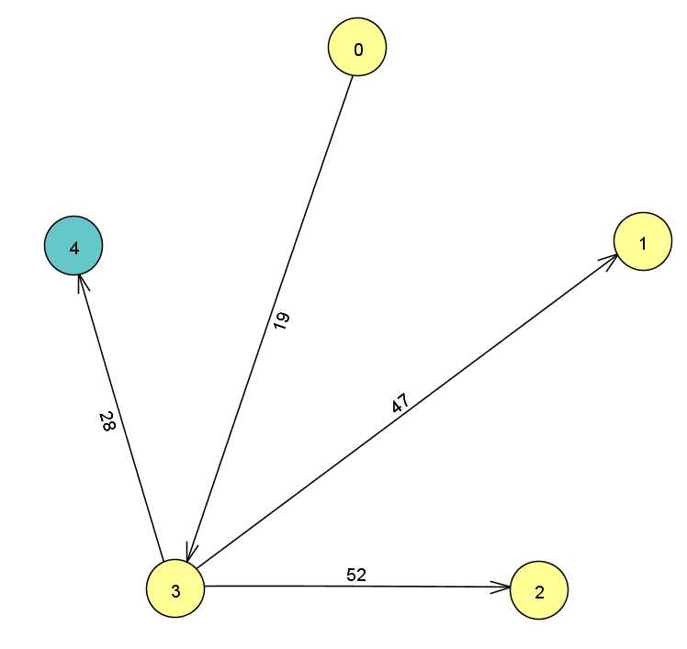
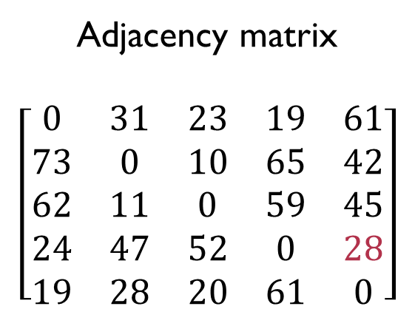
Introducing TSP | Brute force solution | Best first search | Nearest neighbor | Greedy heuristic | Time analysis
13
Adjacency matrix
$$\left[\begin{matrix}0 & 31 & 23 & 19 & 61 \\ 73 & 0 & 10 & 65 & 42 \\ 62 & 11 & 0 & 59 & 45 \\ 24 & 47 & 52 & 0 & 28 \\ 19 & 28 & 20 & 61 & 0\end{matrix}\right]$$

Slide 27
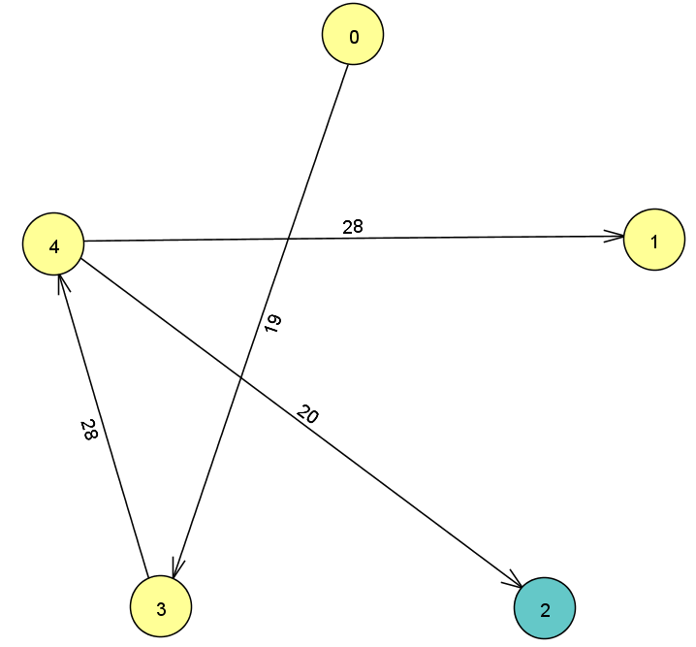
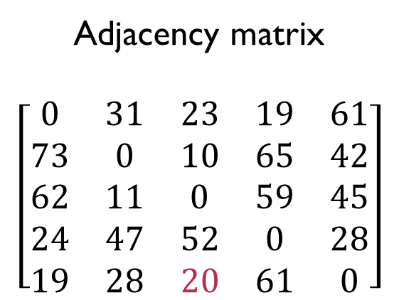
Introducing TSP | Brute force solution | Best first search | Nearest neighbor | Greedy heuristic | Time analysis
13
Adjacency matrix
$$\left[\begin{matrix}0 & 31 & 23 & 19 & 61 \\ 73 & 0 & 10 & 65 & 42 \\ 62 & 11 & 0 & 59 & 45 \\ 24 & 47 & 52 & 0 & 28 \\ 19 & 28 & 20 & 61 & 0\end{matrix}\right]$$

Slide 28
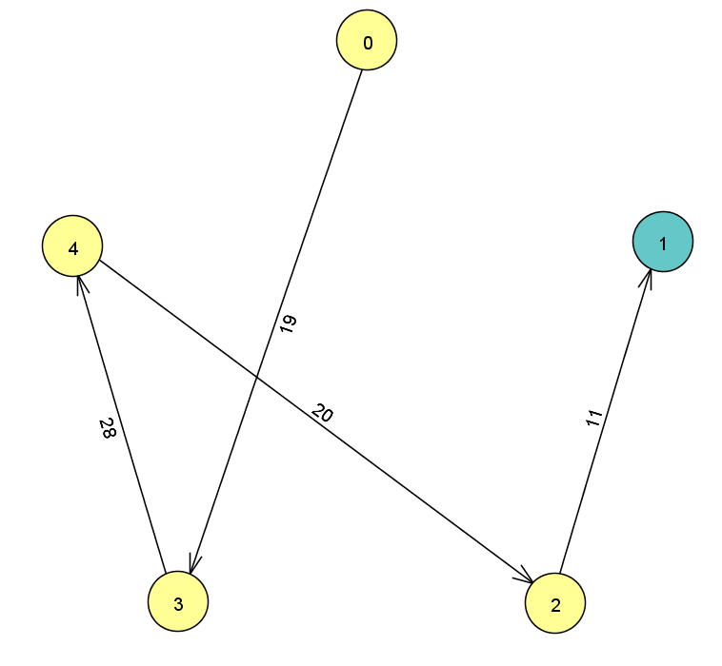
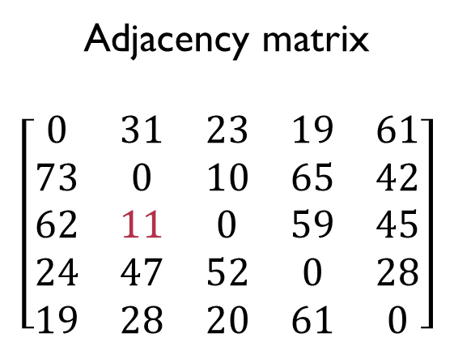
Introducing TSP | Brute force solution | Best first search | Nearest neighbor | Greedy heuristic | Time analysis
13
Adjacency matrix
$$\left[\begin{matrix}0 & 31 & 23 & 19 & 61 \\ 73 & 0 & 10 & 65 & 42 \\ 62 & 11 & 0 & 59 & 45 \\ 24 & 47 & 52 & 0 & 28 \\ 19 & 28 & 20 & 61 & 0\end{matrix}\right]$$

Slide 29
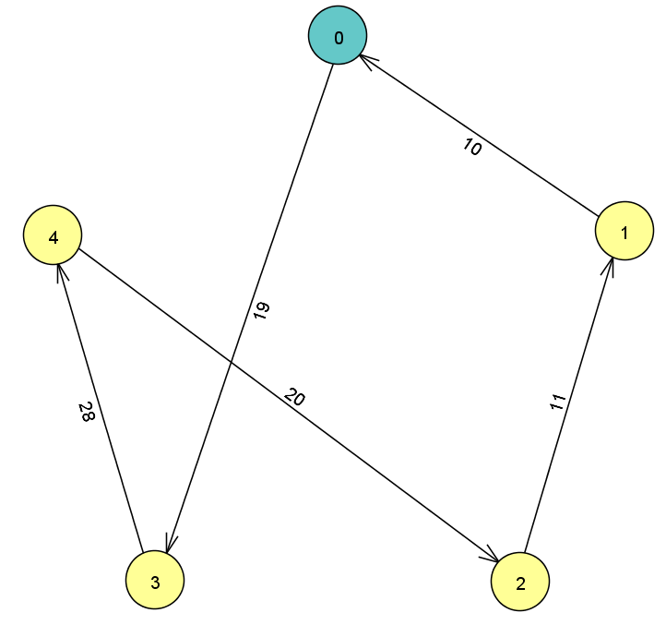
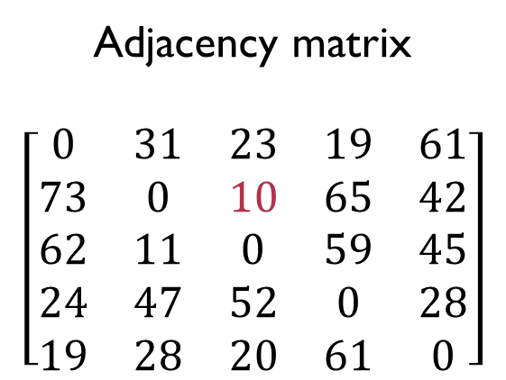
Introducing TSP | Brute force solution | Best first search | Nearest neighbor | Greedy heuristic | Time analysis
13
Adjacency matrix
$$\left[\begin{matrix}0 & 31 & 23 & 19 & 61 \\ 73 & 0 & 10 & 65 & 42 \\ 62 & 11 & 0 & 59 & 45 \\ 24 & 47 & 52 & 0 & 28 \\ 19 & 28 & 20 & 61 & 0\end{matrix}\right]$$

Slide 30
Greedy Heuristic
Introducing TSP | Brute force solution | Best first search | Nearest neighbor | Greedy heuristic | Time analysis
14
Picks lowest cost edge from all edges (greedy choice)
Invalidates edges that cannot be part of this solution
Repeats until a Hamiltonian cycle is constructed (picks v-1 edges)
O(n³) – For each edge chosen, look through n² edges (n * n²)

Slide 31
Pseudocode
Introducing TSP | Brute force solution | Best first search | Nearest neighbor | Greedy heuristic | Time analysis
GREEDY-HEURISTIC(A, v ):
A’ = A
pairs, reverse_pairs = [– 1, … , – 1] // length of arrays = v
min_cost = ∞
for i = 1 to v – 1:
for each non-diagonal element a in A’ :
if a < min_cost && a != – 1:
min_cost = a
loc_i, loc_j = row and column index of a in A’
pairs [loc_i ] = loc_j
reverse_pairs [loc_j ] = loc_i
// Removing edges leaving vertex at loc_i and entering vertex at loc_j
for k = 0 up to v:
A’ [loc_i ][k ] = –1
A’ [k ][loc_j ] = – 1
Invalidation cases:
if edge connects 0 or 1 connected components:
remove back edges
else if edge connects 2 connect components:
remove back edges and cross edges
15

Slide 32
Pseudocode
Introducing TSP | Brute force solution | Best first search | Nearest neighbor | Greedy heuristic | Time analysis
// Checks if edge connects two connected components
if pairs [loc_j ]!= -1 && reverse_pairs [loc_i ]!= -1:
for i = 1 to v :
A’[i ][loc_i ] = A’ [loc_j ][i ]= –1; // Remove all in and out edges to this edge
// Connects the two connected components by removing cross edges between them
for i = reverse_pairs [loc_i ] while i != –1:
for k = loc_j while k != –1:
A’ [k ][i ] = –1
k = pairs [k ]
i = reverse_pairs [i ]
for j = pairs [loc_j ] while j != –1:
for k = loc_i while k != –1:
A’ [j ][k ] = –1
k = reverse_pairs [k ]
j = pairs [j ]
// Case where edge is alone or connects to only one connected component
else:
// Remove back edges of connected segment from vertex at loc_i to prevent cycles
for j = loc_j while pairs [j ] != –1:
A’ [pairs [j ]][loc_i ] = –1
j = pairs [j ]
// Removes back edges of connected segment from vertex at loc_j to prevent cycles
for i = loc_i while i != –1:
A’ [loc_j ][i ] = –1
i = reverse_pairs [i ]
16

Slide 33
Introducing TSP | Brute force solution | Best first search | Nearest neighbor | Greedy heuristic | Time analysis
17
Adjacency matrix
$$\left[\begin{matrix}0 & 31 & 23 & 19 & 61 \\ 73 & 0 & 10 & 65 & 42 \\ 62 & 11 & 0 & 59 & 45 \\ 24 & 47 & 52 & 0 & 28 \\ 19 & 28 & 20 & 61 & 0\end{matrix}\right]$$

Slide 34
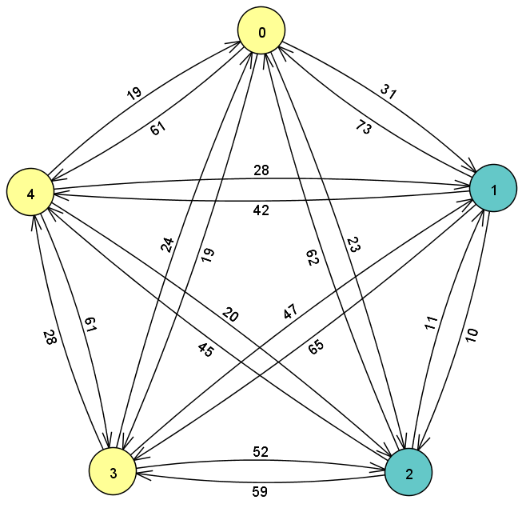
Introducing TSP | Brute force solution | Best first search | Nearest neighbor | Greedy heuristic | Time analysis
17
Adjacency matrix
$$\left[\begin{matrix}0 & 31 & 23 & 19 & 61 \\ 73 & 0 & 10 & 65 & 42 \\ 62 & 11 & 0 & 59 & 45 \\ 24 & 47 & 52 & 0 & 28 \\ 19 & 28 & 20 & 61 & 0\end{matrix}\right]$$

Slide 35
Introducing TSP | Brute force solution | Best first search | Nearest neighbor | Greedy heuristic | Time analysis
17
Adjacency matrix
$$\left[\begin{matrix}0 & 31 & 23 & 19 & 61 \\ 73 & 0 & 10 & 65 & 42 \\ 62 & 11 & 0 & 59 & 45 \\ 24 & 47 & 52 & 0 & 28 \\ 19 & 28 & 20 & 61 & 0\end{matrix}\right]$$

Slide 36
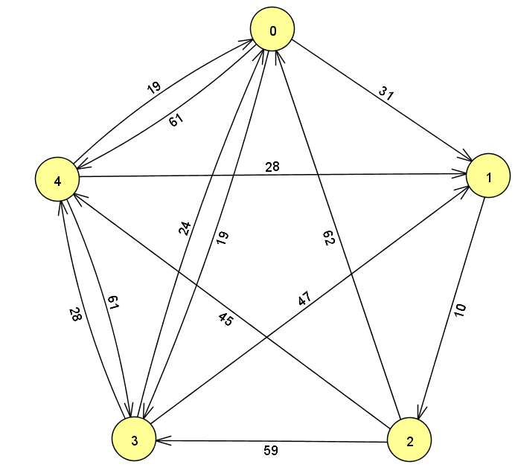
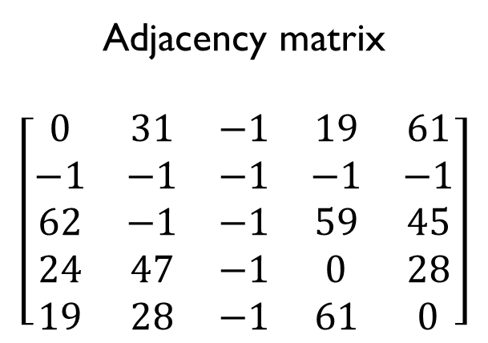
Introducing TSP | Brute force solution | Best first search | Nearest neighbor | Greedy heuristic | Time analysis
17
Adjacency matrix
$$\left[\begin{matrix}0 & 31 & −1 & 19 & 61 \\ −1 & −1 & −1 & −1 & −1 \\ 62 & −1 & −1 & 59 & 45 \\ 24 & 47 & −1 & 0 & 28 \\ 19 & 28 & −1 & 61 & 0\end{matrix}\right]$$

Slide 37
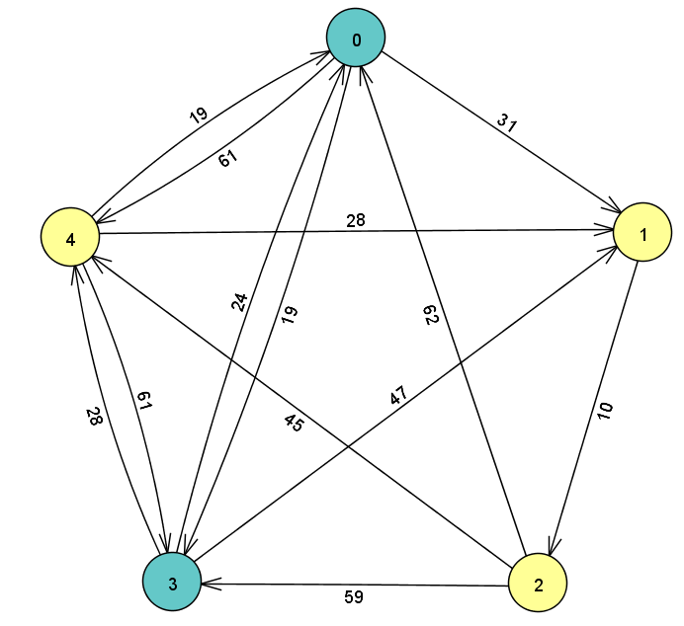
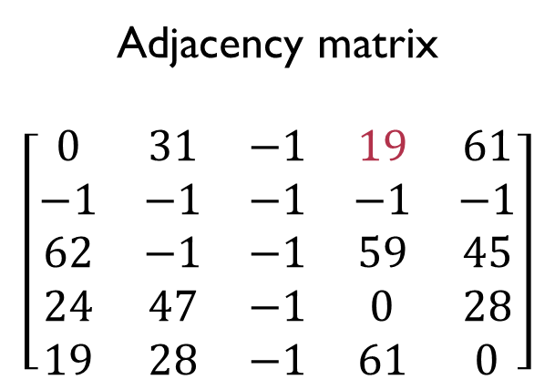
Introducing TSP | Brute force solution | Best first search | Nearest neighbor | Greedy heuristic | Time analysis
17
Adjacency matrix
$$\left[\begin{matrix}0 & 31 & −1 & 19 & 61 \\ −1 & −1 & −1 & −1 & −1 \\ 62 & −1 & −1 & 59 & 45 \\ 24 & 47 & −1 & 0 & 28 \\ 19 & 28 & −1 & 61 & 0\end{matrix}\right]$$

Slide 38
Introducing TSP | Brute force solution | Best first search | Nearest neighbor | Greedy heuristic | Time analysis
17
Adjacency matrix
$$\left[\begin{matrix}0 & 31 & −1 & 19 & 61 \\ −1 & −1 & −1 & −1 & −1 \\ 62 & −1 & −1 & 59 & 45 \\ 24 & 47 & −1 & 0 & 28 \\ 19 & 28 & −1 & 61 & 0\end{matrix}\right]$$

Slide 39
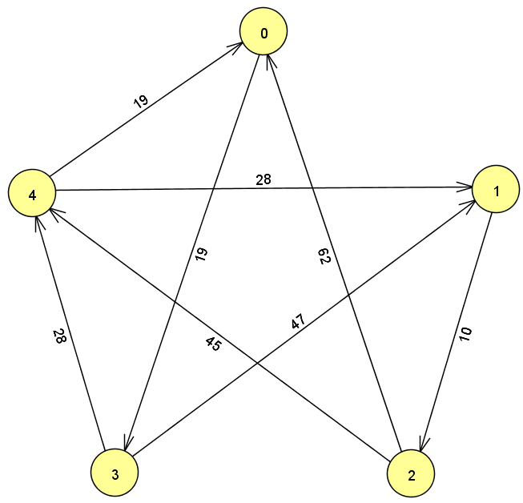
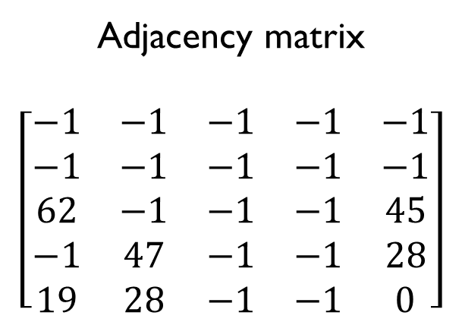
Introducing TSP | Brute force solution | Best first search | Nearest neighbor | Greedy heuristic | Time analysis
17
Adjacency matrix
$$\left[\begin{matrix}−1 & −1 & −1 & −1 & −1 \\ −1 & −1 & −1 & −1 & −1 \\ 62 & −1 & −1 & −1 & 45 \\ −1 & 47 & −1 & −1 & 28 \\ 19 & 28 & −1 & −1 & 0\end{matrix}\right]$$

Slide 40
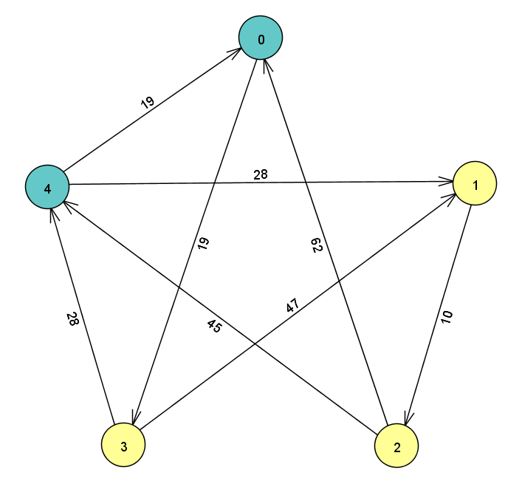
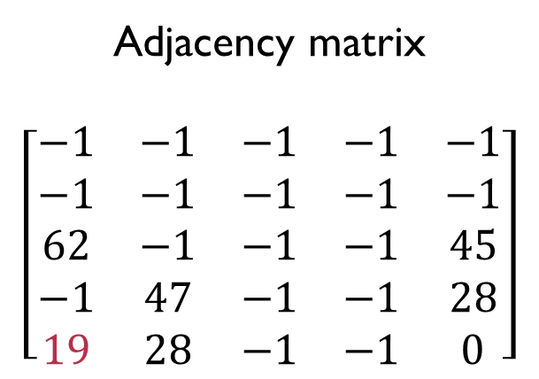
Introducing TSP | Brute force solution | Best first search | Nearest neighbor | Greedy heuristic | Time analysis
17
Adjacency matrix
$$\left[\begin{matrix}−1 & −1 & −1 & −1 & −1 \\ −1 & −1 & −1 & −1 & −1 \\ 62 & −1 & −1 & −1 & 45 \\ −1 & 47 & −1 & −1 & 28 \\ 19 & 28 & −1 & −1 & 0\end{matrix}\right]$$

Slide 41
Introducing TSP | Brute force solution | Best first search | Nearest neighbor | Greedy heuristic | Time analysis
17
Adjacency matrix
$$\left[\begin{matrix}−1 & −1 & −1 & −1 & −1 \\ −1 & −1 & −1 & −1 & −1 \\ 62 & −1 & −1 & −1 & 45 \\ −1 & 47 & −1 & −1 & 28 \\ 19 & 28 & −1 & −1 & 0\end{matrix}\right]$$

Slide 42
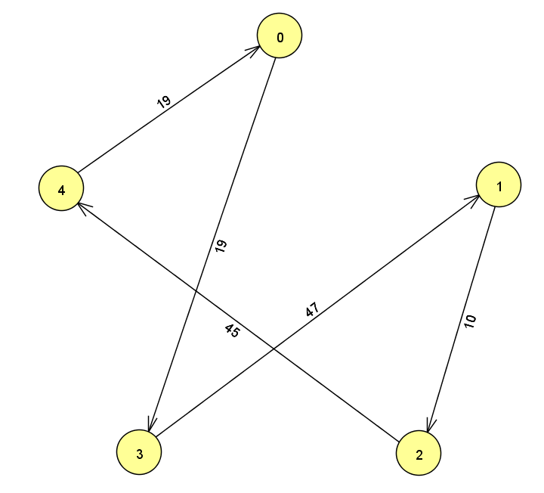
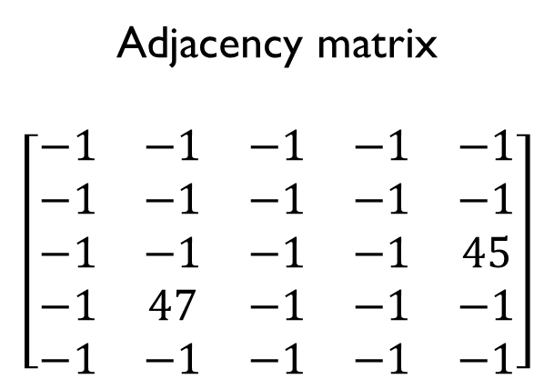
Introducing TSP | Brute force solution | Best first search | Nearest neighbor | Greedy heuristic | Time analysis
17
Adjacency matrix
$$\left[\begin{matrix}−1 & −1 & −1 & −1 & −1 \\ −1 & −1 & −1 & −1 & −1 \\ −1 & −1 & −1 & −1 & 45 \\ −1 & 47 & −1 & −1 & −1 \\ −1 & −1 & −1 & −1 & −1\end{matrix}\right]$$

Slide 43
Implementation
Introducing TSP | Brute force solution | Best first search | Nearest neighbor | Greedy heuristic | Time analysis
18
Language: C++
All solutions use an adjacency matrix
Brute force solution:
Single array used to store and permute path
Best first search:
Node class: holds cost/bound and path array
Priority queue: holds promising Nodes
Nearest neighbor:
Populates a path array with each chosen element
Greedy heuristic:
Uses adjacency prime matrix to invalidate edges

Slide 44
Problem statement
Introducing TSP | Brute force solution | Best first search | Nearest neighbor | Greedy heuristic | Time analysis
19
We know solving TSP and getting a brute force solution is difficult, but we do not know what “difficult” means in relation to the heuristic algorithms.
To what extent can we use the exact algorithms in a reasonable amount of time?
How much faster are the heuristic algorithms?
At what point is the trade-off between accuracy and computation time worthwhile?

Slide 45
DEMO and results
Introducing TSP | Brute force solution | Best first search | Nearest neighbor | Greedy heuristic | Time analysis
20
Ran exact algorithm with n up to 12.
Ran heuristic algorithms with n up to 500.
Results of running program where recorded in tables to create graphs.

Slide 46
Introducing TSP | Brute force solution | Best first search | Nearest neighbor | Greedy heuristic | Time analysis
 |  | v = 4 |  | v = 6 |  | v = 8 |  | v = 10 |  | v = 12
 | run | cost | time | cost | time | cost | time | cost | time | cost | time
Brute Force: | 1 | 1135 | 6.00E-06 | 1573 | 4.90E-05 | 1594 | 0.001904 | 1523 | 0.121871 | 1712 | 16.8795
 | 2 | 1593 | 2.00E-06 | 869 | 4.10E-05 | 1682 | 0.002511 | 1949 | 0.120384 | 2337 | 16.9117
 | 3 | 748 | 2.00E-06 | 1724 | 3.70E-05 | 2003 | 0.002118 | 2537 | 0.122839 | 1732 | 16.9
 | 4 | 863 | 2.00E-06 | 1283 | 3.80E-05 | 2439 | 0.002071 | 1500 | 0.123275 | 1187 | 16.9917
 | 5 | 1442 | 1.00E-06 | 1699 | 4.50E-05 | 1962 | 0.001722 | 1752 | 0.121927 | 1957 | 17.0318
Best First Search: | 1 | 1135 | 2.80E-05 | 1573 | 6.20E-05 | 1594 | 0.000361 | 1523 | 0.001173 | 1712 | 0.023328
 | 2 | 1593 | 1.60E-05 | 869 | 6.40E-05 | 1682 | 0.000208 | 1949 | 0.000562 | 2337 | 0.000536
 | 3 | 748 | 9.00E-06 | 1724 | 6.70E-05 | 2003 | 0.000221 | 2537 | 0.004836 | 1732 | 0.008576
 | 4 | 863 | 1.20E-05 | 1283 | 2.60E-05 | 2439 | 0.00078 | 1500 | 0.000824 | 1187 | 0.002672
 | 5 | 1442 | 8.00E-06 | 1699 | 2.30E-05 | 1962 | 0.000135 | 1752 | 0.011143 | 1957 | 0.0458
Greedy heuristic: | 1 | 1135 | 6.00E-06 | 1790 | 6.00E-06 | 2358 | 8.00E-06 | 2301 | 1.00E-05 | 1912 | 1.60E-05
 | 2 | 1767 | 4.00E-06 | 1985 | 5.00E-06 | 2191 | 7.00E-06 | 2307 | 9.00E-06 | 2388 | 1.60E-05
 | 3 | 933 | 4.00E-06 | 2294 | 6.00E-06 | 2278 | 7.00E-06 | 2790 | 9.00E-06 | 2915 | 8.00E-06
 | 4 | 1300 | 4.00E-06 | 1541 | 4.00E-06 | 2564 | 8.00E-06 | 2233 | 8.00E-06 | 2222 | 2.40E-05
 | 5 | 1442 | 4.00E-06 | 2213 | 3.00E-06 | 2033 | 8.00E-06 | 2201 | 8.00E-06 | 2624 | 8.00E-06
Nearest Neighbor: | 1 | 1135 | 2.00E-06 | 2529 | 2.00E-06 | 2522 | 4.00E-06 | 2645 | 3.00E-06 | 2753 | 8.00E-06
 | 2 | 1767 | 1.00E-06 | 1985 | 1.00E-06 | 2241 | 2.00E-06 | 2307 | 3.00E-06 | 2949 | 1.00E-06
 | 3 | 748 | 1.00E-06 | 2131 | 1.00E-06 | 2473 | 2.00E-06 | 3150 | 3.00E-06 | 2661 | 8.00E-06
 | 4 | 863 | 2.00E-06 | 1801 | 1.00E-06 | 2978 | 3.00E-06 | 3157 | 3.00E-06 | 2101 | 1.00E-06
 | 5 | 1442 | 2.00E-06 | 2077 | 2.00E-06 | 2339 | 2.00E-06 | 2112 | 3.00E-06 | 2331 | 8.00E-06
21

Slide 47
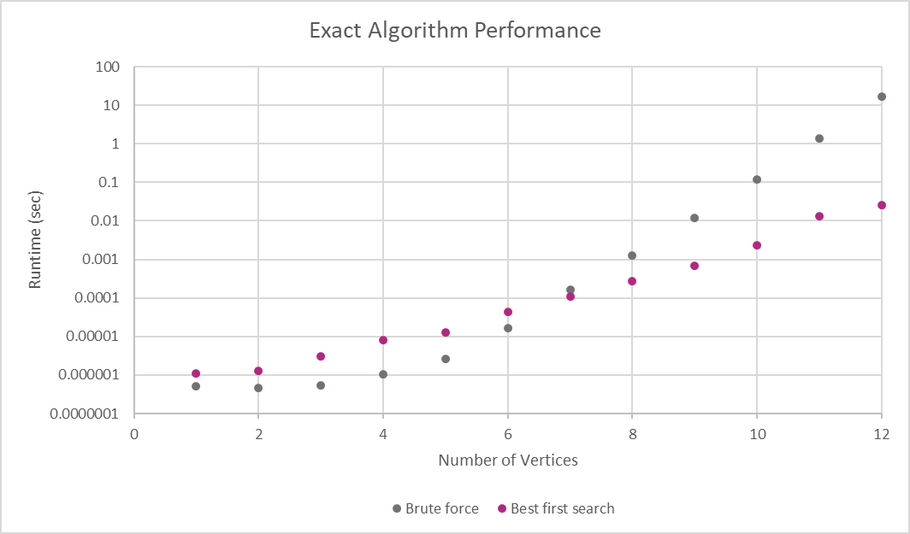
Introducing TSP | Brute force solution | Best first search | Nearest neighbor | Greedy heuristic | Time analysis
22
Scale is logarithmic:
Linear derivative on logarithmic scale is factorial growth.
Both algorithms exhibit factorial growth, but best first search has a much faster average case.
Brute force has smaller hidden constants than best first search.
Following this trend, brute force will take an hour at n = 14 and seven months for n = 17.

Slide 48
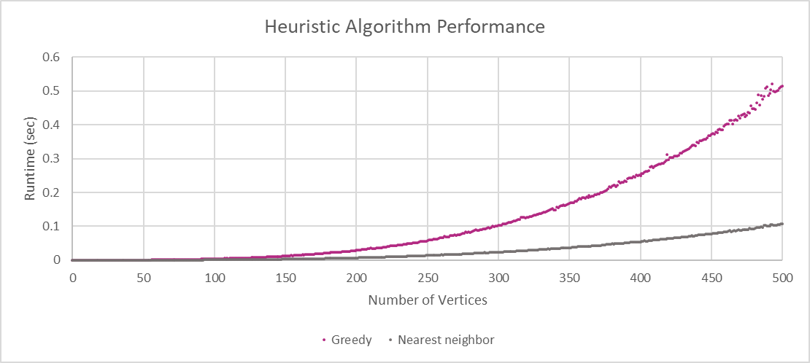
Introducing TSP | Brute force solution | Best first search | Nearest neighbor | Greedy heuristic | Time analysis
23

Slide 49
Introducing TSP | Brute force solution | Best first search | Nearest neighbor | Greedy heuristic | Time analysis
24
Greedy heuristic exhibits O(n³) growth.
Nearest neighbor exhibits O(n²) growth.
Both algorithms grow in polynomial time, with case 500 not even exceeding one second for either algorithm.
Each data point is the average runtime of running each algorithm on 100 different matrices.

Slide 50
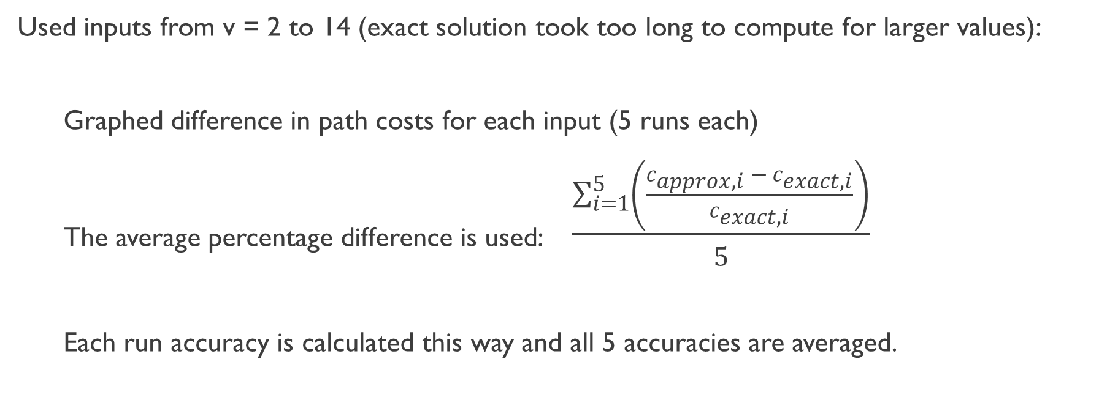
Experimental Plan
Introducing TSP | Brute force solution | Best first search | Nearest neighbor | Greedy heuristic | Time analysis
25
Used inputs from v = 2 to 14 (exact solution took too long to compute for larger values):
Graphed difference in path costs for each input (5 runs each)
The average percentage difference is used: $\frac{\sum_{i=1}^{5}{\left(\frac{c_{approx, i} − c_{exact, i}}{c_{exact, i}}\right)}}{5}$
Each run accuracy is calculated this way and all 5 accuracies are averaged.

Slide 51
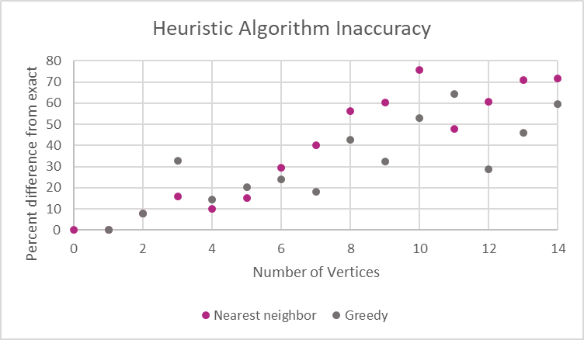
Introducing TSP | Brute force solution | Best first search | Nearest neighbor | Greedy heuristic | Time analysis
26
Vertices | Greedy Heuristic: Percent Inaccuracy | Nearest Neighbor: Percent Inaccuracy
2 | 7.733783 | 7.733783
3 | 16.05812 | 32.69521
4 | 10.03318 | 14.38517
5 | 15.3602 | 20.41894
6 | 29.34082 | 23.91451
7 | 40.15068 | 18.20282
8 | 56.16993 | 42.59132
9 | 60.47724 | 32.42706
10 | 75.92465 | 52.9159
11 | 47.72851 | 64.19722
12 | 60.59493 | 28.92176
13 | 70.90247 | 45.93449
14 | 71.59878 | 59.65423

Slide 52
Accuracy vs computation time tradeoff
Introducing TSP | Brute force solution | Best first search | Nearest neighbor | Greedy heuristic | Time analysis
27
On average, inaccuracies were higher for nearest neighbor.
Trend shows an increase in average inaccuracy as problem size increases, but the trend is not definitive.
At problem sizes larger than n = 14, even best first search will take very long to compute.
Despite reaching over 50% inaccuracy (cost of heuristic solution is 50% than optimal solution), having a solution for a large problem size is preferable.
At n > 20, any large inaccuracy is better than trying to solve for an exact solution that might take years for even the fastest computers to compute.

Slide 53
Limitations and Future work
Introducing TSP | Brute force solution | Best first search | Nearest neighbor | Greedy heuristic | Time analysis
28

Slide 54
Thank You
Introducing TSP | Brute force solution | Best first search | Nearest neighbor | Greedy heuristic | Time analysis
Contributions:
James:
Brute force algorithm
Greedy heuristic algorithm
Nearest neighbor algorithm
PowerPoint slides (both)
Melanie:
Best first search algorithm
Ran program and collected results
Graphed results
PowerPoint slides (both)
29

