Slide 1
Instructions
Contact: jamesongjingwen@u.nus.edu Number: +65 9116 8824

Slide 2
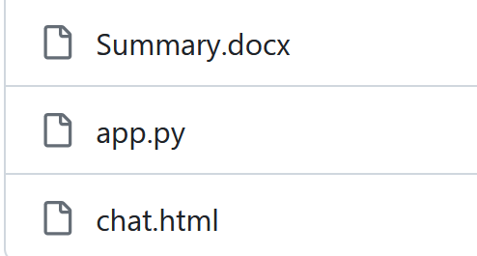
Download Files
There are 3 files in my repository. Summary.docx represents the unstructured dataset about my background. app.py represents the python codes. chat.html represents the html codes.
Please download them.

Slide 3
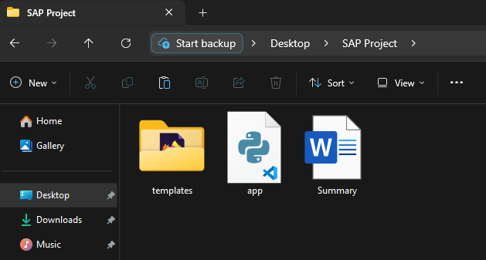
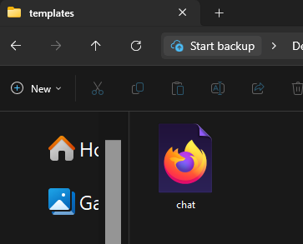
Save the files
Please create a folder and name it ‘SAP Project’. Save ‘app.py’ and ‘Summary.docx’ under ‘SAP Project’ folder.
Create another folder and name it ‘templates’ under ‘SAP Project’ folder. Save ‘chat.html’ under ‘templates’ folder.

Slide 4
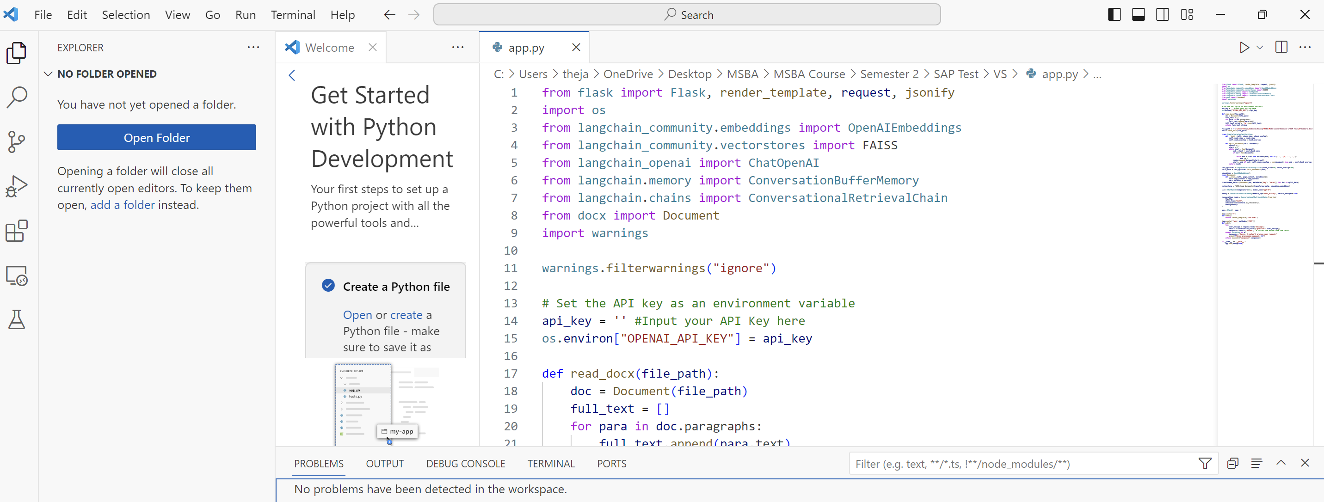
Use Visual Studio Code
Use Visual Studio Code and open ‘app.py’. You can do this by File > Open File > SAP Project > app.py

Slide 5
Key in your OpenAI API
As individual APIs are confidential to share, I did not put it in my codes.
Therefore, you will need to put in your own OpenAI API key in the code <api_key = ‘’> Please contact me if yours do not work and I will send you my temporary API Key instead. My contact can be found on slide 1.

Slide 6
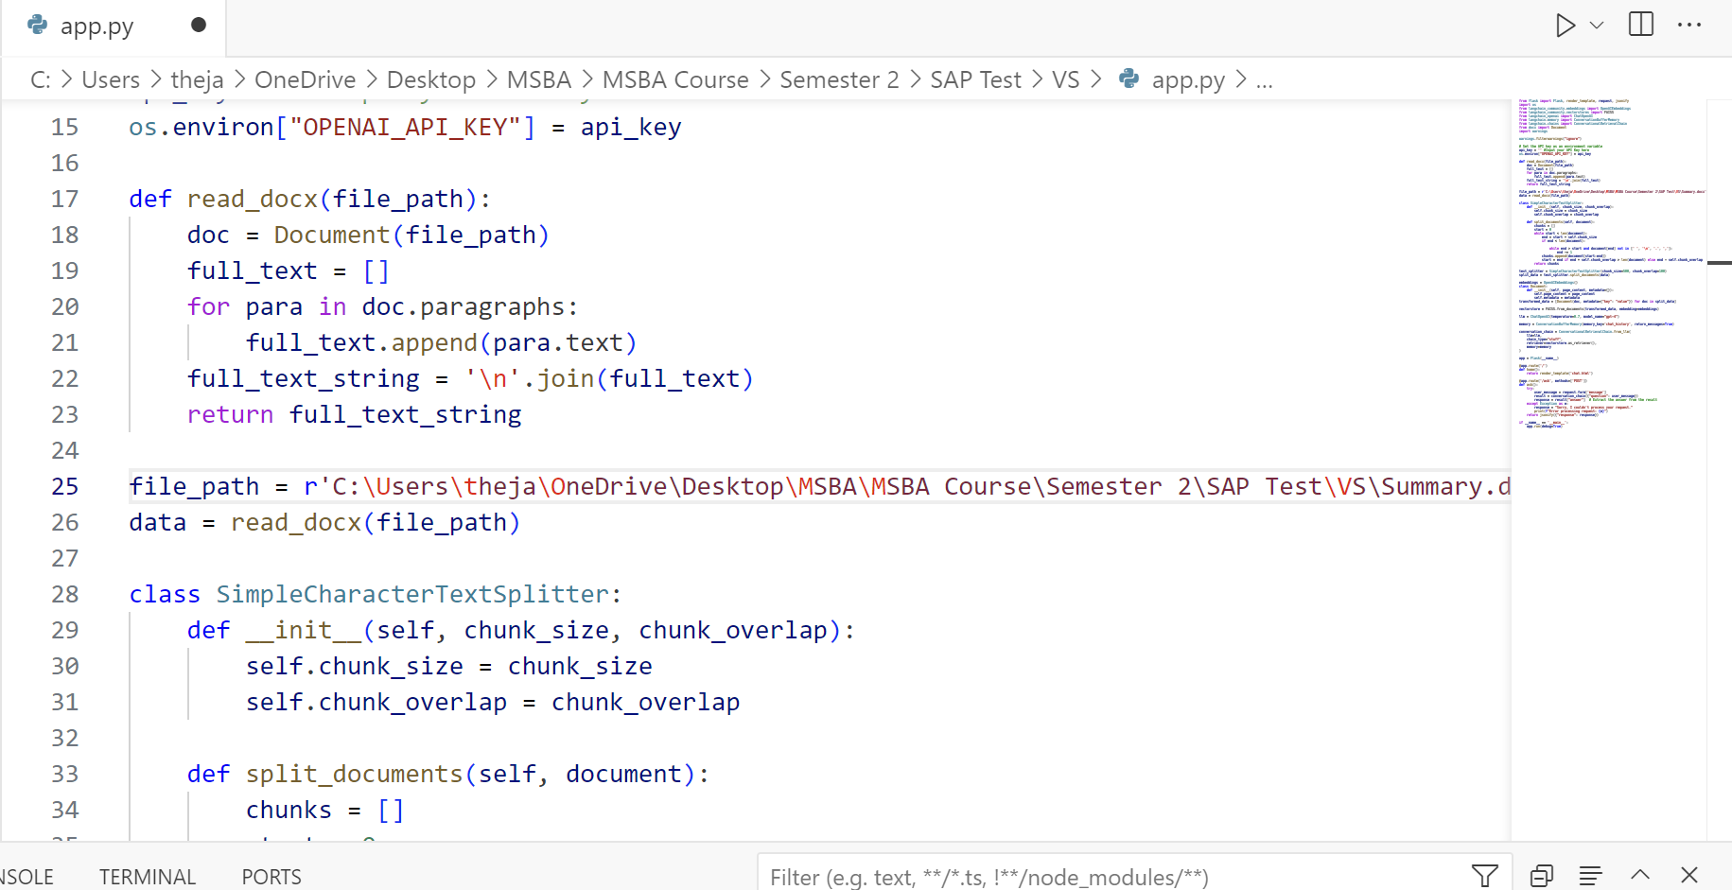
Change the data file directory in the code
This file_path will read your raw unstructured data that is saved under ‘Summary.docx’. Please change the directory to the directory that you saved the ‘Summary.docx’ at.

Slide 7
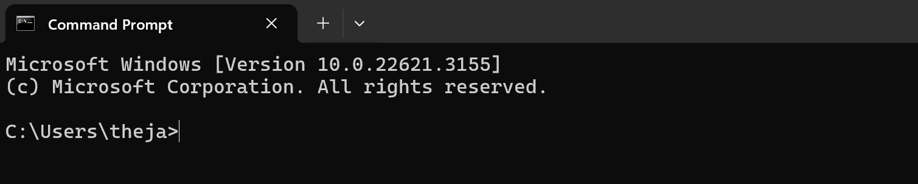
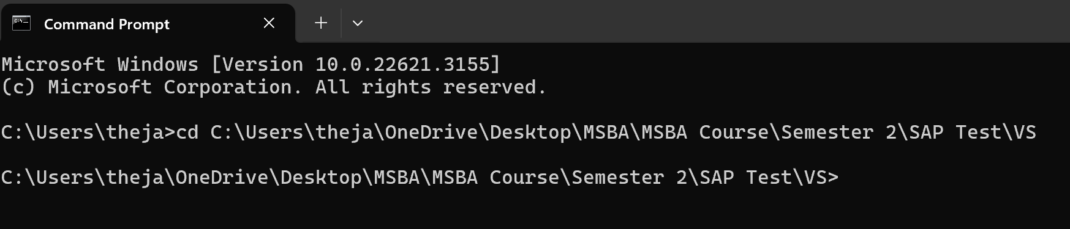
Run Command Prompt
Open your command prompt
Located where you saved your ‘app.py’. This can be done by right click ‘app.py’ > click properties > copy the directory under Locate. In my case is this: C:\Users\theja\OneDrive\Desktop\MSBA\MSBA Course\Semester 2\SAP Test\VS Go back to command prompt and type cd and C:\Users\theja\OneDrive\Desktop\MSBA\MSBA Course\Semester 2\SAP Test\VS cd C:\Users\theja\OneDrive\Desktop\MSBA\MSBA Course\Semester 2\SAP Test\VS

Slide 8
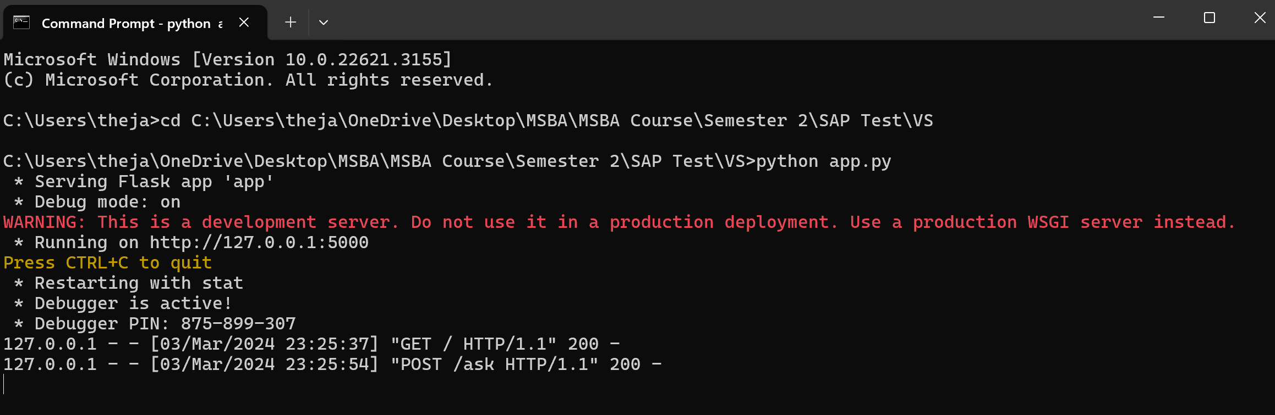
Get your local server link
Next, type python app.py on the command prompt. A local server link should appear. In this case, mine is http://127.0.0.1:5000/ Ctrl+click on the local server link and it should redirect you to a web address page that showcase the interface.

Slide 9
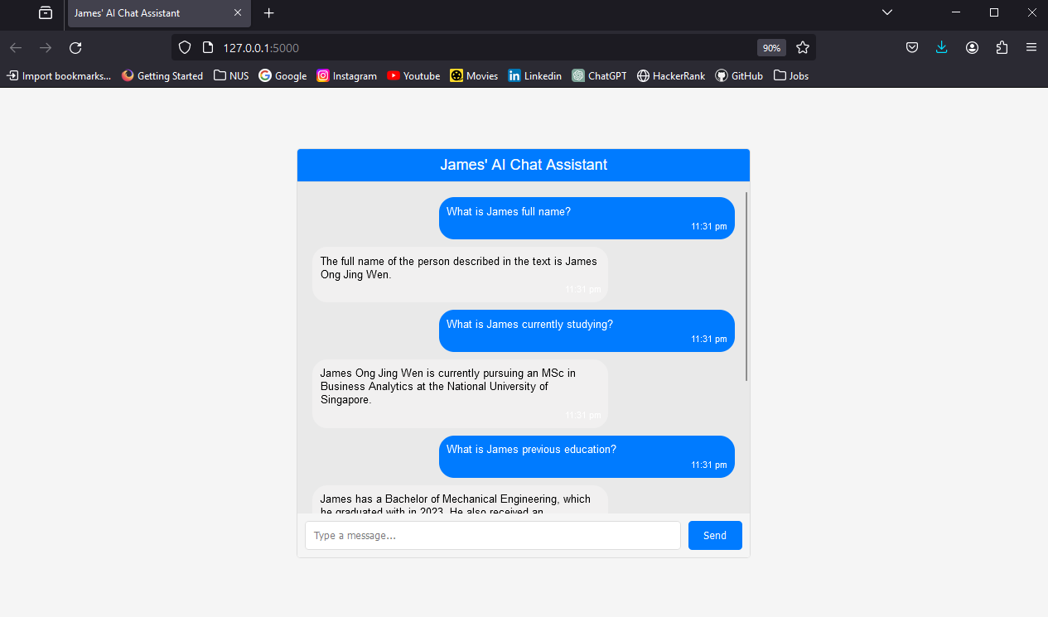
Interface
This is a screenshot of the chat interface where users can enter prompts and the chat bot will provide responses based on my background.

