Slide 1
Global Product Sales Analysis
Early Sales Performance Review
JO
April 2025

Slide 2
Objective
Validate product sales data integrity.
Explore sales performance by outreach method.
Define a key business metric.
Deliver actionable recommendations.

Slide 3
Data Validation Summary
15,000 records, 8 fields verified.
Minor corrections in 'sales_method' labels.
~7% missing revenue handled separately.
No anomalies detected.

Slide 4
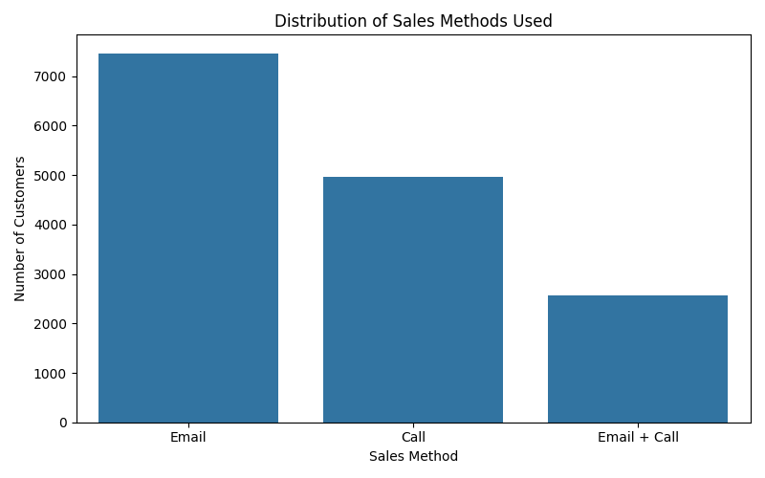
Sales Method Overview
Email and Call most frequent.
Email + Call underutilized but important.

Slide 5
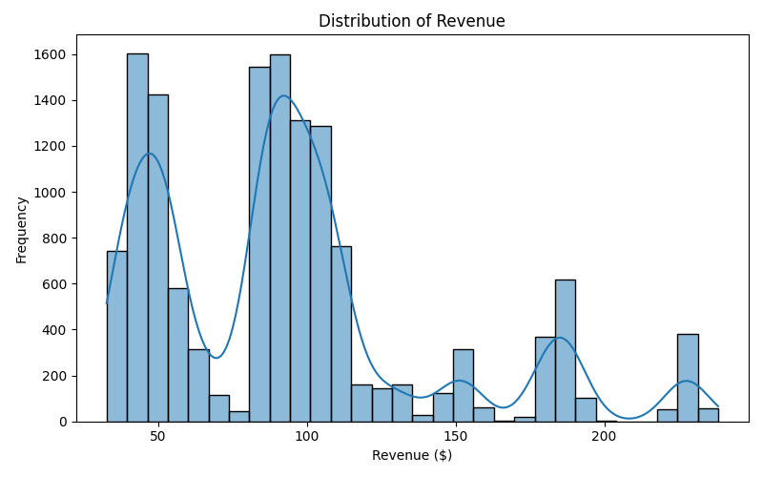
Revenue Distribution
Revenue clusters: $250-$350 and $450-$550.
Few high-value transactions observed.

Slide 6
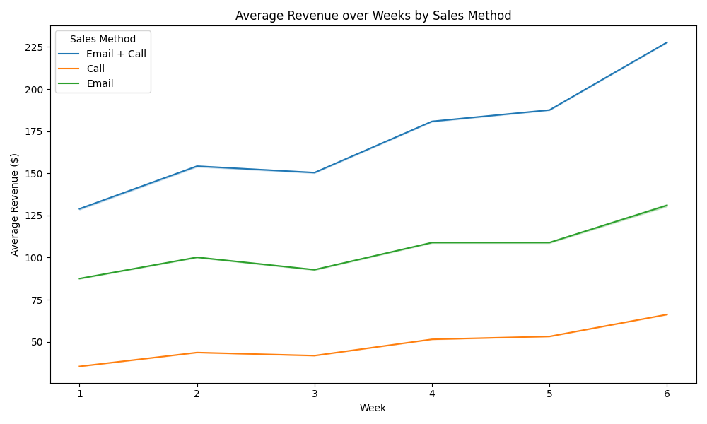
Revenue Trends Over Time
Email + Call achieved higher revenue consistently.
Call-only stronger than Email-only after Week 2.

Slide 7
Key Metric: ARPC
Definition: Total revenue / number of customers.
Overall ARPC: $93.93.
Easy-to-track KPI for customer value.

Slide 8
ARPC by Sales Method
Call: $47.60
Email: $97.13
Email + Call: $183.65
Email + Call strategy most effective.

Slide 9
Insights & Recommendations
Prioritize Email + Call outreach.
Enhance standalone call strategies.
Track ARPC monthly as a KPI.
Further explore customer segmentation.

Slide 10
Thank You!
Open for Questions

