Slide 1

Final Project Azure Logic Apps
Adair, James
Deep Azure@McKesson
Dr. Zoran B. Djordjević

Slide 2
Overview
The problem statement
What is Logic Apps
A demo
Summary

Slide 3
Problem Statement
Investors need access to current, up-to-date data in order perform their own ‘fundamental’ analysis.
The challenge is how can we automate a process of capturing the various kinds of data that investors need, making it available in their own database, for example.
I’ll provide one solution to address this challenge using Azure Logic Apps as an automation tool.

Slide 4
What are Logic Apps
A serverless workflow engine in the cloud
Has personal task integration capabilities like those found in IFTTT, Zapier and Microsoft Flow
Has enterprise application integration capabilities similar to Microsoft BizTalk
Connect, integrate, orchestrate applications and services with a visual designer
Explore the building blocks
Workflow
Triggers
Actions
Connectors

Slide 5
Logic App building blocks - Workflow
Workflow – a container or unit of serverless work
The Logic Apps designer provides a graphical tool to compose a workflow application comprised of a trigger and actions that can be selected from a large gallery of connectors.
The designer provides for rich control flow mechanisms like conditions, switches, for each loops and nesting to build the workflow application.
The designer also provides for implementing error and exception handling as well as a monitor of triggers and workflows and their execution status.
A Logic Apps application is an Azure resource of type, ‘Microsoft.Logic/workflows’ defined with a JSON schema where we define the steps for how the workflow is executed.

Slide 6
Logic App building blocks - Triggers
Triggers – the event bootstrap that gets us going
When an event notification is received for the specified trigger, the trigger fires and an instance of the Logic App is run. Also supports conditions for whether or not the Logic App runs or not.
Polling triggers - check for arrival of data
Recurrence - Fires based on defined schedule (like cron)
HTTP - makes an outgoing request to HTTP endpoint
ApiConnection – works like an HTTP trigger but uses Microsoft-managed APIs.
E.g. - ‘File Updated’ trigger in the FTP connector
E.g. - ‘Email arrived’ trigger in the Office Outlook 365 connector
Push triggers - responds to arrival of data
Request - makes the logic app an HTTP endpoint that can be called
HTTPWebhook – subscribes to service endpoint, registering a callback URL
ApiConnectionWebhook – works like HTTPWebhook but uses Microsoft-managed APIs

Slide 7
Logic App building blocks – Actions
Standard actions
HTTP - makes an outgoing request to HTTP endpoint
ApiConnection – works like an HTTP action but uses Microsoft-managed APIs
ApiConnectionWebhook – works like an HTTPWebhook
Response – defines response for an incoming call initiated on HTTP trigger
Function – an Azure function
Wait – waits fixed amount of time or until a specified time
Workflow – a nested workflow
Compose – constructs arbitrary object from action’s inputs
Query – filters an array based on a condition
Select – projects array elements into new values
Table – converts items array into CSV or HTML table
Terminate – stops the running workflow

Slide 8
Logic App building blocks – Actions(2)
Collection actions
Condition – runs a branch based on result of evaluating an expression
Scope – group other actions
ForEach - perform actions on each iteration of an array
Until - perform actions on each iteration of an array until a condition is ‘true’

Slide 9
Logic App building blocks – Connectors
Connectors – application connectivity galore!
Connectors are the proxies or wrappers around OpenAPI (Swagger) implementations of triggers and actions. Some have shared access with Microsoft Flow and PowerApps.
Connector Gallery - Azure provides over a 125 SaaS connectors that we can choose from to build our Logic App.
https://docs.microsoft.com/en-us/azure/connectors/apis-list
Built-in Action Connectors – built into the workflow engine
HTTP
Functions (those implemented as Generic WebHook functions)
Data Operations
Variables
etc.

Slide 10
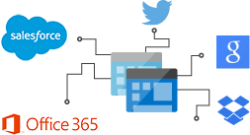
Logic App building blocks – Connectors(2)
Managed Connectors – API connections
Standard – automatically available access to Service Bus, Blob Storage, etc.
On-premises – uses gateway for access to SharePoint, SQL Server, Oracle, etc.
Integration account (EIP)– messaging with AS2/X12/EDIFACT/XML, etc.
Enterprise - MQ, SAP, etc.

Slide 11
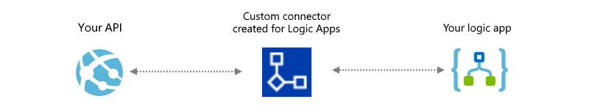
Logic App building blocks – Connectors(3)
Custom Connectors – create your own API connector
Expand the reach of your API
Supports OpenAPI 2.0 spec and Swagger JSON format
Enables integration with Microsoft Flow, PowerApps and Logic Apps
Option to host in Azure App Services
Submit for certification – validates functionality of connector
https://docs.microsoft.com/en-us/azure/logic-apps/logic-apps-create-api-app
https://docs.microsoft.com/en-us/azure/logic-apps/custom-connector-overview

Slide 12
Logic App building blocks – Code View
Behind the scenes - the essence of workflow!
The Logic Apps Designer is an effective visual tool but you also have the option and sometimes necessity, to compose directly in the workflow code, accessible in the Code View.
Workflow Definition Schema
The workflow definition is a JSON document which contains the actual logic that executes as part of the logic app.
Contains 1 or more triggers and 1 or more actions
Basic workflow
{
"$schema": "<schema-of the-definition>",
"contentVersion": "<version-number-of-definition>",
"parameters": { <parameter-definitions-of-definition> },
"triggers": [ { <definition-of-flow-triggers> } ],
"actions": [ { <definition-of-flow-actions> } ],
"outputs": { <output-of-definition> }
}

Slide 13
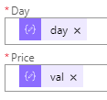
Logic App building blocks – Code View(2)
Workflow Definition Language (WDL)
Made up of expressions, operators and functions
JSON values in the schema (definition) can be literal or expressions that are evaluated on execution of the application
For example:
"Insert_row": {
"inputs": {
"body": {
"Day": "@items('For_each_2')?['day']",
"Price": "@items('For_each_2')?['val']"
},
For more information:
https://docs.microsoft.com/en-us/azure/logic-apps/logic-apps-workflow-definition-language

Slide 14
Logic Apps - Pricing
Pricing
Every time a Logic App definition runs a trigger, action and connector executions are metered
Price Per Execution
Actions $0.000025
Standard Connector $0.000125
Enterprise Connector $0.001
Data retention: $0.12 GB/month
Alternatively, for Logic Apps Enterprise Integration Pack (EIP), an integration account enables customers to take advantage of Logic Apps B2B/EDI and XML processing capabilities
https://azure.microsoft.com/en-us/pricing/details/logic-apps/

Slide 15
Solution Demo
Logic Apps:
1- Capture daily crude oil and natural gas prices
from the Energy Information Administration.
2- Transform JSON representation for easier use.
3- Import data into SQL server database.
4- Visualize some graphs of our data using R/RStudio
Data Sets:
1-Europe Brent Spot Price FOB, Daily ($/barrel) http://api.eia.gov/series/?api_key=YOUR_API_KEY_HERE&series_id=PET.RBRTE.D
2-Henry Hub Natural Gas Spot Price, Daily ($/Million BTUs)
http://api.eia.gov/series/?api_key=YOUR_API_KEY_HERE&series_id=NG.RNGWHHD.D

Slide 16
Azure Function - JSON Transformation
{"request":
{"command":"series",
"series_id":"PET.RBRTE.D"},
"series":[{
"series_id":"PET.RBRTE.D",
"name":"Europe Brent Spot Price FOB, Daily",
"units":"Dollars per Barrel",
"f":"D",
"unitsshort":
"$\/bbl",
"description":"Europe Brent Spot Price FOB",
"copyright":"Thomson-Reuters",
"source":"Thomson-Reuters",
"start":"19870520",
"end":"20180122",
"updated":"2018-01-24T13:22:12-0500",
"data": [
["20180122“, 69.32],
["20180119", 68.56]
]
}]
}
{
"series_id":"PET.RBRTE.D",
"name":"Europe Brent Spot Price FOB, Daily",
"units":"Dollars per Barrel",
"f":"D",
"unitsshort":
"$\/bbl",
"description":"Europe Brent Spot Price FOB",
"copyright":"Thomson-Reuters",
"source":"Thomson-Reuters",
"start":"19870520",
"end":"20180122",
"updated":"2018-01-24T13:22:12-0500",
"data": [
{"day":20180122, "val":69.32},
{"day":20180119, "val":68.56}
]
}

Slide 17
SQL Server Data Objects
…
"data " :[
{"day":20180122, "val":69.32},
{"day":20180119, "val":68.56} ]
CREATE TABLE dbo.BrentPetroleumPrices
(
[Day] INT NOT NULL PRIMARY KEY,
[Price] MONEY NOT NULL
)
GO
CREATE PROCEDURE dbo. uspBatchInsertBrentPetroPrices
@jsonObject nvarchar(max)
AS
BEGIN
set NOCOUNT ON;
INSERT INTO dbo.brentPetroleumPrices([day],price)
SELECT [day],price
FROM OPENJSON (@jsonObject, '$.data' )
WITH (
day integer '$.day',
price money '$.val'
)
END
GO

Slide 18
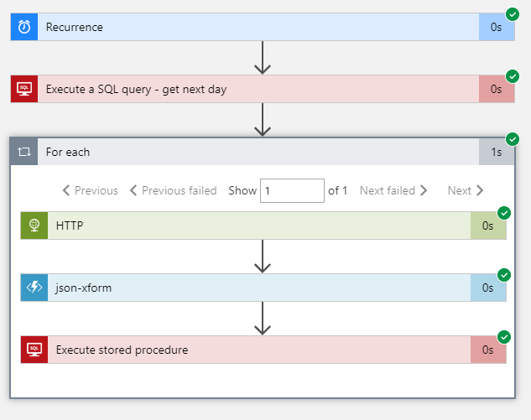
Logic App in Action

Slide 19
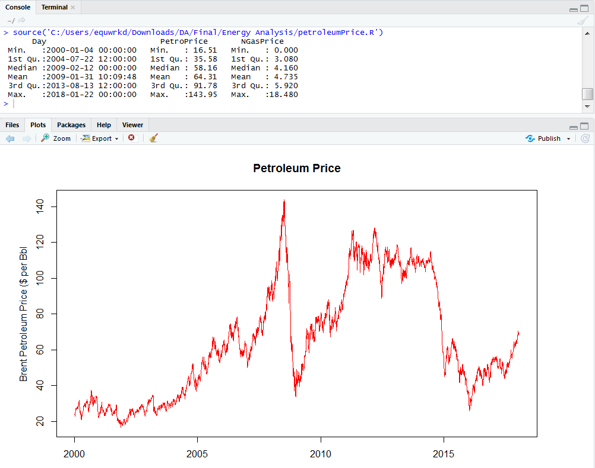
Petroleum Prices

Slide 20
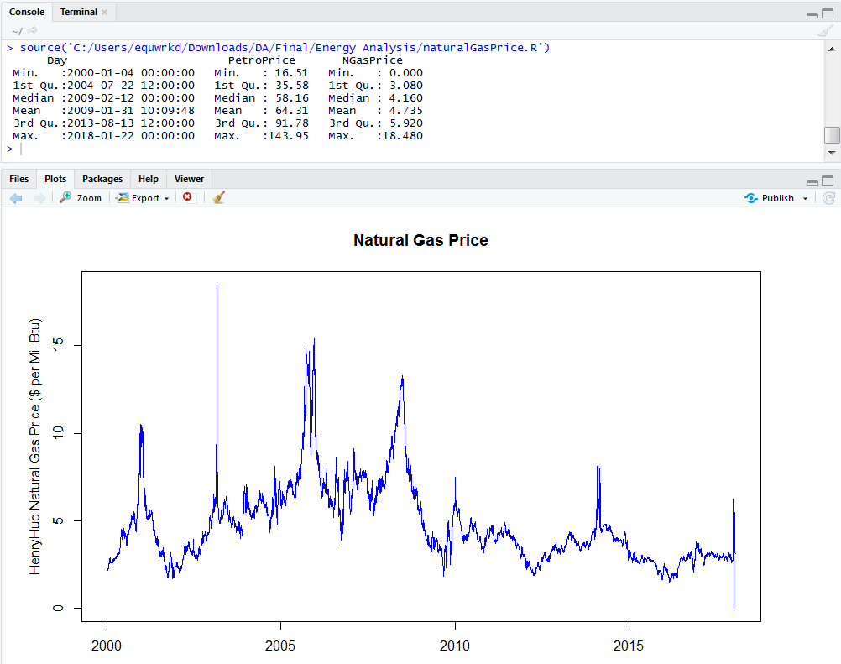
Natural Gas Prices

Slide 21
Petroleum and Natural Gas Price Comparison
The conventional wisdom gained by the energy experts is that crude oil and natural gas price correlation can be divided into a pre-shale and shale eras with the widespread use of fracking techniques used to extract oil and gas from sedimentary rock.
In the pre-shale period, gas price movement generally followed crude oil because gas extraction was a by-product of crude oil extraction where crude oil is a well-established global commodity. Natural gas fracking extraction opened new regional markets with independent price supply and demand factors that cause its price to vary differently than crude oil.
 | Correlation coefficient | My analysis
1997-2008 (pre-shale) | 0.9 | correlation= 0.7206092[1] " " Day PetroPrice NGasPrice Min. :2000-01-04 00:00:00 Min. : 16.51 Min. : 1.690 1st Qu.:2002-04-03 00:00:00 1st Qu.: 27.53 1st Qu.: 4.400 Median :2004-07-01 00:00:00 Median : 37.11 Median : 5.910 Mean :2004-07-04 12:24:13 Mean : 48.34 Mean : 6.026 3rd Qu.:2006-10-10 00:00:00 3rd Qu.: 62.95 3rd Qu.: 7.220 Max. :2008-12-31 00:00:00 Max. :143.95 Max. :18.480
2009-present | 0.54 | correlation= 0.3768616[1] " " Day PetroPrice NGasPrice Min. :2009-01-02 00:00:00 Min. : 26.01 Min. :0.000 1st Qu.:2011-04-08 18:00:00 1st Qu.: 52.97 1st Qu.:2.840 Median :2013-07-24 12:00:00 Median : 77.28 Median :3.420 Mean :2013-07-19 15:24:43 Mean : 79.87 Mean :3.475 3rd Qu.:2015-10-28 18:00:00 3rd Qu.:108.51 3rd Qu.:4.070 Max. :2018-01-22 00:00:00 Max. :128.14 Max. :8.150

Slide 22
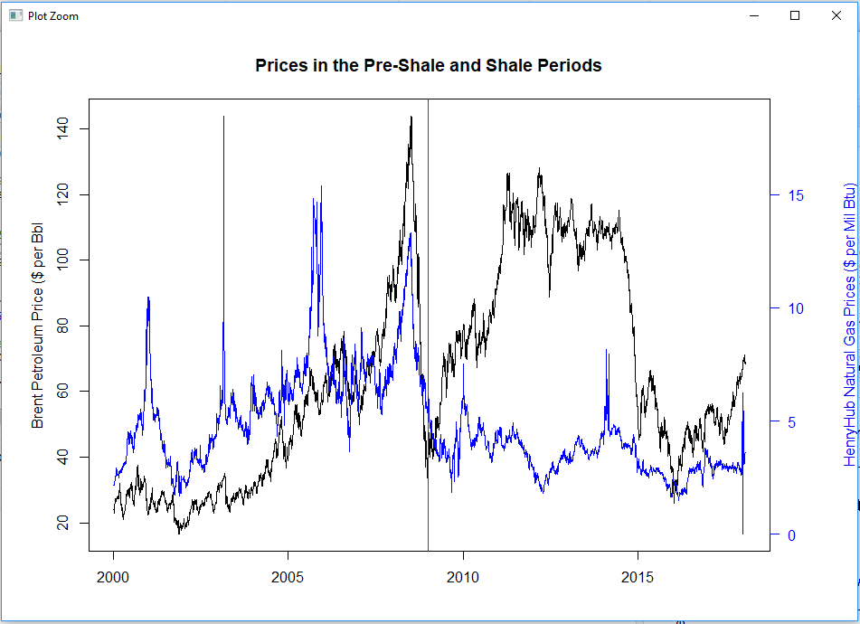
Petroleum and Natural Gas Prices

Slide 23
Summary
Lessons Learned:
You can cobble together Logic Apps with relative ease but consider all the design, cost and benefit options for achieving the same results.
The productivity gained with visual design, build and test lends itself to the need to continue refining processes.

Slide 24
YouTube URLs, GitHub URL, Last Page
Two minute (short):
https://youtu.be/9aivyGOm4HY
15 minutes (long):
https://youtu.be/b_1saRulwvU
GitHub Repository with all artifacts: https://github.com/jamespadair/deep_azure_final

