Slide 1


PYTHON
Therearemomentsinlifewhenyoumisssomeonesomuchthatyoujustwanttopickthemfromyourdreamsandhugthemforreal!
商業分析決策
輕鬆學系列

Slide 2
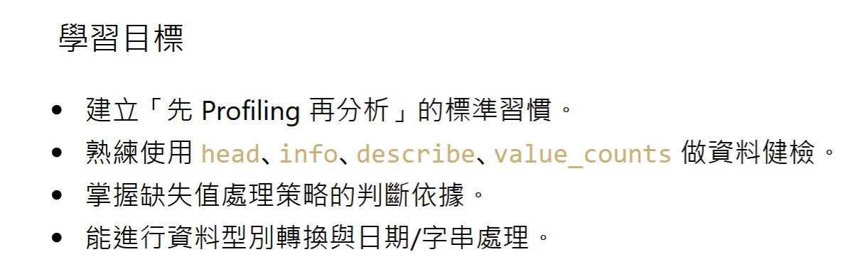

3

Slide 3
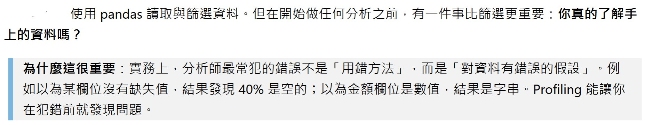
PYTHON
THEbeautifysimplelanguage

Slide 4

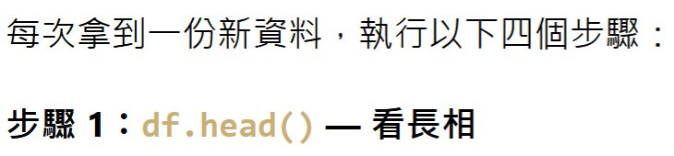

PYTHON
THEbeautifysimplelanguage

Slide 5
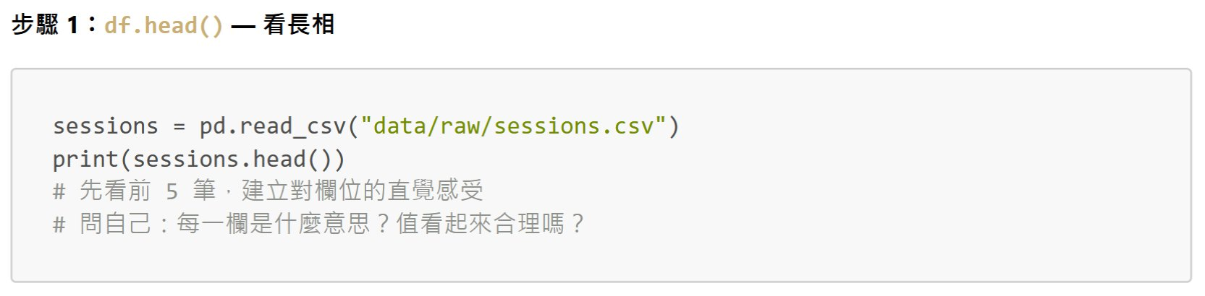
PYTHON
THEbeautifysimplelanguage

Slide 6
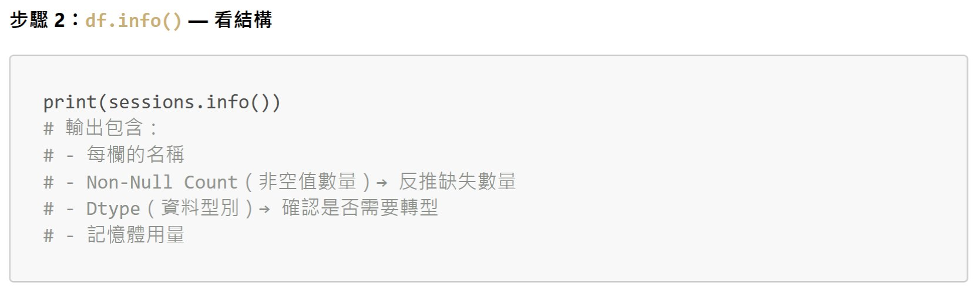
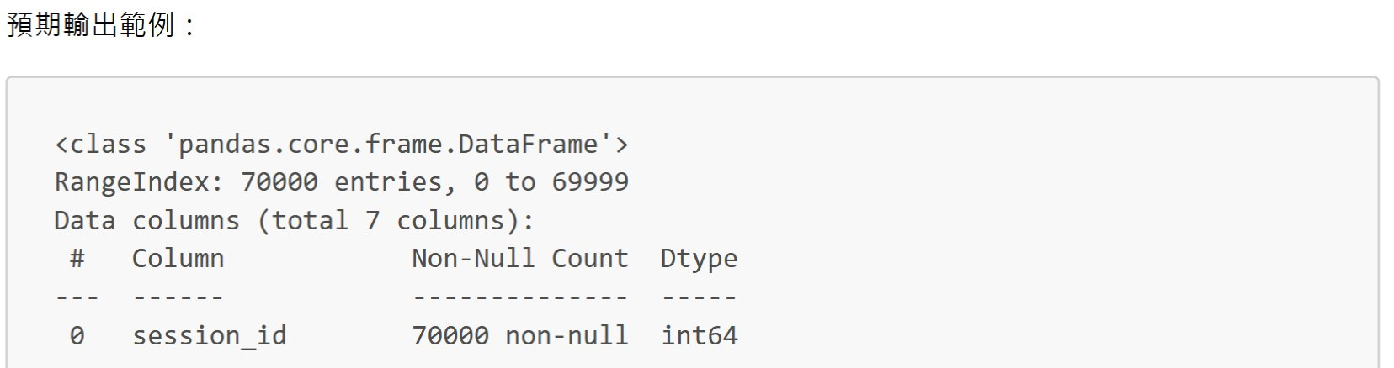
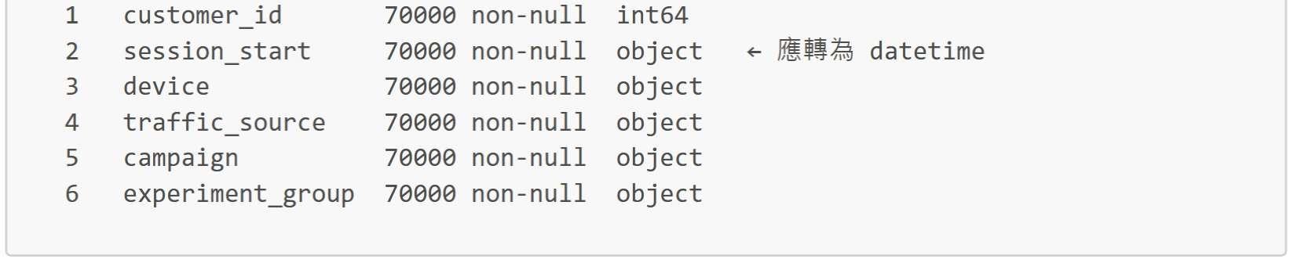
PYTHON
THEbeautifysimplelanguage

Slide 7
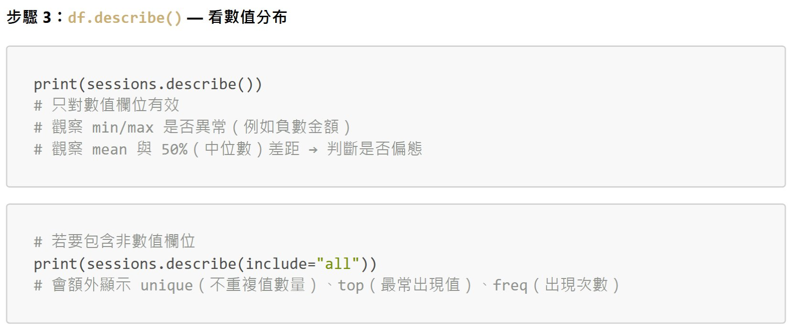
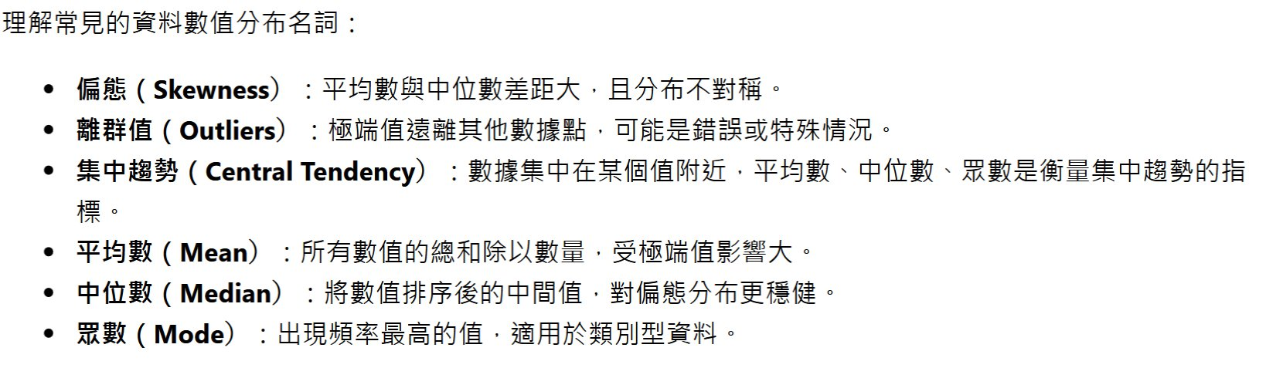
PYTHON
THEbeautifysimplelanguage

Slide 8
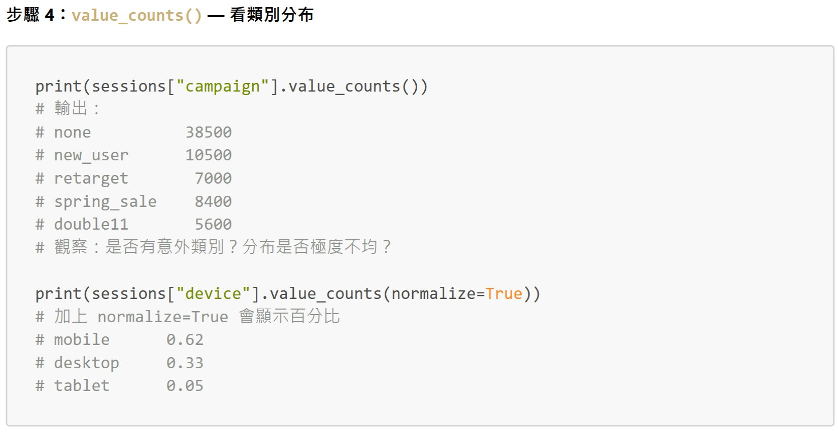
PYTHON
THEbeautifysimplelanguage

Slide 9
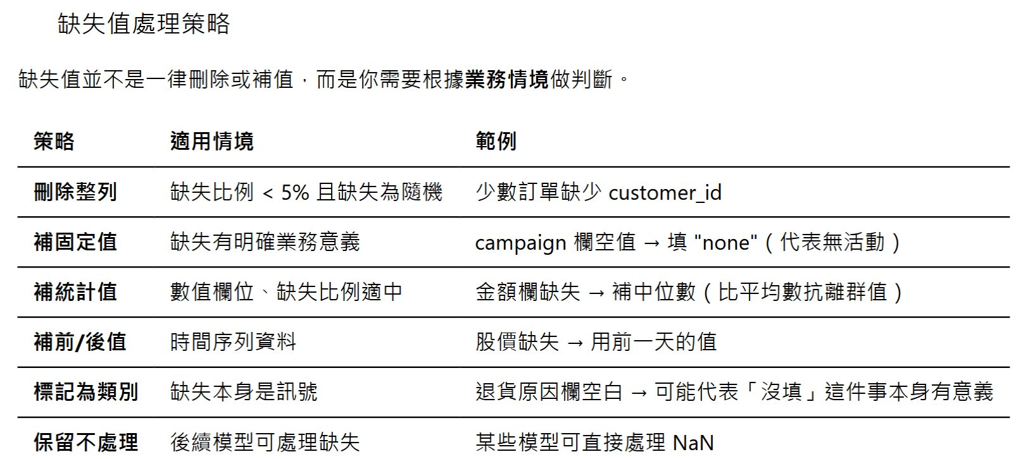
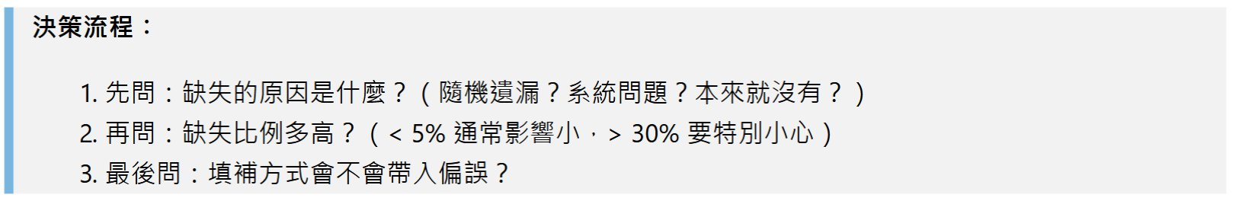
PYTHON
THEbeautifysimplelanguage

Slide 10
PYTHON
THEbeautifysimplelanguage

Slide 11
PYTHON
THEbeautifysimplelanguage

Slide 12
PYTHON
THEbeautifysimplelanguage

Slide 13
PYTHON
THEbeautifysimplelanguage

Slide 14
PYTHON
THEbeautifysimplelanguage

Slide 15
PYTHON
THEbeautifysimplelanguage

Slide 16
PYTHON
THEbeautifysimplelanguage

Slide 17
PYTHON
THEbeautifysimplelanguage

Slide 18
PYTHON
THEbeautifysimplelanguage

Slide 19
PYTHON
THEbeautifysimplelanguage

Slide 20
PYTHON
THEbeautifysimplelanguage

Slide 21
PYTHON
THEbeautifysimplelanguage

Slide 22
PYTHON
THEbeautifysimplelanguage

Slide 23
PYTHON
THEbeautifysimplelanguage

Slide 24
PYTHON
THEbeautifysimplelanguage

