Slide 1


PYTHON
Therearemomentsinlifewhenyoumisssomeonesomuchthatyoujustwanttopickthemfromyourdreamsandhugthemforreal!
商業分析決策
輕鬆學系列

Slide 2
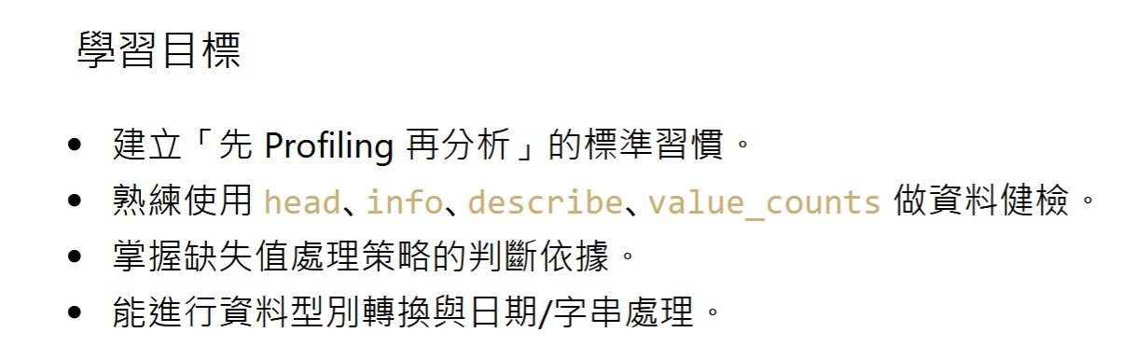

3

Slide 3
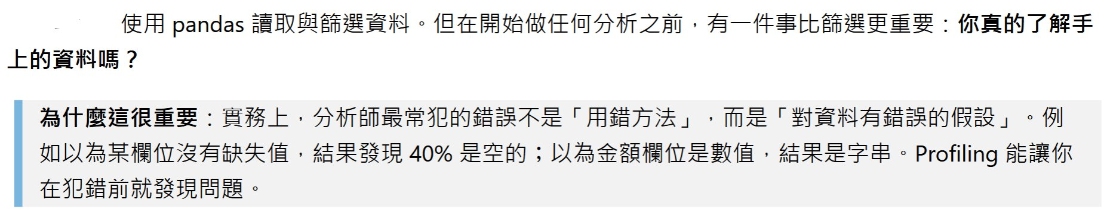
PYTHON
THEbeautifysimplelanguage

Slide 4

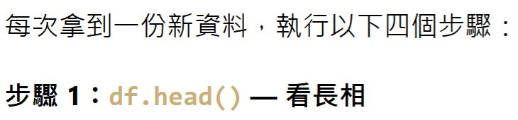

PYTHON
THEbeautifysimplelanguage

Slide 5
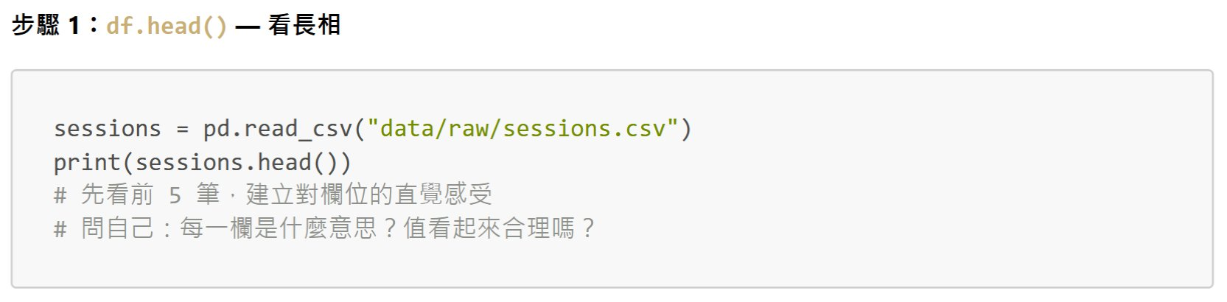
PYTHON
THEbeautifysimplelanguage

Slide 6
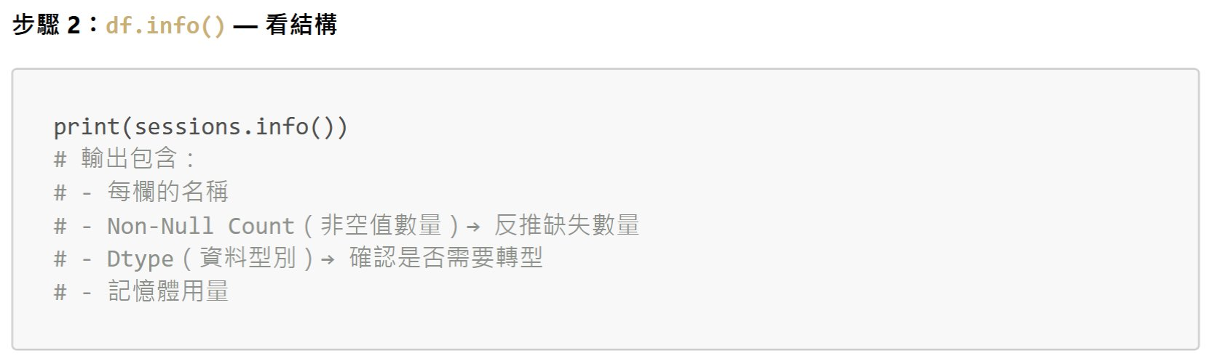
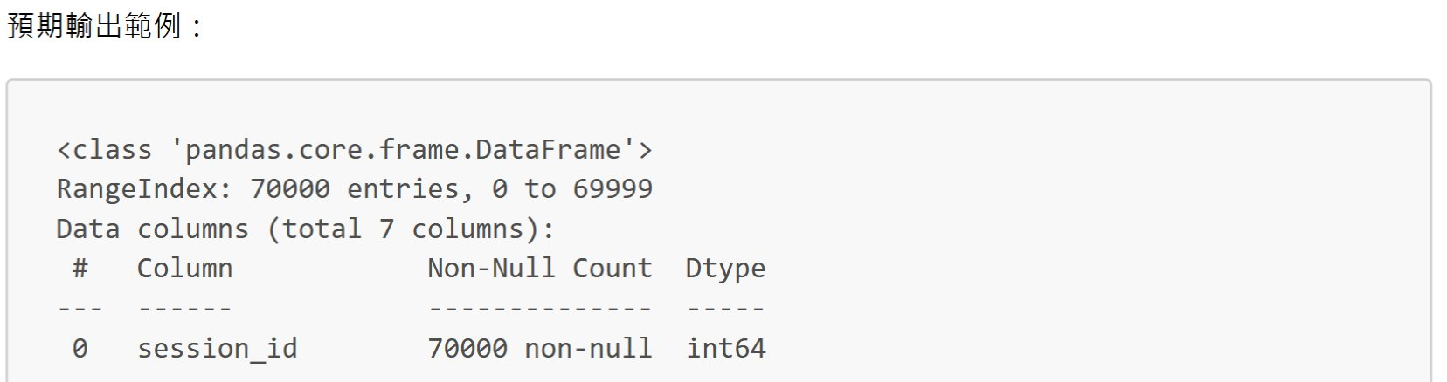
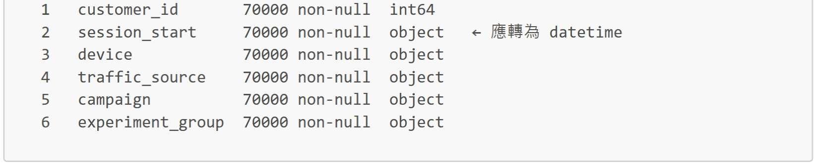
PYTHON
THEbeautifysimplelanguage

Slide 7
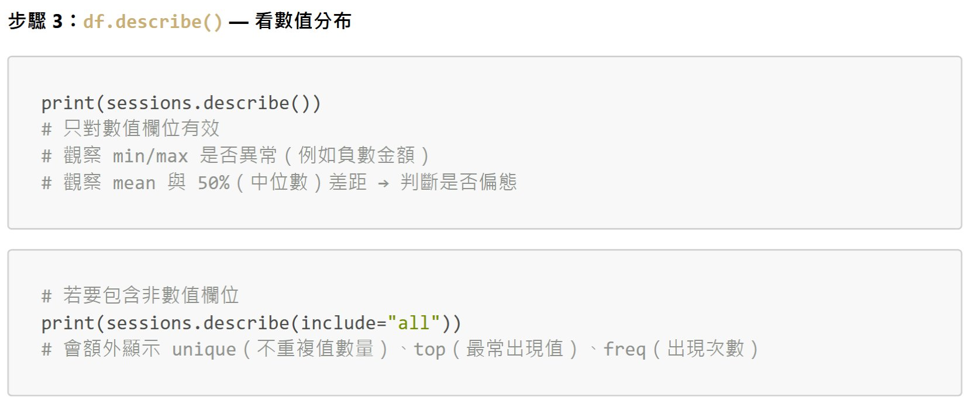
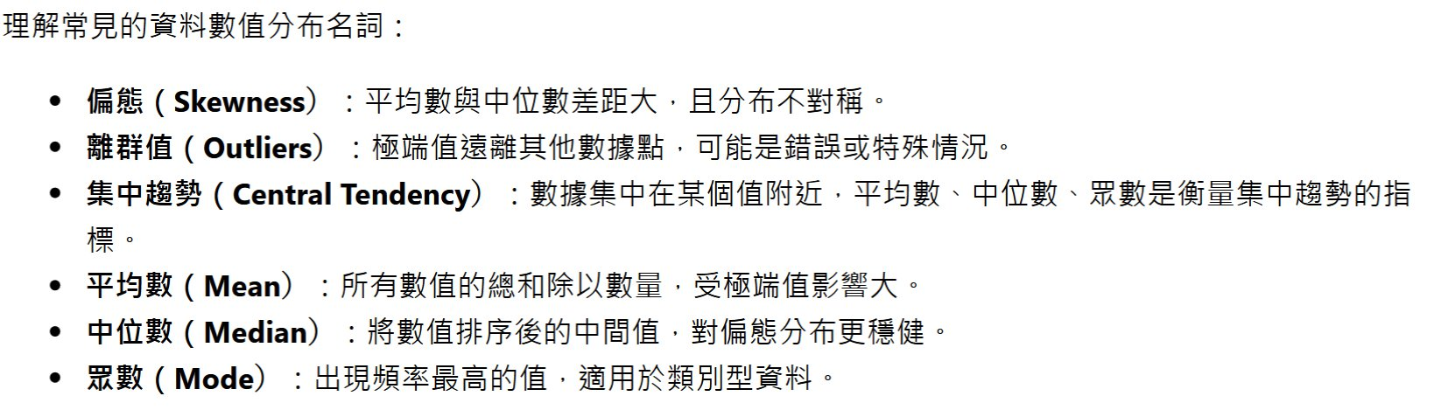
PYTHON
THEbeautifysimplelanguage

Slide 8
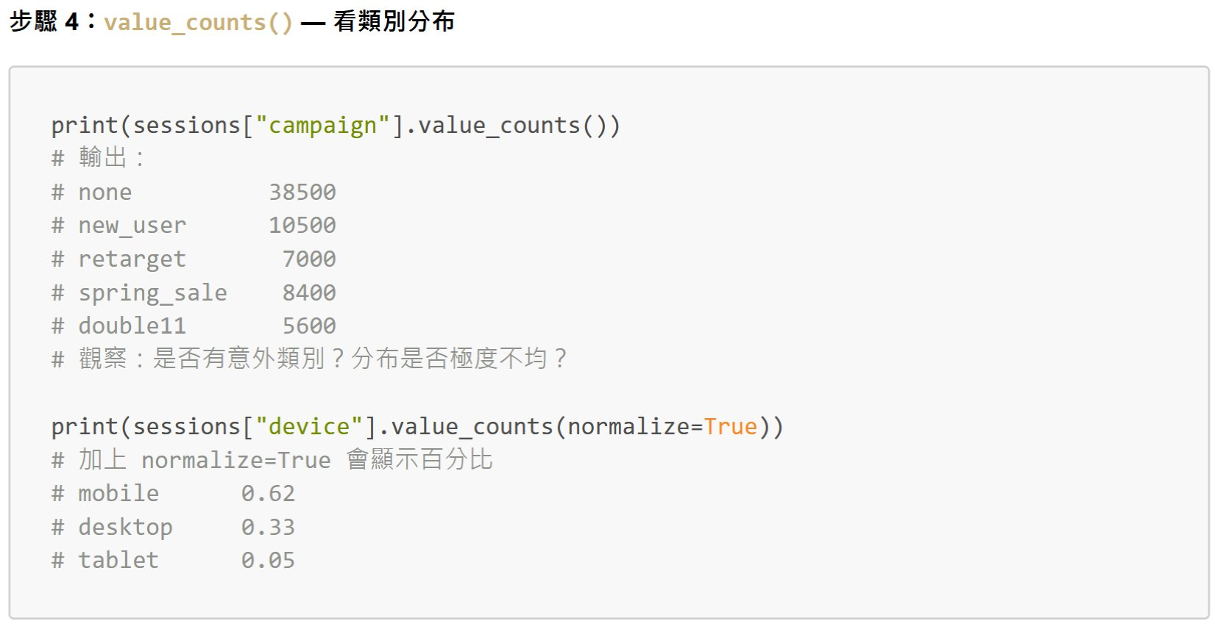
PYTHON
THEbeautifysimplelanguage

Slide 9
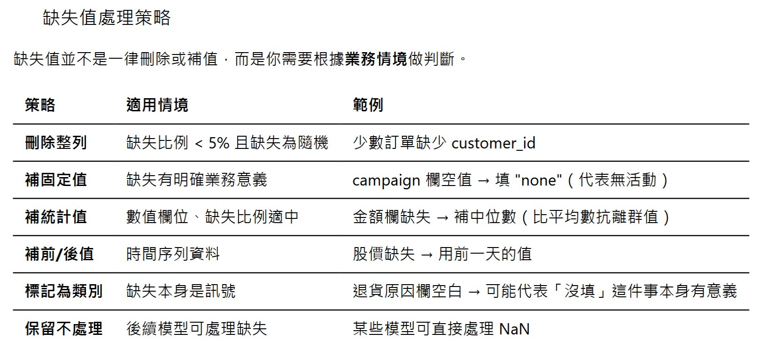
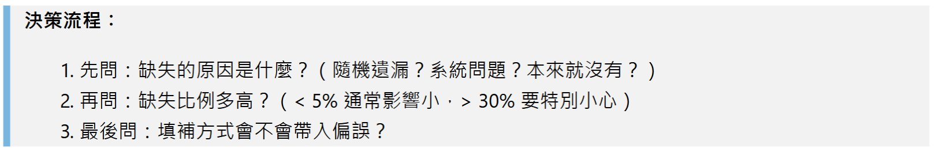
PYTHON
THEbeautifysimplelanguage

Slide 10
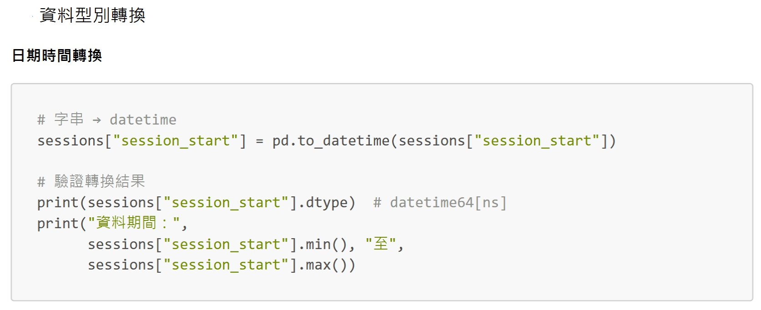
PYTHON
THEbeautifysimplelanguage

Slide 11
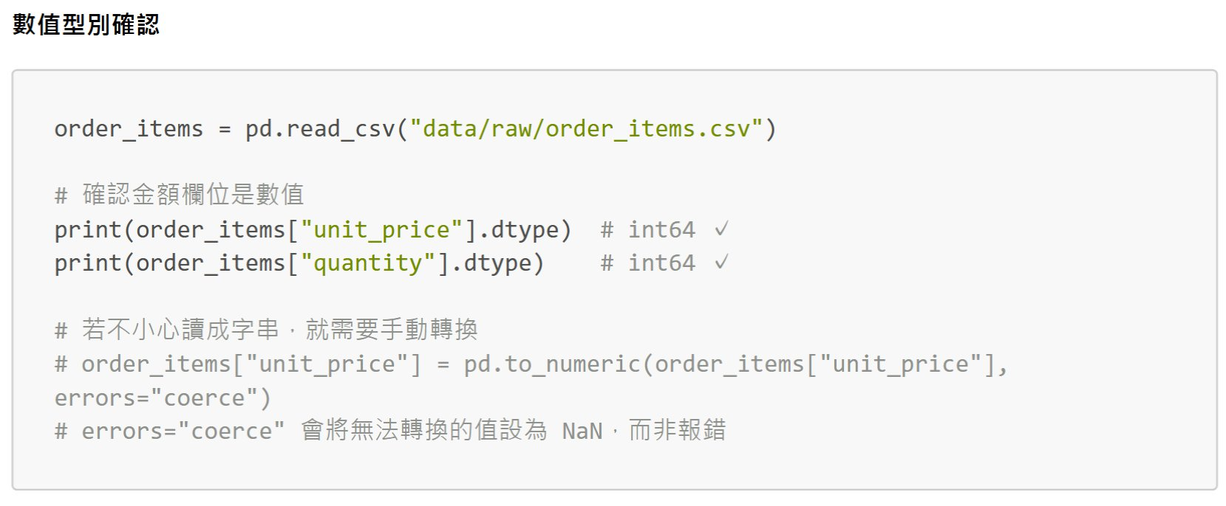
PYTHON
THEbeautifysimplelanguage

Slide 12
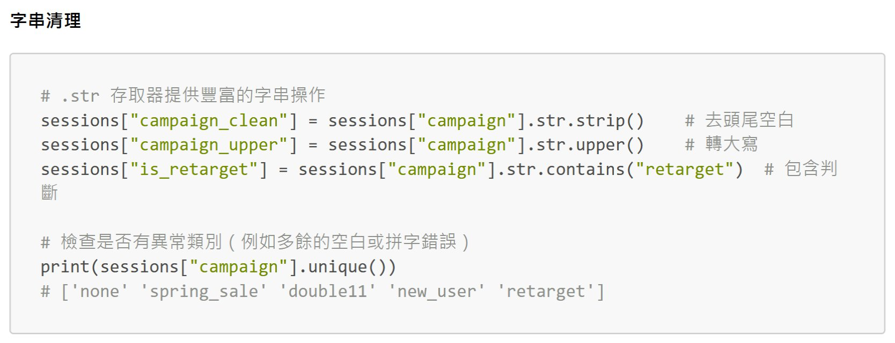
PYTHON
THEbeautifysimplelanguage

Slide 13

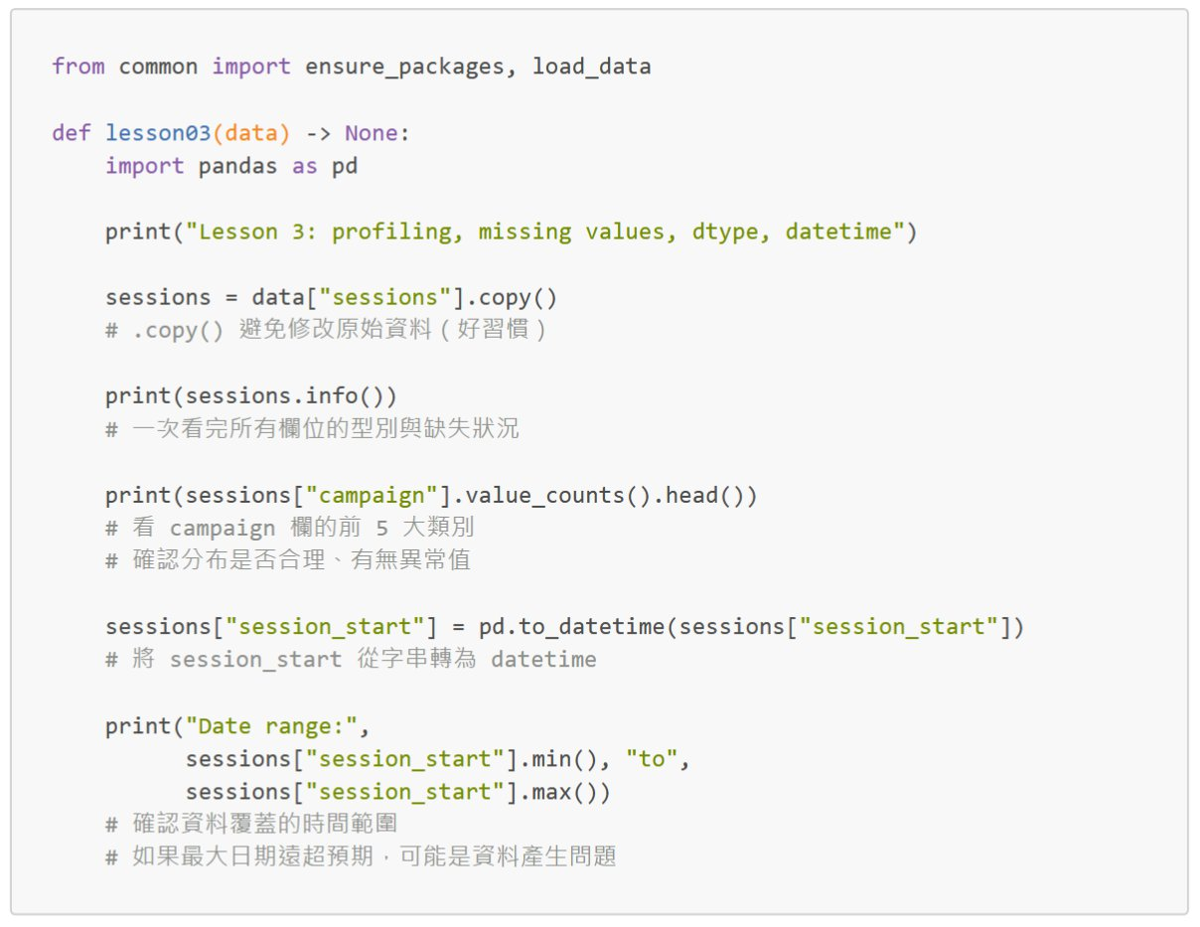
PYTHON
THEbeautifysimplelanguage
import pandas as pd
sessions=pd.read_csv(‘data/raw/sessions.csv’)
(sessions)
lesson03(sessions)

Slide 14
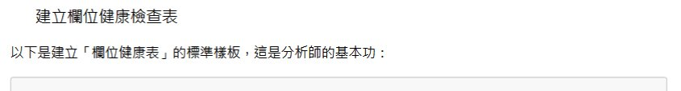
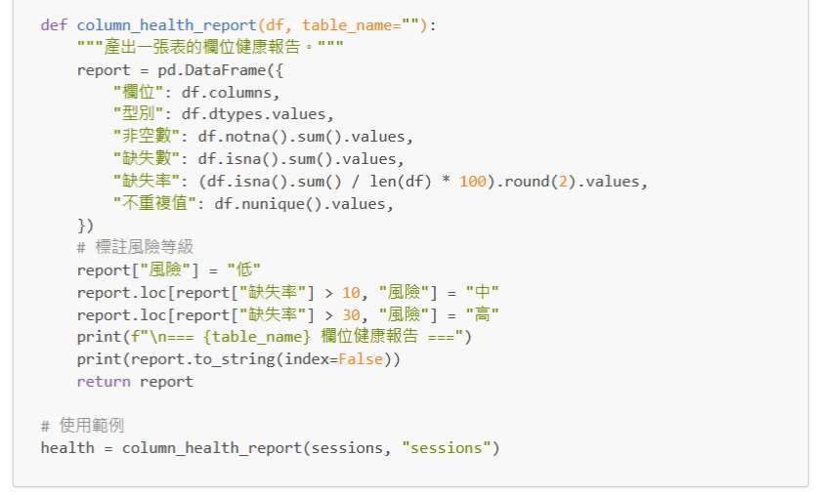
PYTHON
THEbeautifysimplelanguage

Slide 15
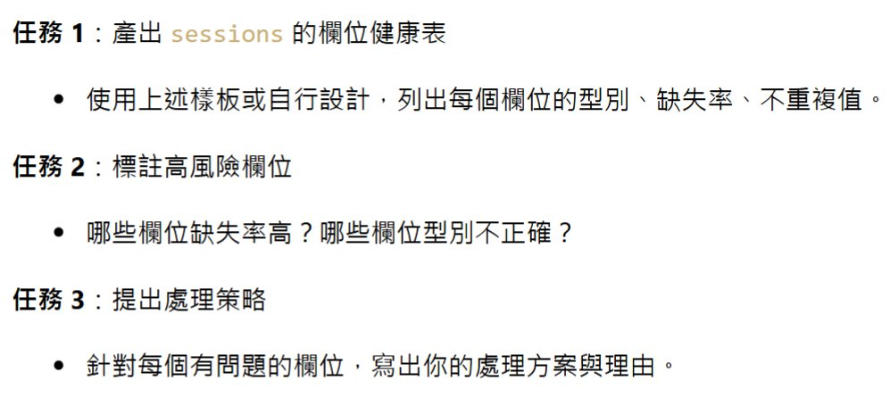
PYTHON
THEbeautifysimplelanguage

Slide 16
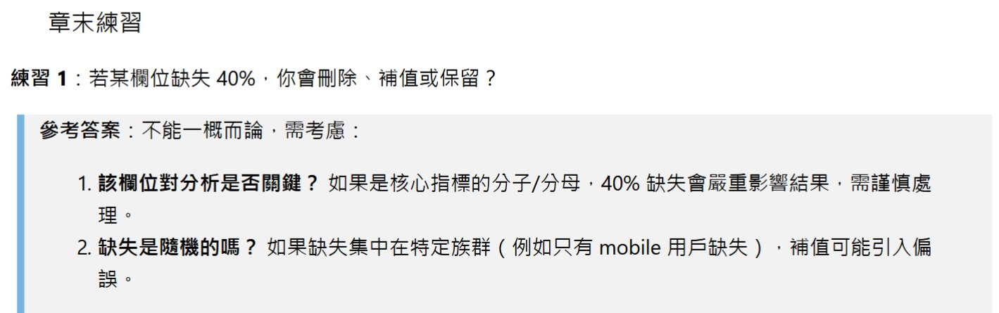
PYTHON
THEbeautifysimplelanguage

Slide 17

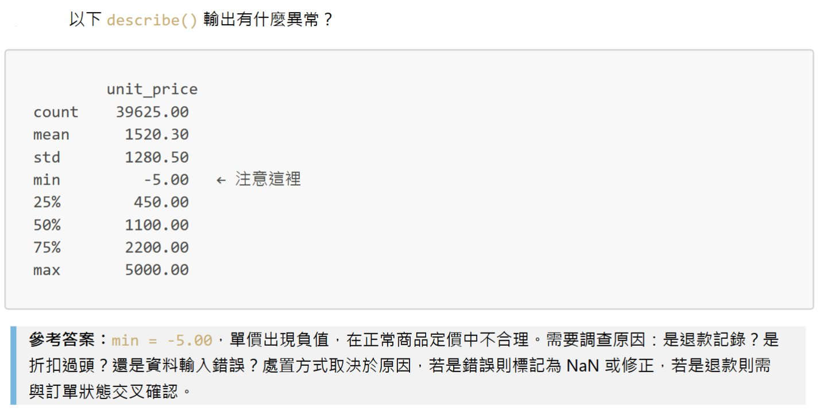
PYTHON
THEbeautifysimplelanguage

Slide 18
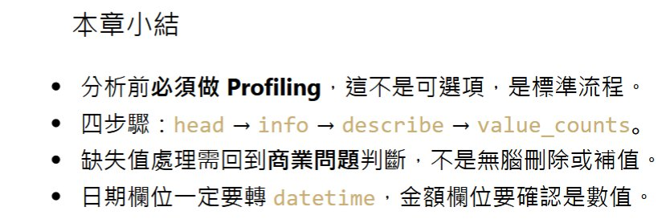
PYTHON
THEbeautifysimplelanguage

