Slide 1
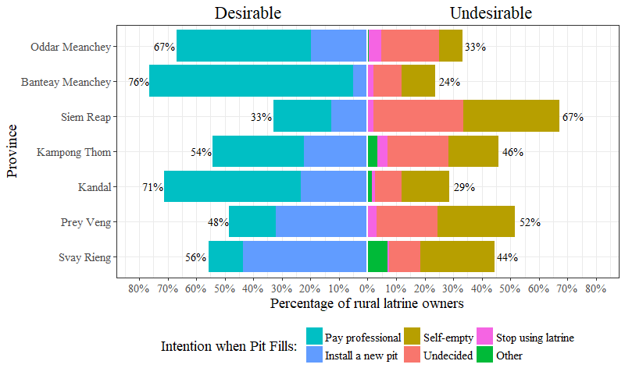
Multidimensional
Poverty Index
0.233
0.189
0.240
0.271
0.170
0.223
0.229

Slide 2
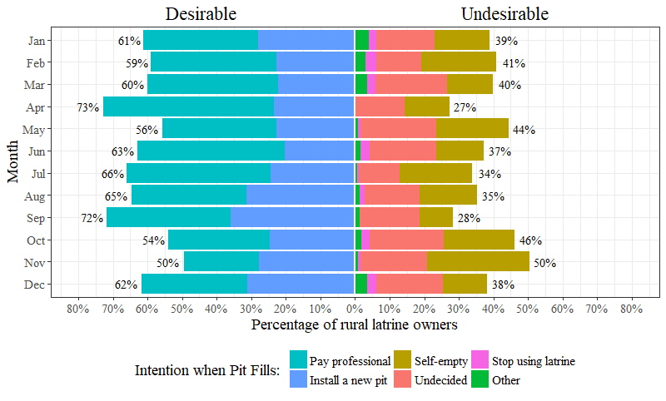

Average
Monthly
Rainfall
Rice Crops
Main 2nd
Sowing
Growing
Harvesting
≈ 50 mm of rain
Notes:
Switch in intentions from self-empty in 2015 to installing a new pit in 2017: increasing familiarity with installing a new pit as an FSM solution, associated increase in aspiration
Relatively large frequencies of undecided latrine owners: have not thought about FSM or don’t know which option to chose because expensive, ineffective, dangerous or unavailable
Because November is when the primary crop is growing, and the secondary crop is being sowed, farmers likely earn little income and experience high work demands during this month. Farmers are thus likely busiest and least financially solvent in the month of November.
may explain the reduction in intentions to pay for professional emptying, the increase in intentions to self-empty, and the lowest frequency of desirable FSM intentions observed during this month
Harvest brings income and food security, and likely makes rural latrine owners more willing to pay for professional emptying towards the end of harvest (Maskey & Singh, 2017); this mirrors the increase the desirability of FSM intentions, particularly paying for professional empty, shown in April.

Slide 3
Rice Crops
with Rainfall
Main 2nd
Sowing
Growing
Harvesting
Notes:
Switch in intentions from self-empty in 2015 to installing a new pit in 2017: increasing familiarity with installing a new pit as an FSM solution, associated increase in aspiration
Relatively large frequencies of undecided latrine owners: have not thought about FSM or don’t know which option to chose because expensive, ineffective, dangerous or unavailable
Because November is when the primary crop is growing, and the secondary crop is being sowed, farmers likely earn little income and experience high work demands during this month. Farmers are thus likely busiest and least financially solvent in the month of November.
may explain the reduction in intentions to pay for professional emptying, the increase in intentions to self-empty, and the lowest frequency of desirable FSM intentions observed during this month
Harvest brings income and food security, and likely makes rural latrine owners more willing to pay for professional emptying towards the end of harvest (Maskey & Singh, 2017); this mirrors the increase the desirability of FSM intentions, particularly paying for professional empty, shown in April.

