Slide 1
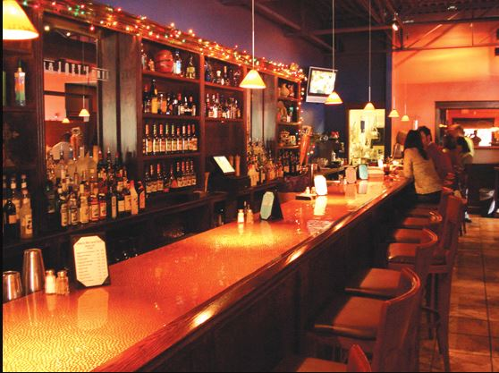

Location Analysis for a New Bar Business in Boston
Coursera - Applied Data Science Capstone
James Maxwell

Slide 2
Project goals and results achieved
Goal: The goal of this project was to produce useful data about the existing bar scene across 26 neighborhoods in Boston to use as input to a feasibility study regarding opening up a new bar in Boston.
Methodology: The methodology used to get the information about the number and type of bars in Boston neighborhoods is sourced from the FourSquare API.
Results: Valuable data was generated from the analysis. The count and type of bars in each neighborhood was determined. Similar neighborhoods were grouped together using a clustering analysis.
Conclusion: Ultimately, additional data is required before a decision about which neighborhood to locate a new bar can be made but this is a great start in the decision process!

Slide 3
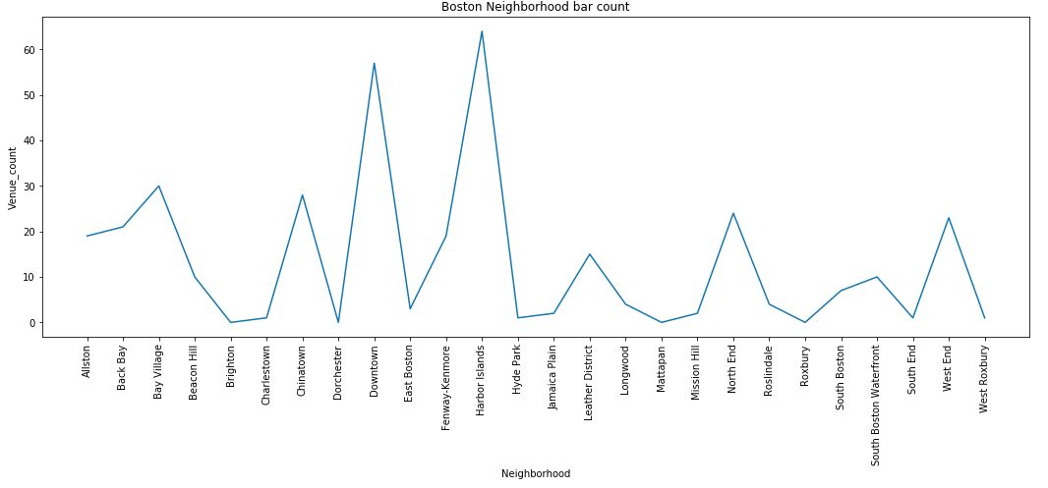
Results: Existing bar count by Boston Neighborhood

Slide 4
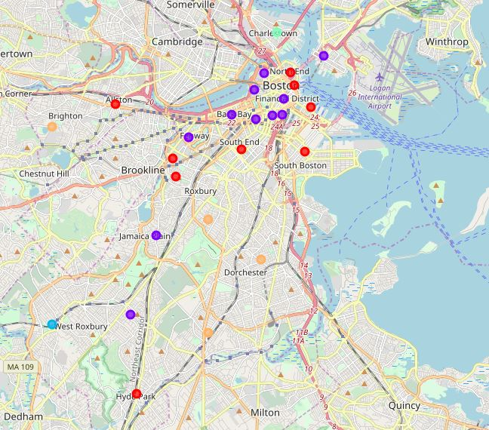
Results: using k-means clustering – 5 clusters defined for 26 Boston neighborhoods – answers the question : which neighborhoods are similar in terms of the existing bar scene?

