Slide 1
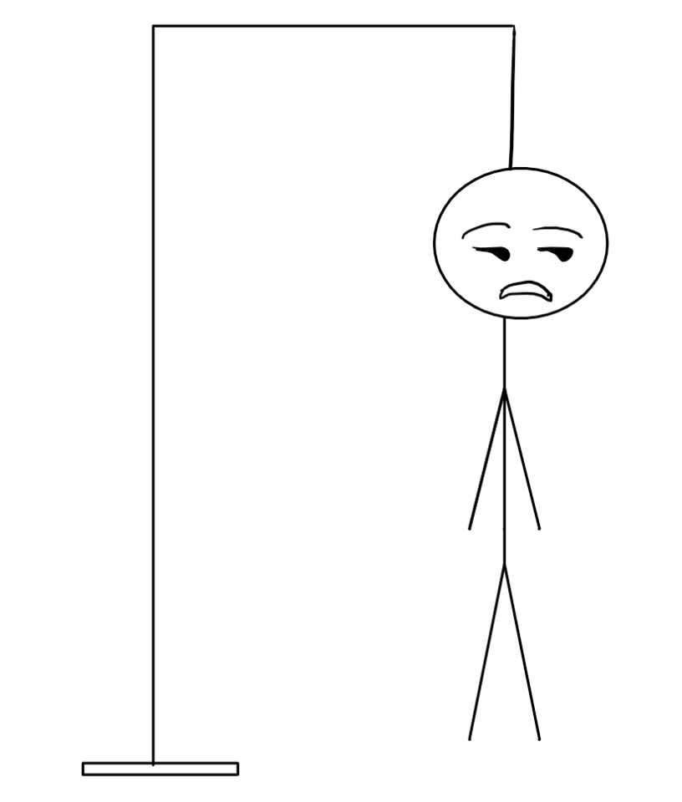
Php project:hangman
By: James Gangavarapu | Trini Key | Tiffani Buck

Slide 2
Incase you didn’t know: OBJECTIVE
The user will try and guess what the secret word is.(Category will be provided.)
The user will then guess a letter of the word.
If the user guesses the correct letter, then the letter will be placed in its correct location and appear on the screen.However, if the letter is incorrect, then a part of hangman will be displayed.
You want to guess all letters of the word before the hangman has been completely drawn.

Slide 3

Let’s get logical!

Slide 4

implementation
Arrays:
Create an array of images.
-If the user inputs an incorrect letter, the image will update with something added to the hangman
Create an array of words.
-Need an array of words and clues associated with it.
.strln()
Must provide user with word size

Slide 5
implementation

Slide 6
Show me some code!

Slide 7
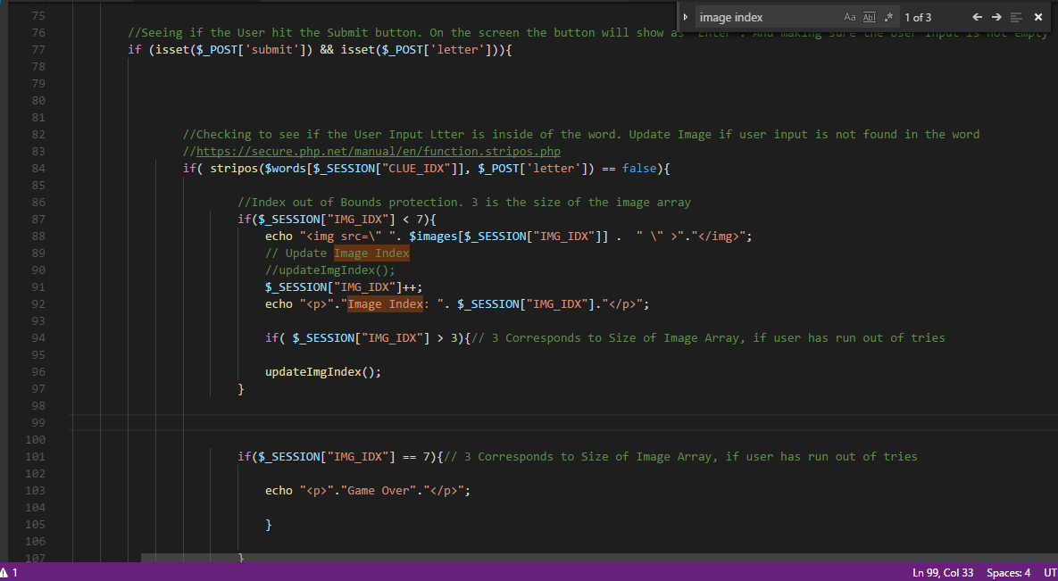
HANGMAN.PHP
Making sure the user hit the submit button and did not leave input blank.
Checking to see if the user inserted a correct letter.
Notes:
Explain codeee

Slide 8
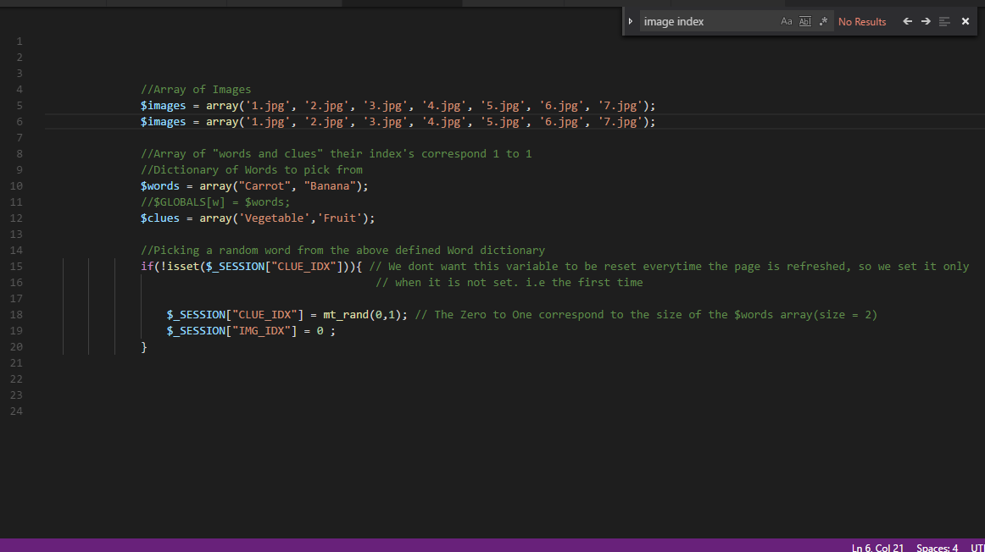
CONSTANTS.PHP
Array of words and clues!
Dictionary of words to choose from
Picking random words from the given arrays.
Notes:
Explain codee

Slide 9
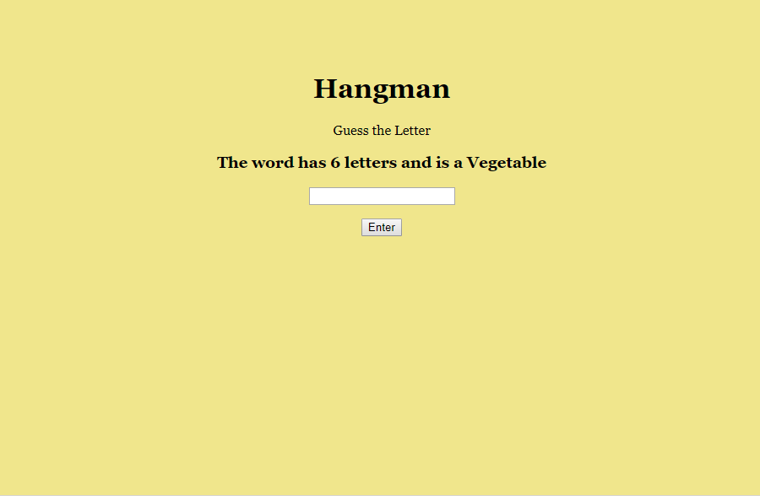
LET’S PLAY!

