Slide 1
Core Knowledge Series: Hands-On with Seurat
Bioinformatics Core (BSR)

Slide 2
R Studio and R
R is a powerful open-source programming language specifically designed for statistical computing, data analysis, and visualization. Many bioinformatics tools are developed in R.
RStudio is user-friendly and makes coding in R easier with features like debugging, plotting, and environment.
Packages native to R
Bioinformatics tools:
DESeq2 for RNA-Seq
Seurat for single-cell
Diffbind for ChIP and ATAC-seq
Data Manipulation
dplyr, tibble, tidyr, tidyverse

Slide 3
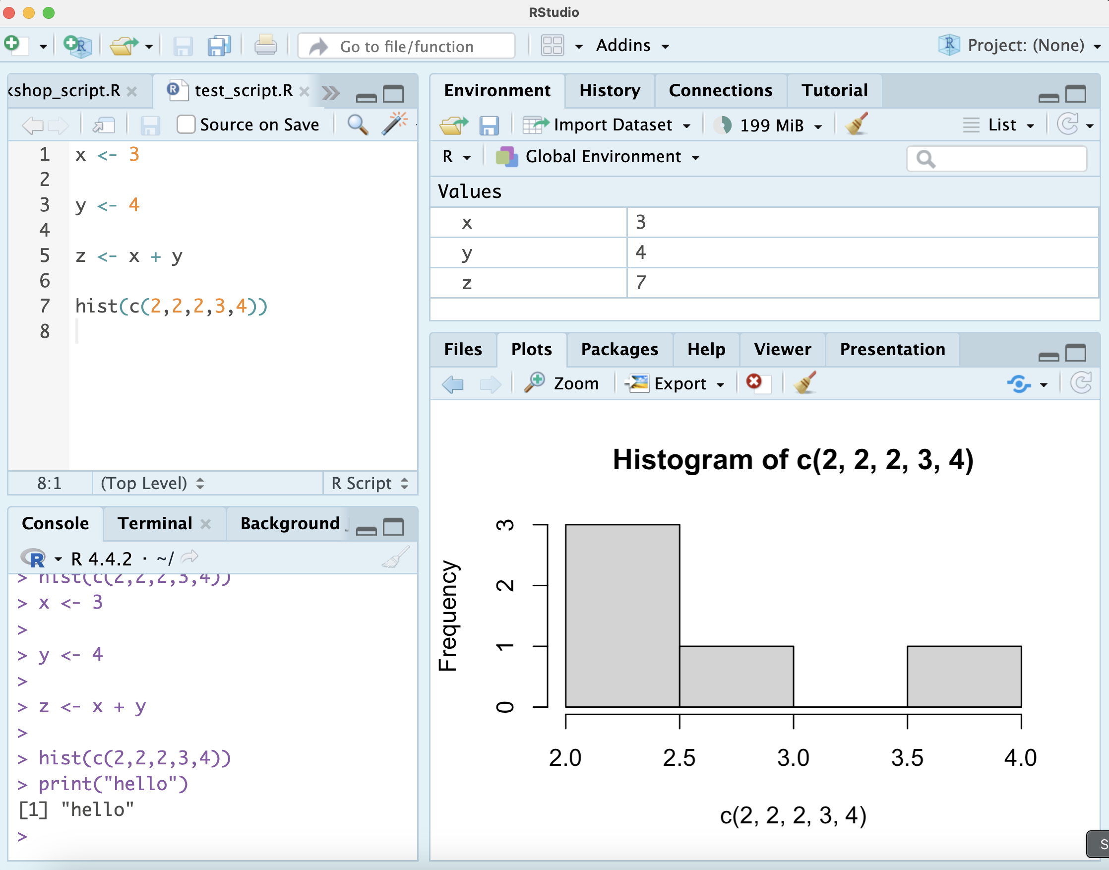
R Studio
Source Editor (Top-Left)
Writing/editing R and Rmd scripts
Environment (Top-Right)
Stores all created variables
Console/Terminal (Bottom-Left)
Console: Executes R commands
Terminal: Navigate through files
Files/Plots/Help (Bottom-right)
Mainly used for plot viewing. Can also navigate files and display help for functions.
Environment
Source Editor
Plot viewer
Console

Slide 4

Libraries in R
Libraries in R are collections of functions, datasets, and documentation that extend R's capabilities.
Libraries must be installed and loaded before use

Slide 5
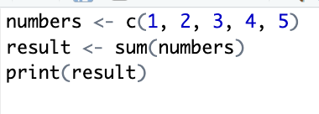
Basic syntax – Variables and Functions
Object – Fundamental data structure
Example: List/vector of numbers
Variable – Name to store fundamental data structure
Example: “numbers” variable
Function – Takes in input, performs operation(s), produces output
Sum function

Slide 6
Basic syntax – Variables and Functions
Variables are assigned using “<-” in R
Functions often come before parenthesis with arguments inside
Inputs to a function that tell provide specifications for the function to perform its task
sum(numbers)
Numbers is the argument to the sum function.
How can we see what arguments a function takes?

Slide 7

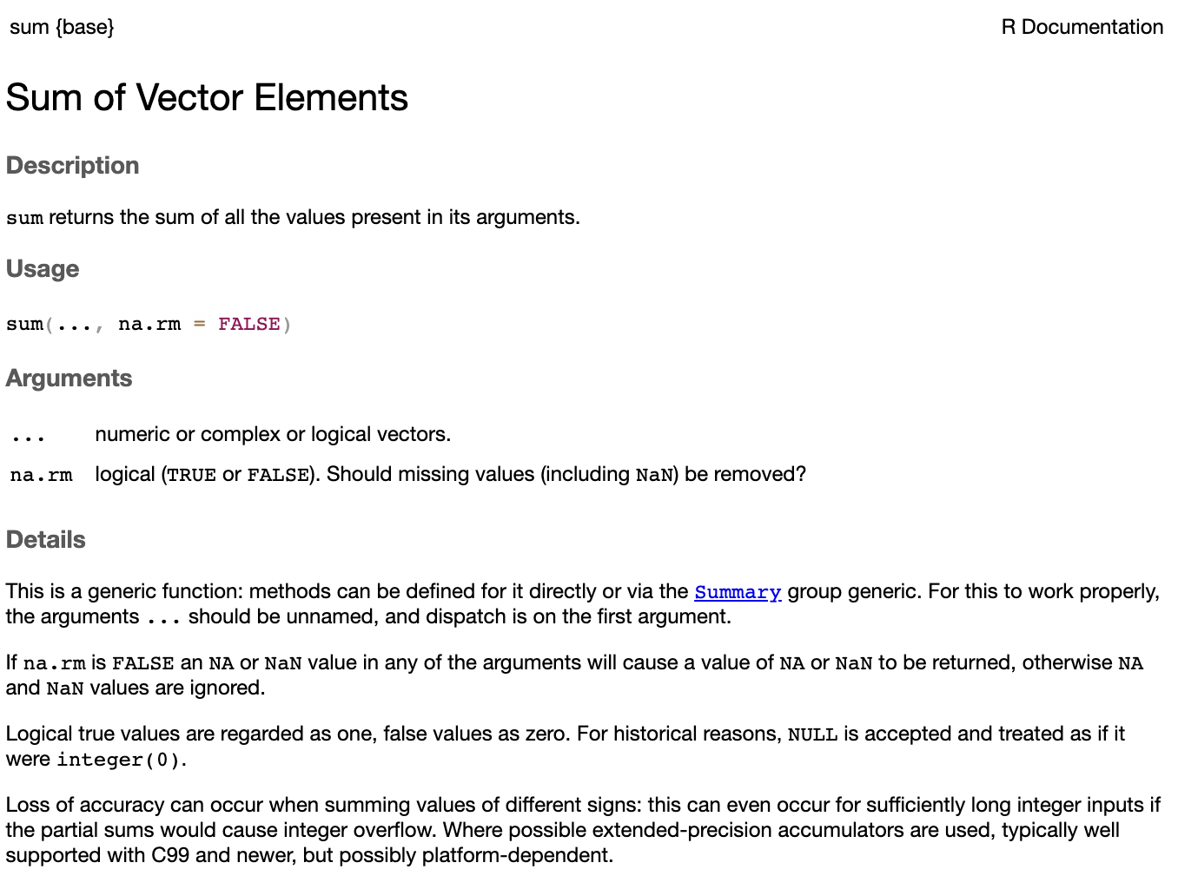
Using the help operator
The help operator ”?” can be placed in front of a function to open documentation for that function
Example: ?sum
Note: The sum function has an optional parameter na.rm that will remove NA values if you specify TRUE
Default is na.rm = FALSE
The ? operator is very helpful for Seurat functions
Well documented and often have many arguments

Slide 8

Seurat
Seurat is an R package for analyzing single-cell RNA-seq data.
It provides functions for normalization, clustering, plotting, differential analysis, integration, etc.

Slide 9
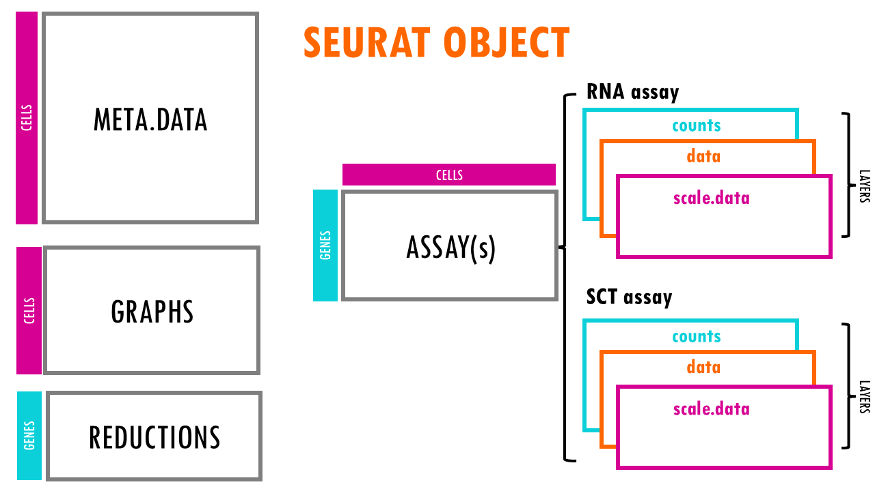
Seurat Object

Slide 10
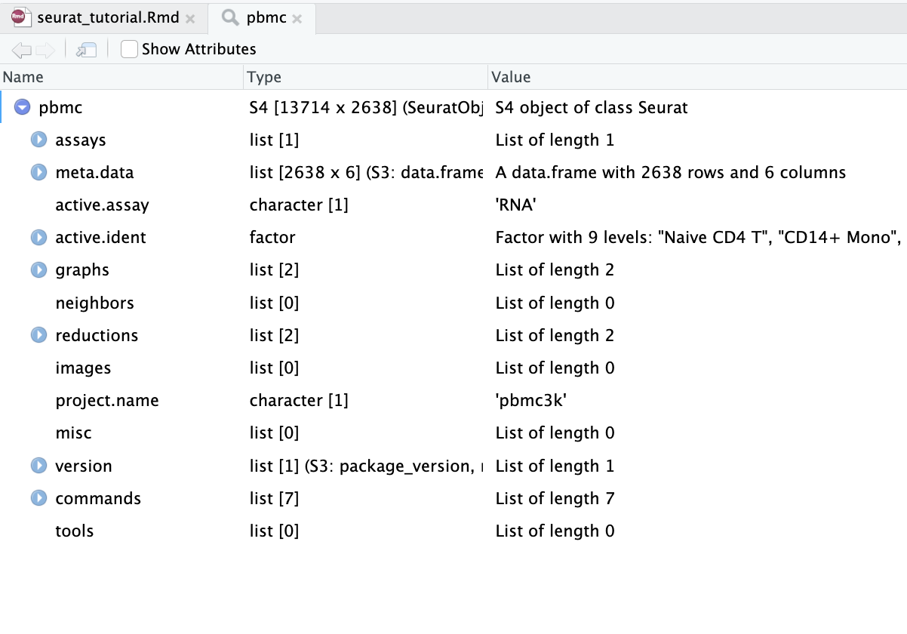
Our PBMC Seurat Object
Seurat objects contain slots. Think of them as compartments of the object.
Assays: Holds expression data
counts
data
scale.data
meta.data: Per-cell metadata
active.ident: Current identity of cells
Usually cluster number or cell type
reductions: Dimensionality reductions
PCA, tSNE, UMAP

Slide 11
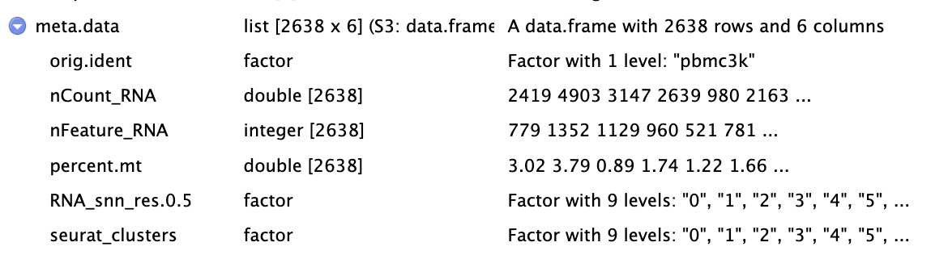
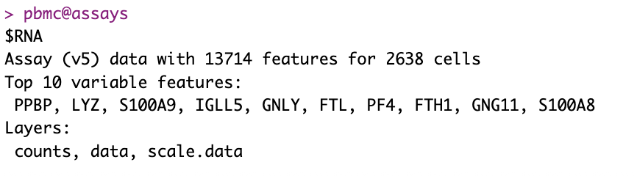
R syntax with Seurat Object
$ operator is used to access metadata.
@ operator is used to access other slots

Slide 12
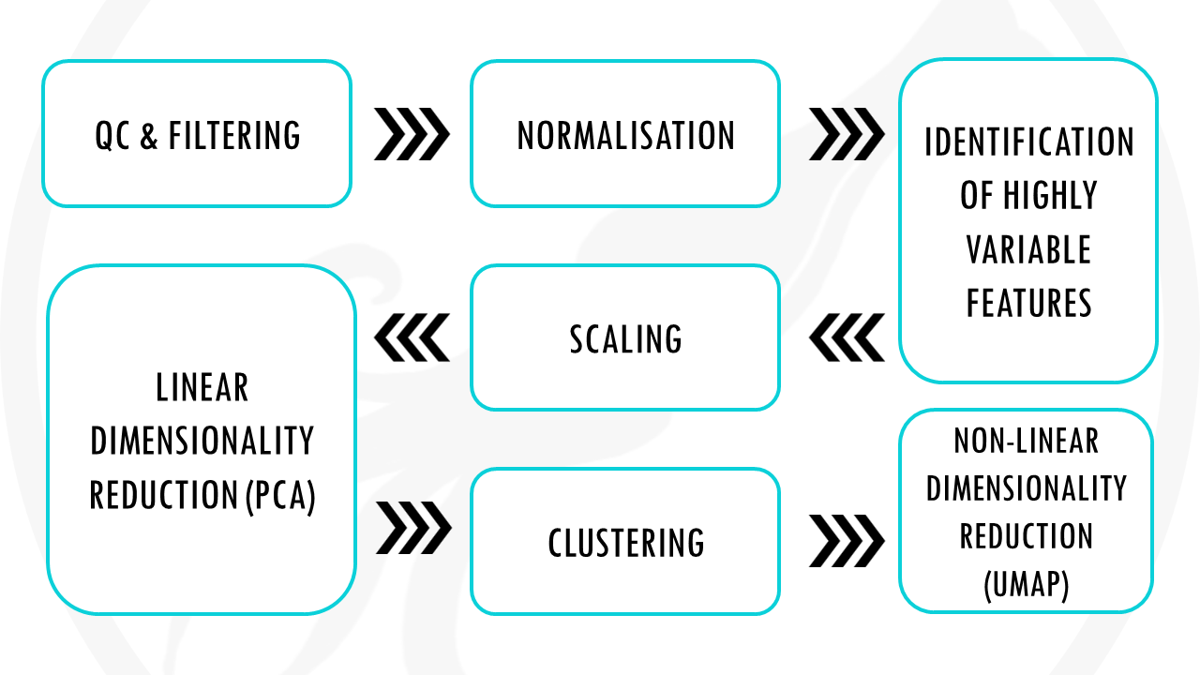
Seurat workflow
Create object – Read10X, CreateSeuratObject QC & filter – % mito, nFeature/nCount, subset
Normalize – NormalizeData() or SCTransform()
Variable features – FindVariableFeatures()
Scale data – ScaleData() PCA – RunPCA(), inspect PCs (ElbowPlot)
Clustering – FindNeighbors(), FindClusters() UMAP/tSNE – RunUMAP() / RunTSNE()
Find markers – FindMarkers(), FindAllMarkers()
Annotate – label clusters with known markers
Save object – saveRDS()

Slide 13
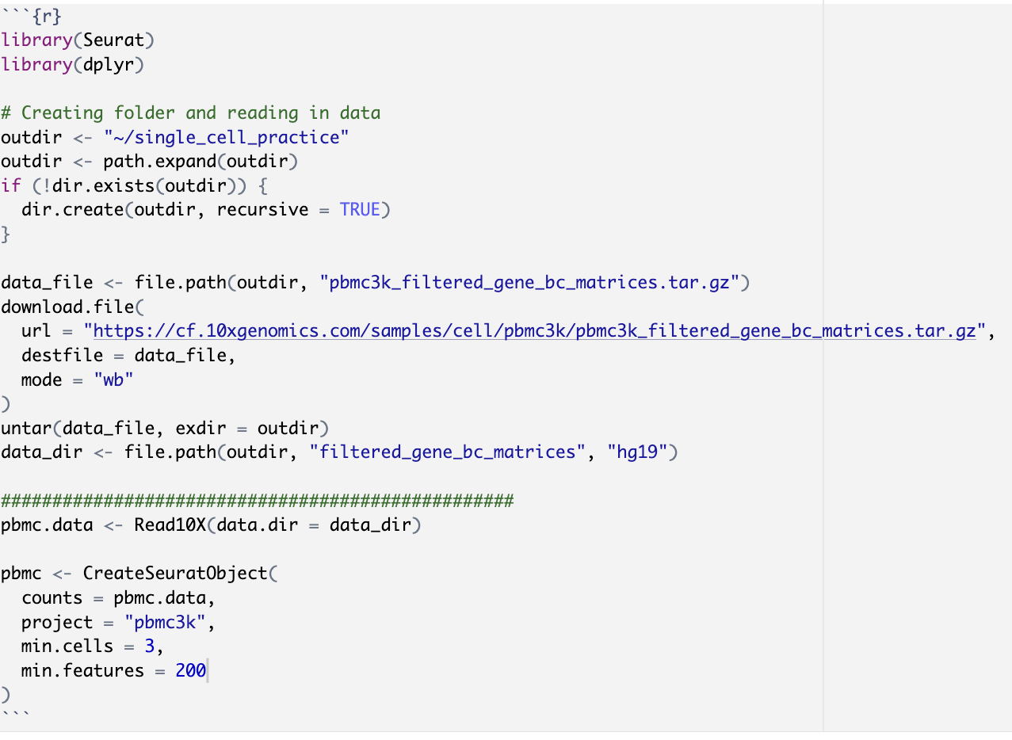
Creating the Seurat Object
The Seurat Object is the central container that stores
single-cell expression data
all downstream analysis results (QC metrics, clustering, embeddings, markers).
Here, we read in the counts and create the object
CreateSeuratObject is the function used.

Slide 14
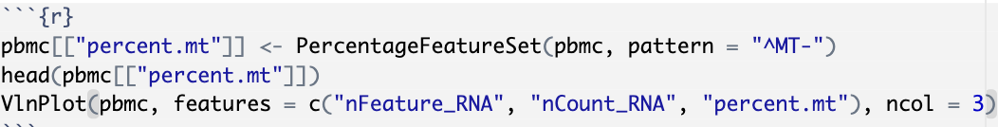
Quality Control
Here, we add mitochondrial percentage as meta data
Note: Can use double brackets or $ to add to metadata
The head() function gives the first few rows(cells)
Seurat auto generates nFeature_RNA and nCount_RNA when creating the object
High mitochondrial content could mean dying or low quality cells

Slide 15
Practice Question
Use ?VlnPlot to get more information about the function
Plot MALAT1 expression as a violin plot (no points shown).
Hint: Use the point size argument

Slide 16
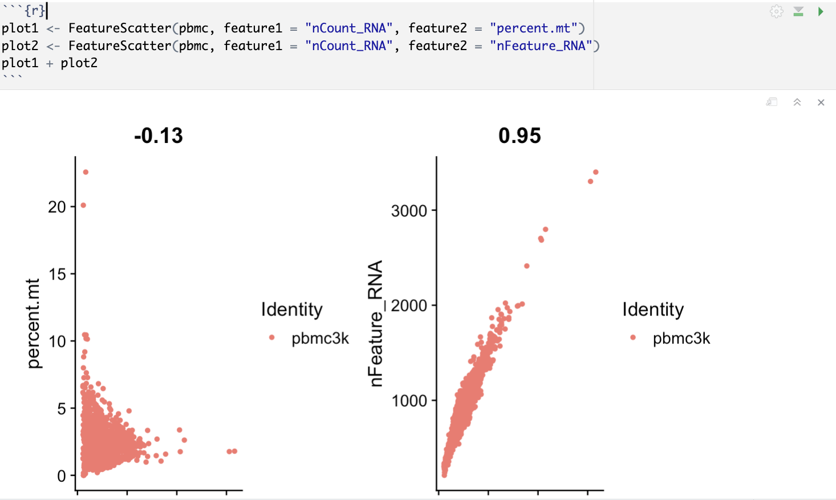
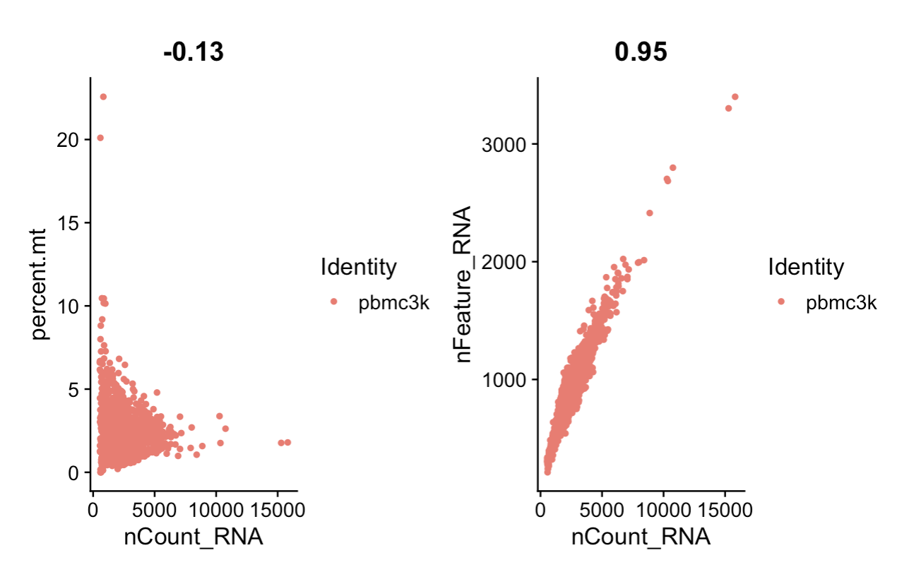
Quality Control
Checking relationships between quality metrics can help detect
Low quality cells
Doublets
Outliers
This helps us decide cutoffs for filtering

Slide 17
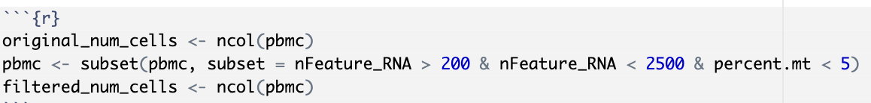
Filtering
The subset function is used to filter the cells
Number of genes expressed above 200
Number of genes expressed below 2500
Mitochondrial percentage < 5
ncol() function will tell us how many cells are in the object
Filtering is performed to remove low quality cells and artifacts

Slide 18
Practice Question
Create variable pbmc2, where we filter pbmc using these parameters
Number of genes expressed above 500
Number of genes expressed below 2000
Percent mitochondria < 4
How many more cells are in pbmc than pbmc2?
What percentage of the cells were filtered out?

Slide 19
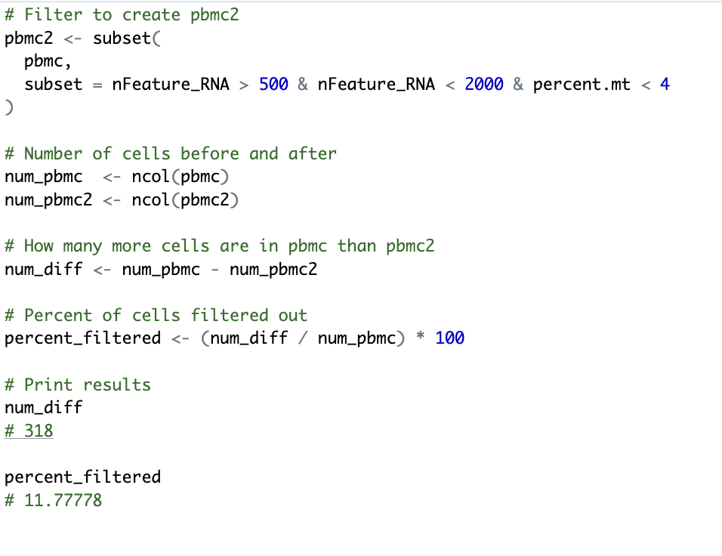
Solution

Slide 20
Normalizing Data
Counts need to be normalized so that expression can be compared across cells
Sequencing depth can differ between cells
Highly expressed genes can drown out biological signal
Normalizing for sequencing depth:
Divide expression for all cells by their total counts and multiply by scale factor
Reducing impact of highly expressed genes
Takes natural log of scale factored expression.
This is all done with the NormalizeData() function

Slide 21
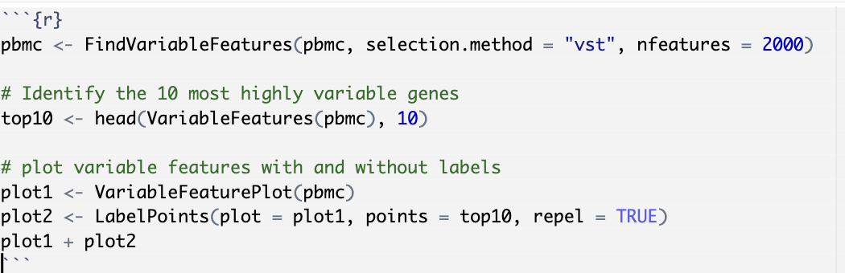
Finding Variable Genes
Highly variable genes capture biological differences strongly
Analyzing only variable genes reduces noise and helps with dimensionality reduction.

Slide 22
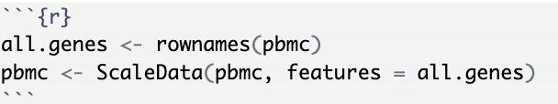
Scaling Data
ScaleData() function scales the data so that each gene’s expression is on the same scale.
Centers expression for each gene at 0
Divides by standard deviation of that gene’s expression
This is important for dimensionality reduction so that each gene has equal importance.

Slide 23

Dimensionality Reduction - PCA
PCA reduces thousands of gene features into a few key components, making the data less noisy and easier to interpret.
Principal component: weighted combination of gene expression
PC1 explains the most variance in the data, PC2 explains the second most, etc.

Slide 24


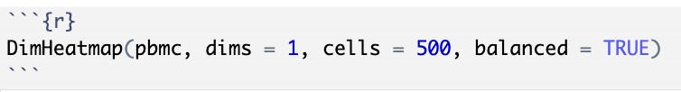

Visualizations with PCA
VizDimLoadings() – Plots the loadings/weights for the top genes for each principal component you specify
DimPlot() will plot the cells on an axis using two principal components
DimHeatmap() creates a heatmap using top genes from a principal component
ElbowPlot() Plots the variance explained by each PC

Slide 25
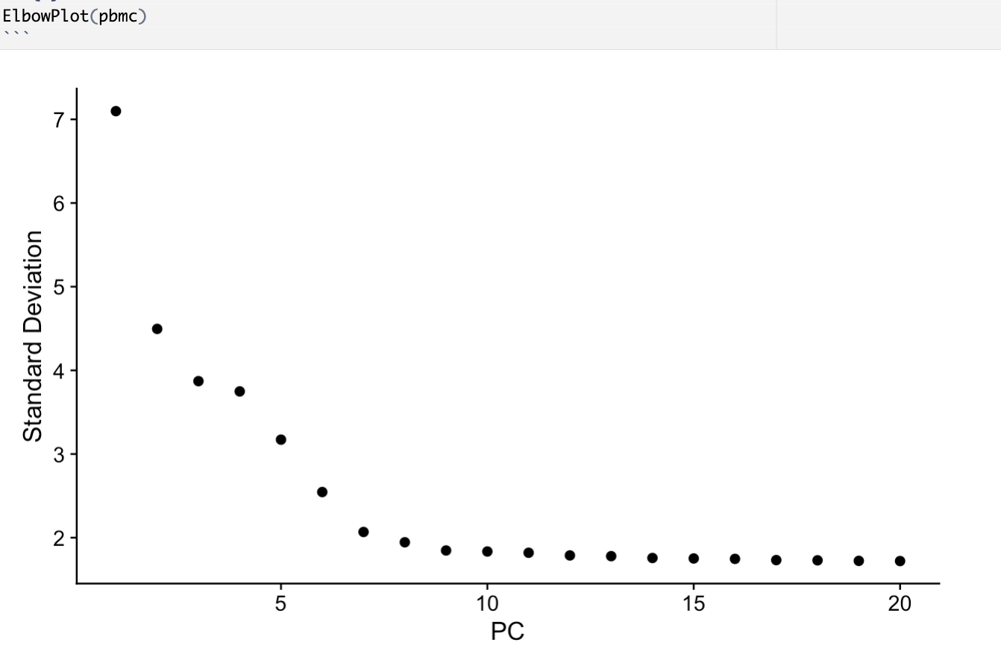
Choosing how many PCs to use in downstream analysis
The elbow plot can help you decide how many PCs to use.
There looks to be an elbow at around 10 PCs.
Majority of the true signal is likely captured in these first 10 PCs

Slide 26
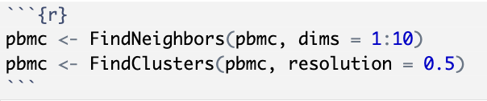
Clustering the Cells
FindNeighbors() builds a graph of cells based on how close they are in PCA space (who is nearest to who).
FindClusters() then groups those cells into clusters the nearest neighbors graph.

Slide 27
Clustering the Cells
Note that with FindNeighbors(), you need to specify which PCs to use.
Based on the elbow plot, we will use PCs 1-10
With FindClusters, you need to specify resolution.
Higher resolution gives more clusters
Lower resolution gives less clusters
Number of clusters depends on study goals/shape of UMAP/known markers that should cluster separately

Slide 28
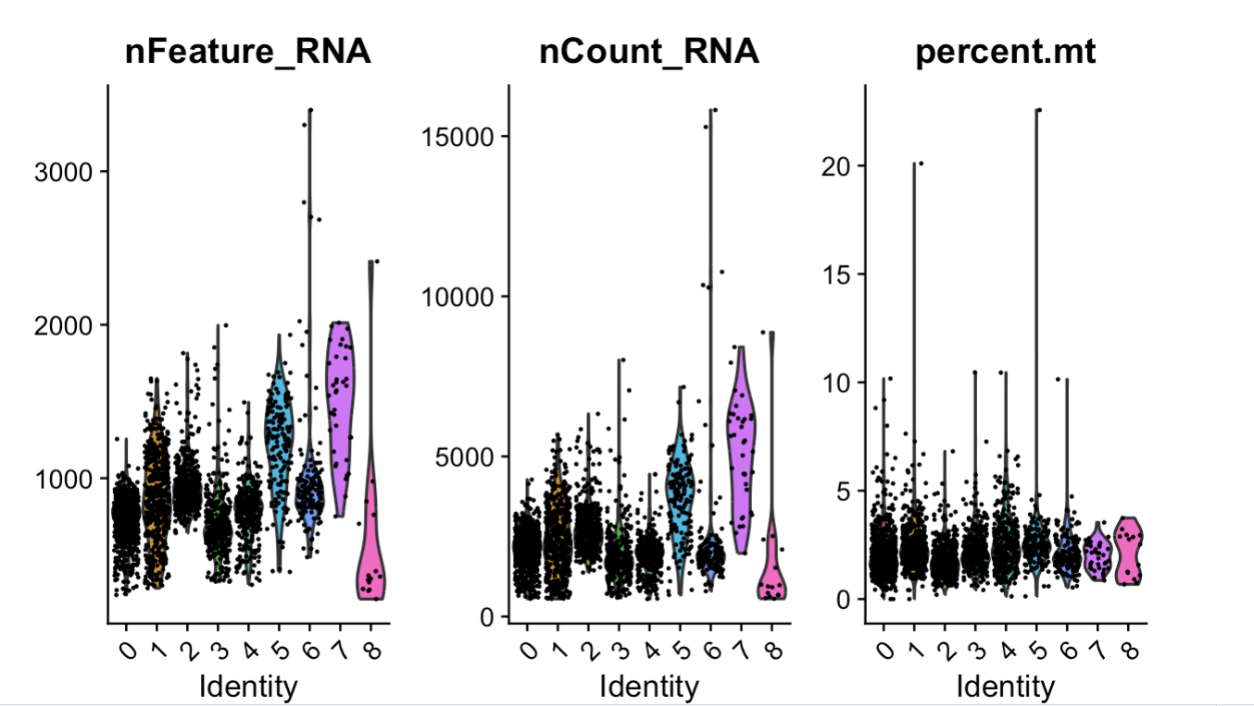
Clustering the cells
Clustering the cells will change the active.ident (identity) of the cells
The violin plot we made before is now split between cluster identities
head(pbmc@active.ident) can tell us what the active identity is

Slide 29
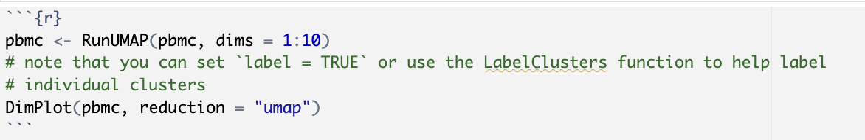
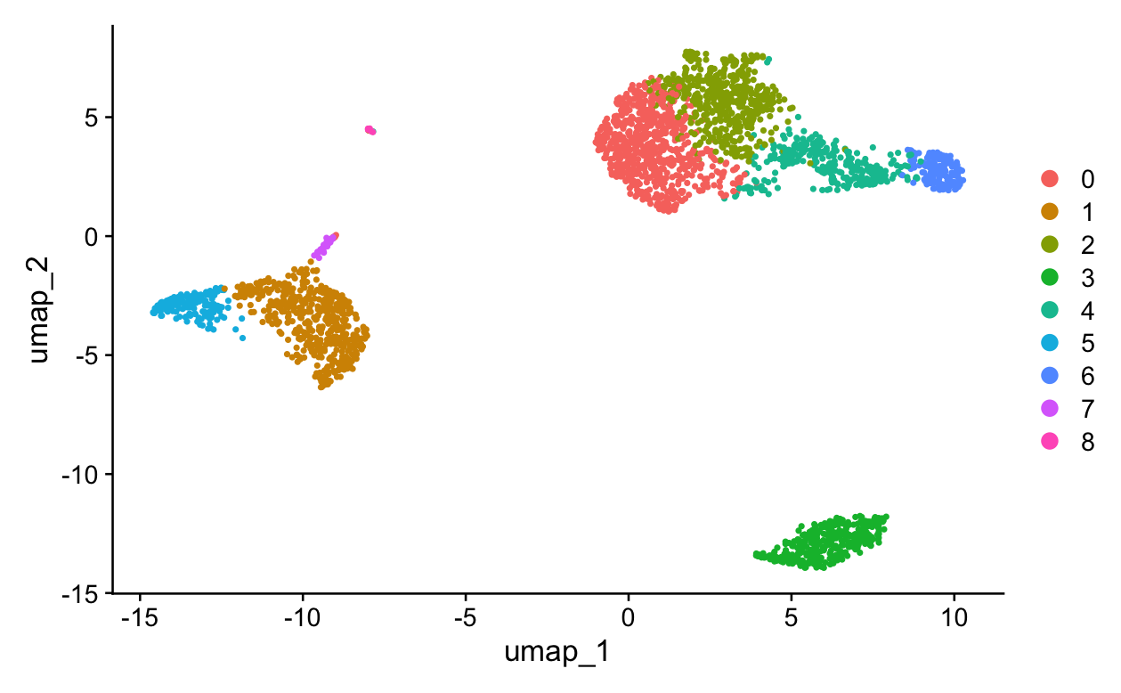
UMAP – Non-linear dimensionality reduction
UMAP learns the structure of the data and projects it into 2D for visualization.
It combines PCA-reduced information with neighbor relationships to preserve similarity between cells.

Slide 30
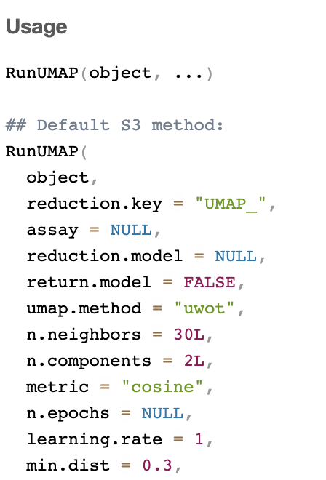
RunUMAP – min.dist and n.neighbors parameters
n.neighbors: neighbors used for graph.
Small = local detail
Large = global structure.
min.dist: spacing of points.
Small = tight clusters
Large = spread out clusters.

Slide 31
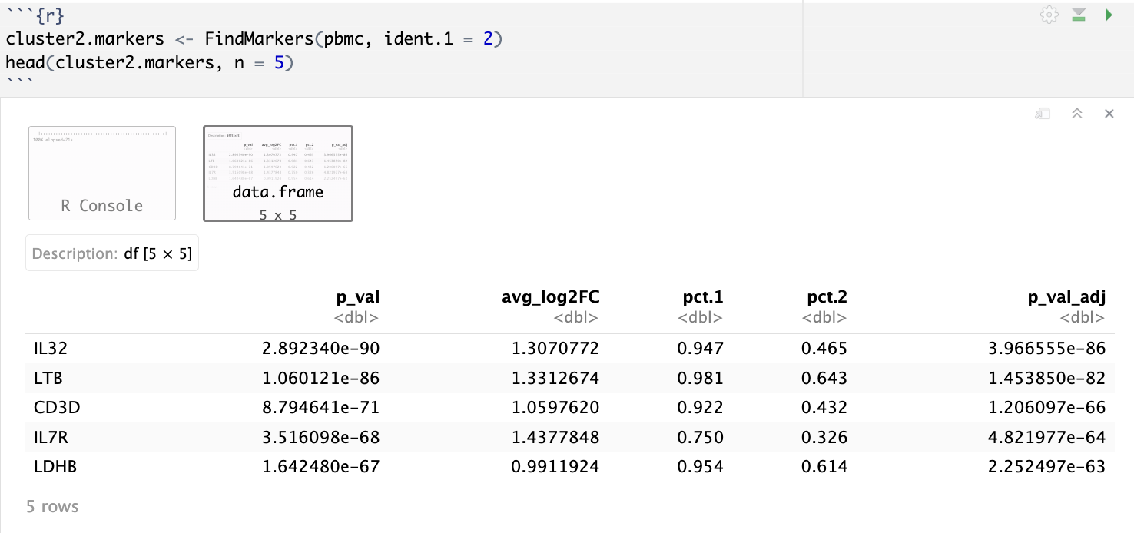
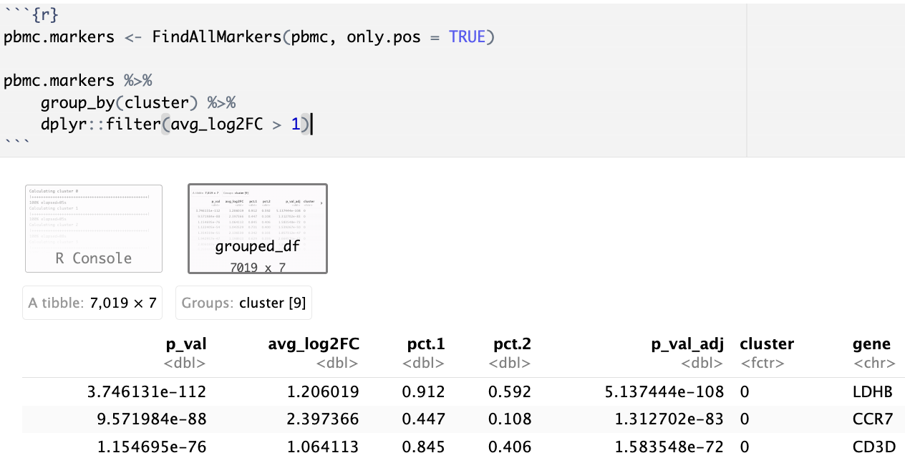
Find Markers
FindMarkers tells you which genes are differentially expressed in a certain cluster
FindAllMarkers tells you which genes are differentially expressed in all clusters

Slide 32
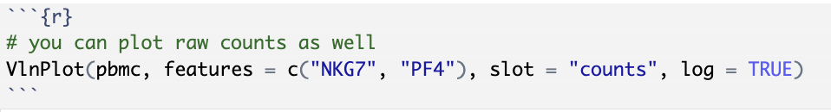
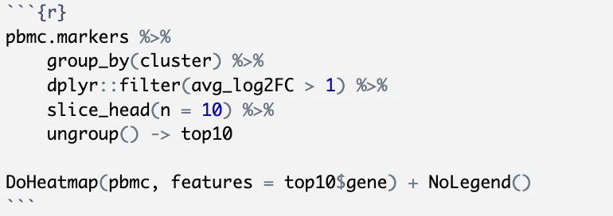
Feature Plotting
You can plot certain features on violin plots, UMAP, and heatmap.
Specify features = c(“Gene1”, “Gene2”,…)

Slide 33
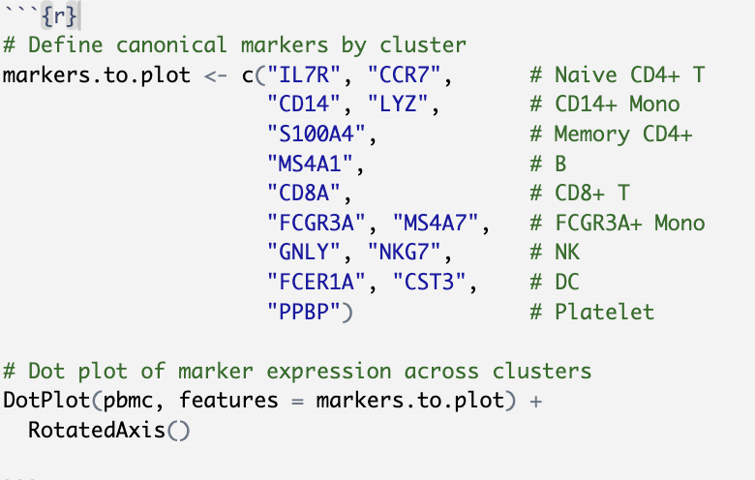
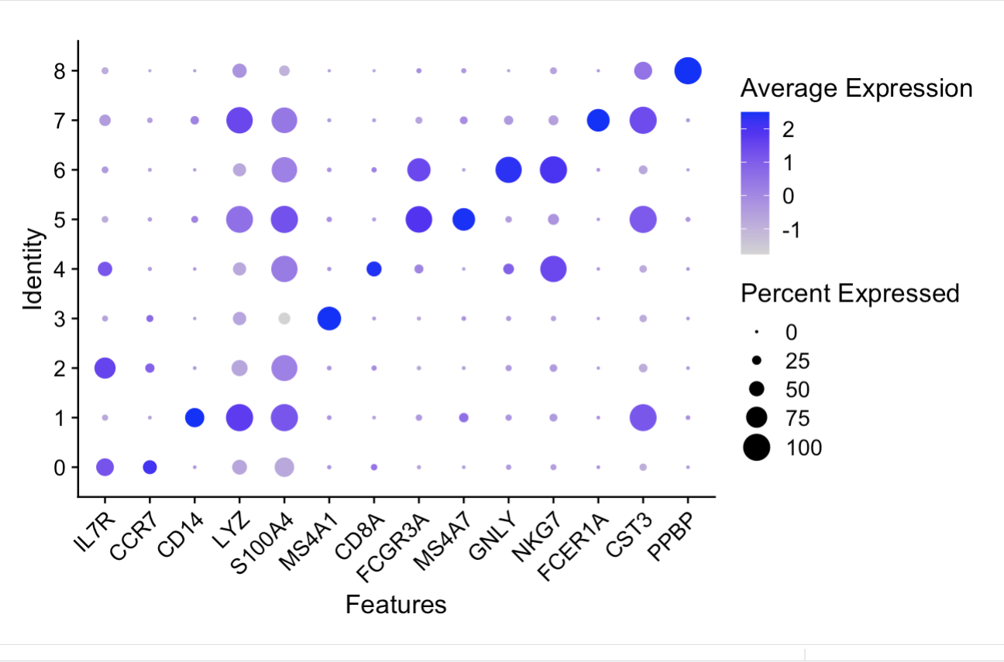
Assigning Cell Types
Dot plots are a good way to visualize expression of pre-defined cell-type markers

Slide 34
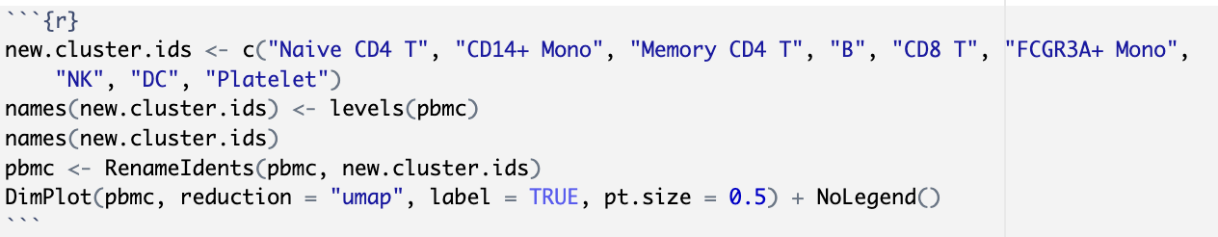
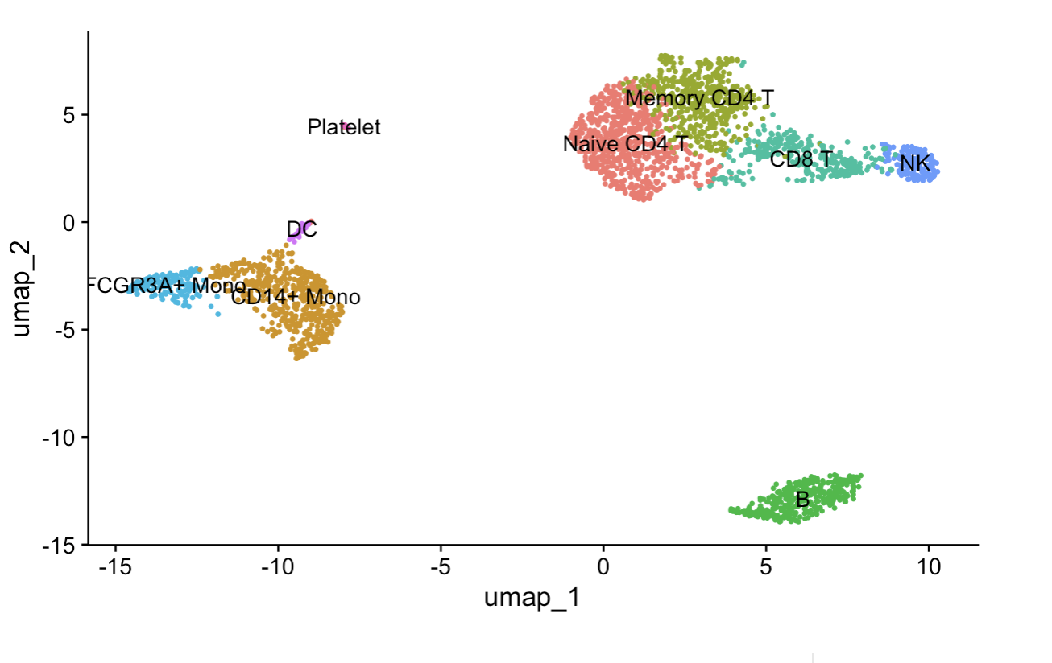
Assigning Cell Types
The new cluster ids are stored as a list corresponding to cluster number.
The names of the identity of the cells is then changed to reflect the cell type rather than the cluster number

Slide 35
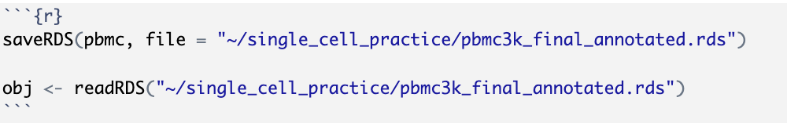
Saving/reading object
R objects can be saved as “.rds” files.
saveRDS() takes in an object and a path
readRDS() will read in an object from a path

Slide 36



Your feedback ensures we provide you with the best content
Please scan the QR code to take our 1-minute survey!

