Slide 1
ATAC-Seq Best Practices
James Rouse

Slide 2
ATAC-Seq
Maps open chromatin regions, revealing active regulatory elements like promoters and enhancers.
While similar to ChIP-seq, which focuses on specific protein-DNA interactions, ATAC-seq provides a more global view of chromatin accessibility without the need for antibodies.

Slide 3
Experimental Design
Majority of published ATAC-seq experiments have two biological replicates, but 3 or more is recommended – Liu et al.
To be cost-effective, input controls are usually not performed in ATAC-seq.
Tn5 transposase selectively targets open chromatin, typically creating low-background data with a clear signal from accessible regions

Slide 4
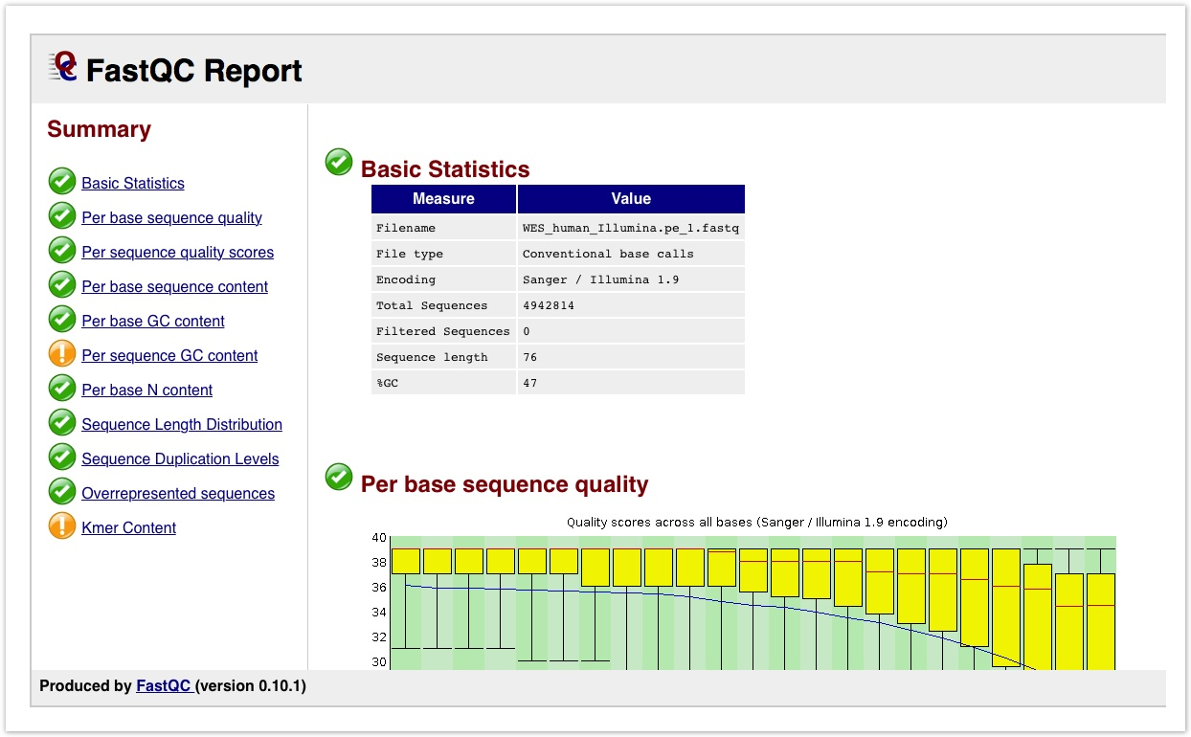
Best practices during quality control of sequence reads
Purpose: Assess the quality of the reads and ensure that the sequencing data is of high quality and reliable for downstream analysis.
FastQC: Identifies potential issues such as poor read quality, adapter contamination, and sequence biases.
MultiQC: Aggregates QC reports to identify trends, batch effects, and outliers, providing a summary across all samples
Fastq_screen: Aligns reads to multiple reference genomes/databases. Good way to detect contamination.
Resequencing often recommended if the results of the FastQC report are poor.

Slide 5
Best practices during alignment
BWA and Bowtie as main tools for ATAC-Seq: These tools are useful for mapping short reads with high accuracy and stringent control over mismatches.
Zhang et al: Bowtie often preferable over BWA for ATAC-Seq since Bowtie only reports uniquely mapped reads, resulting in higher alignment accuracy compared to BWA.
Other alignment tools like STAR’s advantage of being able to detect novel splice junction and sequencing long reads is less important in ATAC-Seq since it sequences short DNA rather than RNA.
Removal of low quality reads and reads with a low mapping score is recommended.

Slide 6
ATAC-seq quality control of aligned reads
Quality control after alignment mainly consists of removing duplicates and uninformative/low
Removing Duplicates
Picard marks PCR duplicates to remove non-informative reads, ensuring only unique fragments are analyzed.
NRF = distinct uniquely mapped reads / total uniquely mapped reads.
High NRF (>0.8) indicates good library complexity, while a low NRF (<0.5) suggests high duplication and low quality, impacting reliability.

Slide 7
ATAC-seq quality control of aligned reads
Filter uninformative reads: Filtering out low quality reads and reads that map to the mitochondrial genome leaves us with a set of more informative reads.
Filter blacklist regions: Filter out reads in blacklisted regions using BEDtools or BlackList to identify reads that may be in typically noisy or artifact-prone regions.
Tn5 shift correction: Use deepTools to accurately adjust Tn5 shift correction. Typically, reads are shifted +4 bp and -5 bp for positive and negative strand.

Slide 8
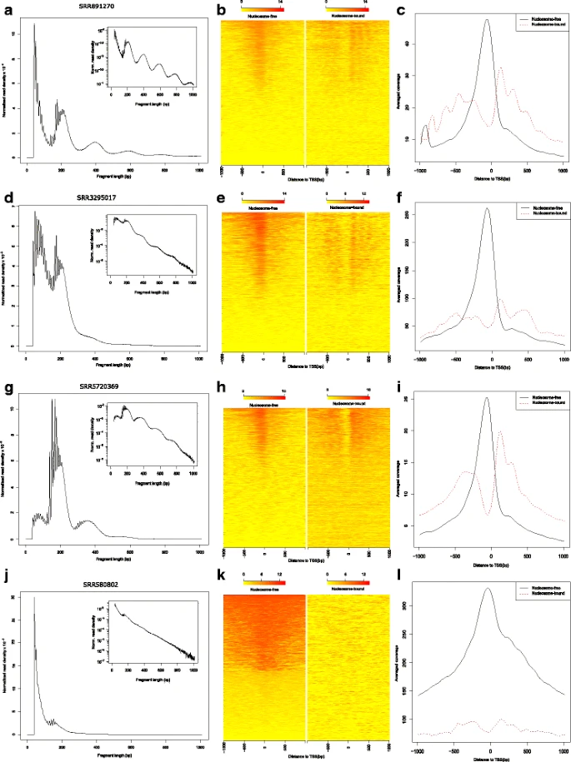
ATACseqQC – Ou et al
b) Left = Nucleosome-free
Right = Nucleosome-bound
c) Solid = Nucleosome-free
Dotted = Nucleosome-bound
ATACseqQC Tool: A quality control tool for ATAC-seq data, assessing chromatin accessibility, library complexity, and sample prep quality.
Fragment Size Distribution: Shows peaks for nucleosome-free (~50-100 bp) and nucleosome-bound fragments (~200, 400, 600 bp); deviations signal issues like over-transposition.
TSS Signal Heatmaps: Display TSS signal intensity; strong nucleosome-free signals indicate good chromatin accessibility, while weak signals suggest sub-optimal transposition.
Smoothed TSS Histograms: Average signal profiles around TSS; sharp peaks for nucleosome free regions confirm data quality.

Slide 9
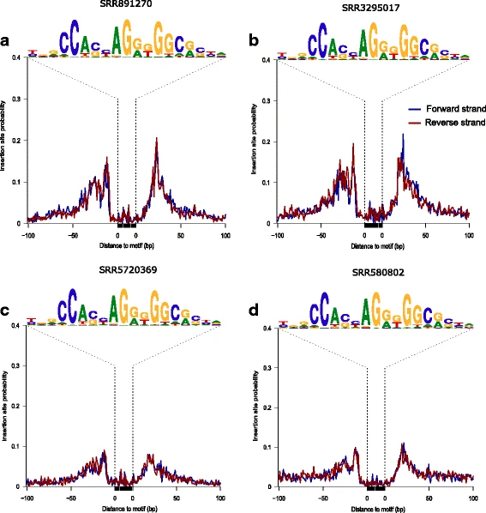
ATACseqQC – Assessment of footprints
Footprint Detection: DNA-binding proteins protect regions from Tn5 insertion, creating “footprints” in open chromatin, indicating protein binding sites.
Footprint Plotting: The `factorFootprints` function aggregates short-read signals around predicted binding sites, highlighting footprints at known motifs.
CTCF Footprints Example: Clear footprints in Fig. 3a versus shallower footprints in Fig. 3d.

Slide 10
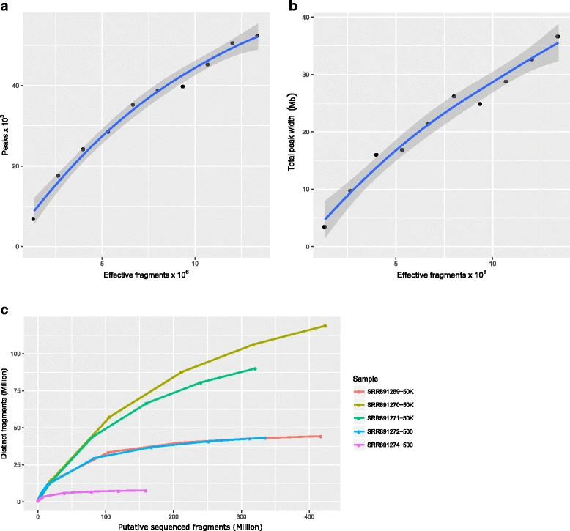
ATACseqQC – Sequencing depth and library complexity
Peaks vs. Effective Fragments: Peaks increase with effective fragments, plateauing as sequencing depth reaches optimal detection.
Total Peak Width vs. Effective Fragments: Total peak width rises with fragment count but levels off, indicating saturation in peak region detection.
Distinct Fragments vs. Total Fragments: Unique fragment detection curves show sequencing efficiency; plateauing curves suggest optimal depth, while rising curves may benefit from more sequencing.

Slide 11
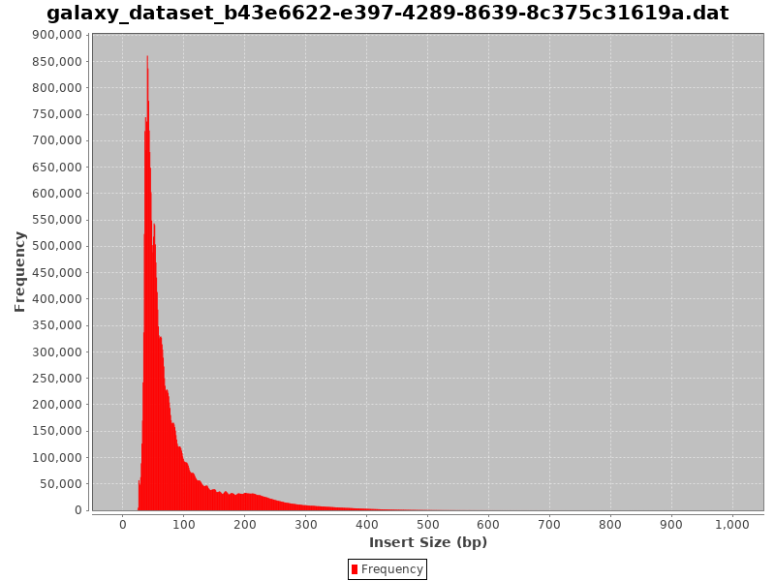
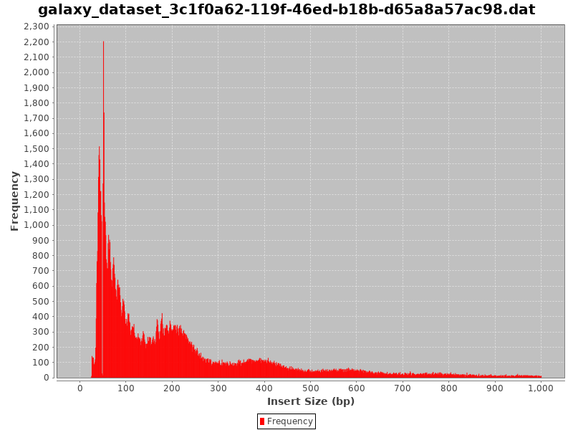
Check Insert Sizes
Checking the distribution size of the insert is often a good indication of whether the experiment worked.
A successful insert size distribution in ChIP-seq or ATAC-seq should show distinct peaks at ~50-100 bp, ~200 bp, ~400 bp, and ~600 bp, reflecting transposase insertion in nucleosome-free regions (open chromatin) and around one, two, and three nucleosomes, respectively.
Failed/noisy
Successful

Slide 12
Best practices during peak calling
MACS2 – MACS2 is the default peak caller of the ENCODE ATAC-seq pipeline and the most widely used tool for peak calling for ATAC-seq (Yan et al.).
Input data isn’t often used for ATAC-seq because the Tn5 transposase selectively targets open chromatin, typically creating low-background data with a clear signal from accessible regions.
To date, there is no comprehensive bookmark study on peak-callers for ATAC-seq.
Study on github benchmarked MACS2, Genrich, and HMMRATAC, the three most well-known ATAC-seq peak callers. Genrich outperformed both, with HMMRATAC and MACS2 following.

Slide 13
Comparison of peak calling tools - Liu et al
For ATAC-seq data, using MACS2 with the BAMPE mode assumes that full fragment regions represent accessible chromatin, but this approach is more suited for ChIP-seq. ”MACS.PE” method
An improved approach, the “MACS2.SITE” method, centers signals on the actual transposase cut sites by shifting read coordinates, providing a more accurate representation of chromatin accessibility.
The “MACS2.SITE” method uses the parameters --shift -s and --extend 2s to center pileup signals on the actual transposase cleavage sites, where s represents the number of bases by which read coordinates are shifted toward the 5′ direction.

Slide 14
Comparison of peak calling tools - Liu et al
Genrich: the most sensitive for multi-replicate ATAC-seq data, detecting the highest number of peaks with clear boundaries, especially in low-signal regions.
MACS2.SITE: effective for single-replicate datasets and also performs well in low-signal regions but with slightly less sensitivity than Genrich.
HMMRATAC: conservative, focusing on high-confidence peaks and broader regions but may miss low-signal peaks, making it best suited for high-signal datasets.
Study advised against using MACS2.PE for ATAC-seq peak calling. Study recommends Genrich when biological replicates are available.

Slide 15
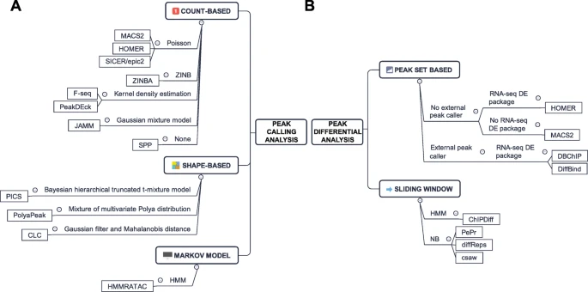
Differential Peak Analysis
Consensus Peak-Based Tools: HOMER, DBChIP, and DiffBind use RNA-seq DE tools (edgeR, DESeq2) and consensus peaks, though intersection may miss condition-specific peaks, and union can inflate false positives.
Sliding Window Approach: Tools like PePr, DiffReps, and ChIPDiff scan all genomic windows, ideal for broad peaks but need strong FDR control.
Paper recommends csaw as top option (Yan et al.)

Slide 16
Peak Annotation/Pathway Analysis
ATAC-seq peak annotation tools (e.g., ChIPpeakAnno, ANNOVAR. HOMER) assign regulatory regions to nearby genes.
Differential accessibility experiments can use ChIPpeakAnno functions like getEnrichedGO for gene ontology or pathway analysis.

Slide 17
Nucleosome Positioning
Nucleosome positioning is important because it controls access to DNA, determining whether genes can be turned on or off by allowing or blocking proteins from reaching key areas like promoters and enhancers.
Use NucleoATAC to analyze fragment size distributions and detect nucleosome-free regions. To date, only NucleoATAC is specifically designed for nucleosome positioning analysis of ATAC- seq data based on the unique ATAC-seq fragmentation - Liu et al.

Slide 18
Transcription Factor Binding and Activity Analysis
TF Occupancy Inference: ATAC-seq and can reveal TF footprints in accessible chromatin regions, TOBIAS is recommended for ATAC-seq due to its superior bias correction and efficiency.
Motif Mapping: Motif mapping in open chromatin regions, supported by tools such as FIMO, HOMER, and MOODS, helps identify potential TF binding sites.
Differential TF Binding Activity Analysis: Changes in TF binding activity can be inferred by analyzing footprint depth (FPD) and flanking accessibility (FA) with tools like TOBIAS, which use bias correction and normalization techniques to detect condition-specific binding differences.

Slide 19
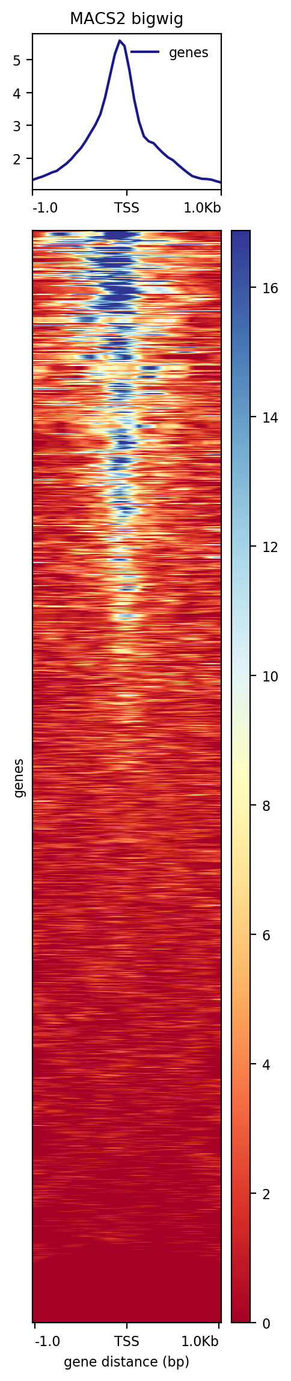
Visualization
Signal Tracks & Heatmaps: Signal tracks visualize read coverage across genomic regions, and heatmaps help compare enrichment profiles across loci. In ATAC-seq, TSS are often a location of interest.
pyGenomeTracks allows multi-layered visualization of ATAC-seq signals across the genome.
IGV (Integrative Genomics Viewer) is a flexible and widely used tool for visualizing ChIP-Seq data
Notes:
Adapter trimming. Multi bigwig summary and then do PCA.
DeepTools, summarize multiple bigwigs and plot the PCA for ChIP-Seq and ATAC-seq
DiffBind shows venn diagram of which sites are common to both
Quantify how many peaks are in certain regions. DiffBind include occupancy and affinity.
Normalize to the background in ATAC-seq. Run on DeSeq2 and edgeR for normalization.
Results are similar and you overlap the results.
Gain or loss in open regions. Global openness.
Examine specific regions or investigate the global openness.
Can have 1 sample if just trying to answer yes or no question not differentially comparing.

