Slide 1
RNA-Seq best practices
James Rouse

Slide 2
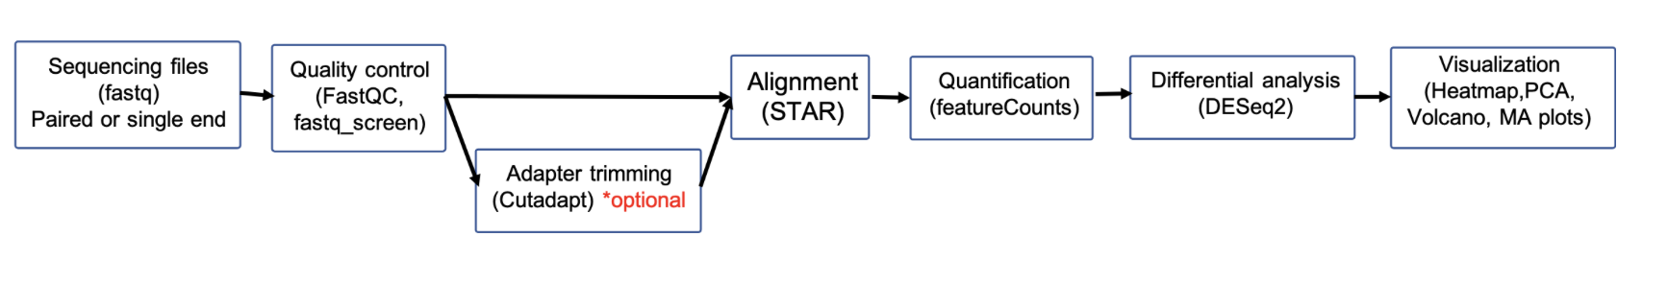
Introduction to RNA-Seq best practices
Quality Control: Use FastQC for quality checks and Trimmomatic or Cutadapt for trimming low-quality bases and adapters.
Alignment/Quantification: Use STAR or HISAT2 for alignment, or Salmon/Kallisto for faster quantification without alignment. Htseq-count or featureCounts used for quantification with alignment.
Differential Expression: Use DESeq2, edgeR, or limma for normalization and differential expression, accounting for technical biases.
Some tools perform better than others, especially when dealing with certain types of data

Slide 3
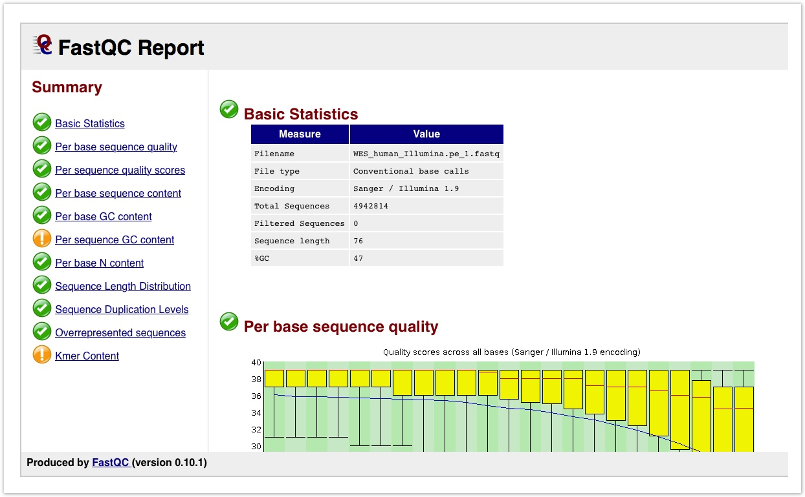
Best practices during quality control
Purpose: Assess the quality of the reads and ensure that the sequencing data is of high quality and reliable for downstream analysis.
FastQC: Identifies potential issues such as poor read quality, adapter contamination, and sequence biases.
Fastq_screen: Aligns reads to multiple reference genomes/databases. Good way to detect contamination.
Resequencing often recommended if the results of the FastQC report are poor.

Slide 4
Best practices during trimming
Adapter trimming: Adapter trimming is optional, but often recommended. Some alignment tools can handle adapters. Trimmomatic and CutAdapt are two common tools used for trimming.
Williams et al. argues that quality-based trimming may negatively impact the downstream analysis. They note that differences come from the short reads that result from trimming and suggest filtering reads by length after trimming.

Slide 5
Best practices during alignment
STAR: STAR is an alignment tool know for its accuracy. STAR is also more robust to variant detections. Allows for discovery of novel splice junctions
HISAT2: Memory efficient compared to STAR, but sometimes slightly less accurate.
Kallisto: Pseudoalignment, maps reads to a set of transcripts rather than to a reference genome. Faster and more memory efficient than traditional alignment, but sometimes less accurate.
Mapping percentage: 90% - ideal, 80% - good, 70% - acceptable, 60% - borderline, <50%- resequence

Slide 6
Evaluation of 7 different alignment tools
Schaarschmidt et al. - bwa, CLC Genomics Workbench, HISAT2, kallisto, RSEM, salmon and STAR were all used for alignment in model plant Arabidopsis thaliana
All tools had similar mapping rates and there was high overlap of mappers.
STAR had the highest fraction of mapped reads, likely due to higher tolerance for soft-clipped and mismatched bases.
Generally, all tools were comparable to each other.

Slide 7
Comparison of 7 different alignment tools
Musich et al. – Comparative analysis of different alignment tools on Erysiphe necator. Runtime, alignment percentage, and transcriptome coverage measured.
TopHat2 showed the lowest alignment rates and the slowest runtime.
Bowtie2 (Local mode) and BWA achieved the highest alignment rates (~87%).
HISAT2 was the fastest aligner, with a runtime of 8.28 ms per read.
STAR and HISAT2 performed better for mapping larger transcripts.
TopHat2 had the highest number of unmapped genes (1,570), while BWA had the lowest (106).

Slide 8
De novo alignment
De novo genome assembly reconstructs a genome from sequencing reads without a reference genome by aligning overlapping sequences.
Jeon et al. - For long reads (e.g., PacBio, ONT), tools like Canu and Flye are optimal for high contiguity and accuracy.
For short reads (e.g., Illumina), SPAdes ,Trinity, and ABySS are highly effective for assembling small to medium-sized genomes​
Notes:
Minimap2 for alignment
Transcript assembly – cufflinks, stringtie. Something from nanopore specifically.
Build genome assembly using flye, then use tool from ONT for transcriptome assembly using stringtie

Slide 9
Alignment-free tools/pseudoaligners
Pseudo-aligners like Kallisto don’t align the reads to a reference base by base. Rather, they determine which transcripts a read is compatible with.
This technique is fast and effective for transcript quantification
Wu et al. - Alignment-free RNA-seq pipelines struggle with accurate quantification of small and lowly-expressed RNAs, particularly tRNAs

Slide 10
Potential strength of alignment-free tools
Zheng et al. - Dependent on type of data and goal of analysis. During analysis to quantify lncRNA in TCGA, salmon and kalisto outperformed STAR.
Salmon and kalisto detected more lncRNAs and stronger concordance with the ground truth.
Notes:
Small RNAs for STAR, longer RNAs for kalisto

Slide 11
Best practices during quantification
HTSeq-count is slower and more memory-intensive and discards multi-mapping reads by default.
featureCounts is faster, more memory-efficient, and handles multi-mapping reads. It is better suited for large-scale, high-throughput workflows.
Corchete et al. - Generally, pipelines that use HTSeq-count showed better accuracy when compared to featureCounts in identifying gene counts.
Jin et al. TPM is better than raw counts because it accounts for both gene length and sequencing depth.
TPM demonstrated better linearity compared to raw counts, as its expression values more closely matched the true mixture proportions and showed stronger linear correlations with the actual gene abundance

Slide 12
Quantification of transcripts
Transcript-level analysis allows for the detection of specific isoforms that may be differentially expressed
RSEM is particularly useful for identifying isoforms, as it quantifies transcript-level expression, enabling investigation of alternative splicing and isoform-specific expression changes.

Slide 13
TPM is better than raw counts, but should it always be used?
TPM normalizes for sequencing depth and gene length but does not account for RNA composition bias, meaning it can be skewed when a few genes are highly expressed in one sample.
DESeq2 accounts for RNA composition bias, making it more reliable for comparing gene expression between samples with different RNA compositions.

Slide 14
Best practices during differential gene expression
edgeR tends to find more DEGs and works efficiently with smaller sample sizes or when you need more statistical power, but at the cost of potentially more false positives.
DESeq2 produces fewer but more reliable DEGs, making it a good choice for experiments where confidence in results is critical, especially in larger datasets with more biological replicates.

Slide 15
Normalization methods in quantification tools
TMM: Calculates a scaling factor by trimming extreme log-fold changes between samples; adjusts for compositional differences and is robust to outlier genes
RLE: Compares each gene's expression to the median across all samples; calculates scaling factors from median log ratios; assumes most genes are similarly expressed
MRN: Uses the median of all replicates in a condition as the reference; provides a condition-specific normalization factor; aims for consistency and stability across replicates.

Slide 16
Which normalization method should be used and when?
TMM: Use for large compositional differences between samples; suitable for both within-sample and between-sample comparisons; ideal for complex designs needing robustness to outliers.
RLE: Use when most genes are similarly expressed; suitable for between-sample comparisons; effective for simple experimental designs.
MRN: Prefer for complex designs with multiple conditions and replicates; ensures condition-specific normalization and stability across replicates.
Maza et al. – MRN performs better on simulated datasets in experimental designs with two conditions and multiple replicates.

Slide 17
DeSeq2 and edgeR may exaggerate false positives
Li et al. - DESeq2 and edgeR showed large discrepancies in the DEGs they identified across 13 population-level RNA-seq datasets, with false positives often inflated due to poor FDR control, especially in large-sample-size datasets.
The Wilcoxon rank-sum test and limma consistently outperformed DESeq2, edgeR, by better controlling FDR and maintaining statistical power.
Permutation analysis showed inflated FDRs. The methods' performance issues were linked to model violations and outliers.

Slide 18
Best practices for pathway analysis
GSEA (Gene Set Enrichment Analysis): Uses a ranked gene list to identify whether predefined gene sets are enriched at the top or bottom of the ranked list. It provides detailed outputs like normalized enrichment scores (NES) and enrichment plots.
Enrichr: A fast and user-friendly tool for analyzing a predefined list of significant genes, comparing it to a wide range of gene set databases (e.g., GO, KEGG, Reactome).

Slide 19
Best practices for visualization
Sletuh: Used in combination with Kallisto. Not well maintained, but provides easy visualization if you have pseudoaligned with Kallisto. Produces PCA plots and can give you the PCA loadings.
DeSeq2 and edgeR: Tools have built in visualization methods for RNA-Seq. Often accessible in R.
R:ggplot2 & Bioconductor packages: Essential for high-quality plots and specialized bioinformatics visualizations (e.g., DESeq2, edgeR).

Slide 20
Troubleshooting using visualization
PCA Loadings Analysis:
Examine PCA loadings to identify the most important genes contributing to principal components. If housekeeping genes or lncRNAs dominate the loadings, differences may be superficial rather than biologically meaningful.
Identifying such patterns can help in deciding if certain samples or genes are causing misleading variation.
Troubleshooting with RNA-Seq Visualizations:
Use PCA plots to assess clustering; poorly clustered replicates could indicate technical issues.
MA and volcano plots help identify problematic genes with unexpected behavior across conditions. For example, a gene well known to be upregulated in breast cancer is downregulated in breast cancer samples.

Slide 21
Gene Fusion
Gene Fusion: Gene fusions occur when parts of two different genes are joined together. These fused genes are often implicated in cancer.
Tools to Detect Gene Fusion:
STAR-Fusion: A popular tool for detecting gene fusions from RNA-seq data using the STAR aligner.
Kallisto: Has an option for gene fusion detection in addition to its main function of quantifying transcript abundances.

Slide 22
Other quality control tools
RSeQC: Performed after read alignment, before downstream analysis. Purpose: Provides metrics like read distribution, gene body coverage, GC content, helping detect RNA degradation and technical biases.
MultiQC: Aggregates QC reports to identify trends, batch effects, and outliers, providing a summary across all samples

Slide 23
Summary
Quality Control: FastQC and Fastq_screen are used for assessing read quality and contamination. Trimming low-quality reads may help but can negatively affect analysis.
Alignment: STAR is used for high precision and novel splice detection, while Kallisto is faster and efficient for transcript-level quantification. Alignment-based tools offer accuracy but are computationally intensive, whereas alignment-free tools are faster but have limitations in feature detection.
Quantification: featureCounts is faster, while HTSeq-count is more accurate. TPM is preferred for comparing expression across samples because it accounts for gene length and sequencing depth.
Differential Gene Expression: DESeq2 provides robust, accurate analysis of differential expression, whereas edgeR identifies more DEGs but has a higher risk of false positives.
Pathway Analysis: GSEA is used for ranked gene set enrichment, while Enrichr provides a fast, user-friendly tool for analyzing predefined gene lists.

