Slide 1
WGS/WES best practices
JAMES ROUSE

Slide 2
Experimental design
Coverage for germline mutations
WES: 100X coverage, where on average, each base in the exonic region can be read 100 times
WGS: 30X coverage
Coverage for somatic (tumor/normal)
WES: 100X-150X
WGS: 100X for tumor samples
If looking at somatic mutations, must have tumor and normal DNA from same patient.
Sample size depends heavily on study objectives, effect sizes, and statistical power
Common variants require fewer samples.
Strong effect (eg. Mendelian Disease) requires fewer samples

Slide 3
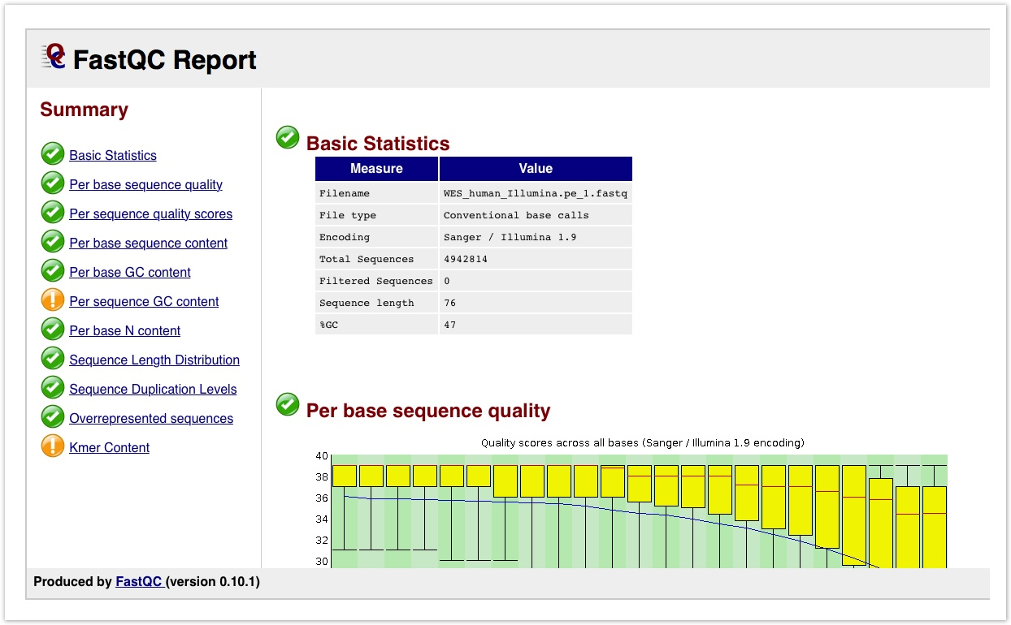
Best practices during quality control
Purpose: Assess the quality of the reads and ensure that the sequencing data is of high quality and reliable for downstream analysis.
FastQC: Identifies potential issues such as poor read quality, adapter contamination, and sequence biases.
Fastq_screen: Aligns reads to multiple reference genomes/databases. Good way to detect contamination.
Adapter trimming: Adapter trimming is optional, but often recommended. CutAdapt is the most common tool used for adapter trimming.

Slide 4
WES vs. WGS
WES focuses on the coding regions of the genome.
Often used in smaller studies where cost is a concern.
Difficult time capturing structural variants, mutations in non-coding region.
Used as first-line, quicker analysis compared to WGS
WGS sequences the entire genome
Used when cost and time aren’t a problem
Captures structural variants and mutations in non-coding regions

Slide 5
Best practices during alignment
BWA (BWA-MEM2) – Most popular for WGS/WES
Pros: Accurate, works well with GATK
Cons: Can be slow and computationally intensive
Bowtie2 – High speed and memory efficient aligner.
Pros: Fast, not as computationally intensive
Lower sensitivity than BWA-MEM
Novoalign – Closed source, high accuracy
Pros: Very accurate and reliable
Cons: Can be slow and requires a license
DRAGEN – Closed source, high accuracy, fast
Pros: Accuracy, speed, alignment and variant/copy number calling all in one step
Cons: Requires a license

Slide 6
Studies comparing aligners
Betschart et al – Benchmark study comparing BWA-MEM with DRAGEN
Study showed that alignment and mappings step was more accurate and faster using DRAGEN vs. BWA-MEM2/GATK.
Barbitoff et al – Benchmark study comparing various alignment tools and variant callers
Variant callers have a much larger effect on variant than choice of aligner.
Mentioned that BWA-MEM2 is a reliable aligner
Bowtie2 shouldn’t be used for human variant calling, significantly worse performance than other aligners.

Slide 7
Post-alignment processing
Sorting and indexing bam files for downstream analysis
Marking duplicates
Read duplicates give false confident in a specific variant and can affect copy number calling
Base quality score recalibration
Sequencing techniques have certain biases for determining quality scores. Tools like GATK BaseRecalibrator help correct for this

Slide 8
Best practices during variant calling
GATK (HaplotypeCaller) – Most popular tool for germline variant calling
Pros: Good sensitivity for SNVs and indels, BQSR included
Computationally very slow, requires multiple steps
FreeBayes – Germline variant caller sed for small datasets
Pros: Can call complex variants, works well on non-model organisms
Slower than GATK, high false positive rate
Strelka2 – Fast, mainly used for somatic variants
Pros: Fast and memory-efficient, high accuracy
Not well suited for structural variant detection

Slide 9
Best practices during variant calling
Mutect2 (GATK) – Somatic variant calling in cancer
Pros: Good sensitivity for low-frequency SNVs and indels. Works well with matched normal-tumor samples
Computationally very slow and intensive, prone to false positives
DeepVariant (Google) – Germline variant caller
Pros: Highly accurate due to deep learning approach, fewer false positives, open-source
Cons: Requires GPU acceleration for best performance
DRAGEN (Illumina)
Pros: Very fast, integrated QC and filtering, alignment and variant calling all in one step
Cons: Requires license and expensive hardware dependency

Slide 10
Studies comparing variant callers
Betschart et al - Benchmark study comparing GATK/BWA-MEM, DeepVariant, and DRAGEN for germline variant calling
GATK had the lowest performance of the three
However, DeepVariant requires GPU acceleration and DRAGEN requires a license
Barbitoff et al – Benchmark study comparing several germline variant callers
Modern machine learning models like DeepVariant outperform traditional models like GATK, even when using GATK’s machine learning model

Slide 11
Studies comparing variant callers
Abdelwehab et al – Compared 5 germline variant callers for short and long reads
Short reads - DeepVariant provided the most balanced variant calling performance, GPU compatible. Highest F1 score for SNVs and INDELs
GATK4 was the most conventional tool, allows for manual filtering and thresholding
Long reads – DeepVariant outperformed conventional methods, especially for indels. DNAscope is a computationally efficient AI tool that also performed well.

Slide 12
Studies comparing variant callers
Guille et al – Compared 20 somatic variant callers for WES datasets with reference mutations
Reads were aligned using BWA for all variant callers and base qualities were recalibrated using GATK
20 tools were used including widely used tools, commercial tools, deep learning tools
Top performers for somatic SNVs: Dragen, Muse, TNScope, Mutect2
Top performers for somatic indels: NeuSomatic, DeepSomatic, DRAGEN
DRAGEN was the most robust and also was one of the fastest
Commercial tools generally outperformed open-source tools

Slide 13
Germline vs Somatic variants
Different Assumptions: Germline variant callers (e.g., GATK HaplotypeCaller, DeepVariant) assume diploidy with allele frequencies of ~50% or 100%, while somatic callers (e.g., Mutect2, Strelka2) detect low-VAF mutations and require stricter filtering.
Matched Normal Requirement: Somatic callers often need a matched normal sample to filter out inherited variants, whereas germline callers use population databases for filtering.
Error Handling & Sensitivity: Somatic callers are optimized for low-frequency mutations and tumor heterogeneity, while germline callers focus on high-confidence inherited variants

Slide 14
Structural variants/Copy number variantion
Gabrielaite et al. – Study comparing 11 tools for copy-number variation detection in germline WGS and WES data.
GATK gCNV had high recall but low precision.
Lumpy and DELLY had more balanced recall and precision, reducing false positives.
Manta and CNVkit performance varied a lot across datasets
Study suggested that using multiple tools is the gold standard

Slide 15
Variant Filtering
Pedersen et al. - Study evaluates variant filtering strategies using two WGS and WES family cohorts.
Genotyping Quality (GQ >= 20) – ensures confidence in a genotype call
Allele Balance (AB: 0.2-0.8) – Extreme values could suggest sequencing bias or error
Sequencing Depth (DP >= 10) - Minimum sequencing depth covering a variant site to reduce false positives
Population Allele Frequency (<0.001 for dominant and <0.01 for recessive)

Slide 16
Annotation
Functional Annotation: Predicts the biological impact of variants using tools like SIFT, PolyPhen, and CADD to assess protein function and regulatory effects.
Population & Clinical Databases: Filters variants based on population allele frequencies from gnomAD and 1000 Genomes and links to disease databases like ClinVar and COSMIC.
Pathogenicity: Uses quality filters and pathogenicity scoring to identify rare, high-impact variants relevant to disease or functional studies.

Slide 17
GATK –genotype gVCF can genotype across samples.
Long read alignment, minimap

