Slide 1
Long-read best practices
James Rouse

Slide 2
Long-read technology
Sequencing method that produces reads > 10kb, sometimes even megabases.
PacBio and Oxford Nanopore have developed technologies for accurate long-read capturing.
Used for detecting structural variants, full-length transcripts/isoforms, genome assembly, etc.
Long-read is generally less accurate and more expensive than short read, but technology is improving

Slide 3
Oxford Nanopore vs PacBio
Oxford Nanopore is used when you need very long reads
For example, structural variants are better studied using long reads
PacBio is used when you need very high accuracy
SNP/INDEL calling, genome assembly
Feature | Oxford Nanopore | PacBio
Read Length | Very long (Megabases) | Long (>10kb)
Accuracy | 90-98% accuracy | >99% accuracy
Sequencing Method | Real-time | Consensus (Read is read multiple times)
Cost per base | Lower, but generally more bases | Higher due to accuracy

Slide 4
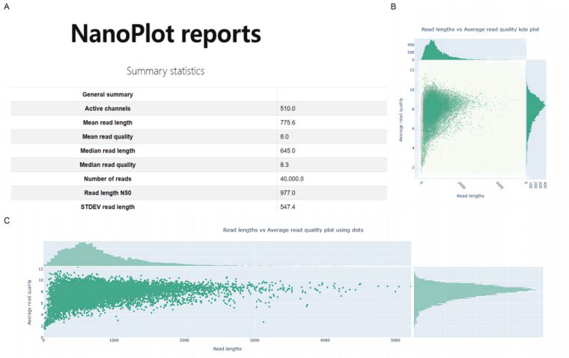
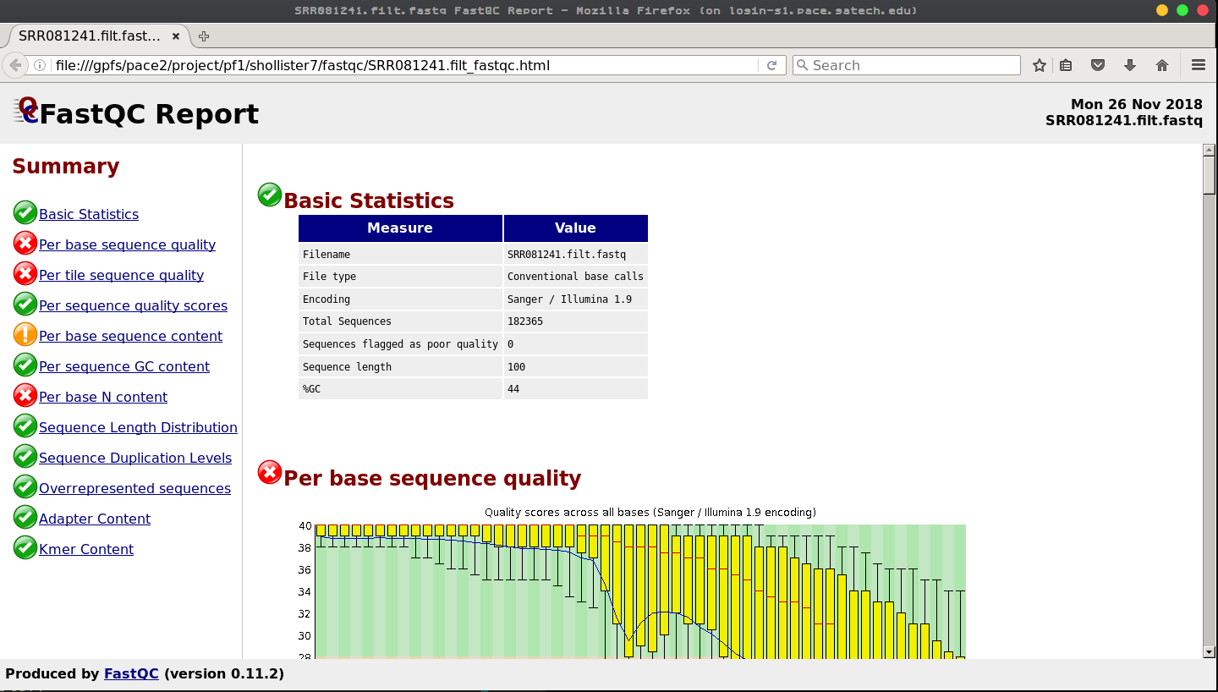
Quality control
Nanoplot – QC tool specifically made for long-read data.
FastQC – can still be used for long-read data, but typically used for short-read data.

Slide 5
Alignment for long-read RNA
Minimap2 is dominant tool for long read RNA alignment.
Benchmark studies mainly look at transcript level tools or assembly tools
Transcript assemblers, quantifiers, differential tools
LoTempio et al – Benchamarks the alignment tools for long-read RNA
Minimap2 outperforms all of the other tools
Winnowmap2 was the fastest tool
Alignment tool generally less important in long-read because the longer reads are often easier to align to the genome.

Slide 6
Dong et al. Benchmark study for long-read RNA analysis
Isoform Reconstruction and Detection
StringTie2: Highest precision (predictions were correct)
Bambu: Highest power (more novel isoforms were detected)
FLAIR, TALON, cupcake all overpredicted – a lot of artifactual isoforms
Differential transcript expression (DTE)
DESeq2, edgeR, limma all effective and performed similarly in differential transcript analysis
Differential transcript usage (DTU)
DRIMSeq and DEXSeq were the most powerful DTU tools but had high false discovery rates; edgeR controlled FDR well but had the lowest power

Slide 7
Pardo-Palacios et al – Benchmark study for long-read transcript indentification
All reads were aligned using minimap2
Read quality and length, not quantity were the drivers of accurate transcript reconstruction
Toos for transcript identification varied in performance
Best Tools for reference based: Bambu and IsoQuant, FLAMES.
De Novo Transcript Detection – StringTie2 for assembly and Isoquant for quantification, RNA-Bloom and rnaSPAdes both prone to overcalling.

Slide 8
Dierckxsens et al – Benchmark study for long-read structural variant
cuteSV, SVIM, and pbsv performed best overall, with pbsv being most accurate for SV position and length.
combiSV, a new tool, combines outputs from 6 SV callers to improve recall, precision, and accuracy.
Higher sequencing depth doesn't always help, but longer reads consistently improve SV detection.

Slide 9
Luth et al. – Genome assembly tools with long-read data
Flye is the top-performing long-read assembler overall for PacBio CLR and ONT reads.
Hifiasm and LJA are best for high-accuracy PacBio HiFi assemblies.
Miniasm, Raven, and wtdbg2 work well for small genomes with lower resource use.
Longer reads improve reduce interruptions in large genomes but don’t always enhance identity or gene recovery.

Slide 10
Varaint Callers for long-read DNA data
Clair3
Deep learning-based
Top accuracy on ONT & PacBio HiFi
PEPPER-Margin-DeepVariant
Ensemble model (PEPPER + DeepVariant)
Excellent for PacBio HiFi
Mutserve2
Best for mitochondrial low-frequency variants
High sensitivity & F1 score

Slide 11
Differences from short-read
Data comes in FAST5 format, not FASTQ.
Tools like Guppy and Bonito are used for base calling
Trimming
Tools like FiltLong or NanoFilt are used to trim long-read data
Deference in tools for variant calling and transcript identification/quantification
As discussed, different tools should be used when dealing with long-read data
Notes:
Polishing before alignment, rescaling the quality score. - Combining short read sequencing.
Assembly is main reason people want to use.
Canu for assembly
Long read methylation, nanocompore and expore detect methylation from the electric current changes.
Epi2me is native to oxford nanopore

