Slide 1
Core Knowledge Series: Machine Learning Session Three: SVM, Hierarchical Clustering, Random Forest/Decision Trees
Bioinformatics Core (BSR)

Slide 2
Support Vector Machines

Slide 3
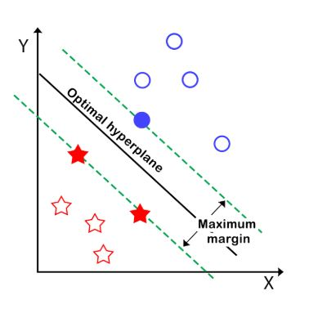
Support Vector Machines
SVM is a supervised ML algorithm used primarily for classification
Finds the best boundary—called a hyperplane—that separates different classes of data in a way that maximizes the distance (margin) between them.
Real world example: Distinguishing between malignant and benign tumors

Slide 4
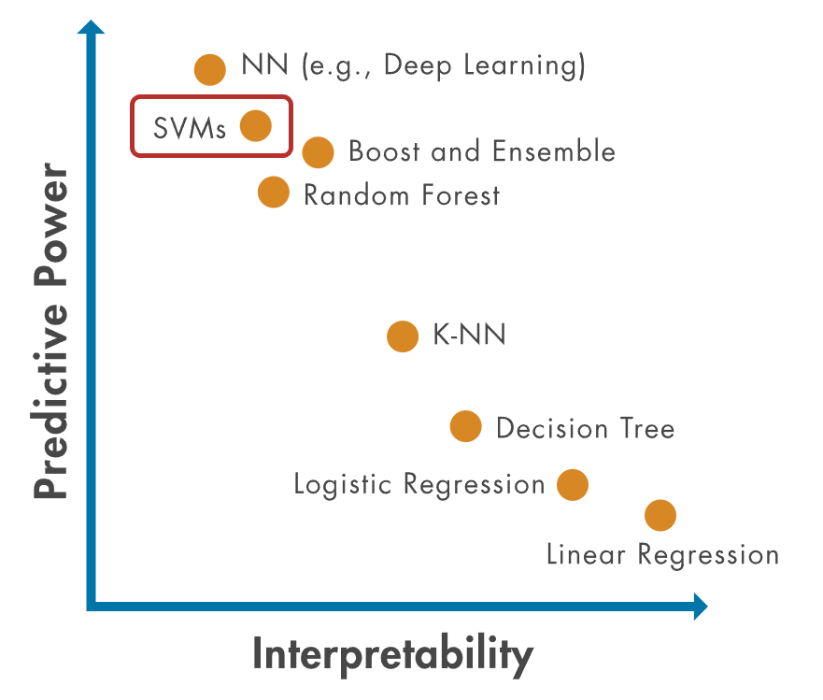
Support Vector Machines – Pros and Cons
Pros | Cons
Effective in high-dimensional spaces | Doesn’t scale well to very large datasets
Can handle non-linear decision boundaries/data | Kernel and hyperparameter tuning (C, kernel choice) can be challenging
Memory efficient (only rely on a subset of training points - support vectors) | Outputs are not naturally probabilistic
Tend to generalize well, resisting overfitting | Harder to interpret than other models

Slide 5
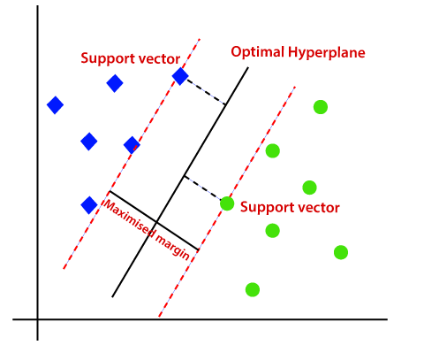
How do SVMS work?
SVM searches for a boundary that best separates the data
SVM selects the one with the largest distance from the nearest points of each class.
Larger margin leaves more room for variation in new data
This reduces the chance that small differences will lead to misclassification.

Slide 6
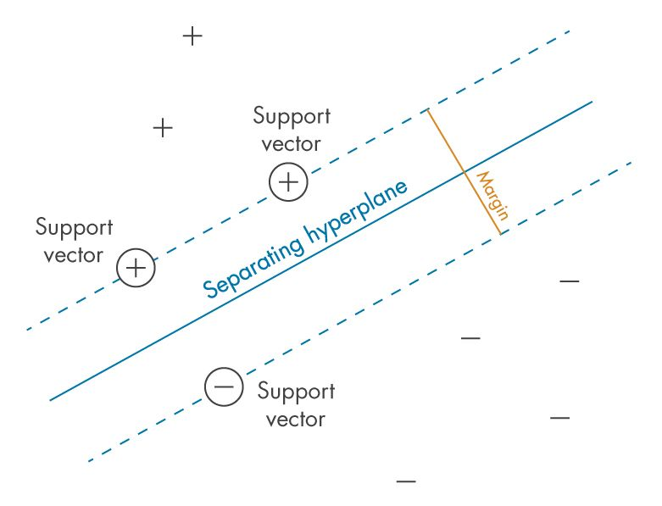
Support Vectors
Support vectors are the data points closest to the initial decision boundary.
Final decision boundary is decided using only support vectors
Moving other points has little/no effect on the boundary.
But what happens when the data cannot be perfectly separated by a boundary?

Slide 7
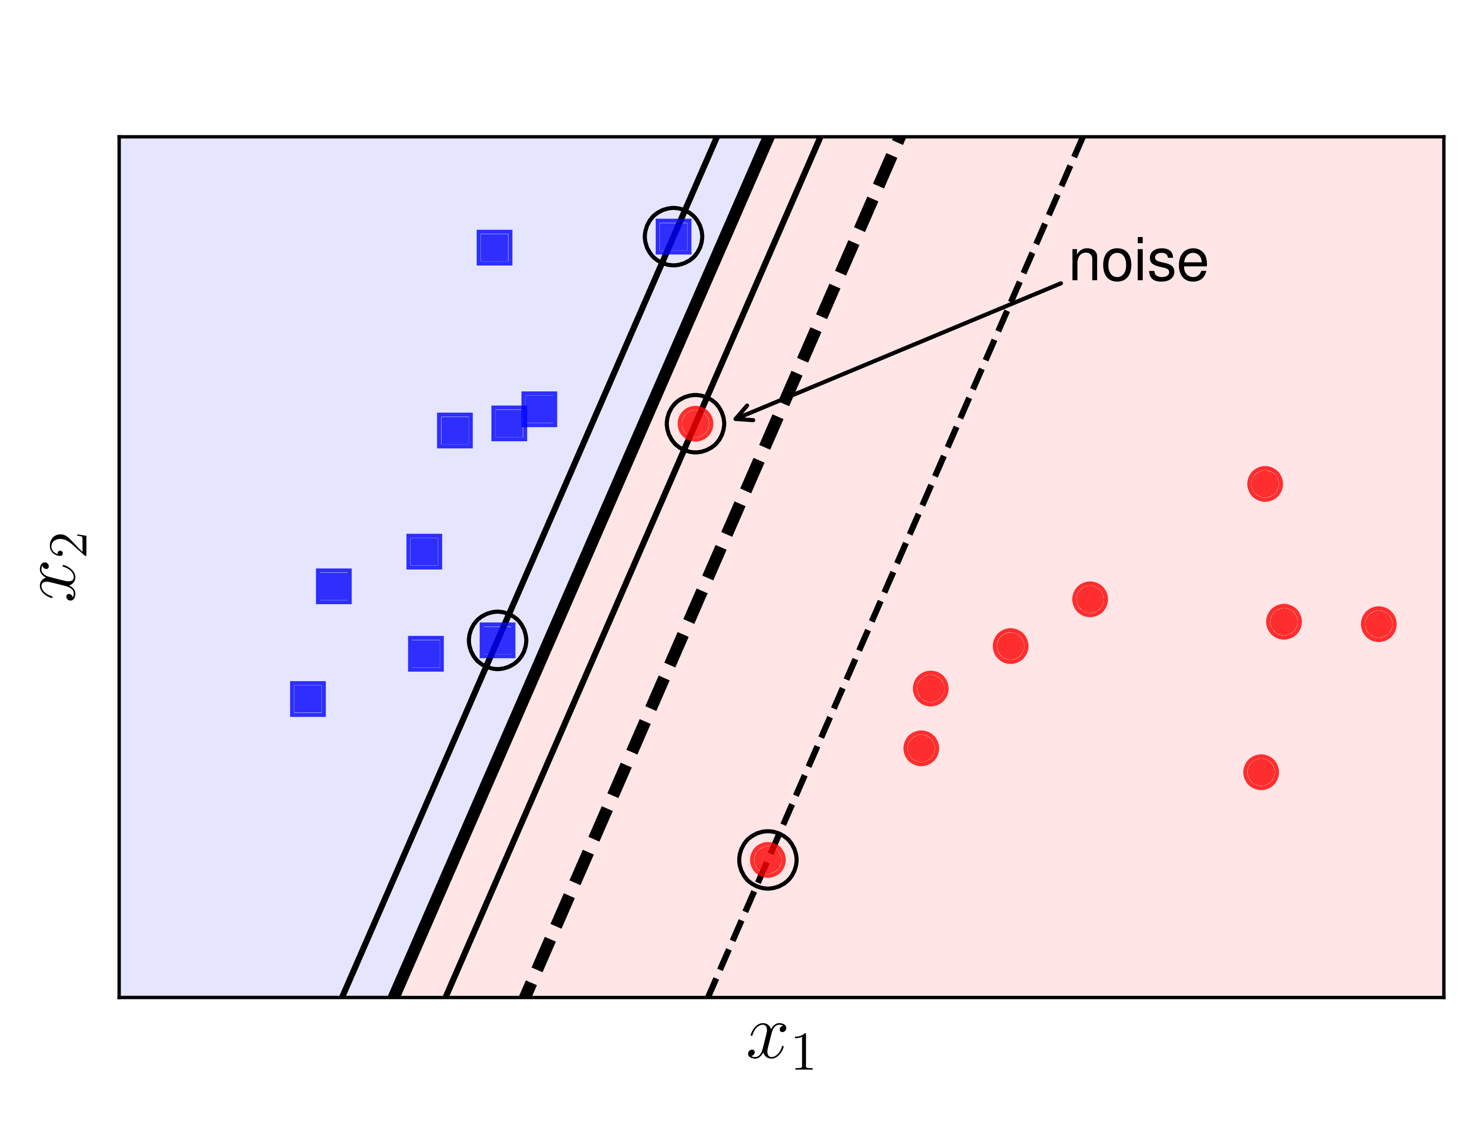
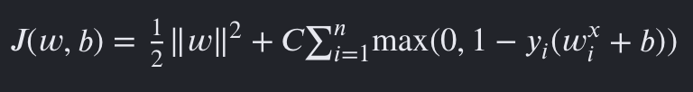
Soft Margin SVM
Real-world data often contains noise and outliers
Soft margin SVM allows some points to fall inside the margin or be misclassified
Maintains a wider, more generalizable boundary
Hard margin SVMs tend to overfit the data and is strongly affected by outliers
Goal: Maximize margin while minimizing error
Inverse of Margin
Penalty for misclassifications

Slide 8
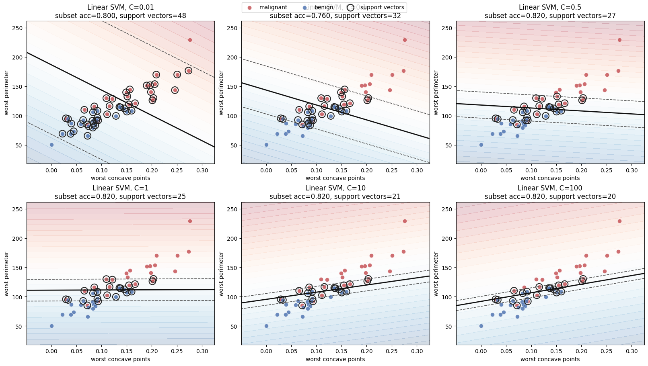
Affect of C Parameter Adjustment
C Parameter: Controls how much the SVM penalizes classification errors.
High C: Fewer errors allowed (higher penalty), boundary tries harder to classify all points correctly.
Low C: More errors allowed (lower penalty), wider margin and less sensitivity to outliers.

Slide 9
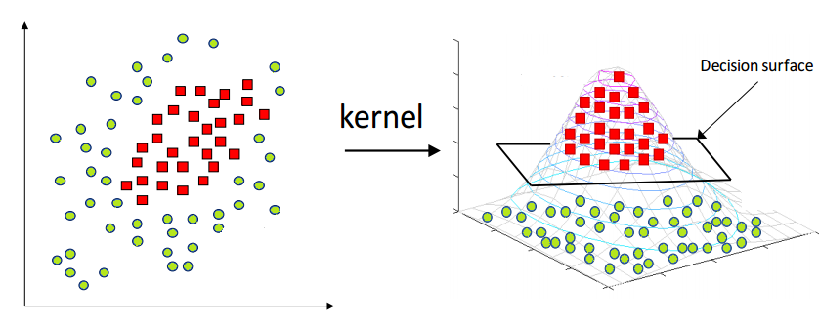
Kernel Trick / Nonlinear SVM
Not all datasets can be separated by a straight line
Kernels transform data into a higher-dimensional space
This allows SVMs to find nonlinear decision boundaries

Slide 10
Hierarchical Clustering

Slide 11
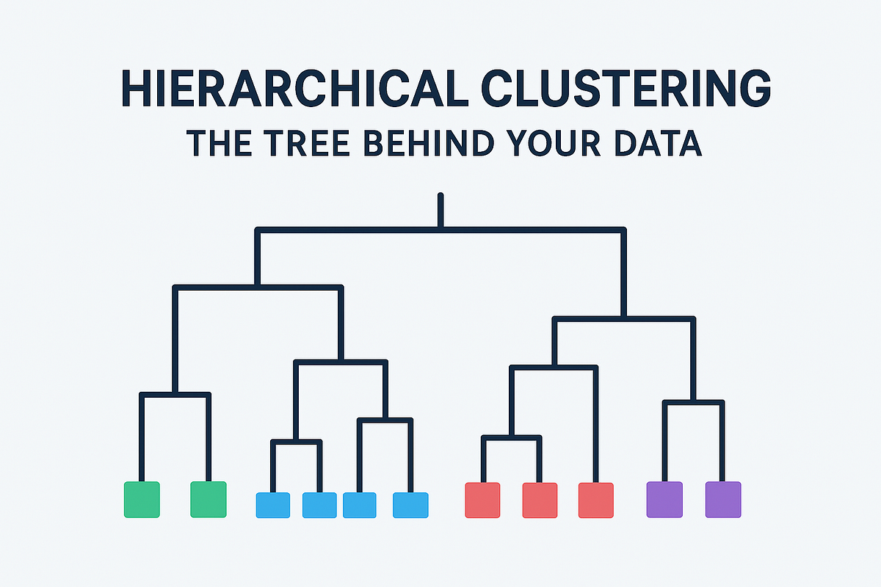
Hierarchical Clustering
Unsupervised machine learning method
Groups similar observations into clusters
Builds a hierarchy of relationships between observations
Results are visualized in a dendrogram (tree)

Slide 12
Hierarchical Clustering– Pros and Cons
Pros | Cons
Don’t need to specify number of clusters | Computationally expensive for large datasets
Dendrogram is intuitive and interpretable | Sensitive to hyperparameters chosen
Reveals relationships between both samples and clusters | Heavily affected by noise and outliers
Commonly used for gene expression and genomic data | No objective “best” number of clusters is reported

Slide 13
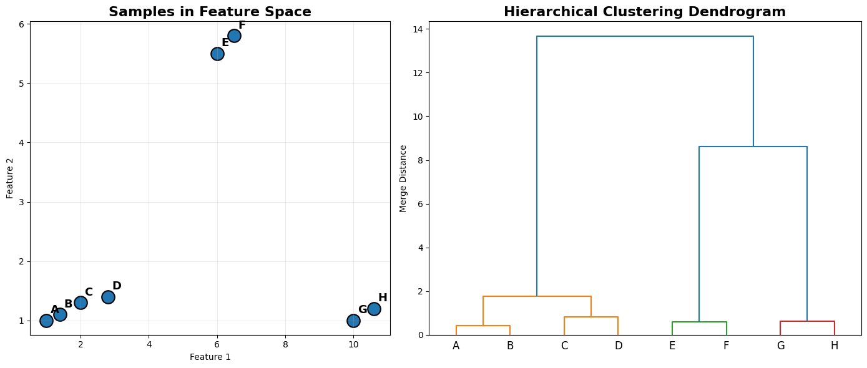
Hierarchical Clustering – How it works
Start with each observation as its own cluster
Every sample begins in a separate cluster.
Calculate distances between all clusters
Similarity is measured using a distance metric (e.g., Euclidean distance).
Merge the two closest clusters
The most similar clusters are combined into a larger cluster.
Repeat until all observations are grouped
Distances are recalculated after each merge until a single cluster remains.

Slide 14
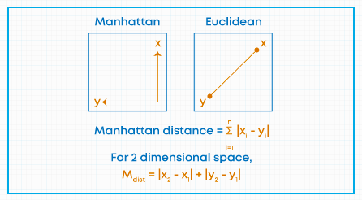
Distance Calculation Methods
Euclidian Distance
Measures the straight-line distance between two measurements
Manhattan Distance
Measures distance traveled across a grid
Other distance metrics
Correlation Distance (Patterns)
Cosine Distance (Similarity in direction)

Slide 15
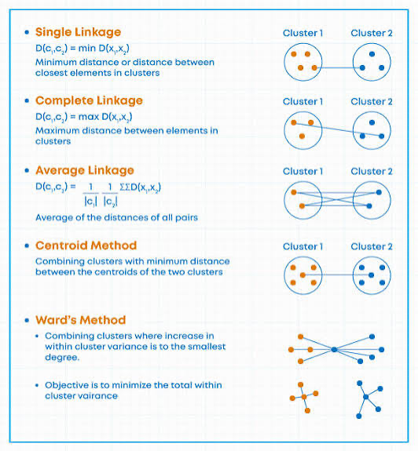
Linkage
Linkage determines how the distance between clusters is calculated.
When clusters contain multiple samples, there is no single distance between them.
Single Linkage
Uses the closest points between clusters.
Complete Linkage
Uses the farthest points between clusters.
Average Linkage
Uses the average distance between all points.
Ward’s Linkage
Merges clusters that result in the smallest increase in cluster variance.

Slide 16
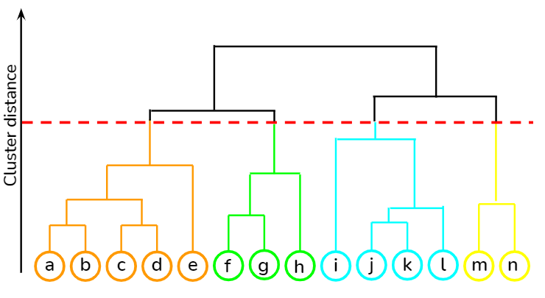
Determining Clusters from Dendrogram
Hierarchical clustering does not require a predefined number of clusters.
Clusters are determined by selecting a cut height on the dendrogram.
Effect of Cut Height
Higher cut: Fewer, larger clusters
Lower cut: More, smaller clusters

Slide 17
Decision Tree

Slide 18
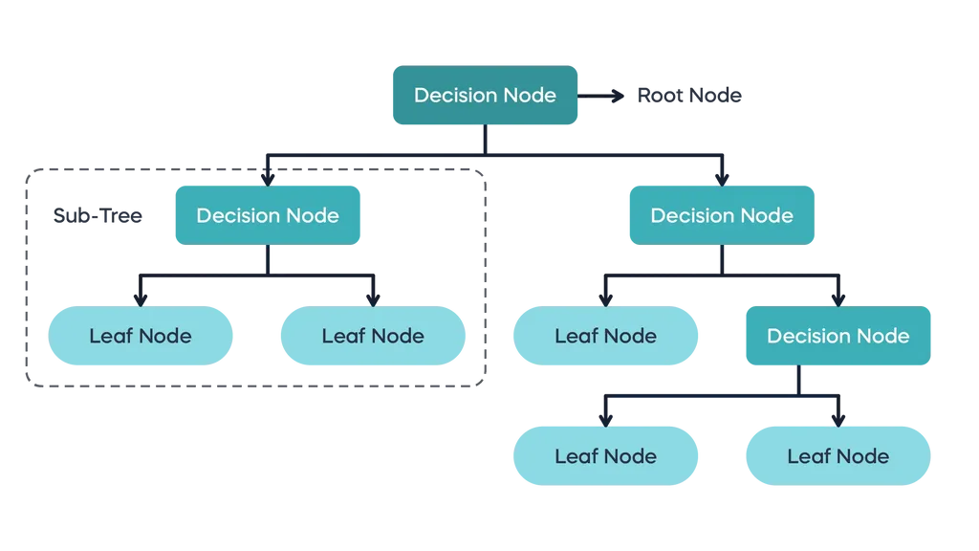
Decision Tree
Supervised machine learning method
Uses a series of decision rules to make predictions
Can be used for classification and regression
Easy to interpret and visualize

Slide 19
Decision Tree – Pros and Cons
Pros | Cons
Easy to interpret and explain | Prone to overfitting
Handles numeric and categorical features | Small data changes can cause large structural alterations in the tree
No feature scaling required | Biased toward dominant features
Provides easy to follow decision trees | Often less accurate than ensemble methods

Slide 20
Decision Tree Structure
Root Node
First decision in the tree
Internal Nodes
Intermediate decision nodes
Branches
Outcomes of decision rules
Connect parent and child nodes
Leaf Nodes
Terminal nodes that make the final prediction
Take majority class as prediction

Slide 21
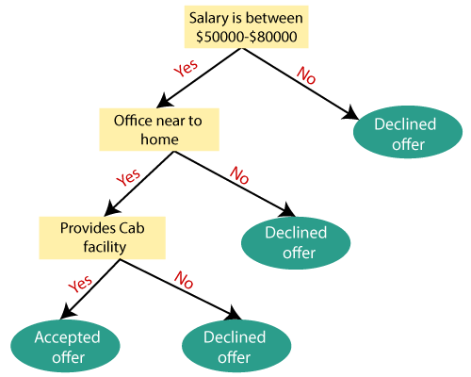
How do Decision Trees work?
Start with all observations in one group.
Find the best feature and threshold to cleanly separate the data.
Partition observations into child nodes based on the split rule and recursively evaluate additional splits.
Stop when a stopping criterion is reached and assign a prediction

Slide 22
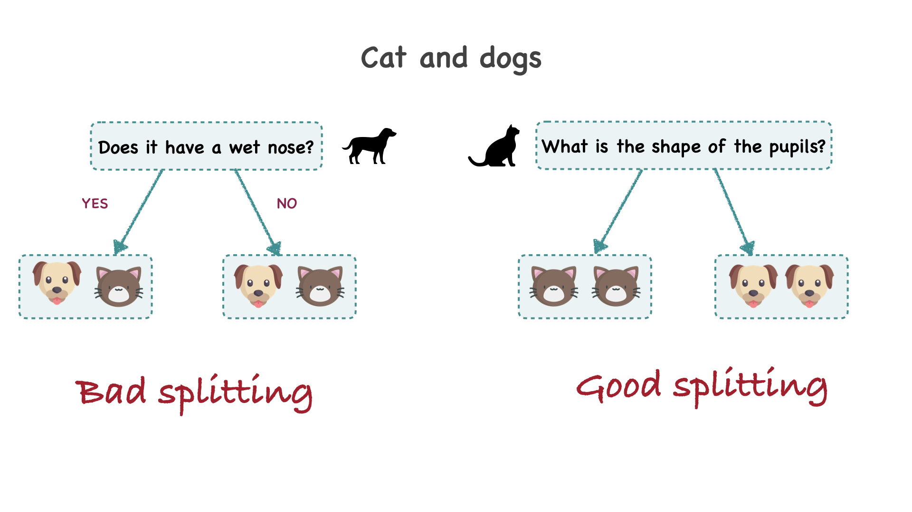
Choosing the best split at decision nodes
Multiple features and thresholds are evaluated at each node.
The best split is the one that separates the classes most effectively.
Gini Impurity is the most common method used to evaluate the quality of a split.
Measures how mixed the classes are within a node.

Slide 23
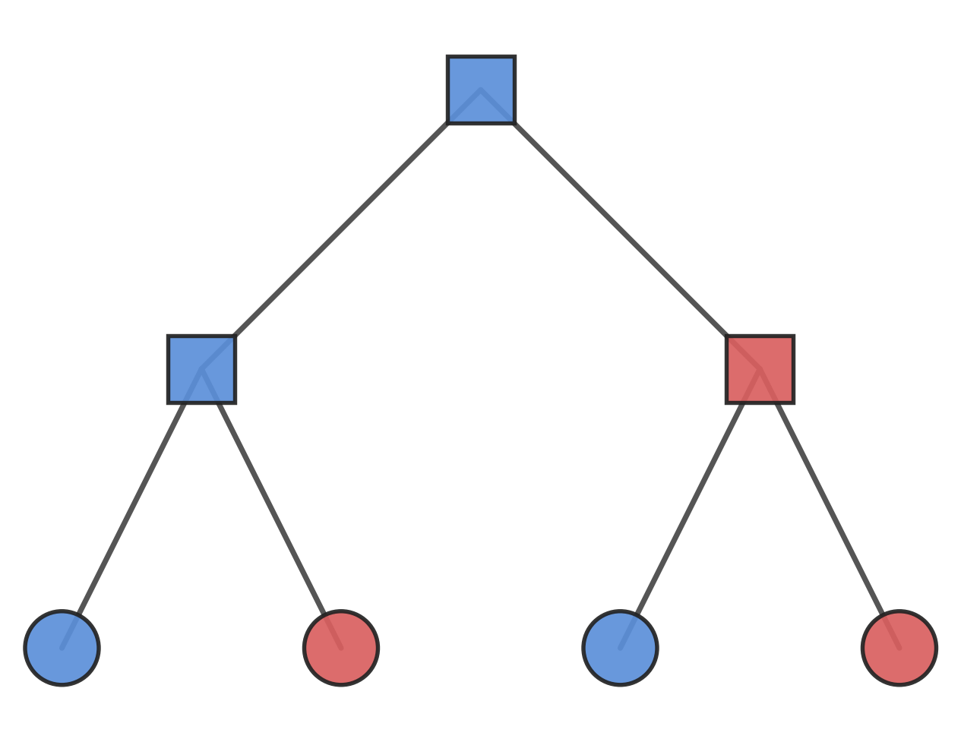
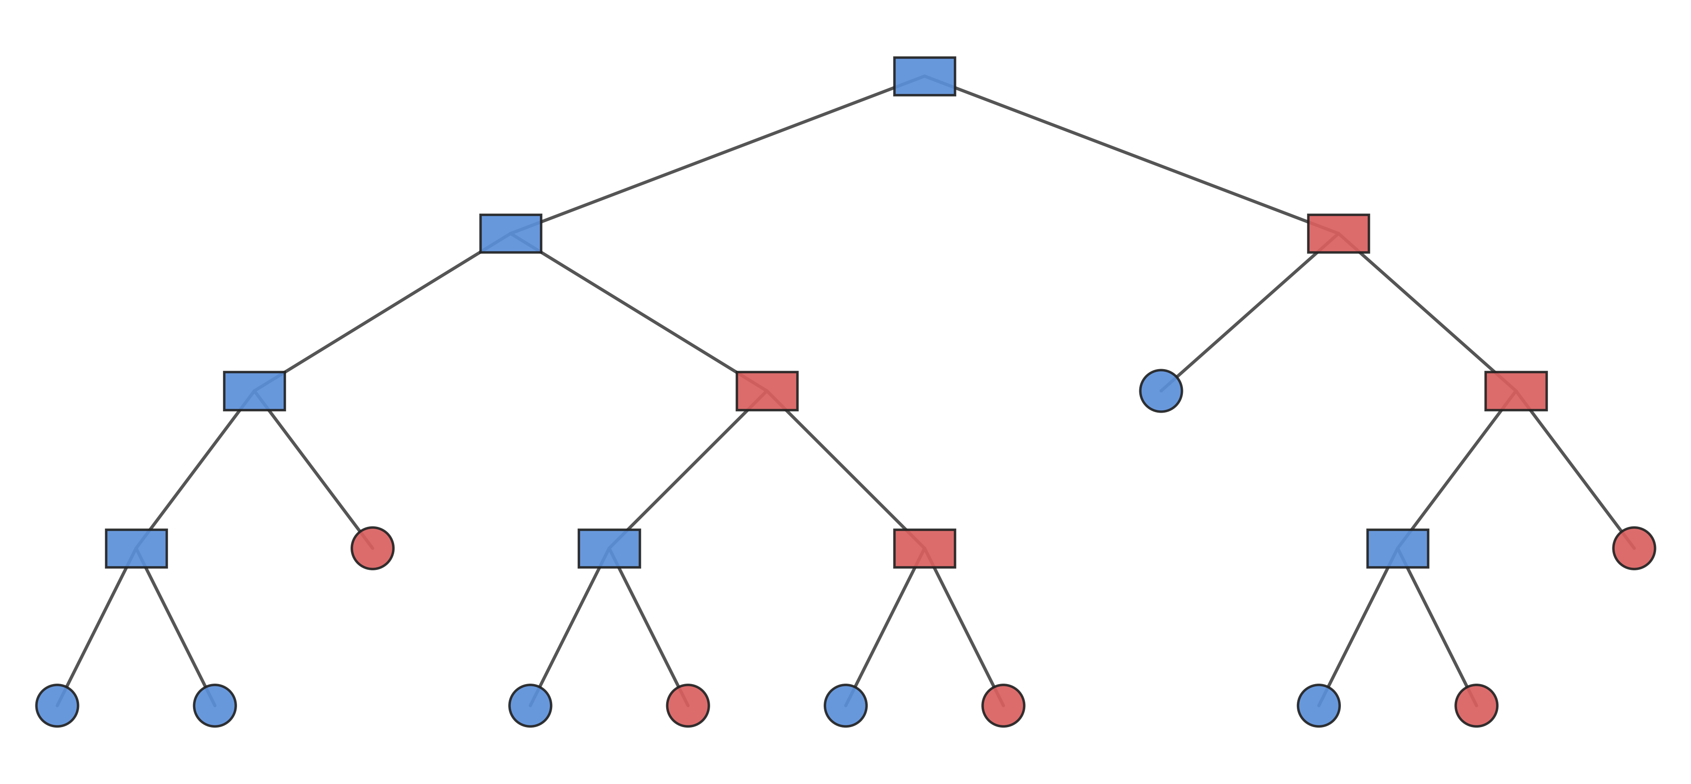
Controlling Tree Growth
Decision trees continue splitting until a stopping criterion is reached.
Limiting tree growth can reduce overfitting and improve generalization.
Several hyperparameters control when the tree stops splitting.
Max_depth: Maximum number of levels in the tree
Min_samples_split: Minimum number of observations required to split a node.
Min_samples_leaf: Minimum number of observations required in a leaf node.

Slide 24
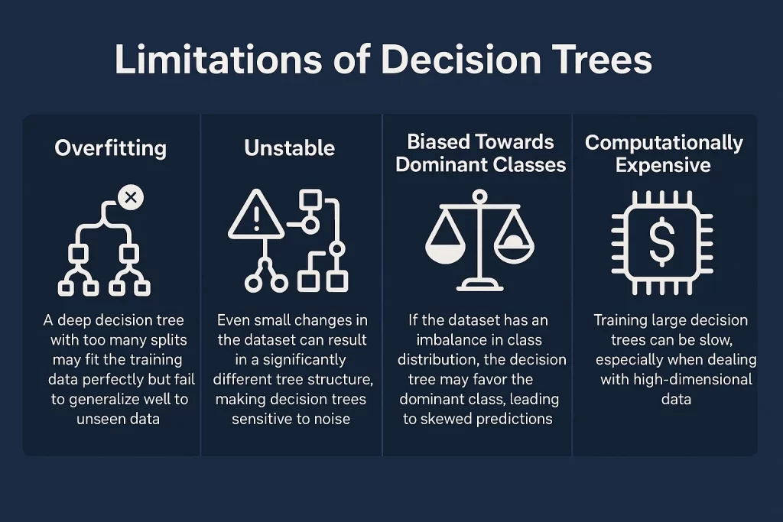
Limitations of a single decision tree
Decision trees are highly sensitive to the training data.
Small changes in the data can produce very different trees.
Deep trees may overfit and memorize training examples.
Predictions from a single tree can be unstable.
How can we maintain the interpretability of decision trees while reducing overfitting and improving prediction accuracy?

Slide 25
Random Forest

Slide 26
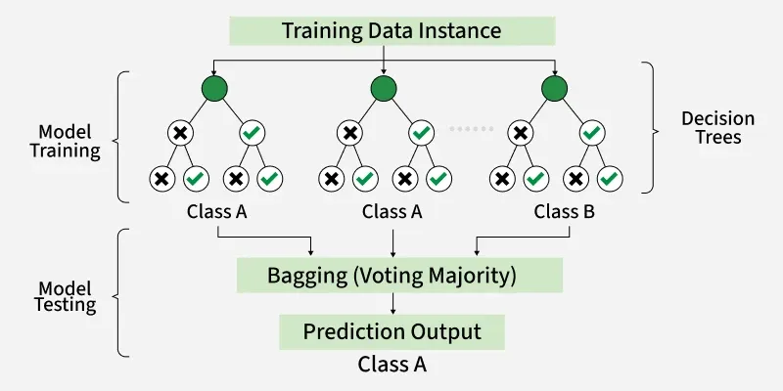
Random Forest
A Random Forest is a collection of decision trees that work together to make predictions.
Each tree is trained on a slightly different dataset.
Predictions from all trees are combined.
Reduces overfitting and improves model stability.

Slide 27
Random Forest– Pros and Cons
Pros | Cons
More accurate than a single decision tree | Less interpretable than a single decision tree
Less prone to overfitting | More computationally expensive
Robust to noise and outliers | Larger memory footprint
Handles high-dimensional data well | Requires more hyperparameter tuning

Slide 28
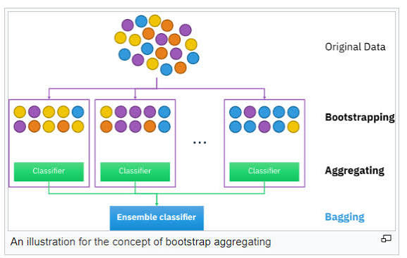
How Random Forest Works
Create multiple random training datasets by sampling observations with replacement
Train a separate decision tree on each bootstrapped dataset
At each split, evaluate only a random subset of features.
Different trees learn different patterns
Combine predictions from all trees
Majority vote

Slide 29
How many trees to build in the forest?
Number of Trees (n_estimators)
Controls how many decision trees are included in the forest.
More trees generally improve model stability and performance.
Performance gains eventually plateau.
More trees increase training time and memory usage.
Number of random features (max_features)
Smaller values increase tree diversity
Larger values make trees more similar
Typically set to the square root of the total number of features

Slide 30
Choosing a machine learning model
Are you predicting an existing answer or finding new patterns?
Known Label
Supervised Learning
Build a prediction model
Unknown Label
Unsupervised Learning
Look for structure
Regression
Predict a number
Classification
Predict a group
Explainable
Interpretable/understandable models
Pattern finding
Find natural groups
Linear Regression
Random Forest
Logistic Regression
SVM
Decision Tree
Linear/logistic regression
Hierarchical clustering/K-means
PCA/UMAP

Slide 31
Additional Models Not Covered
Gradient Boosting:
Combines many simple models to make stronger predictions
Each model fixes the mistakes of the previous ones
Neural Networks:
Learns complex patterns from large datasets using artificial neurons
Deep Learning:
Uses larger neural networks for complex data

Slide 32
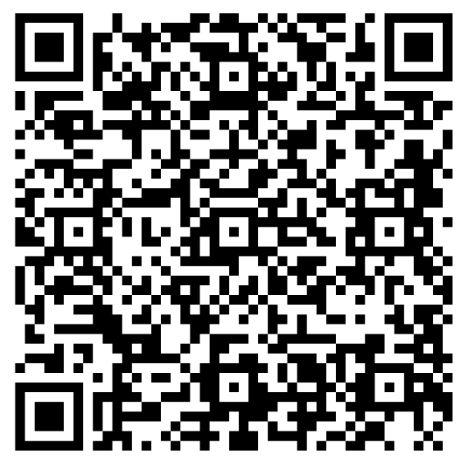

Your feedback ensures we provide you with the best content
Please scan the QR code to take our 1-minute survey!

