Slide 1
Single-Cell RNA-seq best practices
James Rouse

Slide 2
Introduction to scRNA-seq best practices
Filtering out low quality cells
Filter out doublets/triplets (droplets containing multiple cells)
Normalize/scale counts to same number of reads per cell.
Feature selection/dimensionality reduction
Visualization - UMAP
Clustering/Cell-type annotation
Differential expression
Optional: Cell trajectory

Slide 3
Filtering out low quality cells
Cells that are filtered out may have: low count depth, low number of detected genes, a high fraction of mitochondrial counts.
Remove multiplets (droplets containing multiple cells)
Seurat (R tool) and scanpy (python) tool have custom functions to filter out poor quality cells
Seurat doesn’t have a doublet tool, but there are tools developed in R to detect doublets in Seurat data.
Notes:
Scrublet used in Seurat and scanpy

Slide 4
Filtering out low quality cells (continued)
In scanpy tutorial, cells that are expressing less than 100 genes are filtered out and genes that are only expressed in less than three cells are also filtered out. Reasoning they gave is that poor QC metrics could represent real biology.
Seurat removes cells that are expressing less than 200 genes and cells that are expressing over 2500 genes. More conservative and removes cells overexpressing genes, as they may be doublets.
Scanpy recommends determining mitochondrial percentage based on a threshold while Seurat typically removes cells with over 5% mitochondrial content.

Slide 5
Normalization
Standard method of normalization is to scale counts to a fixed number per cell and then to log normalize.
Seurat has a function called SCTransform that models and removes technical variability.
Scaling all genes by a common factor assumes that differences in count depth due to cell size are negligible. – Heumos et al.
Scran package in R will pre-cluster/pool cells and calculate size factors for these individual pools

Slide 6
Normalization (continued)
Seurat uses 10,000 as the default scale factor, but scanpy uses median of total counts this can be manually set in both.
Both have custom functions to log normalize the data.

Slide 7
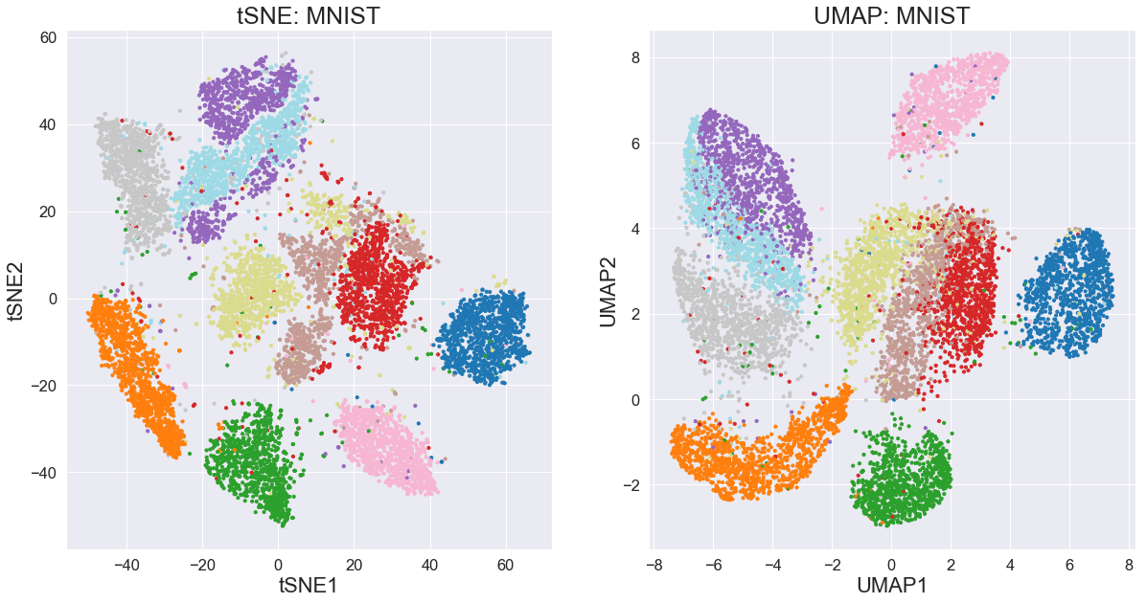
Feature Selection / Dimensionality Reduction
Feature selection: Seurat and scanpy both have functions to select top variable genes to reduce noise. Both recommend using top 2000 variable genes.
Dimensionality reduction: Transforms data into fewer dimensions.
UMAP most commonly used tool: Builds graph based on nearest neighbors and projects onto 2D surface
t-SNE: calculates probability that two cells are neighbors – better for detecting small, fine clusters

Slide 8
Clustering
Number of neighbors must be set for clustering. Low number of neighbors better for local clustering, high number better for global clustering.
Number of principal components must also be set: Too many – too much noise. Too few– missing important variations in the data.
Leiden and Louvain are clustering methods that detect groups in graph data; Leiden improves on Louvain by ensuring better-connected and more robust clusters.
Resolution parameter is used to set how many clusters will be made.

Slide 9
Integration/Batch effects
Identify Batch Effects - Use **PCA/UMAP/t-SNE to visualize batch effects. Check for batch-associated variation in gene expression.
Batch Correction with Harmony - Harmony aligns datasets while preserving biological variation. Harmony works well for large and complex batch effects.
Post-Integration QC - Visualize corrected data using UMAP/t-SNE. Check batch effect removal using **PCA variance plots**.

Slide 10
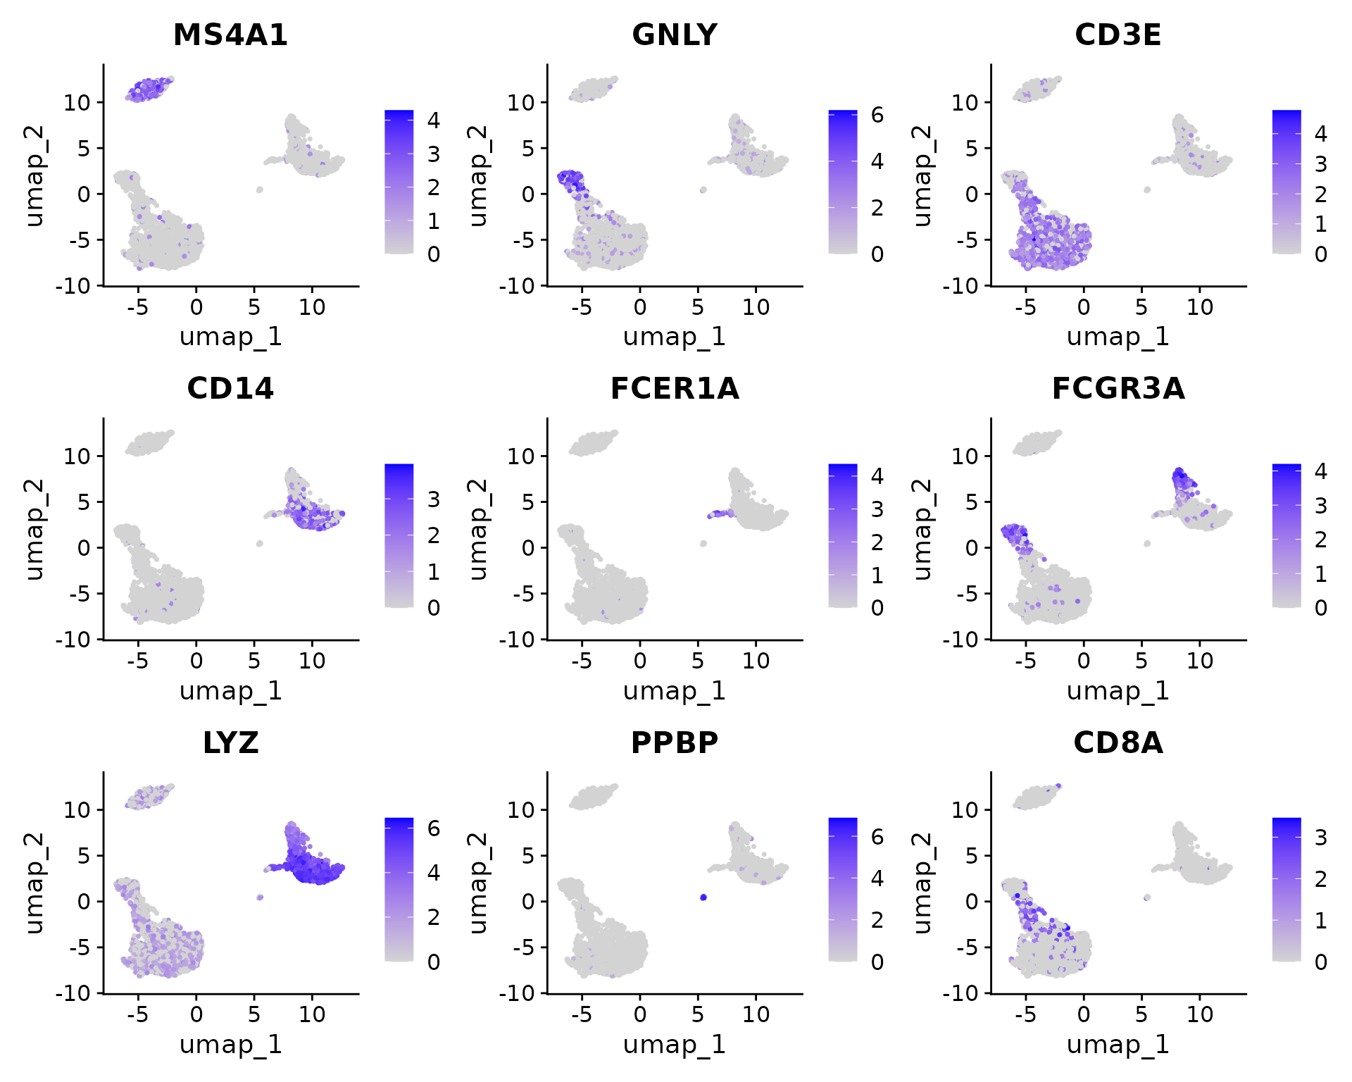
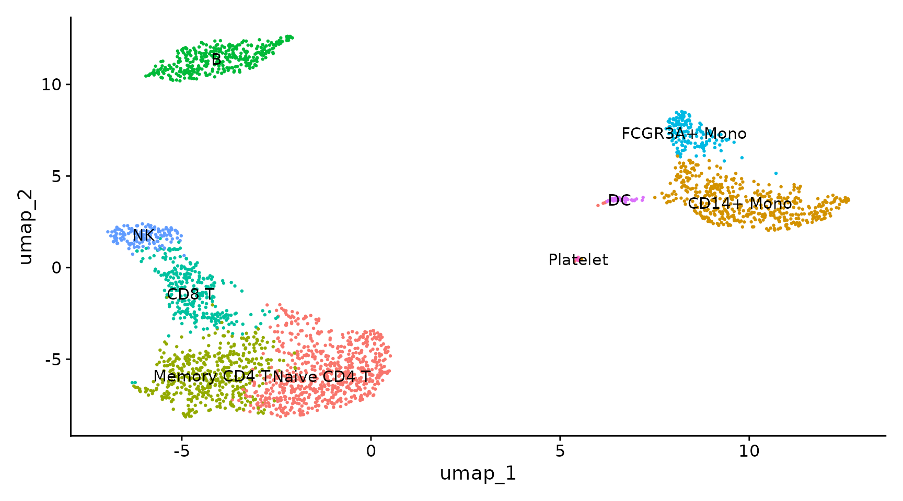
Clustering example with Seurat

Slide 11
Clustering benchark study – Yu et al
Top-performing methods: Stability-based approaches like scCCESS-SIMLR and Monocle3 excel at accurately estimating the number of cell types, even in datasets with varying complexity, while SC3, ACTIONet, and Seurat tend to overestimate, especially with large datasets or many cell types.
Data characteristics impact performance: Increasing cell types or cells per type often introduces overestimation (SC3, Seurat) or underestimation (SHARP, densityCut).
Clustering vs. cell type estimation: High clustering accuracy (e.g., SC3, Seurat) doesn’t always translate to accurate cell type number estimation, underscoring the need to evaluate these metrics independently.

Slide 12
Cell-type annotation
Determine differentially expressed genes in each cluster. FindAllMarkers in Seurat and rank_genes_groups in scanpy.
Assign cluster identities based on marker genes.
For example, if epithelial markers are highly expressed in one cluster, the cluster could be a group of epithelial cells

Slide 13
Differential Expression Analysis
Differential expression analysis can be done between certain cell types of interest.
Genes of interest plotted on UMAP to see which cell type the gene is expressed in.
Use differential expression results for pathway enrichment analysis

Slide 14
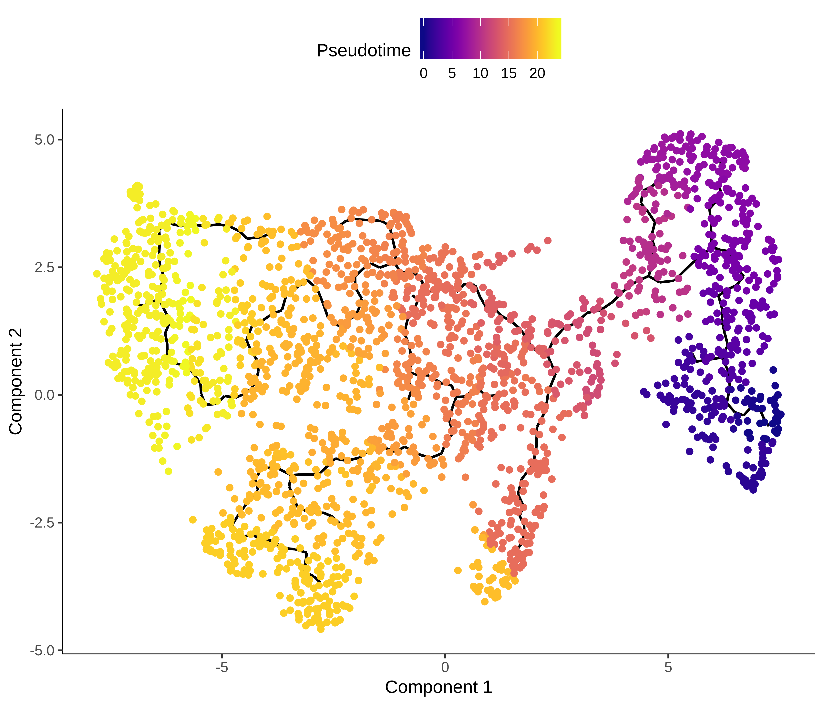
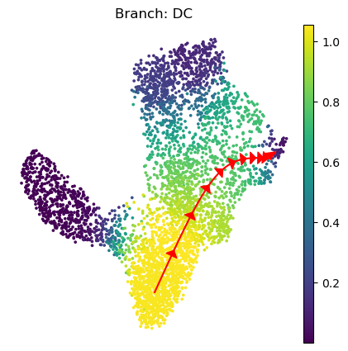
Pseudotime/Trajectory Analysis
Pseudotime analysis infers the progression of cells along a trajectory.
Monocle3 – Monocle calculates pseudotime by constructing a trajectory graph of cells based on their transcriptional similarity. Supports branching differentiation
Palantir – More robust to noise, but doesn’t support branching differentiation.

Slide 15
Cell ranger/Loupe browser
Cell Ranger is a software developed by 10X genomics for processing scRNA data from their platform.
Can output barcode matrix and h5 file, compatible with Seurat and scanpy. Also performs clustering and dimensionality reduction.
Cell Ranger also produces a loupe file, which can be visualized using their interactive visualization tool. User-friendly way to view scRNA results.
Cons to Cell Ranger: Highly customized to 10X Genomics data, but lacks flexibility for other platforms. Limited downstream analysis (need to use Seurat or scanpy). Not easy to modify processing steps (use a different tool)

