Slide 1

Multi-user Interactive
Delay/Disruption Tolerant Network
Rekop Poker
James Scully

Slide 2
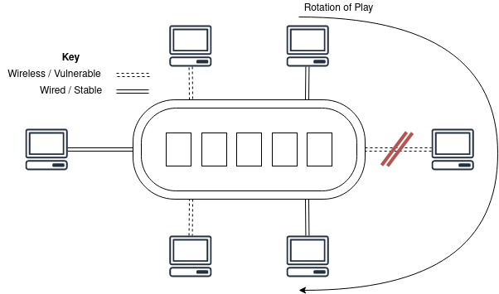
Delay Tolerant Networking
Allows those with unstable or delay to use a service/network as normal
Particularly useful in spacecraft or mobile locations
Server must handle re-connections in a controlled, stable manner

Slide 3
Motivation

Slide 4
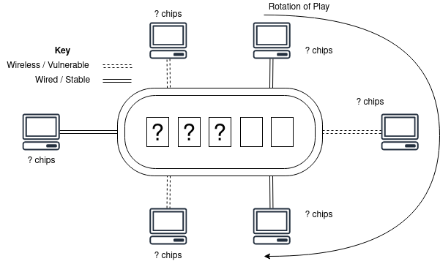
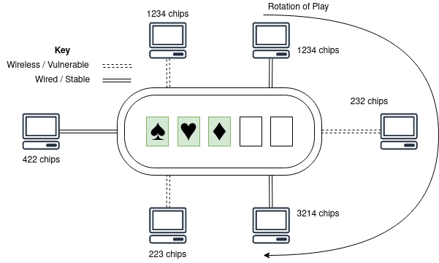
Objectives
On connection loss, players have an amount of time to reconnect.
Players that disconnect never lose their information (chips, cards, etc.)

Slide 5
Motivation

Slide 6
Motivation

Slide 7
Motivation

