Slide 1
Building An Eject-A-Bed
Jamie Dixon
Code Stock: 7/12/2014

Slide 2
Material
Mattress
Metal-framed box spring
Used hospital bed
Erector Set
Servo
Netduino
Wifi Hub

Slide 3
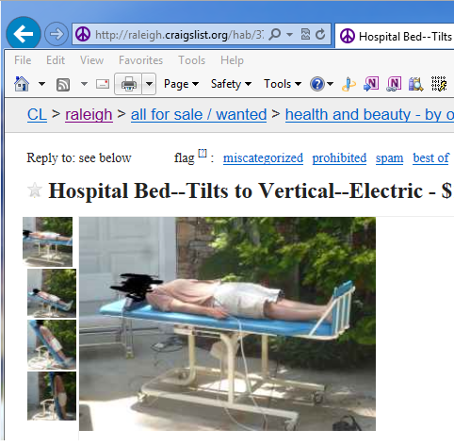

Get The Bed

Slide 4
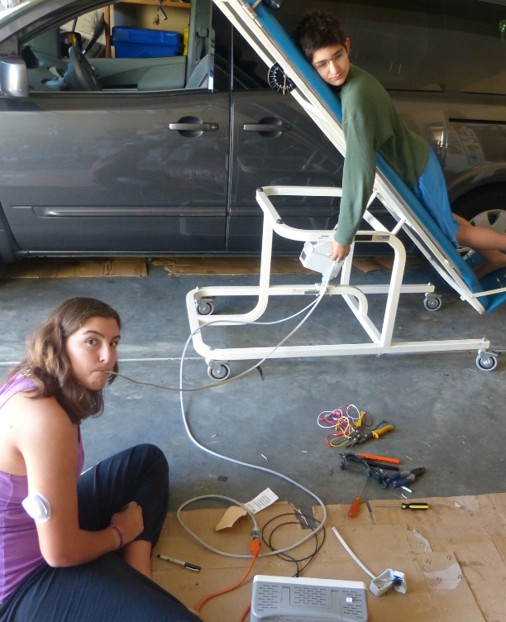
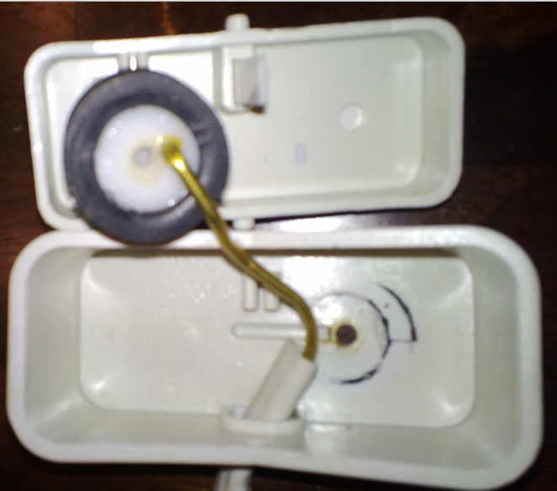
Figure Out How To Raise And Lower It
It runs on air – not electrical signals!

Slide 5
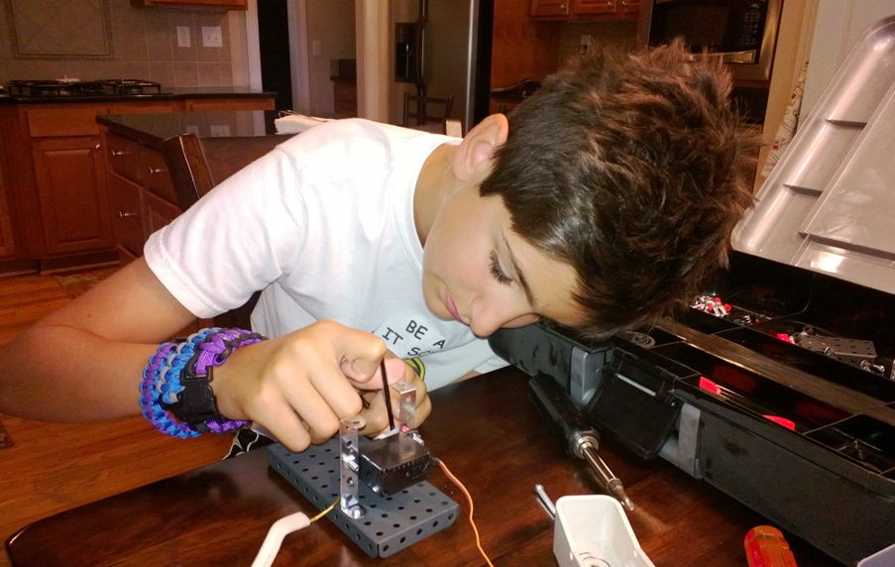
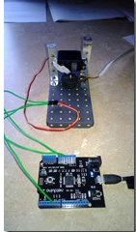
Attach a servo to the bellow Attach the servo to the Netduino

Slide 6
Add code to move the servo up and down
private static void ActivateServoForBellows()
{
uint period = 20000;
uint duration = 1500;
PWM servo = new PWM(PWMChannels.PWM_PIN_D5, period, duration, PWM.ScaleFactor.Microseconds, false);
servo.Start();
Thread.Sleep(2000);
InputPort button = new InputPort(Pins.ONBOARD_BTN, false, Port.ResistorMode.Disabled);
while (true)
{
if (button.Read())
{
servo.Duration = 1250;
Thread.Sleep(2000);
servo.Duration = 1500;
}
}
}

Slide 7
Add code to move the servo up and down

Slide 8

Add code to receive commands from a local browser
Make a socket
Set up web server
Listen for request
Get a request
Handle the request
Move servo up/down
Move servo back to TDC
Generate a response

Slide 9
Add code to receive commands from a local browser

Slide 10
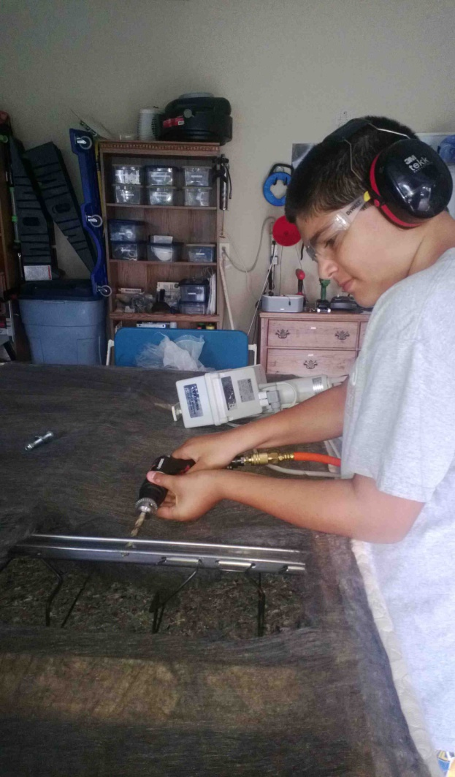
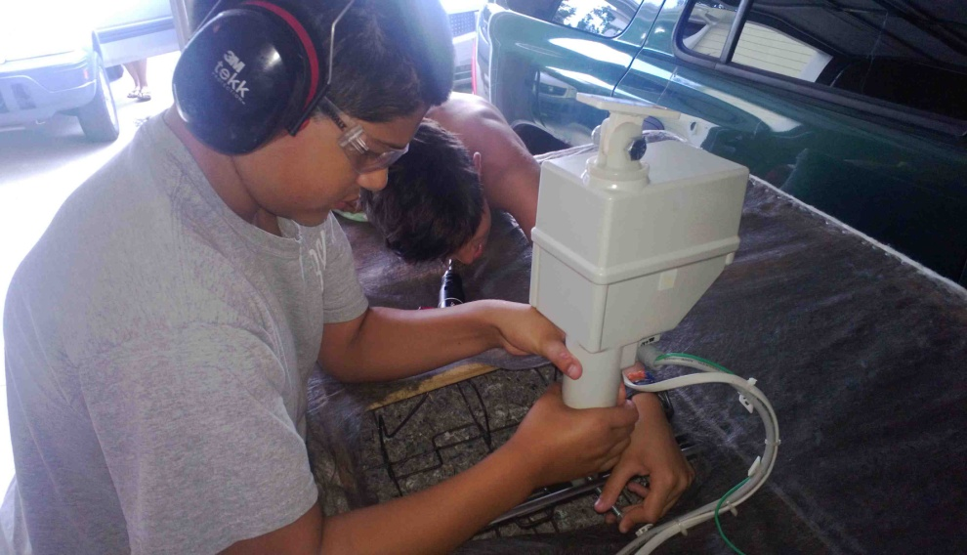
Attach lift to frame

Slide 11
Put it all together

Slide 12
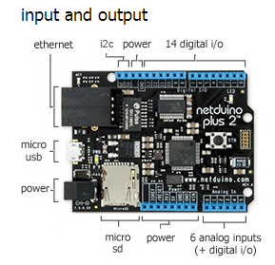
Intro To Netduino

Slide 13
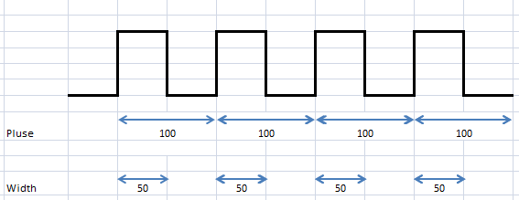
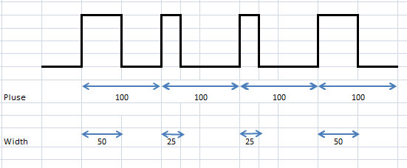
PWM

Slide 14
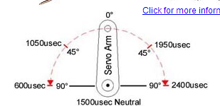
Servo

Slide 15
Questions?
jamessdixon@gmail.com
jamessdixon.wordpress.com
@jamie_dixon

