Slide 1
Visual Studio Online (VSO), Release Management (RM) & Azure
By Anubha Gupta (anugupt@Microsoft.com)
(Software Engineer-VSO, Microsoft)
WE ARE HIRING

Slide 2
What is Visual Studio Online
It is not an IDE, it’s everything else.
Version Control – unlimited, private, secure:
1. Store and collaborate code anywhere with private team projects.
2. Team Foundation Version Control (TFVC) - massively scalable repo
3. GIT – multiple repositories for maximum flexibility.
Tools for agile teams – Kanban, scrum, dashboards
Continuous integration – build, validate, deploy
1. Catch quality issues early
2. Automatically deploy applications or websites that pass tests.
Language and tools – Eclipse, Xcode and more
Performance and load testing – Apps, APIs, websites
Notes:
- provides a set of cloud-powered collaboration tools that work with your existing IDE or editor, so your team can work effectively on software projects of all sizes.
Be agile, on your terms. Capture, prioritize, and track work with backlogs and customizable Kanban boards.
Catch quality issues early with continuous integration (CI) builds that compile and test your application automatically after any code change. Use continuous delivery to automatically deploy applications or websites that pass tests.
Use your favorite language and development tool. Version control supports any language, as well as any Git client (including Xcode). Java teams can access code and work items through a free plugin for Eclipse – and run continuous integration builds based on config files from Ant or Mavin.
Make sure your code can stay up and running with cloud-based load testing. Generate tests from regions around the world to simulate the scale of hundreds of thousands of users.

Slide 3
Do you have VS installed? & Do you have VSO account ?
Connect to VSO
Create your first project
Open your team project in Visual Studio
Clone the repository
Create a new web app
Share your code in GIT
Get your code reviewed
Create your build definition
Get your code built continuously

Slide 4
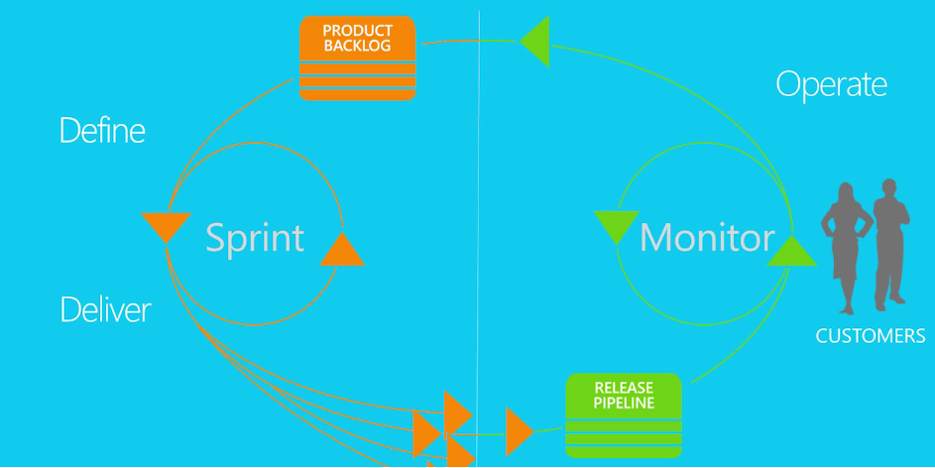
Release management
Notes:
Release Management for Visual Studio and Visual Studio Online is a continuous delivery solution that automates the release process through various environments all the way to production.
With Release Management in Visual Studio and Visual Studio Online you can configure, approve and deploy your applications for any environment. Create automated deployment orchestrations for each environment no matter how complex the configuration. Delivering your software more frequently and easily to an environment allows your testers to get to work validating your system and keeps your stakeholders involved in giving feedback.

Slide 5
Release management
Automate multi-stage deployments
Deploy the same way to all stages
Automate approval workflows
Retain full traceability
Manage and control release security
Fail elegantly using Rollbacks

Slide 6
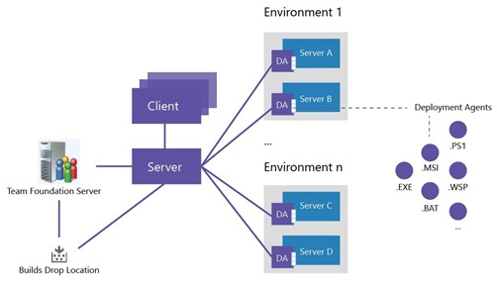
How it works

Slide 7
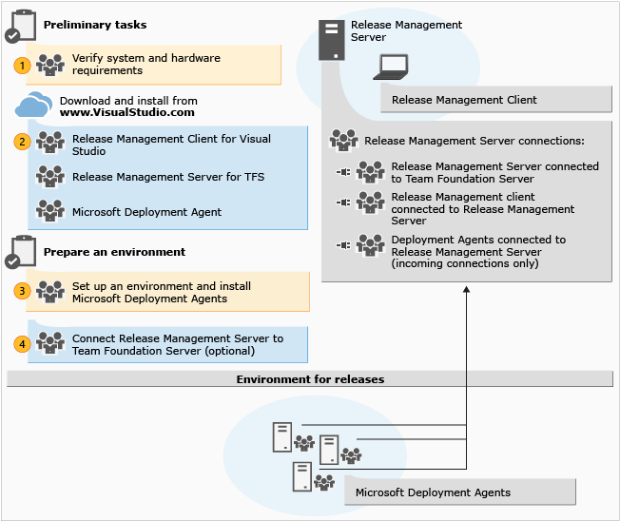
Release management

Slide 8
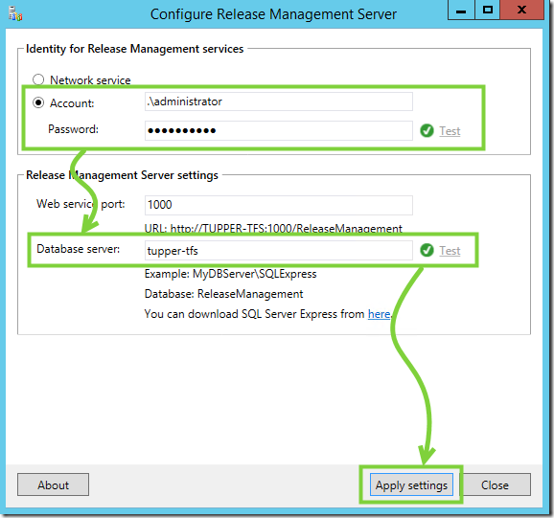
How to configure?

Slide 9
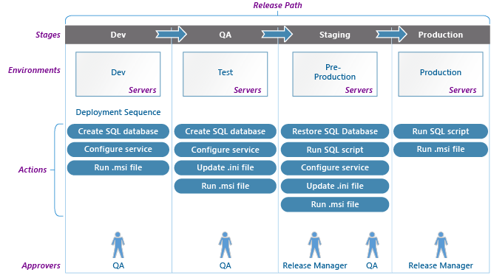
Notes:
Automate multi-stage deployments
Visually create the configuration paths that describe the promotion path through your environments.
Automatically trigger releases upon completion of builds.
One click to deploy to all environments of the pipeline.
Deploy to Windows or Linux servers using PowerShell, Desired State Configuration, Chef, or Visual Studio Deployment Agent.
Faster time to market – respond with greater agility to customer feedback
Use the same deployment artifacts for every environment, including deploying to production.
Test the same deployment sequence multiple times before going to production.
Define pre-deployment or post deployment approvals for multiple approvers or teams.
Retain full traceability of everything that happens to a release with release logs and approval tracking.
Manage deployment failures gracefully using rollbacks.
Easily diagnose failures using logs collected from all servers.
Assign roles and responsibilities to the right groups for releases, definitions and release artifacts.

Slide 10
Set up and start a release
Set up the RM server, client and deployment agents (or not)
Set up users and groups and control access to Release Management
Create your release path and start a release.

Slide 11


Notes:
How many stages do you need? You might need only test and production. But if you need a different environment for a pre-production stage that needs testing, consider adding a pre-production stage. And if it's important to track who approves that the dev work is ready to test, you might want to add a dev stage, too.
Who needs to approve each stage? You can have multiple approvers for each stage. You must add each approver as a user and assign them permissions.
What environments do you need for each of these stages to deploy your app? How many servers do you need for each environment to host your app? Do you need multiple web servers? Do you need a database server?
Do you want to use PowerShell, DSC or Chef to deploy your app? Do you already have scripts that you can use? Do you want to use Windows Azure for your servers in your environment? Or, do you want to use deployment agents?

Slide 12
Questions?
Anubha Gupta (anugupt@Microsoft.com)
(Software Engineer-VSO, Microsoft)
WE ARE HIRING

