Slide 1
REPL Driven Development, Scrum, and the Wright Brothers
Jamie Dixon
NDC Oslo: 19 juni 2016

Slide 2
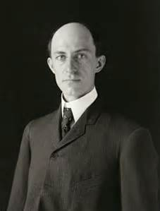
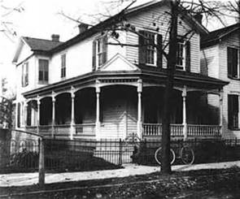
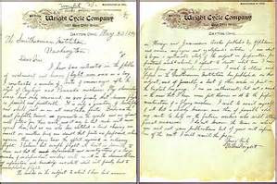
I am about to begin a systematic study of the subject in preparation for practical work to which I expect to devote what time I can spare from my regular business.
Notes:
May 30, 1899 – Letter to the Smithsonian

Slide 3
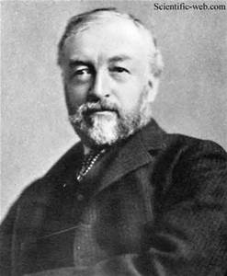
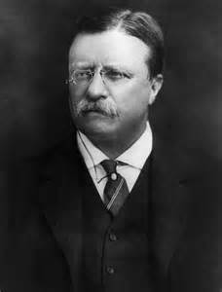
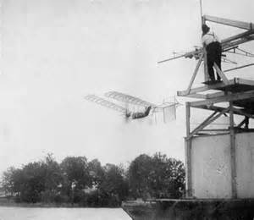
Notes:
Samuel Pierpont Langley
Most prominent scientist in the US
1896 – unmanned flight for 2 minutes (Alexander Graham Bell)
1898 - $50,000 war department and $20,000 Smithsonian - $2M

Slide 4
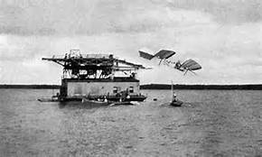
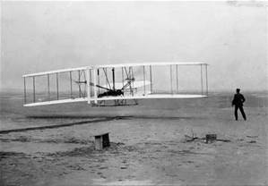

Slide 5
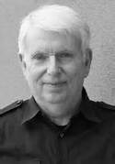
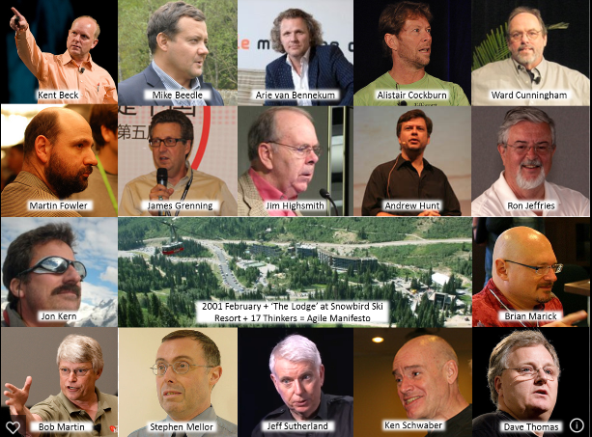

Notes:
Jeff Sutherland
Fighter pilot in Vietnam
Uncle Bob – SOLID
Andy Hunt – Grows Method
Jeff Sutherland - Scrum

Slide 7
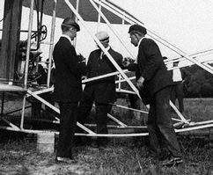
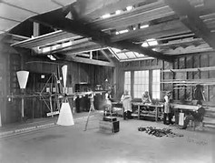
Need A Small Team
Notes:
30 people at max
“He would be married 1 day and expect a grown-up family next”
He did not know his employees names – 1 step behind
“Only speak when asked a question. Otherwise he was not listening”
Charlie Taylor

Slide 8
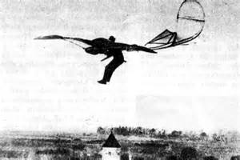
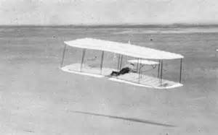
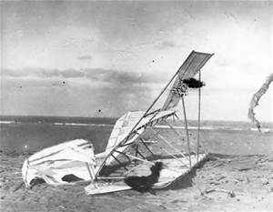
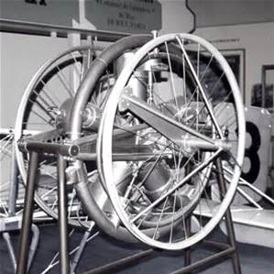
One Thing At A Time
Notes:
Otto Lilienthal
Power to stay aloft
There are 2 ways to learn how to ride a horse: sit on the fence or get on it

Slide 9
Incremental Small Changes
SL | 1900 | 1901 | 1902 | 1903
Jan
Feb
Mar
Apr
May
Jun |  | 3
Jul
Aug |  |  |  | 1
Sep
Oct |  |  |  | 1
Nov
Dec |  |  |  | X
WW | 1900 | 1901 | 1902 | 1903
Jan
Feb
Mar
Apr
May
Jun
Jul |  | 10
Aug |  | 25
Sep |  |  | 25
Oct | 25 |  | 250
Nov
Dec |  |  |  | 3 -X

Slide 10
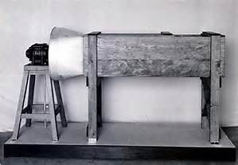
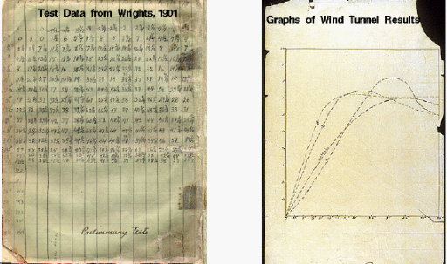
Challenge Everything

Slide 11
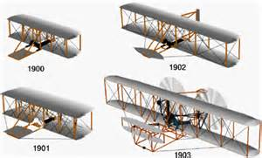
Evolve The Design

Slide 12
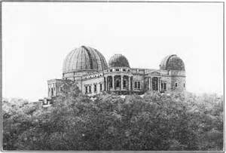
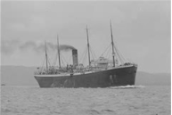
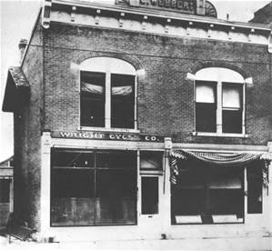
Remove The Clutter

Slide 13
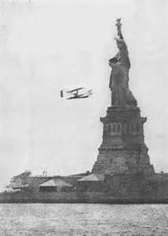
What Does This Have to Do With Writing Software?
One thing at a time?
Evolve the design?
Incremental small changes?
Safely make small changes?
Example…

Slide 14
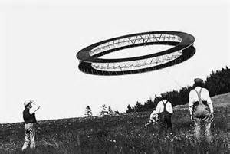
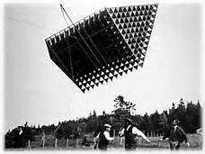
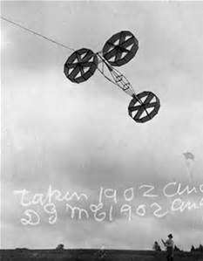
Fail Fast and Early
Extract an interface
Create unit test class
Create test method
Create SUT class
Implement method
Wash… Rinse… Repeat…

Slide 15
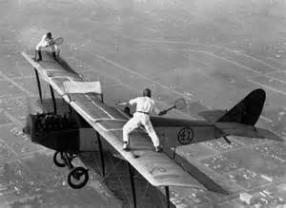
Stop Context Switching
Switch between UT and SUT

Slide 16
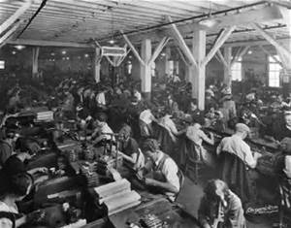
Working Too Hard Makes More Work
What % Code Coverage is right?
Props need to be unit tested?
Does 1 +1 need to be tested?
What about mocks?
Example…
Notes:
Property based versus Example Based Testing

Slide 17
Why Unit Tests?
Why REPL?
Benefits
Correctness
Change-Proof
Force small testable methods
Costs
More Code
More Noise
More Context Switching
Benefits
Correctness
Force small testable methods
Costs
Does not protect against change

Slide 18
SUT
SUT
REPL
UNIT TESTS
UNIT TESTS

Slide 19
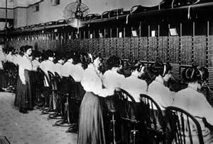
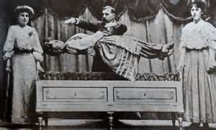
Remove the Noise & Clutter
Why is so important that we have intention revealing names?
Why do you need Resharper?
Do you really know what that code-gen or template is doing?
Should you?
Example…
https://skillsmatter.com/skillscasts/6938-7-ineffective-coding-habits-with-yan-cui
http://fsharpforfunandprofit.com/rop/

Slide 20
Questions?
https://github.com/jamessdixon/REPL-Driven-Development
@jamie_Dixon
jamessdixon@gmail.com
jamessdixon.wordpress.com

