Slide 2
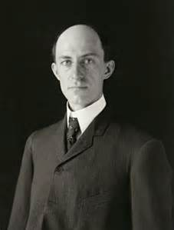
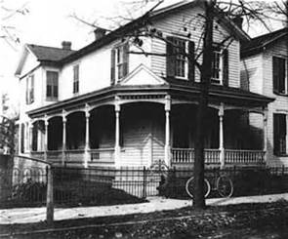
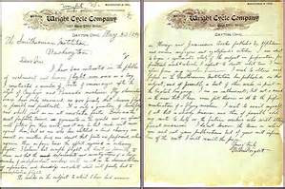
I am about to begin a systematic study of the subject in preparation for practical work to which I expect to devote what time I can spare from my regular business.
Notes:
May 30, 1899 – Letter to the Smithsonian

Slide 3
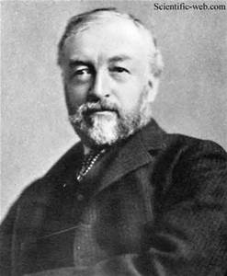
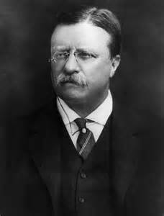
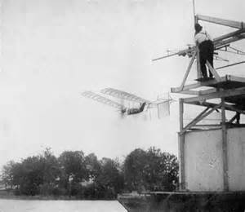
Notes:
Samuel Pierpont Langley
Most prominent scientist in the US
1896 – unmanned flight for 2 minutes (Alexander Graham Bell)
1898 - $50,000 war department and $20,000 Smithsonian - $2M

Slide 4
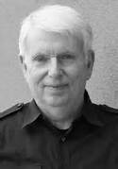
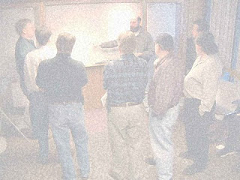
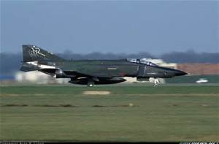
Notes:
Jeff Sutherland
Fighter pilot in Vietnam
Uncle Bob – SOLID
Andy Hunt – Grows Method
Jeff Sutherland - Scrum

Slide 6
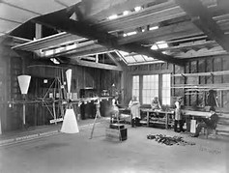
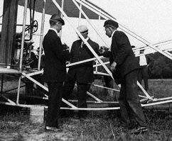
Need A Small Team
Notes:
30 people at max
“He would be married 1 day and expect a grown-up family next”
He did not know his employees names – 1 step behind
“Only speak when asked a question. Otherwise he was not listening”
Annual vacation to the Pacific, Caribbean, Europe

Slide 7
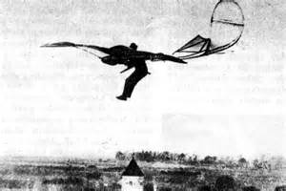
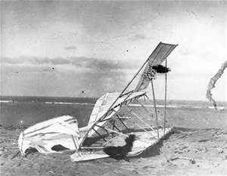
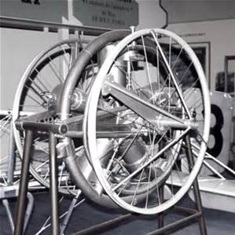
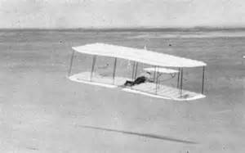
One Thing At A Time
Notes:
Power to stay aloft
There are 2 ways to learn how to ride a horse: sit on the fence or get on it

Slide 8
Incremental Small Changes
SL | 1900 | 1901 | 1902 | 1903
Jan
Feb
Mar
Apr
May
Jun |  | 3
Jul
Aug |  |  |  | 1
Sep
Oct |  |  |  | 1
Nov
Dec |  |  |  | X
WW | 1900 | 1901 | 1902 | 1903
Jan
Feb
Mar
Apr
May
Jun
Jul |  | 15
Aug |  | 60
Sep |  |  | 25
Oct | 50 |  | 350
Nov
Dec |  |  |  | 3 - X

Slide 9
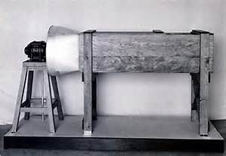
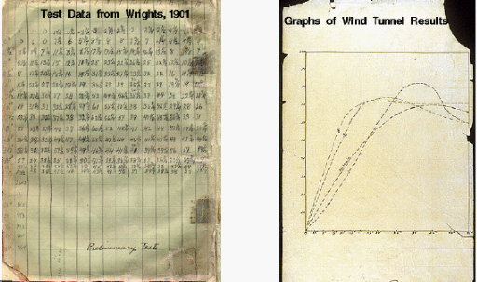
Challenge Everything

Slide 10
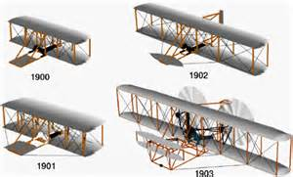
Evolve The Design

Slide 11
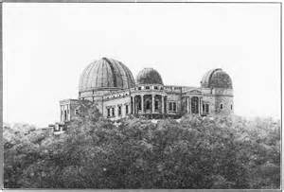
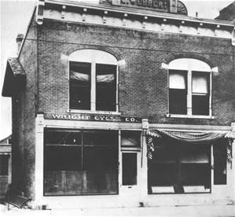
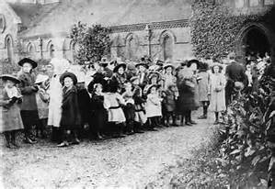
Remove The Clutter

Slide 12
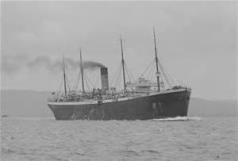
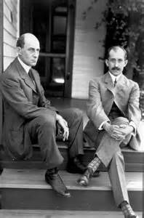
Take Breaks

Slide 13
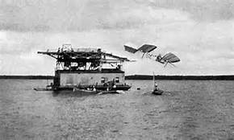
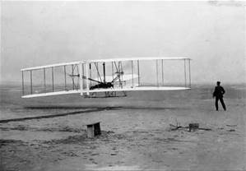

Slide 14
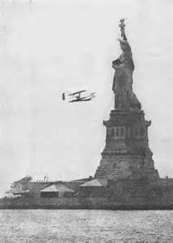
What Does This Have to Do With Writing Software?
Language?
Tools?
Ensure Correctness?

Slide 15
Fail Fast and Early

Slide 16
Stop Context Switching/Remove the Noise
See The Burning Monks series

Slide 17
Working Too Hard Makes More Work
What % Code Coverage is right?
Props need to be unit tested?

Slide 18
Duplication/Boilerplates/Templates are a complete and total waste

Slide 19
Why TDD?
Correctness
Change-Proof
Force small testable methods

Slide 20
Is This a Natural Evolution?

Slide 21
BREAK

Slide 22
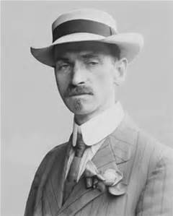
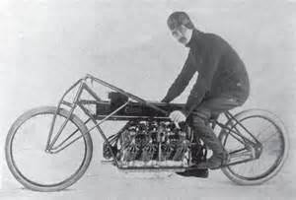

Slide 23
Summary
Round 1: Discovery
Round 2: Monetization

Slide 24
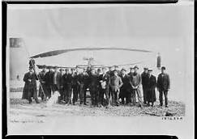
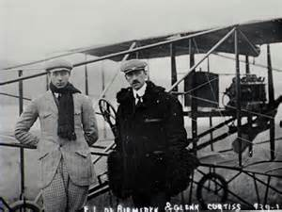
Small Teams

Slide 25
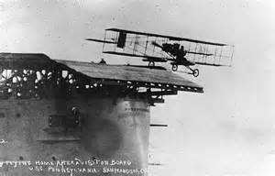
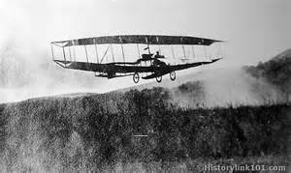
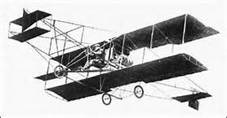
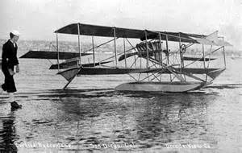
Evolve The Design/Small Changes

Slide 27
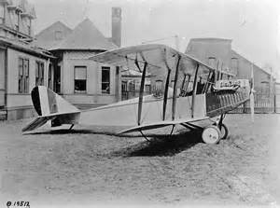
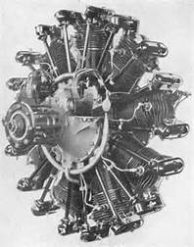
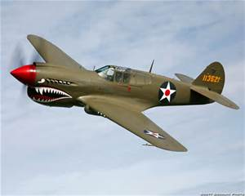

But Who Really Won?

