Slide 2
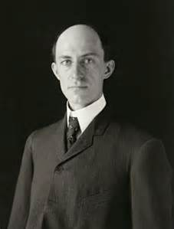
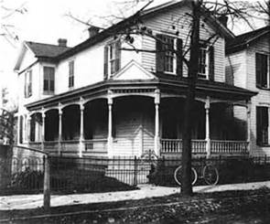
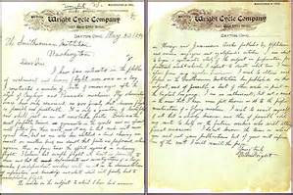
I am about to begin a systematic study of the subject in preparation for practical work to which I expect to devote what time I can spare from my regular business.
Notes:
May 30, 1899 – Letter to the Smithsonian

Slide 3
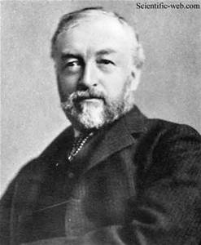
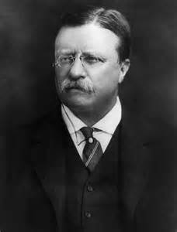
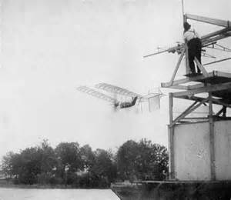
Notes:
Samuel Pierpont Langley
Most prominent scientist in the US
1896 – unmanned flight for 2 minutes (Alexander Graham Bell)
1898 - $50,000 war department and $20,000 Smithsonian - $2M

Slide 4
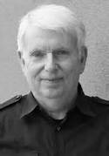
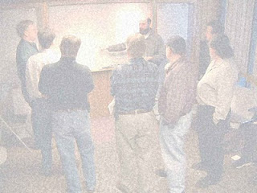
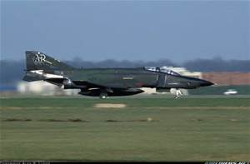
Notes:
Jeff Sutherland
Fighter pilot in Vietnam
Uncle Bob – SOLID
Andy Hunt – Grows Method
Jeff Sutherland - Scrum

Slide 6
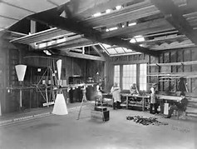
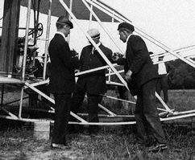
Need A Small Team
Notes:
30 people at max
“He would be married 1 day and expect a grown-up family next”
He did not know his employees names – 1 step behind
“Only speak when asked a question. Otherwise he was not listening”
Annual vacation to the Pacific, Caribbean, Europe

Slide 7
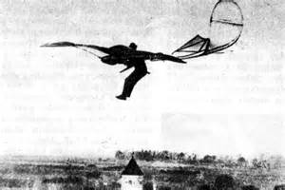
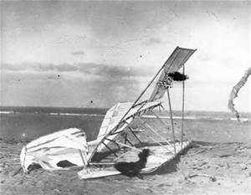
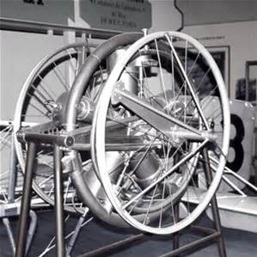
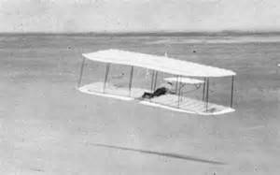
One Thing At A Time
Notes:
Power to stay aloft
There are 2 ways to learn how to ride a horse: sit on the fence or get on it

Slide 8
Incremental Small Changes
Flights by month

Slide 9
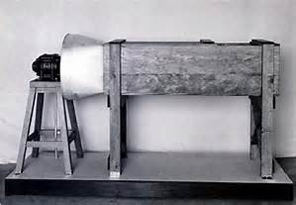
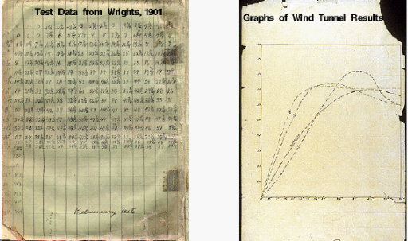
Challenge Everything

Slide 10
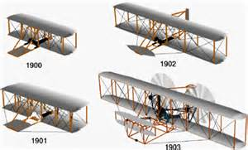
Evolve The Design

Slide 11
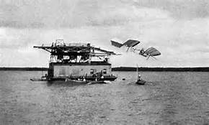
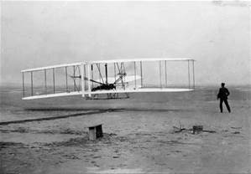

Slide 12
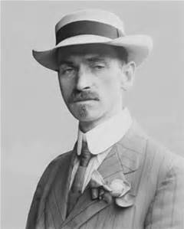
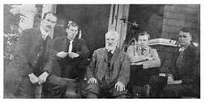
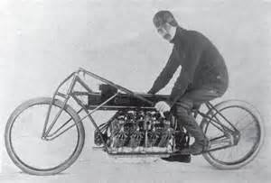

Slide 13
Notes:
75,000 franc prize
UsDoD Contract: $25,000
FDoD Contract

Slide 14

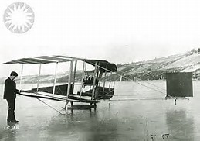
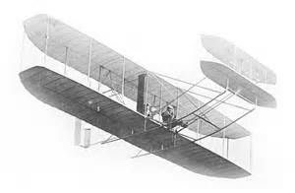
Single Direction

Slide 15
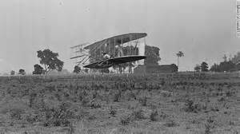
Cut The Noise

Slide 16
Evolve The Design/Small Changes

Slide 17
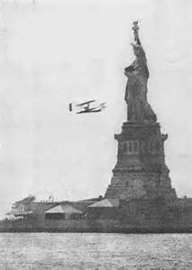
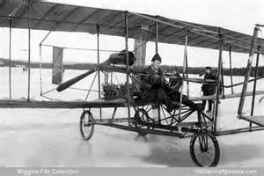
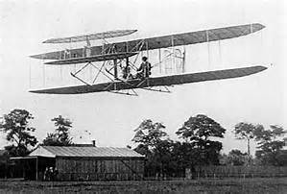

Slide 18
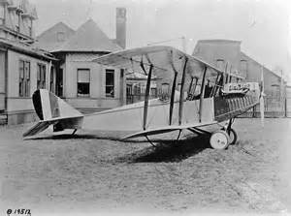
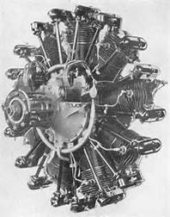
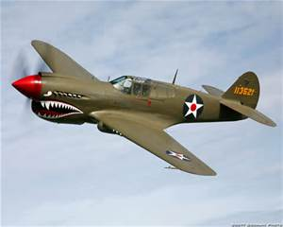

But Who Really Won?

Slide 19
Summary
Round 1: Discovery
Round 2: Monetization

Slide 20
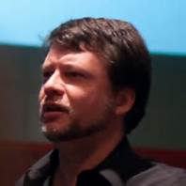
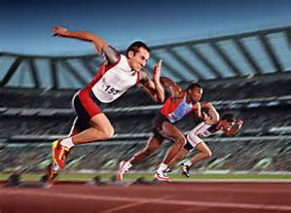
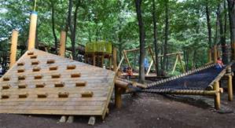
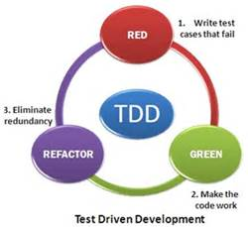
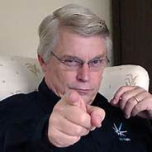

Slide 21
What Does This Have to Do With Software?
Language?
Tools?
TDD?

Slide 22
Context Switching Are A Killer
Is your idea “the code” ?
; is this helpful?
Yan Chu’s talk

