Slide 1
Azure Functions
Jamie Dixon
TRINUG 3/8/2017

Slide 2
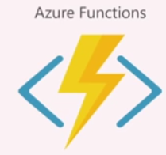
Agenda
Example #1
Introduction to Azure Functions
Example #2
Details of Azure Functions
Example #3
Best practices/helpful hints
Magic Trick
Notes:
How many on Azure
How many heard of Azure Functions
How many using?
How many on AWS
How many using Lambda Functions

Slide 3
Example #1
Notes:
Develop for the cloud? Develop in the cloud
C# Timer

Slide 4
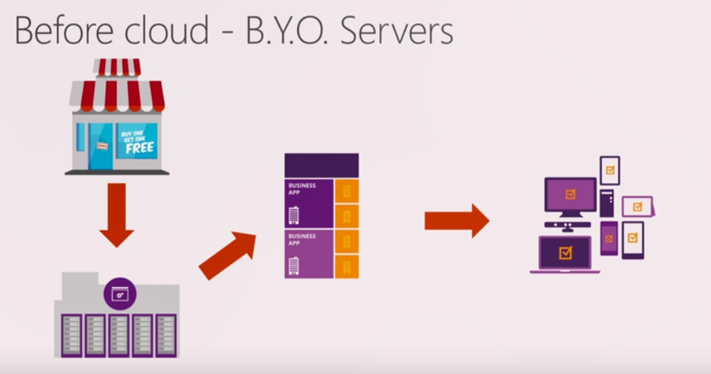
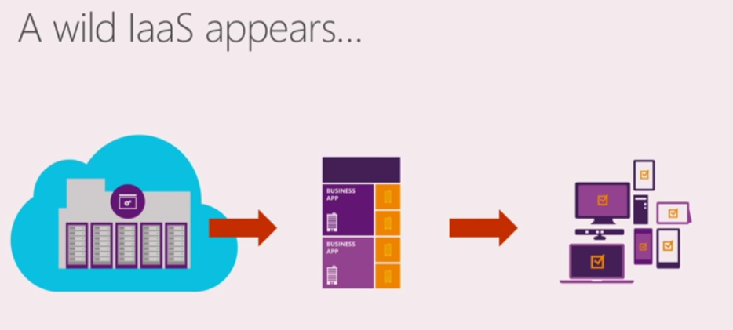
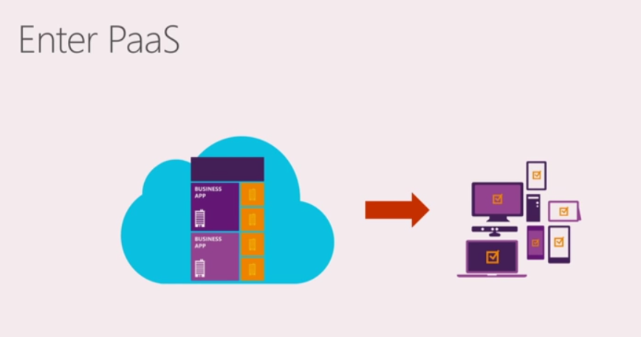
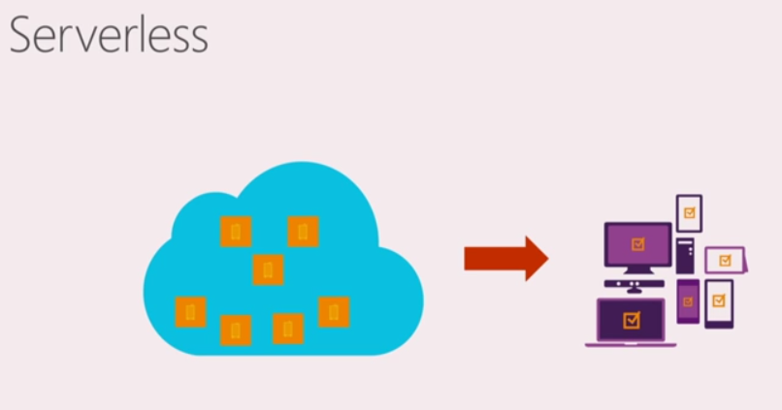
Notes:
Buy a server
Order
Ship and cohost
Install OS
Install VM
Install IS
Install Business App
VM to manage
OS updates
Security patches
IIS Management
Web Service
Azure Sql
Containers
Azure App Servic

Slide 5
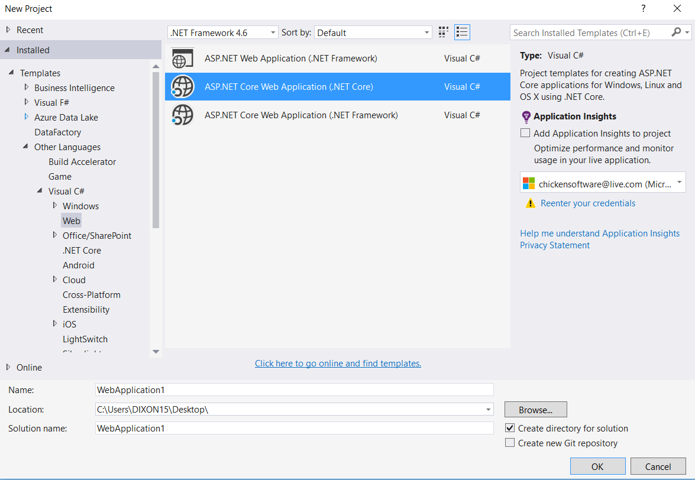
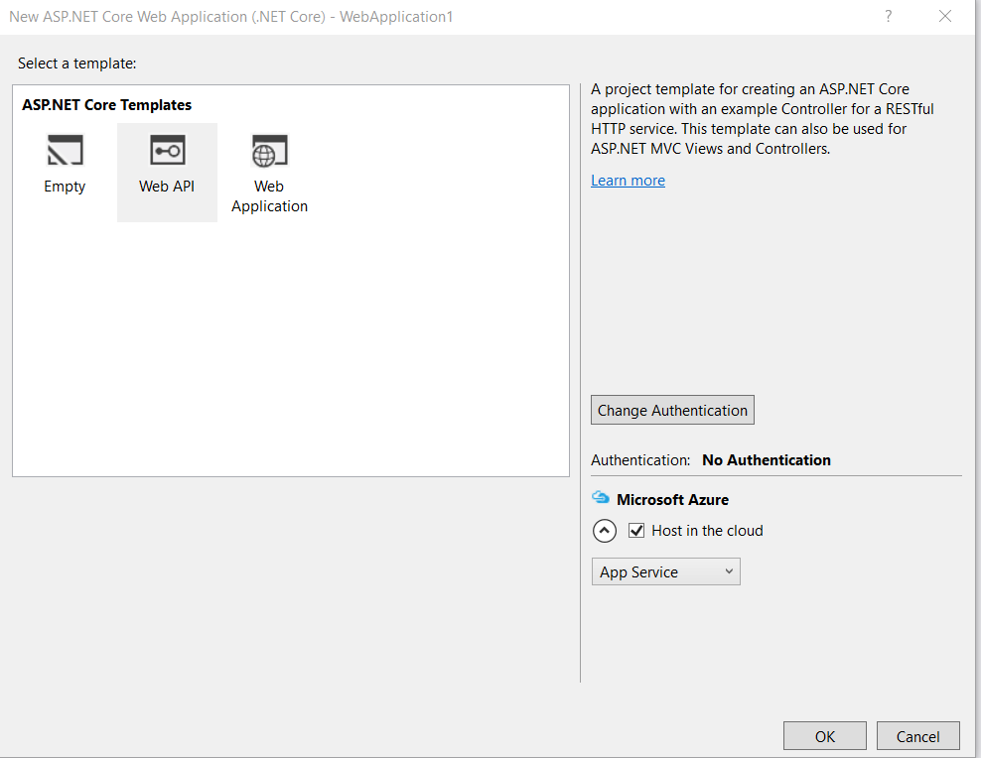
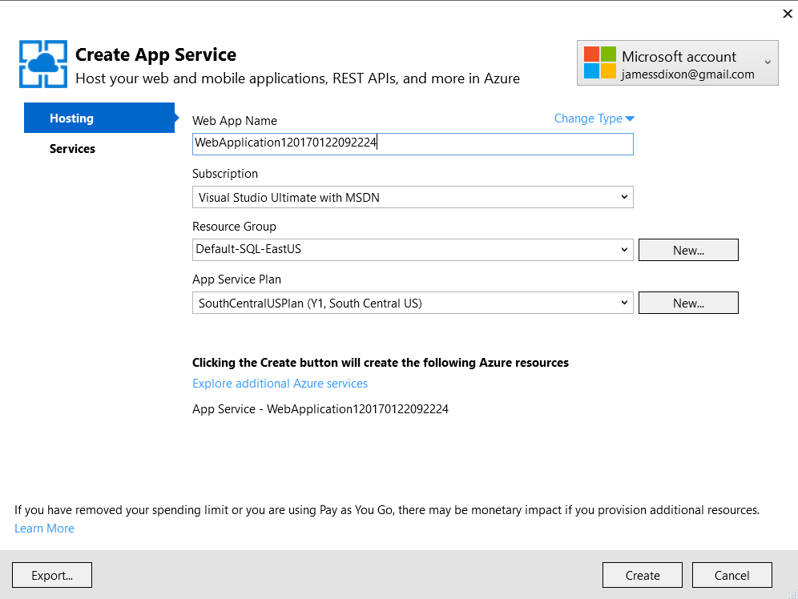
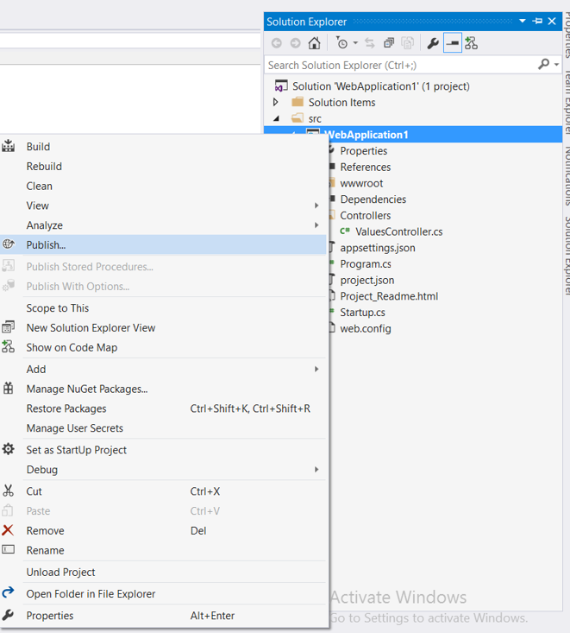
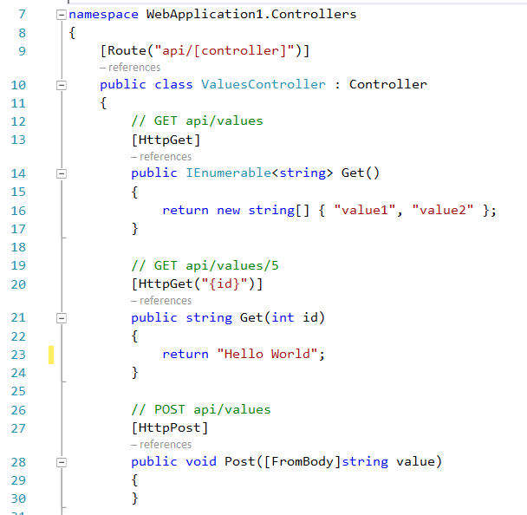
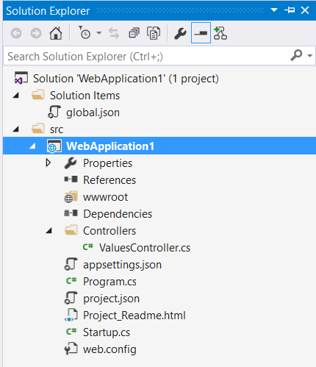
Notes:
11 files
200 lines of code (not include the ms build stuff)
ASP.NET is designed to make the hard stuff simple – but is also makes the simple stuff hard
Need a full web app for a single piece of work?

Slide 6
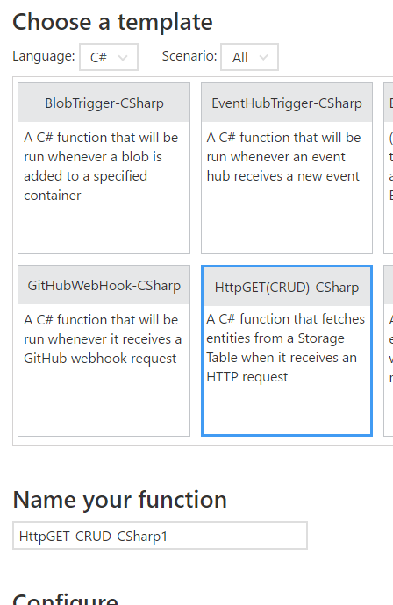
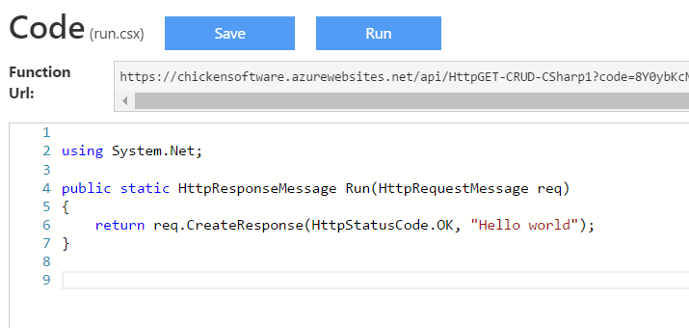

Slide 7
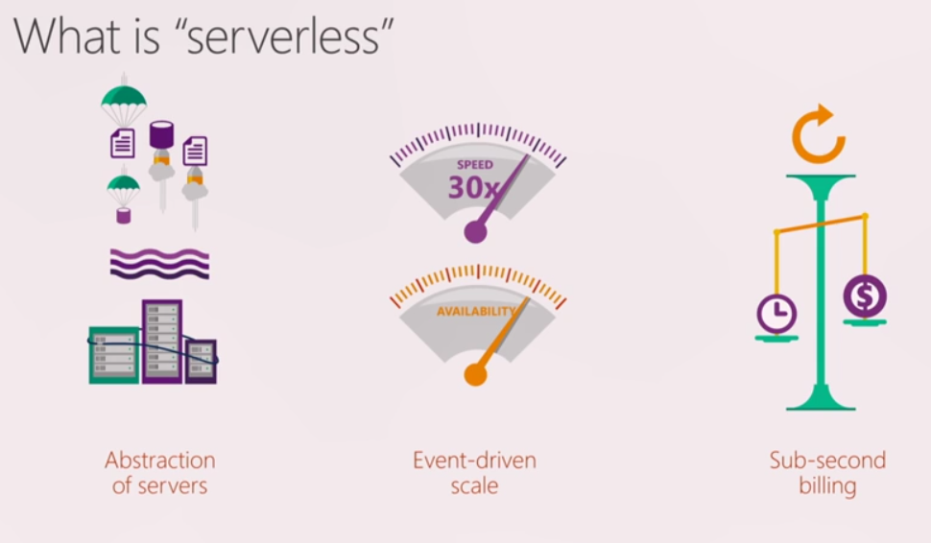
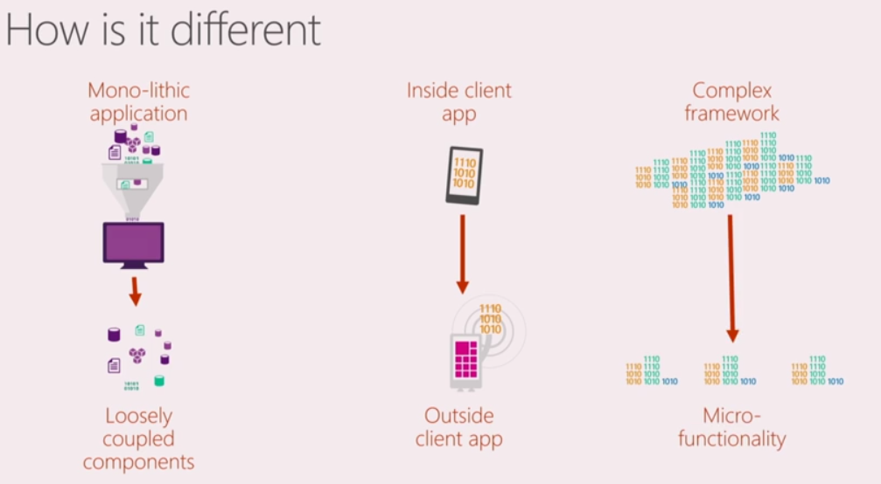
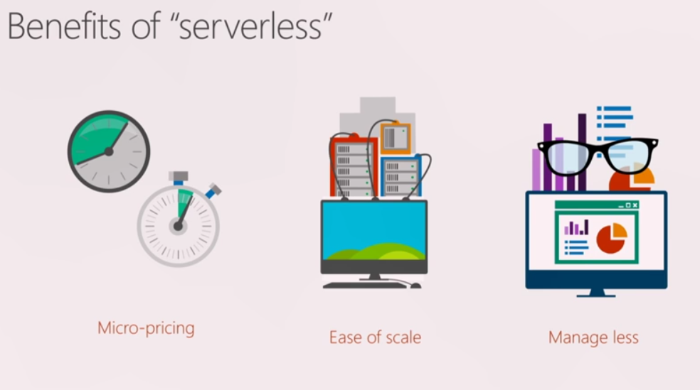
Notes:
Pay for a site?
Everything is an event
Http request
Timer
Something placed in a queue
Not guaranteed to be on same machine
Compute payment – Consumption hosting -> auto scale out

Slide 8
Developer Shift
O: How do I build a route, controller, integrate in my web app?
N: Build a Function
O: Is this work effort worth spinning up a new site?
N: Build a function
O: How do I build and deploy web apps?
N: Build a series of functions

Slide 9
Triggers
Http
Azure Storage
Blob
Table
Queue
Timer
EventHub, Webhooks (Github, Twitter, SO, etc..), ServiceBus

Slide 10
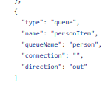
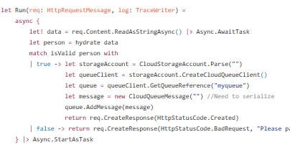
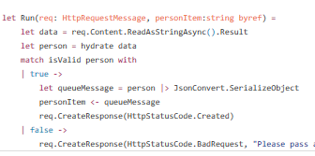
Bindings
function.json
run.fsx
run.fsx

Slide 11
Existing Bindings
Azure DocumentDb (including Mongo)
Azure Event Hubs
Azure Mobile Apps
Azure Notification Hubs
Azure Service Bus
Azure Storage
On-prem (using Service Bus)

Slide 12
Example(s) #2
Notes:
Visual Studio – httpGet
Visual Studio – postTable
Visual Studio – postQueue
Browser – Drain Queue

Slide 13
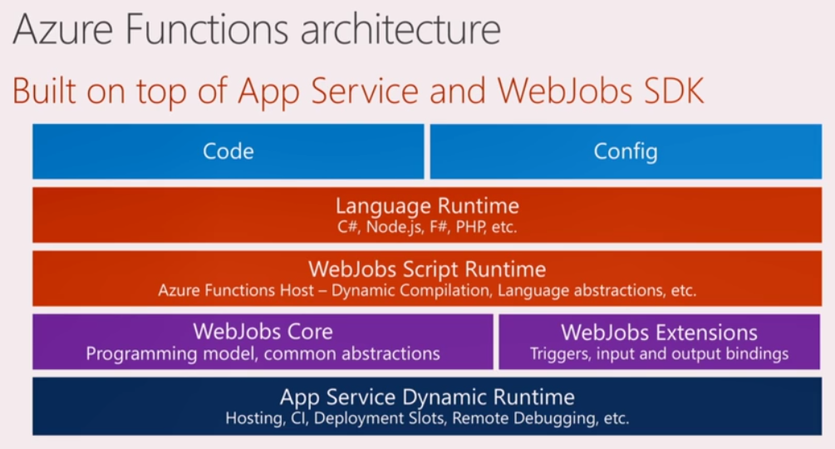
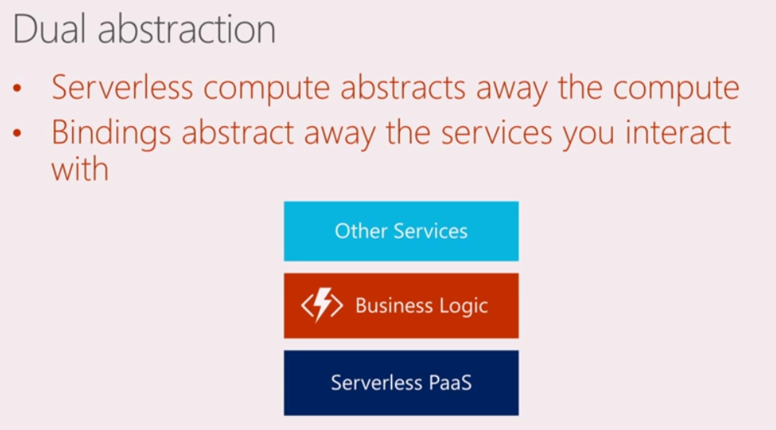
$.20 for 20 million executions

Slide 14
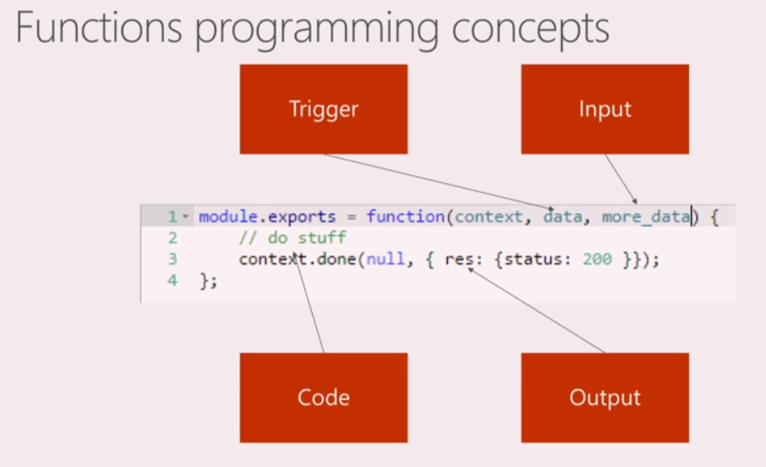
Notes:
Maintain state across functions
Speed and ease of understanding
5-10 minutes

Slide 15
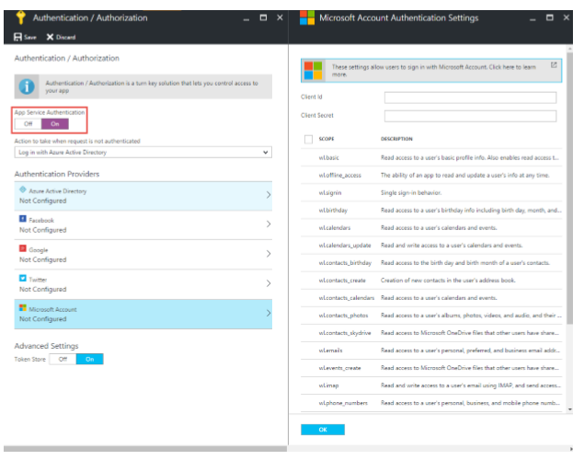
Security

Slide 16
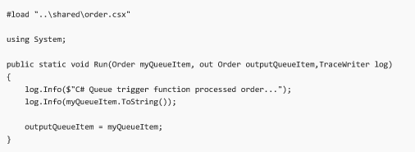
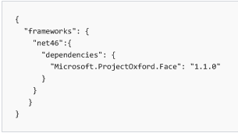
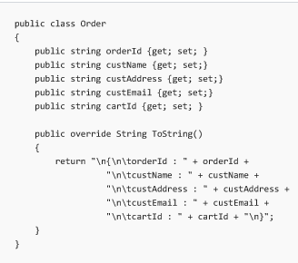
.NET Dependencies
project.json
Another Azure Function
Notes:
internal: refer to another AF file or put into a .dll
external: put in project.json
Only 4.6 and above

Slide 17
Example #3
Timer Trigger
Queue Trigger
Table Trigger
Web Page
HTTP GET
Twitter
Notes:
Every minute, get tweet and put it on the table (C#)
Get values from table, analyze it, and put it into a queue (python)
Get values from queue and notify (node p.57, 115)

Slide 18
Serverless Best Practices
Thick Clients: Thin and Stateless Server
SPA model: Angular/React
Can do sync, but really want to do async
http://www.reactivemanifesto.org/
Kick off long running job. Use queues to hold intermediate data
Return 202, not 201
This is all-in on the cloud
Design for portability ☺
Notes:
You can try maintain state
We throw away state whenever we want
Pay for function processing
Want to respond immediate (I started)
Inspect for complete (queue)

Slide 19
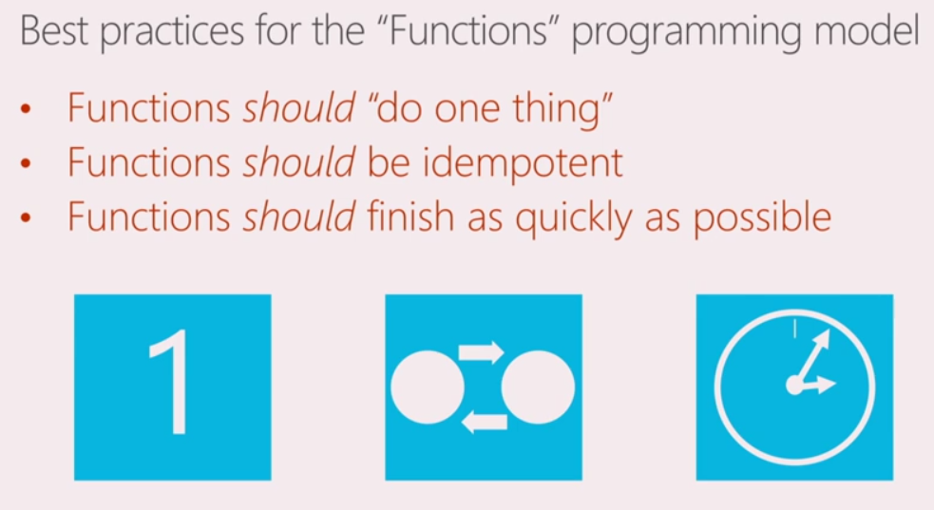
Functions Best Practices
Notes:
Idempotent: same input = same output
No single function to achieve FTP store

Slide 20
Functional Architecture
Microservices
Small, Independent Services
Independent deployments
Versioning is important
Async messages among functions, not Sych http
Avoid shared state
Can store connection manager or redis cache on a machine
Can’t guarantee same machine
Can use hard drive – but blob is much better

Slide 21
Getting Started
Start small. Replace 1 API or background worker
Integration – build Serverless on top of existing code
Have fun – make your life easier. Don’t spend hours coding a single function

Slide 22
Magic Trick

