Slide 1
Machine Learning. Machine Learning.
Jamie Dixon
30 Nov 2023
Notes:
TDD? ADD? HDD?

Slide 2

https://www.amazon.com/Mastering-Machine-Learning-Jamie-Dixon/dp/1785888404

Slide 3
Agenda
Quiz
ML Considerations
Machine Learning
Regressions/Trees/Neural Networks
Improving Performance
Dynamical Models
ODE/PDE Models
Deploying To Prod
Reconsiderations

Slide 4
All Models Are Wrong. Some Are Useful.
– George Box
Do Not Substitute Coding For Thinking.
– Unattributed
How do you start doing ML?
How do you start doing BL?

Slide 5
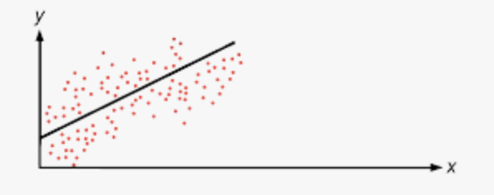
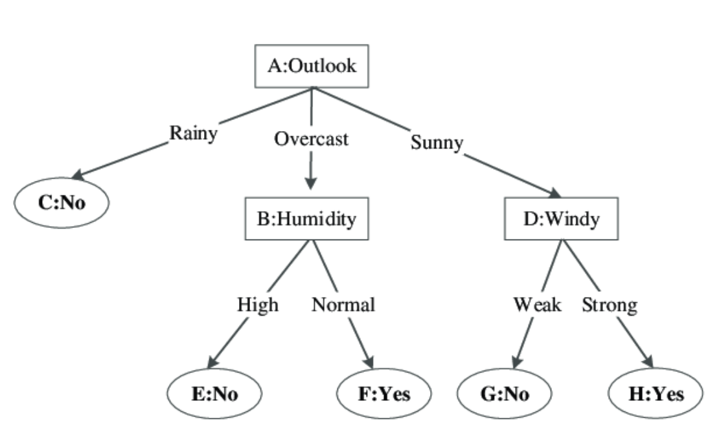
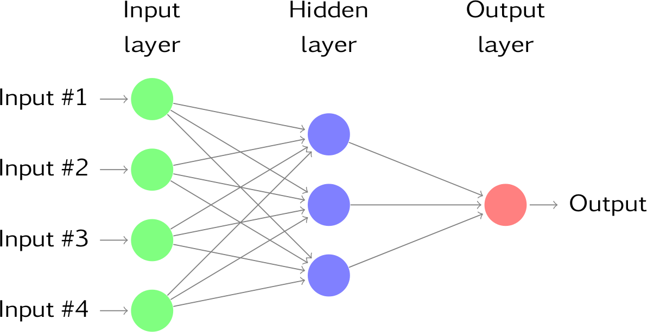
Machine Learning && AI
Regressions
Trees
Neural Networks

Slide 6
Improving Performance
Ensembling
Add Another Feature?
Add more will always improve on some models
Adding highly correlated values does not help much
Obs # | Shot | Dist | Tree | NN | AVG
0 | SLAP | 10 | G | NG | G
1 | WRIST | 15 | NG | NG | NG
2 | WRIST | 20 | NG | NG | NG
3 | SLAP | 35 | NG | NG | NG
4 | WRIST | 5 | G | G | G
5 | WRIST | 6 | G | G | G
6 | WRIST | 16 | NG | NG | NG
7 | WRIST | 21 | NG | NG | NG
8 | WRIST | 18 | NG | NG | NG
9 | SLAP | 11 | NG | NG | NG
10 | WRIST | 21 | NG | NG | NG
Tuning hyperparameters is not such a good idea….

Slide 7
Dynamical Models versus Machine Learning
Modeling Philosophy:
Dynamical Models: These models are based on a set of differential equations that describe how the variables of a system change over time. Dynamical models are often derived from first principles or domain-specific knowledge about the underlying processes governing the system.
Machine Learning Models: Machine learning models, on the other hand, learn patterns and relationships from data. They do not necessarily require explicit knowledge of the underlying processes and can capture complex patterns in the data.
Notes:
You can do time series to explain behavior over time

Slide 8
Dynamical Models versus Machine Learning
Data vs. Theory:
Dynamical Models: These models rely heavily on theoretical principles and domain knowledge. They are designed based on an understanding of the underlying physics or dynamics of the system.
Machine Learning Models: These models are data-driven and learn patterns directly from the data. They do not necessarily require a deep understanding of the underlying processes, making them more flexible in certain situations.
Notes:
Reduce complexity – formulas start simple

Slide 9
Dynamical Models versus Machine Learning
Interpretability:
Dynamical Models: Dynamical models are often more interpretable because they are built on known principles. The parameters of the model usually have clear physical interpretations.
Machine Learning Models: Many machine learning models, especially complex ones like deep neural networks, can be seen as "black boxes" because it might be challenging to interpret how they arrive at a particular decision. Interpretability can be a challenge in certain applications.

Slide 10
Architecture
Data
Train
Model
Request
Cache

Slide 11
Reconsiderations
What, in fact, is the machine “learning”
Does the Turing Test matter?
AL v NI

