Slide 1
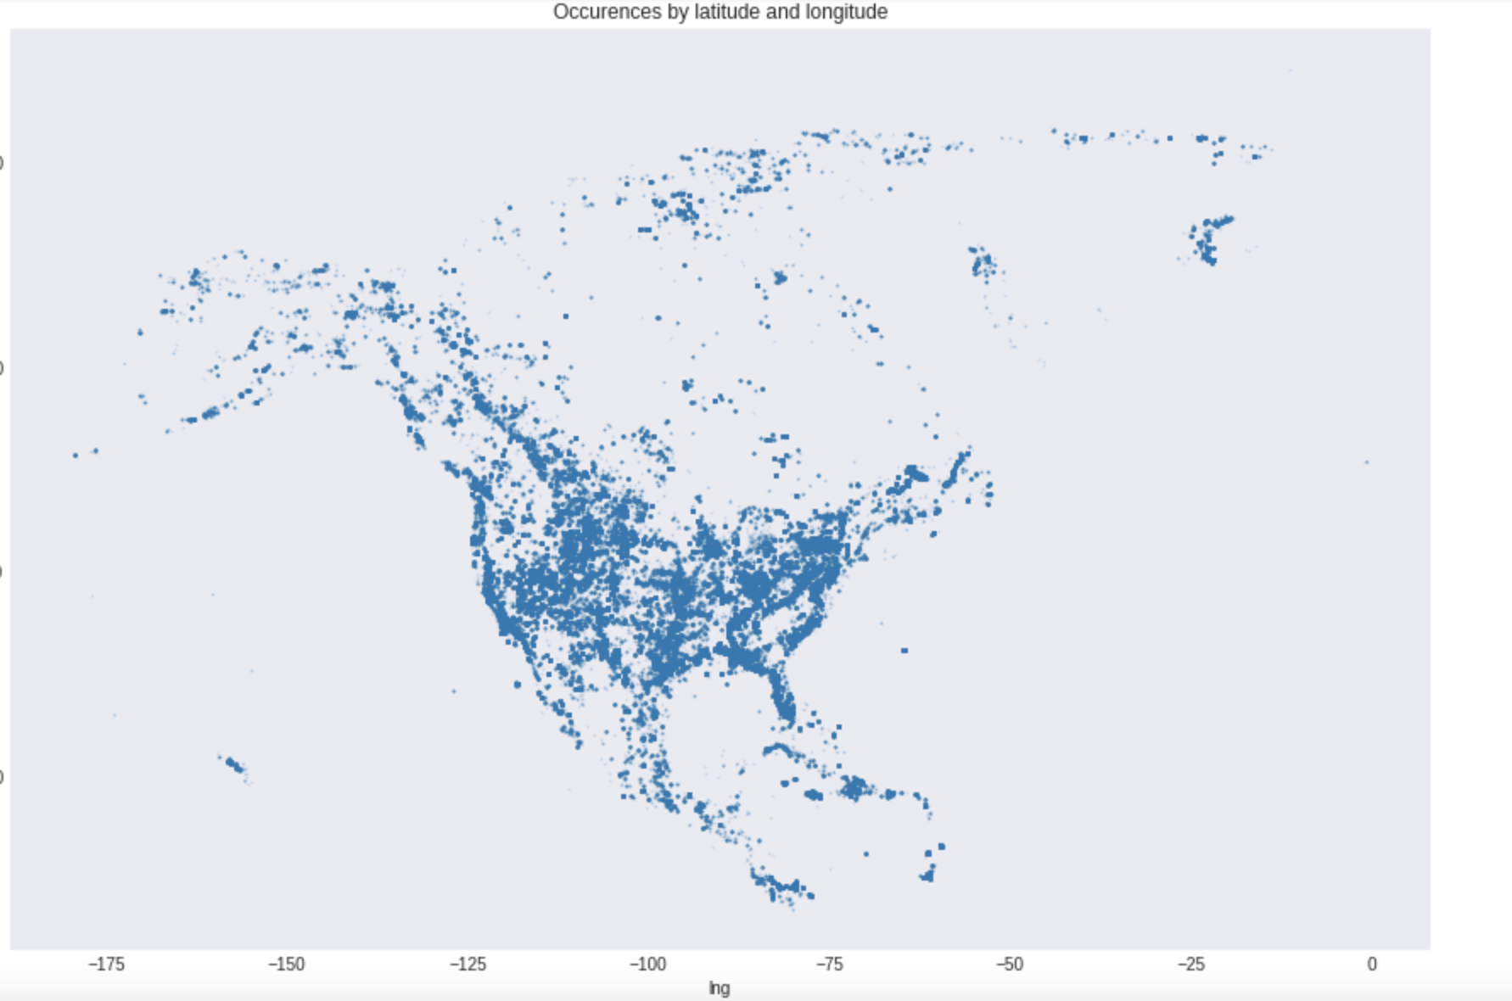
Paleontology Database Analysis
Occurrences of fossil discovery in North America
Ravin Mehta, Veeraj Rangnekar, James Ellsworth

Slide 2
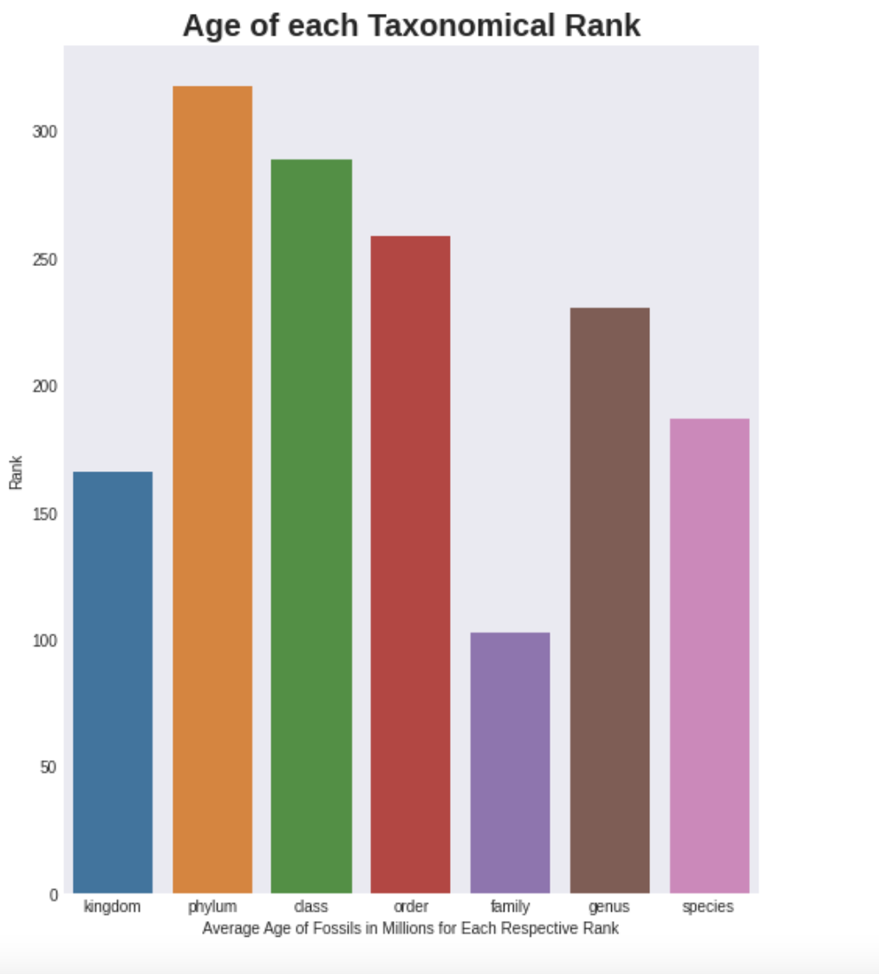
Functions used to find average age of each Taxonomic rank sorted from largest rank to smallest

Slide 3
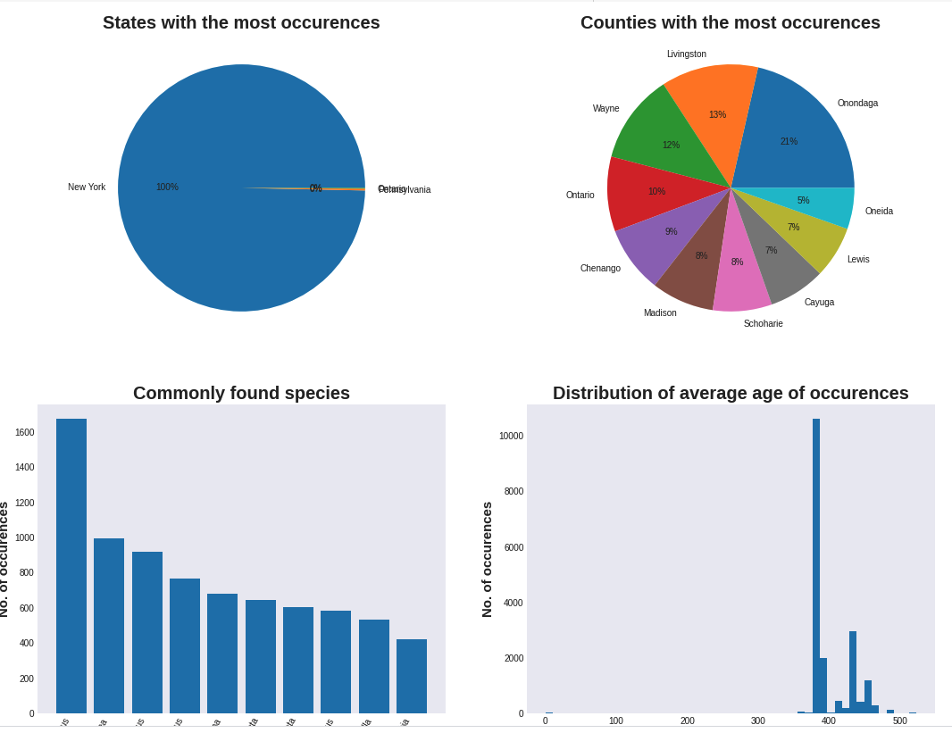
The function allows users to input a location and get a set of summary statistics that describe what their geology looks like based on fossil findings made in the area. The user can use a preset location, or enter latitude and longitude coordinates to specify a location. The information is also presented on an interactive map that shows the different fossils found near the user inputted location.

Slide 4
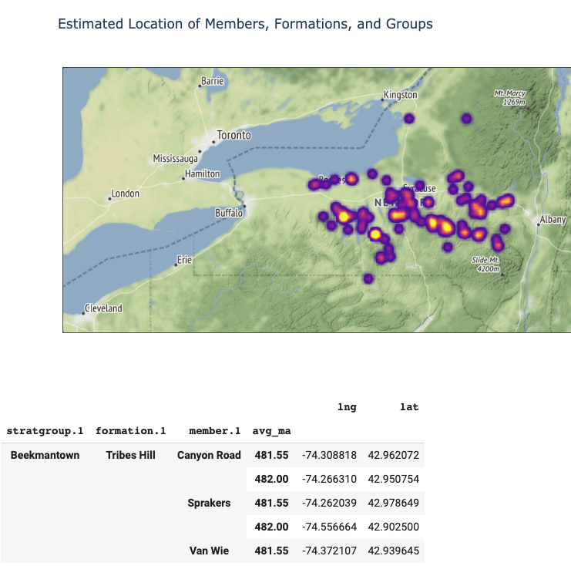
The data is also sorted to pinpoint the estimated location and average age for different stratigraphic groups, and their breakdown as formations and members. This is the only tool we know of that presented formation specific information in this way.
Having this information visualized is important because these locations contain clusters of fossiliferous material that is specific to a certain time period or ecological climate. Knowing about the location and age of different formations can allow users to gain a better understanding of their surrounding geology.

Slide 5
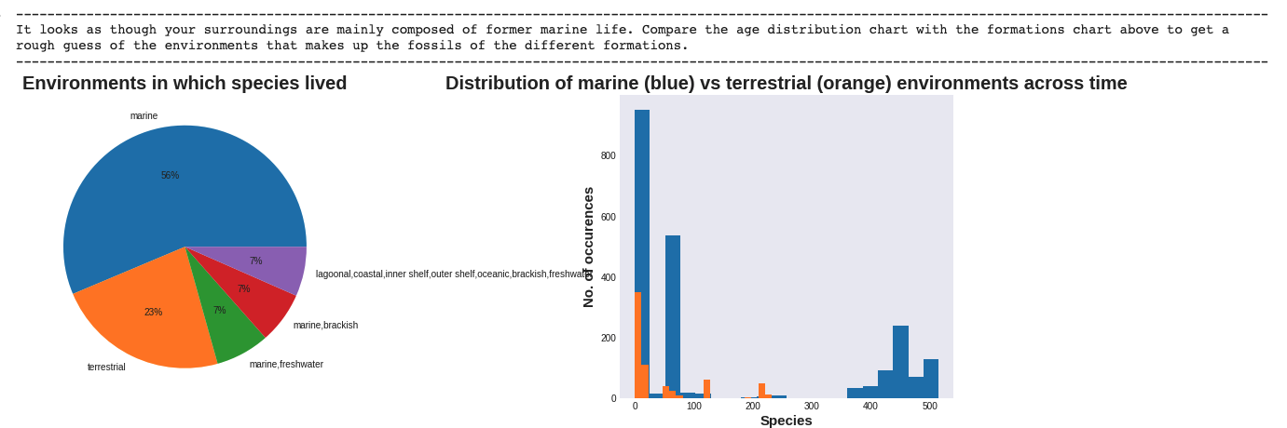
The program also visualizes other key information such as the fossils’ environment, ages, and frequency, and can also track the movement of the user’s location around earth over 500 million years by using “paleolocations” fitted with a spline interpolation.

