Slide 1
Cervical Cancer Predictive Analysis
Ryan Winder & James Spalding

Slide 2
Introduction
Cervical cancer affects around 200,000 women per year in the US
Difficult to detect without a specific screening
If detected in the first year, 80% survival rate
Main goal of study:
Determine which factors can contribute to detecting cervical cancer

Slide 3
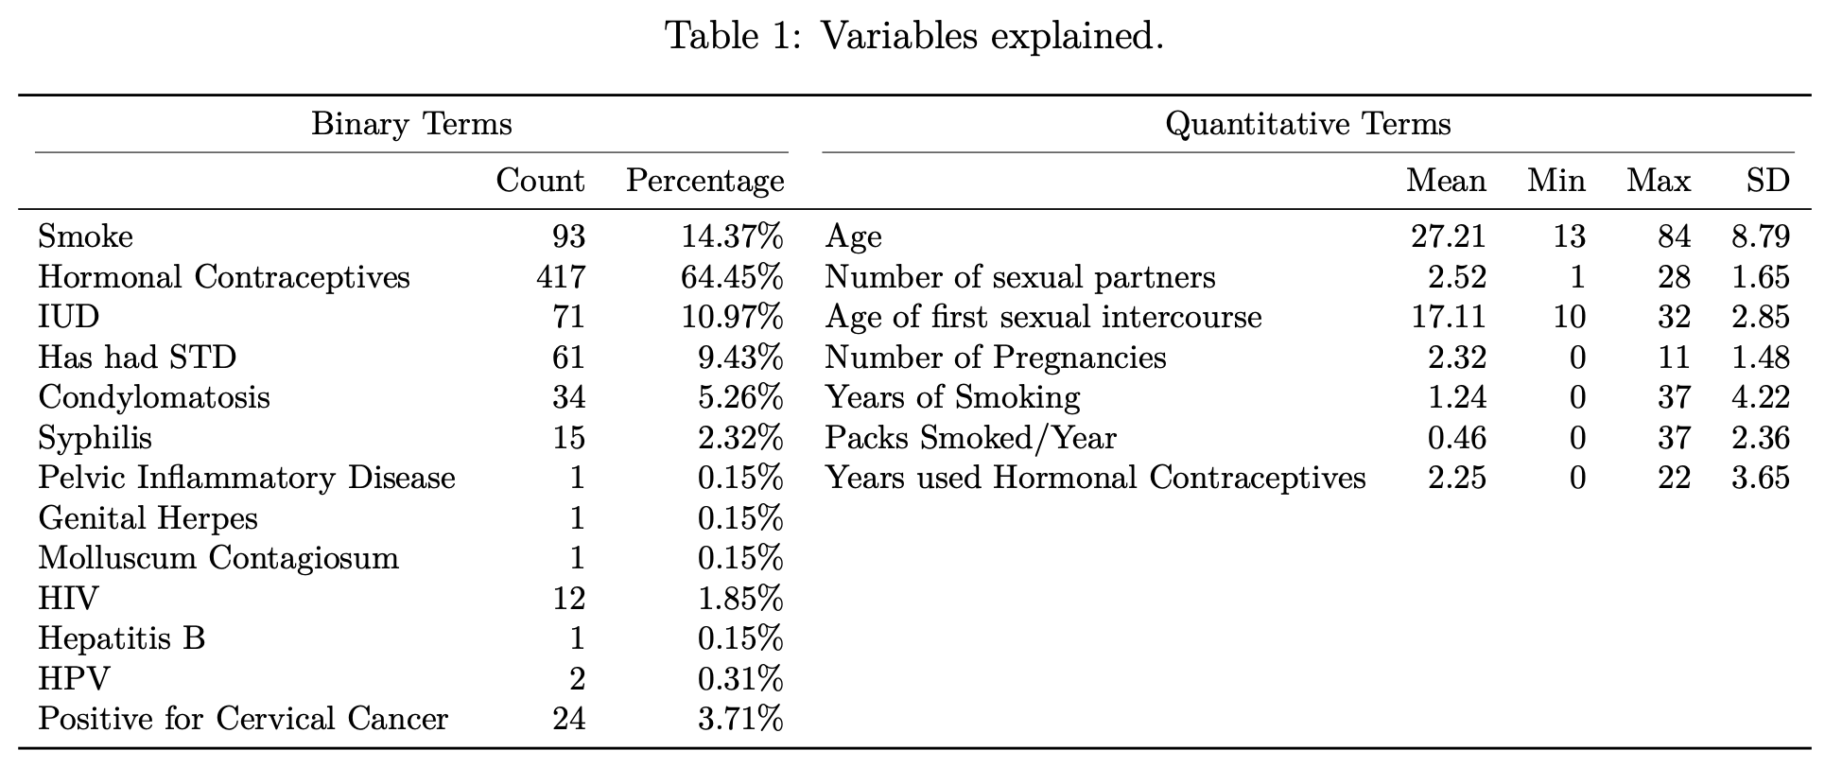
Exploring the data
647 Patients
24 Positive
High % Hormonal Contraceptive
At least 1 sexual partner

Slide 4
Statistical methods
Correlation of variables
Two-sided two-sample permutation test
Fisher's Exact Test
Bootstrapping for Regression

Slide 5

Correlation
Spearman's
Ranked correlation
441 Tests
1,000 permutations per test
Significant correlation with biopsy ( > 0.7):
HPV
Hepatitis
Pelvic Inflammatory Disease
Molluscum Contagiosum
Syphilis
Number of Sexual Partners

Slide 6
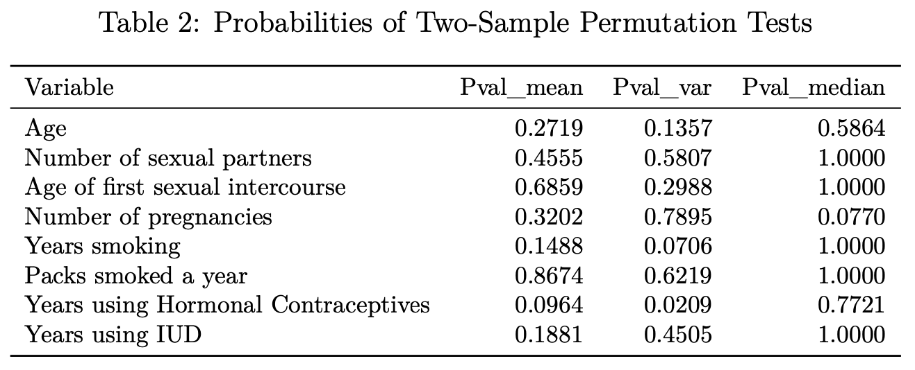
Permutation Test
Only the variance for Years using Hormonal Contraceptives is found to be significant
This variable also gives the lowest p-value for a difference in means

Slide 7
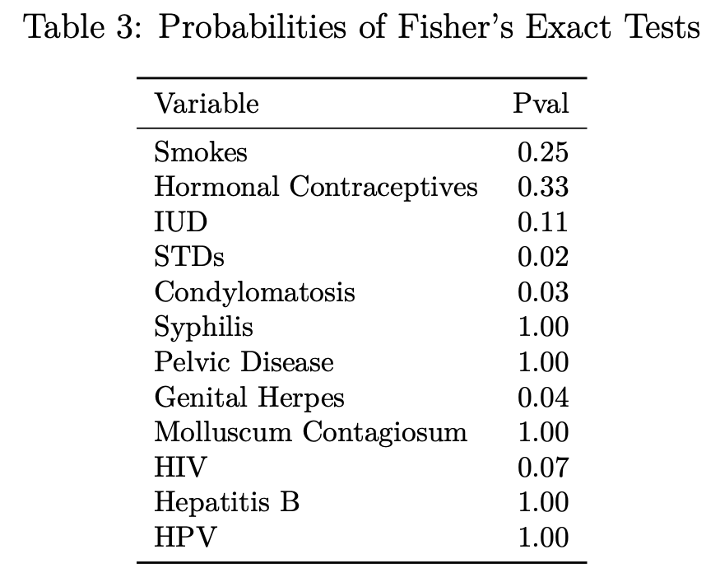
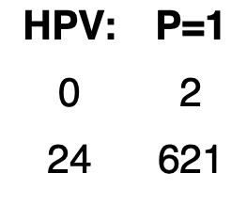
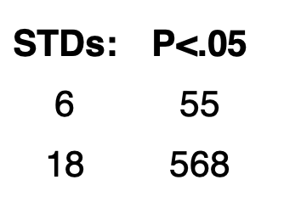
Fisher's Test
Significant variables:
STDs
Condylomatosis
Genital Herpes

Slide 8
Regression
H0: All β values = 0 and are thus useless in predicting biopsy.
Ha: At least one β is not 0.
Bootstrap test
10,000 iterations
P Value = 0.039 > 0.05
Therefore, at least one of the variables is significant...

Slide 9
Regression
However, ONLY 1 variable was significant.
Bootstrap test
Same test on each variable
P Value = 0.05 for Molluscum Contagiosum
P Value > 0.05 for all else
Not super helpful.

Slide 10
Results & conclusion
6 variables found to have high correlation with our variable for cervical cancer (Biopsy)
Only Years using Hormonal Contraceptives variance is statistically different (Quantitative)
STDs, Condylomatosis, and Genital Herpes found to be significant (Qualitative)
Only Molluscum Contagiosum found to be significant in predicting presence of cervical cancer (Regression)
In the end, we suggest scientists and doctors to be on the lookout for cervical cancer in patients' that are diagnosed with the diseases that we found to be significant for detection.

