Slide 1

End of year reflections, or…
I just finished a cut, here’s how it went, and here’s my progress* over time
All data and code for this post can be found in the accompanying GitHub repository
https://github.com/jamessteeleii/blackpill_progress.git
*Terms and conditions apply ;-)

Slide 2
So, most folks will know that earlier this year I joined the MacroFactor team full time as Head of Research.
I was super pumped to join, really excited about the work we’re doing, and couldn’t be happier working with such a great team of people.
It’s been years since I have recorded my own nutrition (or my workouts to be honest).
But I needed to get used to the MacroFactor UI and how the app operates so I thought what the hell… why not do a little cut up to xmas (particularly as my weight has crept upward over the past ~5 years).

Slide 3
Firstly, of course I’m biased, but this cut was super easy using MacroFactor.
I wanted to do it relatively slowly over a few months, be fairly laid back about it, and not stress about the odd binge here and there, travel, social events etc.
Here’s my weight and calorie data over that period… (swipe →)

Slide 4
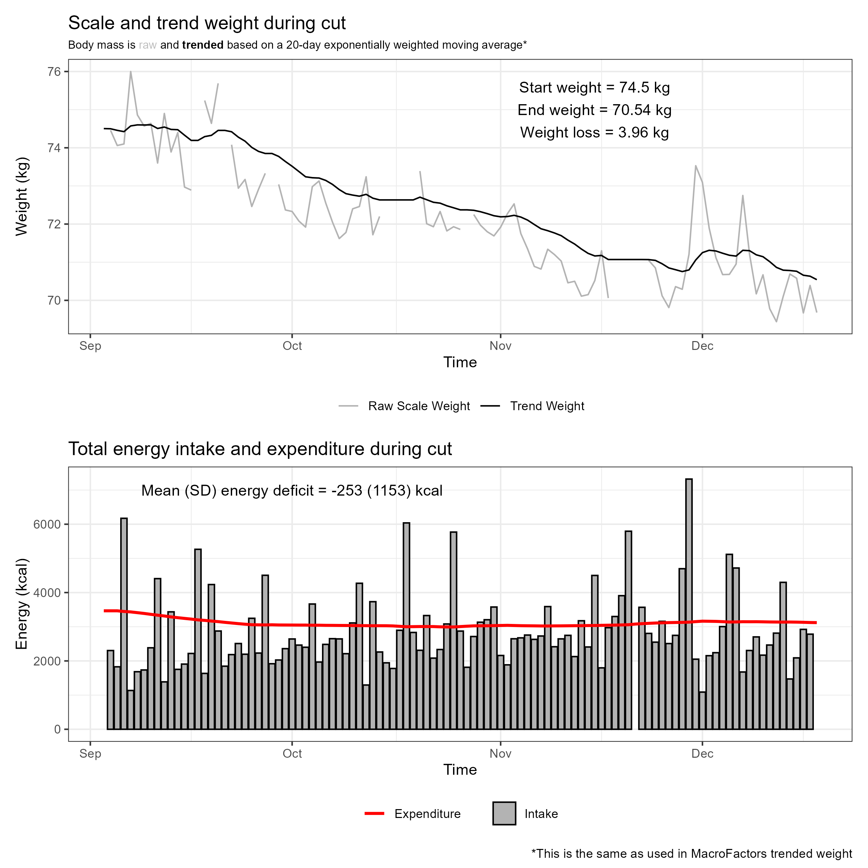

Slide 5
As you can see, there were some decent binges there.
But even with that, as my energy expenditure is pretty high, I was able to keep myself in a caloric deficit over time.
I didn’t quite get to my target trend weight of 70 kg before xmas (a few too many social events in the lead up) but got close.

Slide 6
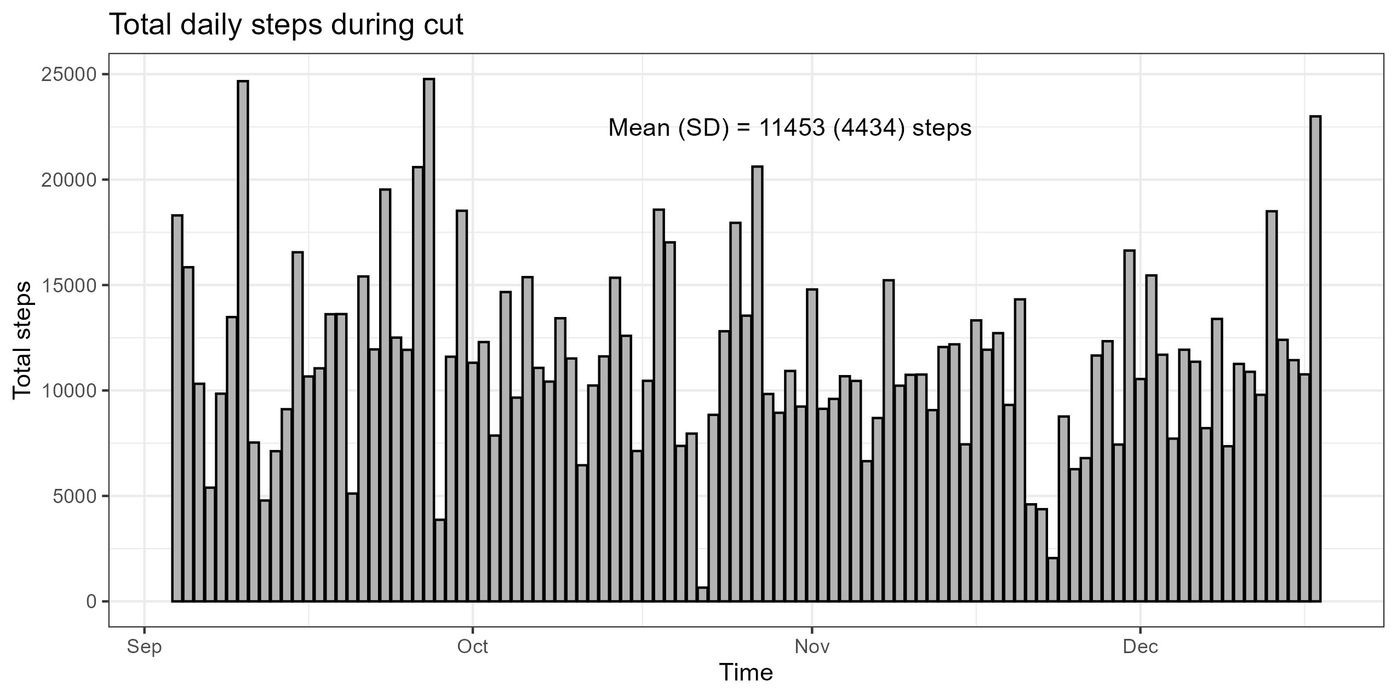
My maintenance calorie intake is pretty high due to a combo of daily steps, lifting 3x/week, running 3x/week, and during this period I did a lot of exercise “snacks” (random non-failure sets of pullups, dips, sissy squats throughout the day 2-3 times)

Slide 7
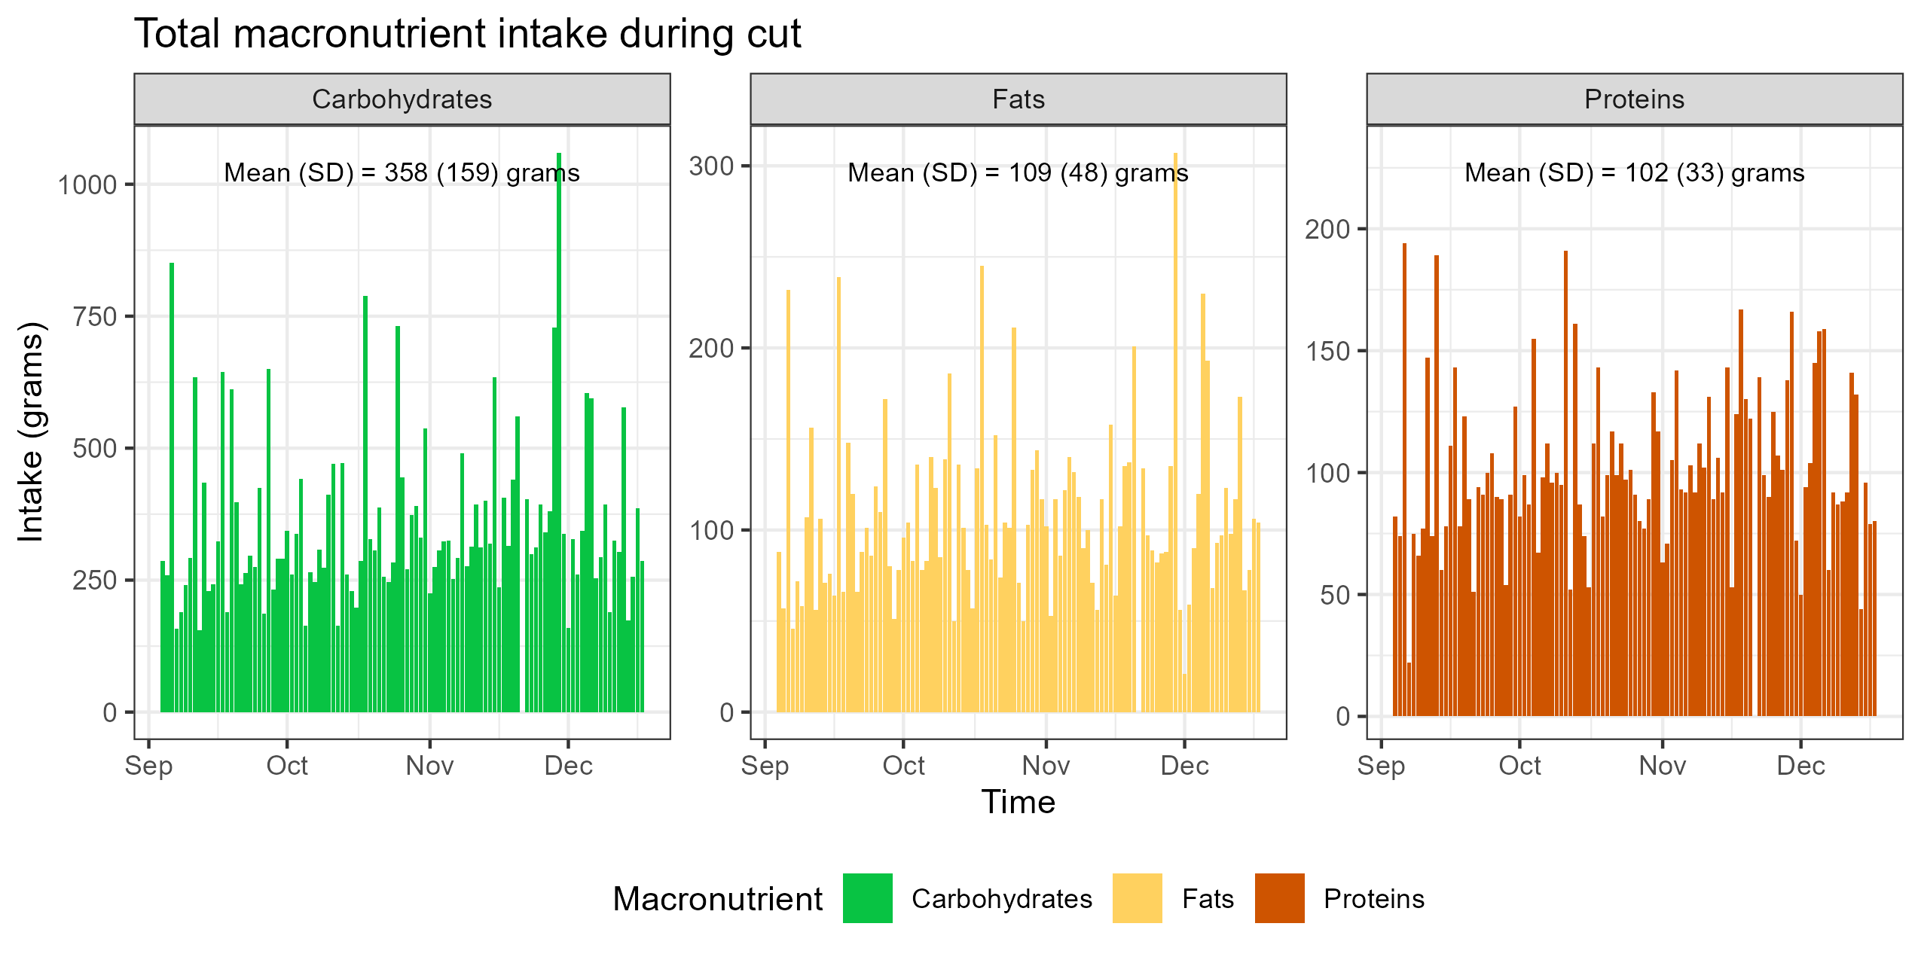
I didn’t stress too much about macros either during this period. I’m vegetarian but despite no concerted effort to eat higher protein I hit 1.36 to 1.44 g/kg… maybe not what most would consider optimal, but meh, it’s absolutely fine
(see previous post ☺)

Slide 8
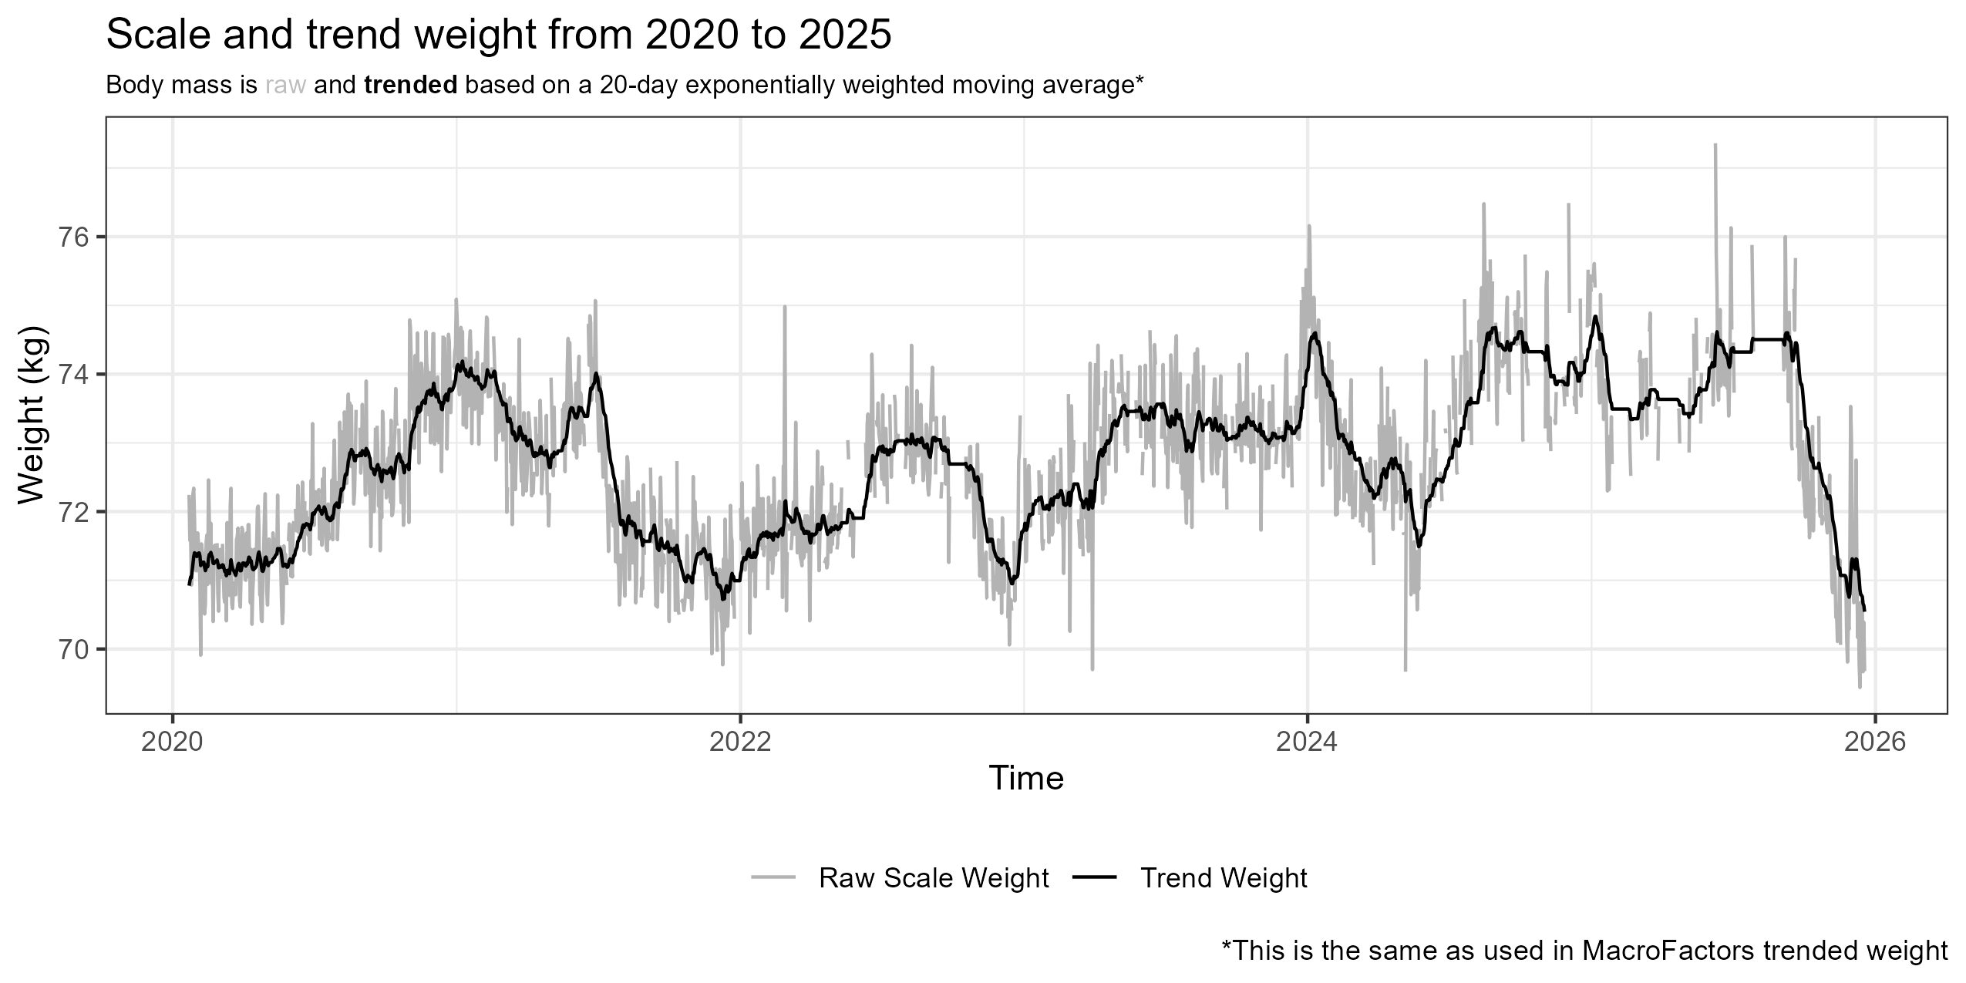
So, I mentioned weight had crept up over the past 5 years…
My weight been in a tight-ish range for years, but I have noticed changes in visible leanness over time.

Slide 9
I actually had a DEXA scan specifically after finishing this cut to see how I had got on (you can see the report on the GitHub repo) which had me at 9% body fat.
But I also had bodpod data as far back as 2010… so I figured why not take a look at the estimated fat free mass (FFM) over time and use that along with the past ~5 years of weight data (we’ve had the digital scales that long) to see whether I’ve gained any FFM.
Now, most people will know already that I am a skeptic about how much gains are possible in the first place, let alone after decades of training
(I even made a fun meme for it – swipe →)

Slide 10
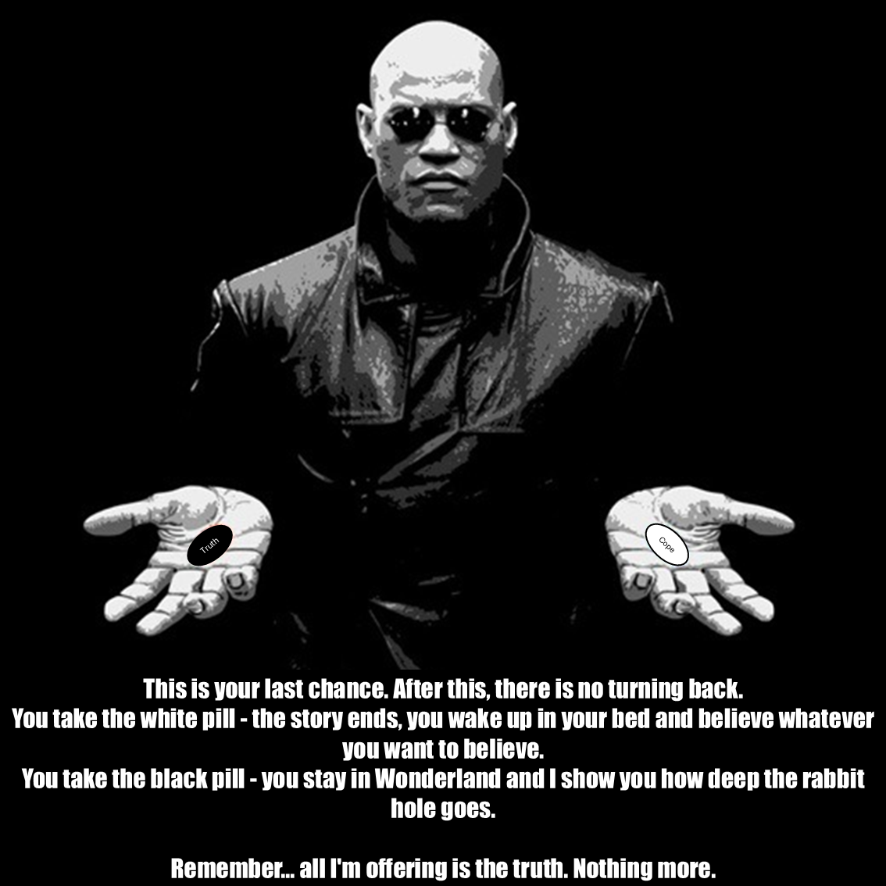

Slide 11
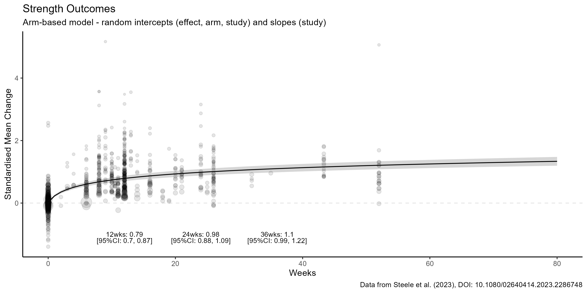
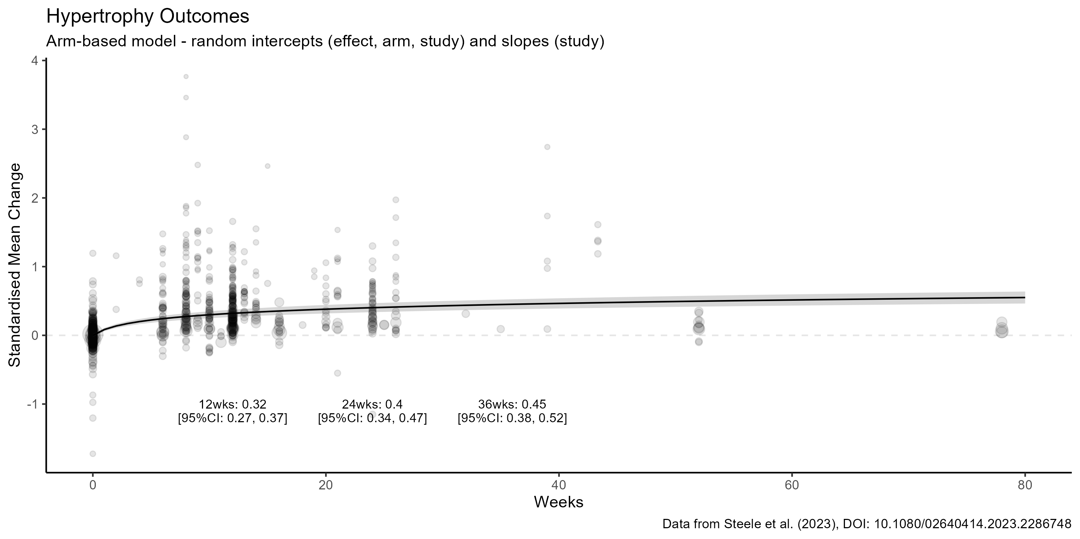
“Blackpilled”… basically, both strength and muscle adapt in a roughly linear-logarithmic rate over time (at least up to the point where aging sends you the other way).
This means that most gains happen early and after that, if you’re hitting the basics, any differences between approaches are tiny if they’re even there at all.
Data from DOI: 10.1080/02640414.2023.2286748

Slide 12
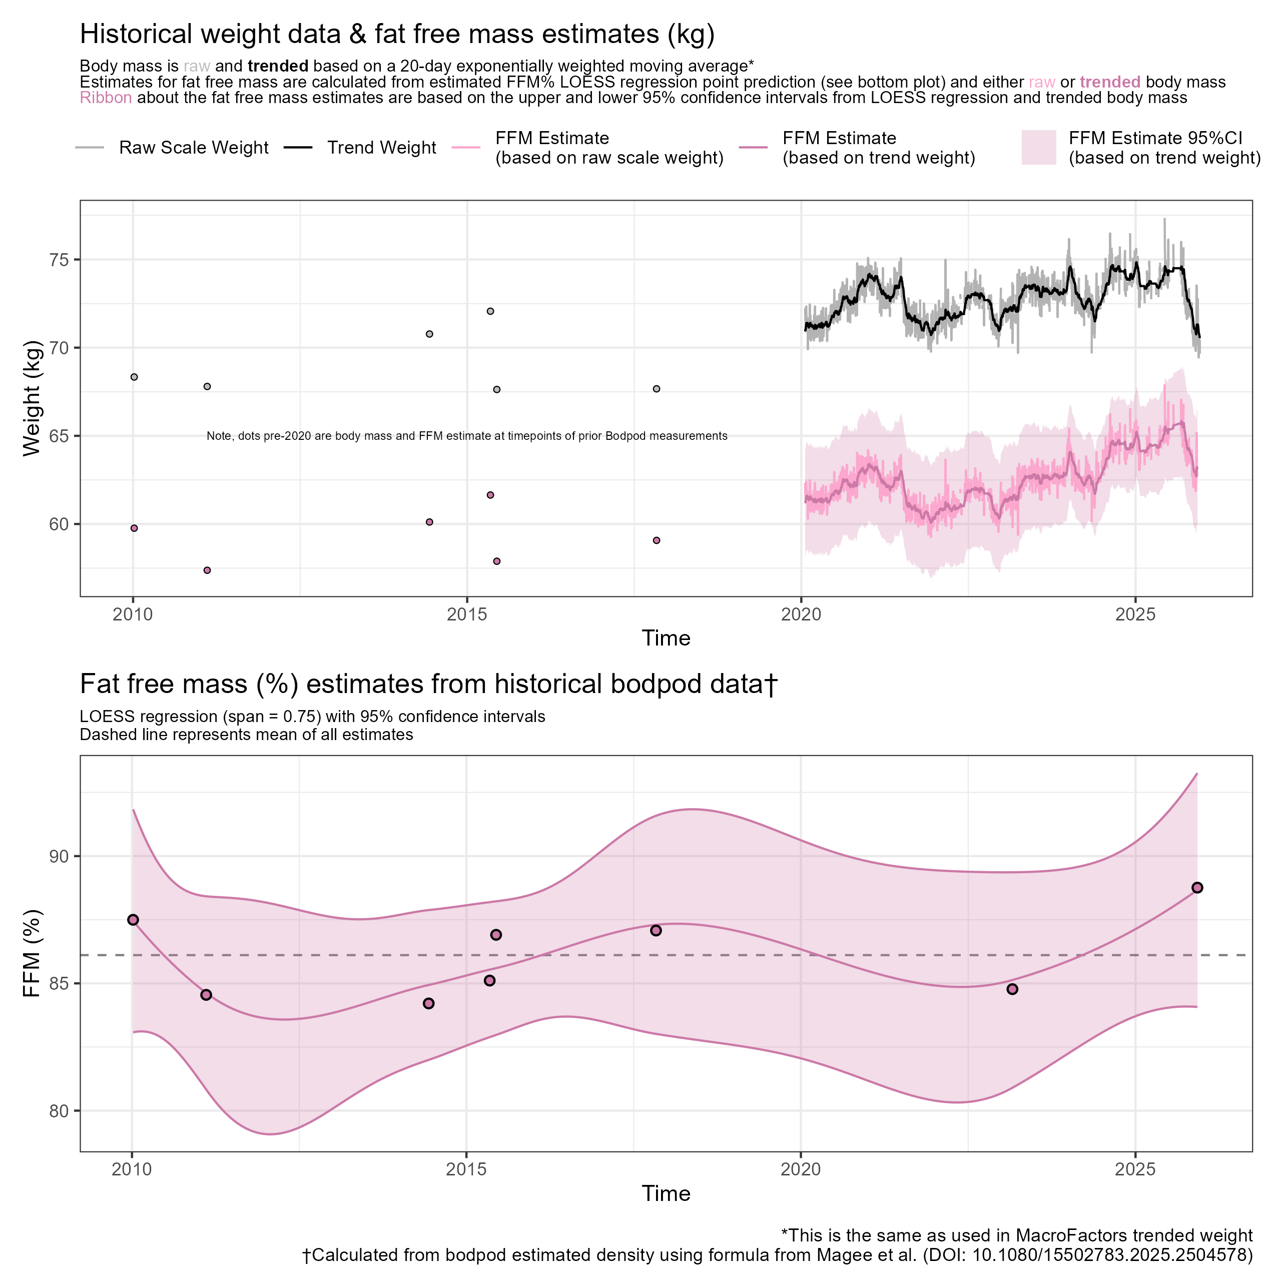
Anyway, I popped back into Solent Universities sport and exercise science labs and was able to get the bodpod density estimates over time for all my tests. I could then re-calculate for myself, using more appropriate formulas, my estimated FFM%.
Below shows a simple LOESS regression of this, the predictions of which for 2020-2025 I could then combine with my weight data from that period
(swipe →)

Slide 14
Some of you might look at the FFM estimates over time and think it looks like the past 5 years have resulted in some gains… but the truth is it’s all consistent with maintenance when we take the longer-term trend into consideration (all pretty much consistent with the mean).
Visually things aren’t much different… ☹
(swipe →)

Slide 15
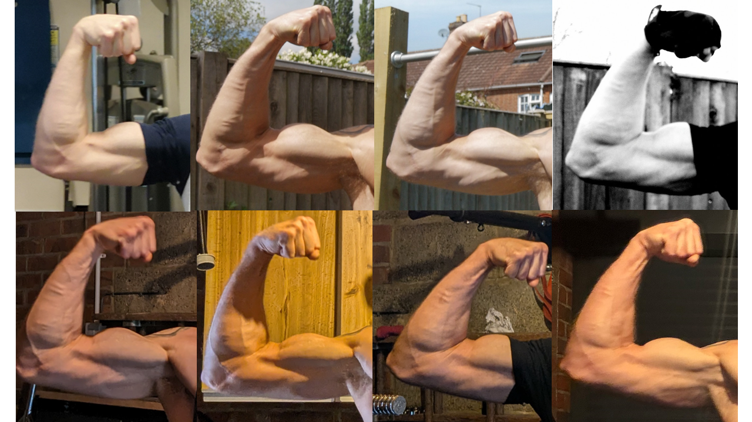
I managed to find a few photos over time with sufficiently similar poses to pull and scale my right flexed arm. Pictures show dates, scale weight (trend weight).
Considering differences in pose, lighting, pump etc. I honestly don’t see much more than maintenance.
28-04-2019
03-05-2020
71.1 kg (71.2 kg)
09-05-2020
71.7 kg (71.3 kg)
25-12-2020
73.9 kg (73.8 kg)
23-04-2023
73.7 kg (73.1 kg)
27-07-2024
73.2 kg (73.6 kg)
04-10-2025
73 kg (73.2 kg)
11-12-2025
69.8 kg (71.0 kg)

Slide 16
Strength-wise… well I said I haven’t really recorded my workouts for years. But I do have at least a couple of exercises I have an idea of.
I do weighted pullups and dips regularly with a 27.5 kg dumbbell set I have and, for as long as I can remember, I’ve been able to do ~4-8 reps to failure depending on how I am feeling on the day.
So not much progress there either.

Slide 17
It’s at this point people might say:
“Well, James, you typically train low volume, you haven’t really done a proper bulk, nor is your protein intake optimal”
True… at least for the past 10-15 years I’ve trained with fairly low volume, haven’t deliberately bulked, though I have been through periods of much higher protein intake (~1.8-2.0 g/kg).
It’s worth noting though that I have been resistance training for almost 25 years. In that time, I have done pretty much all the above at some point including super high-volume stuff when I was in late teens/early twenties… and the reality is, I pretty much looked the same irrespective.

Slide 18
So, does this mean that I (we?) should give up and be a nihilist about training and progress?
Of course not! As good ol’ Walter Sobchak would say:
“Nihilists! Fuck me. I mean, say what you want about the tenets of Periodisation, Dude, at least it's an ethos”
To be honest, I’ve enjoyed having a little goal to focus on during my cut… and so, just to keep that enjoyment, I’m setting another goal.
For the first 6 months of 2026 I’m gonna try a bulk (target trend weight ~76-77kg), increase training volume, and increase protein intake all in the service of seeing how blackpilled I am.

Slide 19
What’s this gonna look like?
Well, rough calculations means I should be able to hit that fairly easily along with a protein target of ~1.8 g/kg by simply adding a bowl of the Fuel granola I like with semi-skimmed milk and a scoop of whey most days.
For training, I am going to be specific… as I have the arm pictures, I figure that’s the best thing to focus on for comparison (plus I don’t want to be having hour long or longer workouts doing everything higher volume).
I currently hit around ~5-6* fractional sets for biceps/triceps a week but will be increasing that to ~15* sets. I’ll track all my volume over that time using MacroFactor’s new workouts app.
I’ll post the workouts in a later post sometime.
*Not including “exercise snacks” though I will record these going forward

Slide 20
So that’s it… an easy cut, plan to try a bulk next year for six months, then will likely cut back down again, then maintain. I’ve prepaid for three follow-up DEXA scans too so will have those for each phase, and we’ve just purchased a new Withings Body Scan for home so will keep daily track of body composition using that.
Let’s see if I can add anything noticeable onto this old frame ☺
But for all of you, hope you had a great 2025, and here’s to a Happy New Year!

