Slide 1
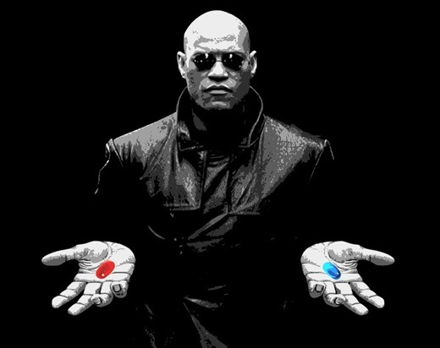
Truth
Cope
This is your last chance. After this, there is no turning back.
You take the white pill - the story ends, you wake up in your bed and believe whatever you want to believe.
You take the black pill - you stay in Wonderland and I show you how deep the rabbit hole goes.
Remember... all I'm offering is the truth. Nothing more.

