Slide 1
Thanks for listening!
Chieft designer: Lucian Bisset
Chief discord bot programmer: David Kuc
Chieft Morale support: Denel
Chief carrier: Jack Stockton
Chief maths?: Ibrahim Aydogan
Chief: Steve Gunn

Slide 2
NekoDachi!

Slide 3
Do u like cats?
UwU

Slide 4
We do too!

Slide 5
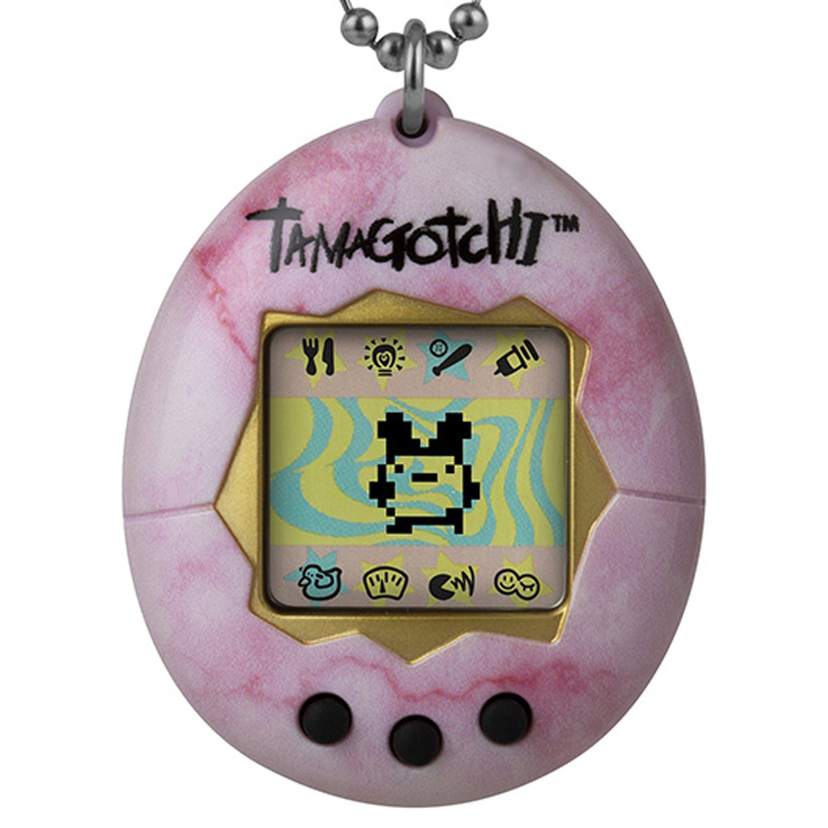
Tamagotchi for Discord!
Reacts!
Get sad TwT
Gets happy UwU
Gets hungy?
Watch them go!
I didn’t make this!
https://www.bandai.com/products/original-tamagotchi-stone/

Slide 6
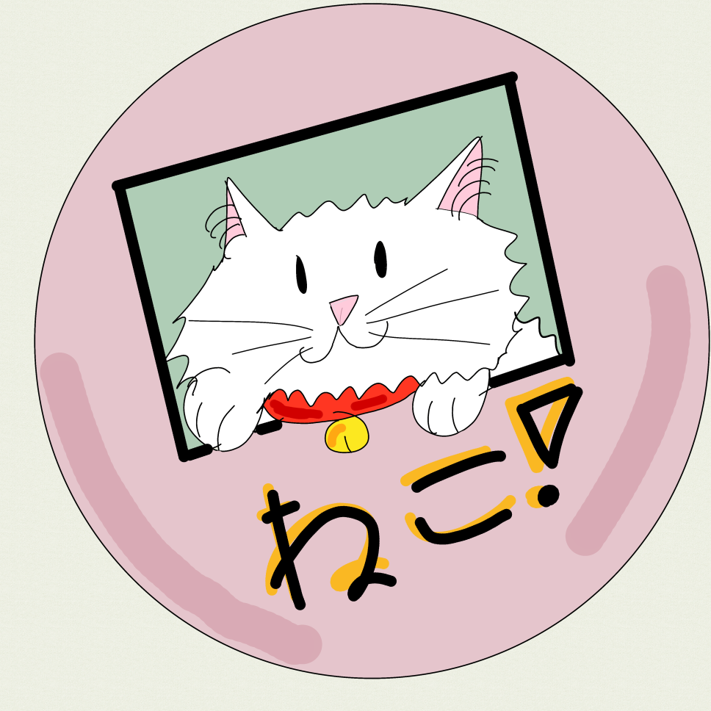
You can:
Look at it!
Care for it!
Name it whatever you want!
Send your friends wacky cat reaction gifs easily!
I made this!

Slide 7
angy

Slide 8
Kewl

Slide 9
ded

Slide 10
Happy ig?

Slide 11
Joy!

Slide 12
OwO *blushes*

Slide 13
blem

Slide 14
Depressed

Slide 15
cheeky

Slide 16
What the cat doin?
Send cat = get happy ☺
Send dog = cat sad ☹
Cat feeds on your messages!
Send more to keep fed!
Send less if you hate them

Slide 17
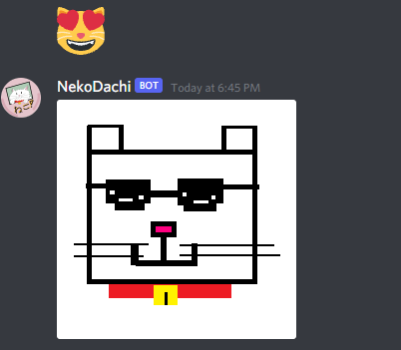
Watch it in action!
As you can see, it improved the cat emoji and all our lives with a wacky catty giffy depending on cat emoji sent!

Slide 18
Nekodachi origin story:
Neko = cat!
Tomodachi = friend
We combined these two words to show what this is all about
A cat that is also your friend!

Slide 19
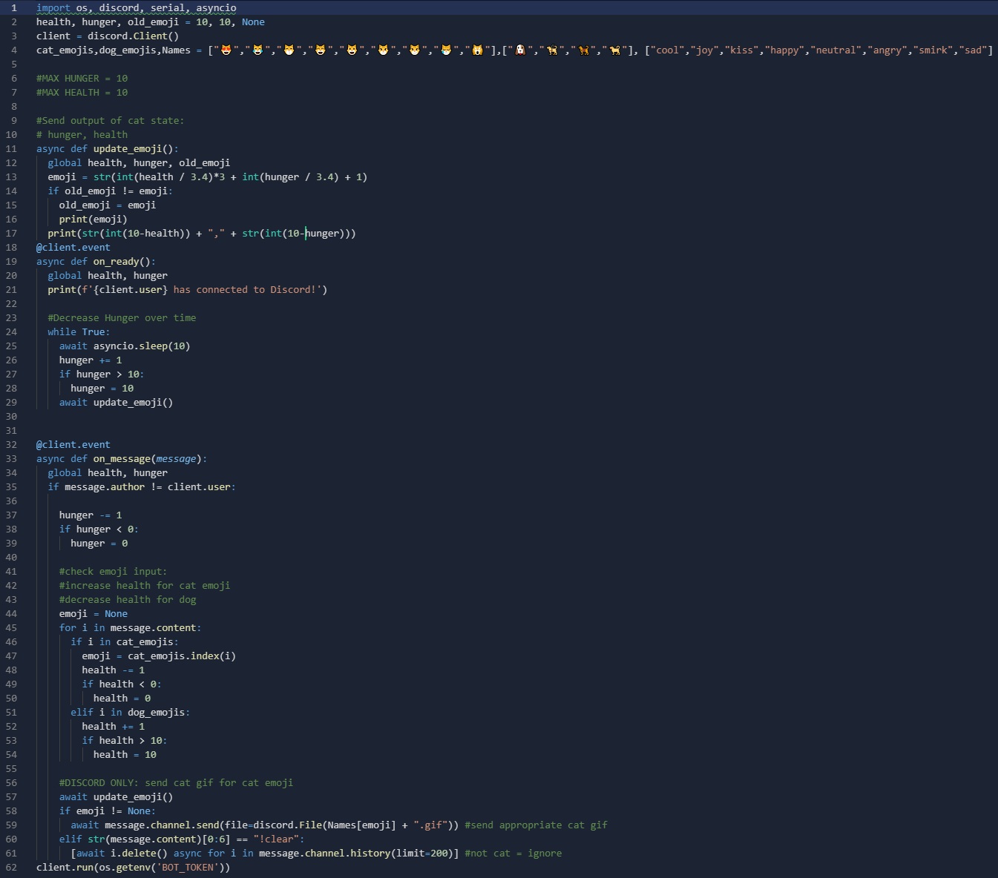
We coded!!
This is a bit of it!
A very little amount of it
More than 1000 lines!
And counting!
Final line:

Slide 20
Uhhh yeah, we have a github
https://github.com/jamesstocktonj1/Nanohack-2021

Slide 21
Market research
Why??:
Freindly companion
Helps you cope with life’s turmoils
Helps prepare you for parenthood!

Slide 22
The moment you’ve been waiting for…

Slide 23
Watch it come alive in your home!!!!

Slide 24
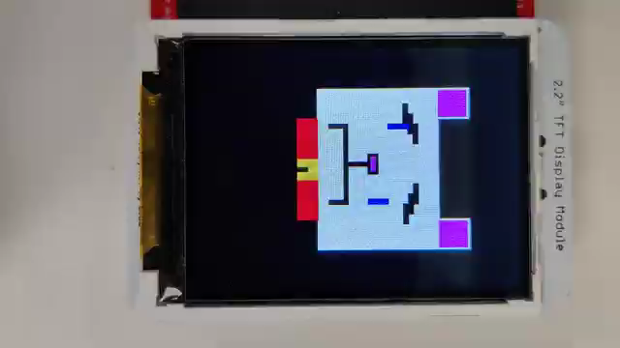

Slide 25
See slide 1

