Slide 1
System Programming Lab 8 Race condition
Lecturer：Professor Pao-Ann Hsiung
Teaching Assistant:湯凱鈞 & Adarsh
Embedded Systems Laboratory
National Chung Cheng University
Chiayi, Taiwan-62102

Slide 2
Outline
Fork & Race condition
Requirements
Turn In
Download

Slide 3
Fork & Race condition

Slide 4
Figure 8.12
#include “apue.h"
static void charatatime(char *);
int
main(void)
{
pid_t pid;
if ( (pid = fork()) < 0)
err_sys("fork error");
else if (pid == 0) {
charatatime("output from child\n");
} else {
charatatime("output from parent\n");
}
exit(0);
}

Slide 5
Figure 8.12(cont’d )
static void
charatatime(char *str)
{
char *ptr;
int c;
setbuf(stdout, NULL); /* set unbuffered */
for (ptr = str; c = *ptr++; )
putc(c, stdout);
}

Slide 6
TELL and WAIT
#include “apue.h”
TELL_WAIT(); /* setup for TELL_XXX and WAIT_XXX */
if ( (pid = fork()) < 0 )
err_sys(“fork error”);
else if (pid==0) { /* child */
/* child does whatever is necessary */
TELL_PARENT(getppid()); /* tell parent we’re done */
WAIT_PARENT(); /* & wait for parent */
/* and child continues on its way */
exit(0);
}
/* parent does whatever is necessary */
TELL_CHILD(pid); /*tell child we’re done */
WAIT_CHILD(); /* wait for child */
/* and parent continues on its way */
exit(0);
child
parent

Slide 7
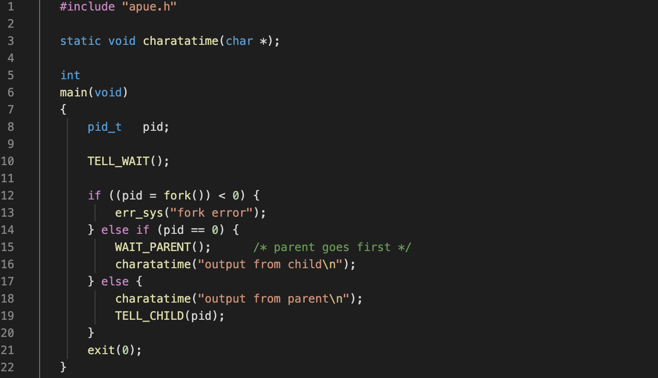
Figure

Slide 8
Reference functions
sprintf
Write formatted data to string
int sprintf( char *str, const char *format,...);
Example
sprintf(filename, “%d-%02d.txt”, pid, week);
fscanf
Read formatted data from stream
int fscanf(FILE *stream ,const char *format,....);
Example
fscanf(fp, "%d", &value);

Slide 9
Requirements

Slide 10
Input data
For each year, there are 52 power consumption data files, each file is for one week. Totally, you are given data files for 5 year power consumptions.
ex：1-01.txt ,…, 1-52.txt
Each text file contains 7 rows, one row for each day of the week.
Each row contains 96 power consumption data, one for each time slot of the day (15 minutes time slot).

Slide 11
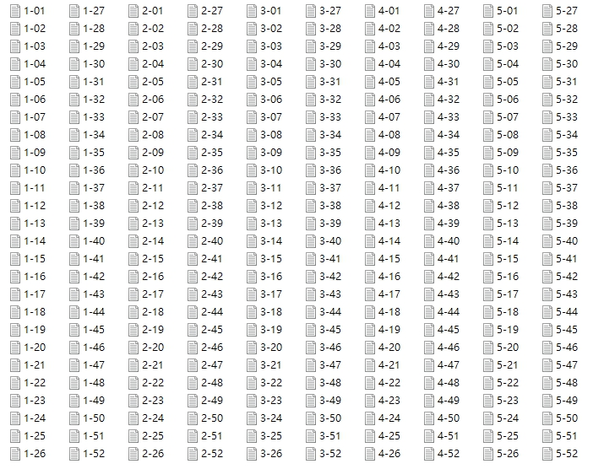
Input data (cont.)

Slide 12
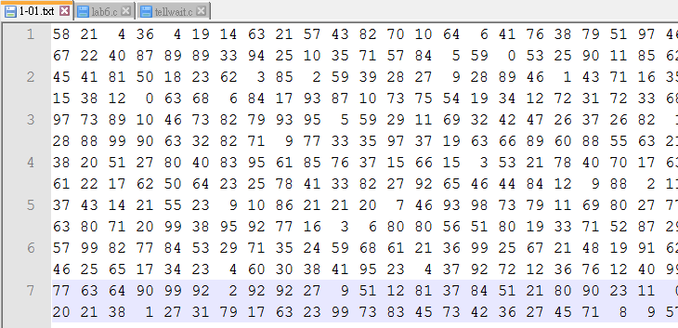
Input data (cont.)
1-01.txt
96 values
7 days

Slide 13
Requirements
Fork 5 processes to compute data of each year separately.
Each process should calculate the sum of data in a row and add the resulting sum to a file named “sum.txt”, before proceeding to the next row.
Solve the problem of “race condition” with TELL and WAIT functions.
What is the average daily power consumption over the 5 years?

Slide 14
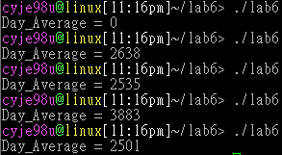

Requirements (cont.)
Execution results with race condition.
Execution results without race condition.

Slide 15
Result of Requirements
Submit the following in table (Answers.doc):
How did you implement the processes?
How did you update the file “sum.txt”?
How did you solve the race condition?
What is the average daily power consumption over the 5 years? (daily means for one day)
Please attach screen shot.

Slide 16
Turn In

Slide 17
Turn In
The E-course2
https://ecourse2.ccu.edu.tw/
Upload 學號.zip into “Lab_8”
Source files
Answers.pdf
Due date
2023/06/08 23:59:59

Slide 18
Turn In (cont’d)
TA’s email:
湯凱鈞：4685231GF@gmail.com
Adarsh: vtu10666@veltechuniv.edu.in

