Slide 1
System Programming Lab 10 Signals - Fishing Game
Lecturer：Professor Pao-Ann Hsiung
Teaching Assistant:湯凱鈞 & Adarsh
Embedded Systems Laboratory
National Chung Cheng University
Chiayi, Taiwan-62102

Slide 2
Outline
Fishing Game & Signal Handling
Requirements
Turn In
Download

Slide 3
Fishing Game & Signal Handling

Slide 4
Fishing Game
Player(user) can use Ctrl + C to put/pull the fishing rod and Ctrl + Z to exit the game.
After the player puts fishing rod in water, fish will eat the bait in a random time.
Player must pull fishing rod in a time limit to get the fish, otherwise the fish will escape.

Slide 5
Fishing Game Flow
Start
Press Ctrl + C
Put
After 1~2 second
Waiting
Press Ctrl + C
Pull
No
Pull in time limit?
Yes
Fish is eating?
No
Yes
Get fish

Slide 6
Signal Handling – sigaction
#include <signal.h>
int sigaction(int signal, const struct sigaction *act, struct sigaction *oldact);
This function sets a function(handler) to handle signal.
Signal | Disposition
SIGINT | Terminal driver generates signal when we type interrupt key (CTRL-C)
SIGTSTP | Terminal driver generates signal when we type suspend key (CTRL-Z)
SIGALRM | timer set with alarm() expires

Slide 7
Signal Handling – sigaction
struct sigaction {
void (*sa_handler)(int);
void (*sa_sigaction)(int, siginfo_t *, void *);
sigset_t sa_mask;
int sa_flags;
void (*sa_restorer)(void);
}
Handler :
void handler (int signum){…}

Slide 8
Signal Handling – sigaction
Ex :
struct sigaction new_action;
new_action.sa_handler = handler;
sigemptyset (&new_action.sa_mask);
new_action.sa_flags = 0;
sigaction (SIGINT, &new_action, NULL);

Slide 9
alarm
unsigned int alarm (unsigned int sec)
Set the real-time timer to expire in sec seconds.
Ex : alarm(1);

Slide 10
rand & srand
void srand(unsigned int seed)
Seed the random number generator used by the function rand.
Ex : srand(time(NULL));
int rand(void)
Return a pseudo-random number in the range of 0 to RAND_MAX.
Ex : rand()%5; (return 0~4)

Slide 11
Requirements

Slide 12
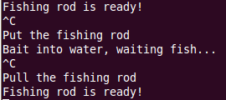
Situation 1 – No fish biting
Start
Press Ctrl + C
Put
After 1~2 second
Waiting
Press Ctrl + C
Pull
No
Pull in time limit?
Yes
Fish is eating?
No
Yes
Get fish

Slide 13
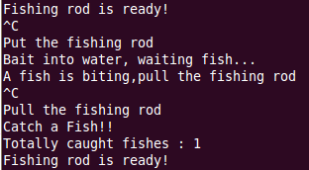
Situation 2 – Catch fish
Start
Press Ctrl + C
Put
After 1~2 second
Waiting
Press Ctrl + C
Pull
No
Pull in time limit?
Yes
Fish is eating?
No
Yes
Get fish

Slide 14
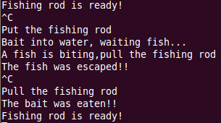
Situation 3 – Fish escape
Start
Press Ctrl + C
Put
After 1~2 second
Waiting
Press Ctrl + C
Pull
No
Pull in time limit?
Yes
Fish is eating?
No
Yes
Get fish

Slide 15

Game Exit
Show the totally number of caught fishes in the game before exiting.

Slide 16
Result of Requirements
Finish the above situation 1~3 and game exit.

Slide 17
Turn In

Slide 18
Turn In
The E-course System
ecourse2
Upload 學號.zip into “Lab 10”
Source code
Due date
2023/06/19 23:59:59

Slide 19
Turn In (cont’d)
TA’s email:
湯凱鈞：4685231GF@gmail.com
Adarsh: vtu10666@veltechuniv.edu.in

